Slide 1
Quantum Computing
AI-Generated Presentation

Slide 2

Introduction - Quantum Computing
Introduction on Quantum Computing:
- A quantum computer is a computer that exploits quantum mechanical phenomena
- On small scales, physical matter exhibits properties of both particles and waves, and quantum computing leverages this behavior using specialized hardware
- Classical physics cannot explain the operation of these quantum devices, and a scalable quantum computer could perform some calculations exponentially faster than any modern "classical" computer
- Theoretically a large-scale quantum computer could break some widely used encryption schemes and aid physicists in performing physical simulations; however, the current state of the art is largely experimental and impractical, with several obstacles to useful applications. The basic unit of information in quantum computing, the qubit (or "quantum bit"), serves the same function as the bit in classical computing.

Slide 3
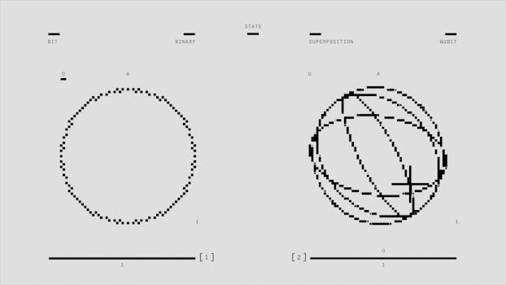
Key Features - Quantum Computing
Key Features on Quantum Computing:
- This glossary of quantum computing is a list of definitions of terms and concepts used in quantum computing, its sub-disciplines, and related fields. Bacon–Shor code is a Subsystem error correcting code
- In a Subsystem code, information is encoded in a subsystem of a Hilbert space
- Subsystem codes lend to simplified error correcting procedures unlike codes which encode information in the subspace of a Hilbert space
- This simplicity led to the first demonstration of fault tolerant circuits on a quantum computer.

Slide 4
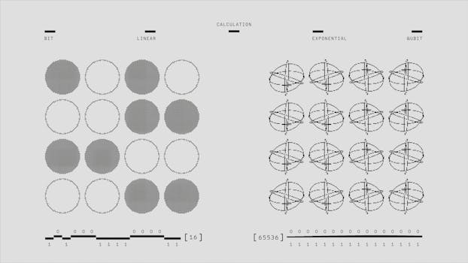
Benefits - Quantum Computing
Benefits on Quantum Computing:
- This article lists the companies worldwide engaged in the development of quantum computing, quantum communication and quantum sensing
- Quantum computing and communication are two sub-fields of quantum information science, which describes and theorizes information science in terms of quantum physics
- While the fundamental unit of classical information is the bit, the basic unit of quantum information is the qubit
- Quantum sensing is the third main sub-field of quantum technologies and it focus consists in taking advantage of the quantum states sensitivity to the surrounding environment to perform atomic scale measurements.

Slide 5
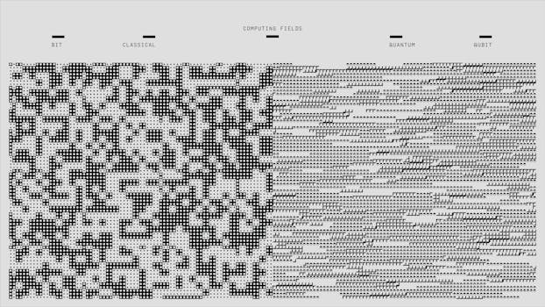
Challenges - Quantum Computing
Challenges on Quantum Computing:
- A quantum computer is a computer that exploits quantum mechanical phenomena
- On small scales, physical matter exhibits properties of both particles and waves, and quantum computing leverages this behavior using specialized hardware
- Classical physics cannot explain the operation of these quantum devices, and a scalable quantum computer could perform some calculations exponentially faster than any modern "classical" computer
- Theoretically a large-scale quantum computer could break some widely used encryption schemes and aid physicists in performing physical simulations; however, the current state of the art is largely experimental and impractical, with several obstacles to useful applications. The basic unit of information in quantum computing, the qubit (or "quantum bit"), serves the same function as the bit in classical computing.

Slide 6
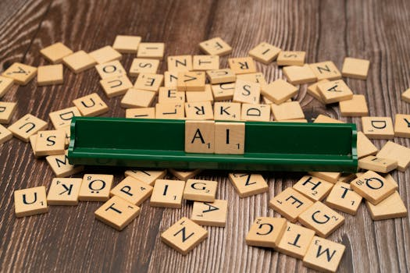
Future Scope - Quantum Computing
Future Scope on Quantum Computing:
- No relevant data found.

Slide 7
Conclusion
Key Takeaways:
- Introduction
- Key Features
- Benefits
- Challenges
- Future Scope

