Slide 1
Ai machine learning
AI-Generated Presentation

Slide 2

Introduction - Ai machine learning
Introduction on Ai machine learning:
- Machine learning (ML) is a field of study in artificial intelligence concerned with the development and study of statistical algorithms that can learn from data and generalize to unseen data, and thus perform tasks without explicit instructions
- Within a subdiscipline in machine learning, advances in the field of deep learning have allowed neural networks, a class of statistical algorithms, to surpass many previous machine learning approaches in performance. ML finds application in many fields, including natural language processing, computer vision, speech recognition, email filtering, agriculture, and medicine
- The application of ML to business problems is known as predictive analytics. Statistics and mathematical optimization (mathematical programming) methods comprise the foundations of machine learning.

Slide 3

Key Features - Ai machine learning
Key Features on Ai machine learning:
- Perplexity AI is a search engine that uses large language models (LLMs) to answer queries using sources from the web and cites links within the text response
- Its developer, Perplexity AI, Inc., is based in San Francisco, California. == History == Perplexity was founded in 2022 by Aravind Srinivas, Andy Konwinski, Denis Yarats and Johnny Ho, engineers with backgrounds in back-end systems, artificial intelligence (AI) and machine learning: Srinivas, the CEO, graduated from UC Berkeley with a PhD in CS. Konwinski, the president, graduated from UC Berkeley with a PhD in CS. Yarats, the CTO, graduated from NYU with a PhD in AI. Ho, the CSO, attended Harvard University, studying math and CS. == Services == Perplexity works on a freemium model
- It also offers a paid enterprise version. === Free plan === The free model uses the company's standalone LLM based on GPT-3.5 with browsing.

Slide 4
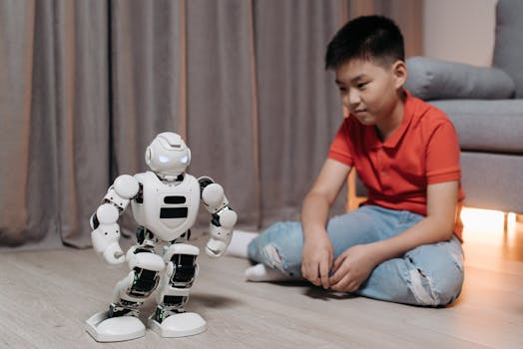
Benefits - Ai machine learning
Benefits on Ai machine learning:
- Meta AI (formerly Facebook Artificial Intelligence Research (FAIR)) is a research division of Meta Platforms (formerly Facebook) that develops artificial intelligence and augmented and artificial reality technologies
- Meta AI deems itself an academic research laboratory, focused on generating knowledge for the AI community, and should not be confused with Meta's Applied Machine Learning (AML) team, which focuses on the practical applications of its products. == History == The laboratory was founded as Facebook Artificial Intelligence Research (FAIR) with locations at the headquarters in Menlo Park, California, London, United Kingdom, and a new laboratory in Manhattan
- FAIR was officially announced in September 2013
- FAIR was first directed by New York University's Yann LeCun, a deep learning professor and Turing Award winner.

Slide 5
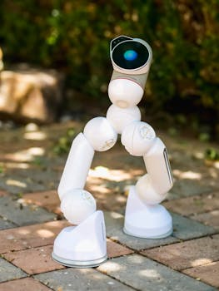
Challenges - Ai machine learning
Challenges on Ai machine learning:
- No relevant data found.

Slide 6
Future Scope - Ai machine learning
Future Scope on Ai machine learning:
- No relevant data found.

Slide 7
Conclusion
Key Takeaways:
- Introduction
- Key Features
- Benefits
- Challenges
- Future Scope

