Slide 1
Artificial intelligence
AI-Generated Presentation

Slide 2
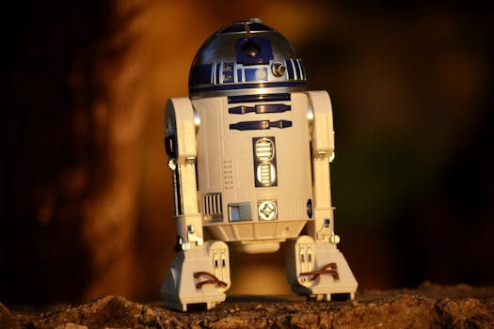
Artificial intelligence - Introduction
Introduction on Artificial intelligence:
- Artificial intelligence art is visual artwork created or enhanced through the use of artificial intelligence (AI) programs. Artists began to create artificial intelligence art in the mid to late 20th century when the discipline was founded
- Throughout its history, artificial intelligence art has raised many philosophical concerns related to the human mind, artificial beings, and what can be considered art in a human–AI collaboration.

Slide 3
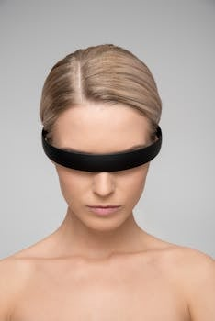
Artificial intelligence - Key Features
Key Features on Artificial intelligence:
- Apple Intelligence is free for all users with supported devices.
- Apple Intelligence is an artificial intelligence system developed by Apple Inc

Slide 4
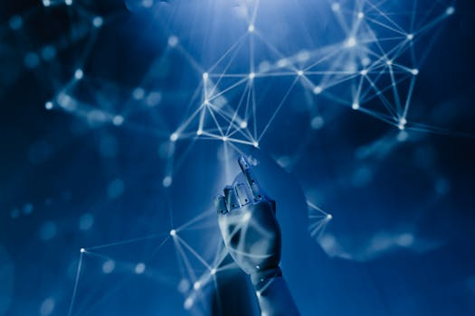
Artificial intelligence - Benefits
Benefits on Artificial intelligence:
- Artificial intelligence (AI) has been used in applications throughout industry and academia
- In a manner analogous to electricity or computers, AI serves as a general-purpose technology

Slide 5
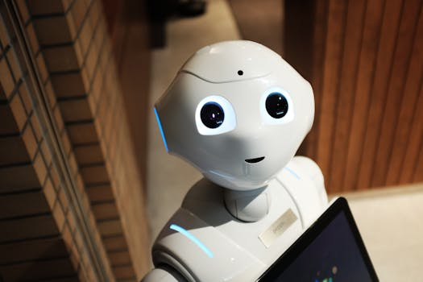
Artificial intelligence - Challenges
Challenges on Artificial intelligence:
- No relevant data found.

Slide 6
Conclusion
Key Takeaways:
- Introduction
- Key Features
- Benefits
- Challenges

