Slide 1
Furniture
AI-Generated PPT with Comprehensive Information

Slide 2
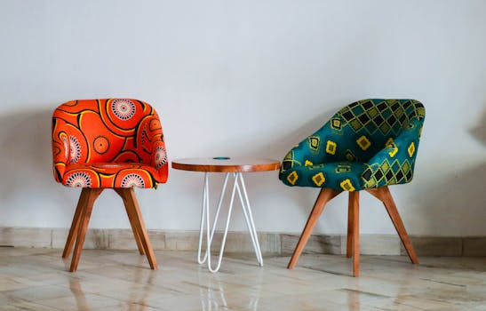
Furniture - Introduction
Introduction on Furniture:
- Furniture refers to objects intended to support various huma n activities such as seating (e.g., stools, chairs, and sofa s), eating (tables), storing items, working, and sleeping (e .g., beds and hammocks)
- Furniture is also used to hold objects at a convenient heigh t for work (as horizontal surfaces above the ground, such as tables and desks), or to store things (e.g., cupboards, she lves, and drawers)
- Furniture can be a product of design and can be considered a form of decorative art
- In addition to furniture's functional role, it can serve a s ymbolic or religious purpose
- It can be made from a vast multitude of materials, including metal, plastic, and wood.

Slide 3
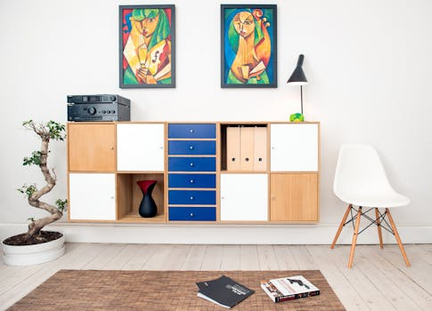
Furniture - Characteristics
Characteristics on Furniture:
- Furniture refers to objects intended to support various huma n activities such as seating (e.g., stools, chairs, and sofa s), eating (tables), storing items, working, and sleeping (e .g., beds and hammocks)
- Furniture is also used to hold objects at a convenient heigh t for work (as horizontal surfaces above the ground, such as tables and desks), or to store things (e.g., cupboards, she lves, and drawers)
- Furniture can be a product of design and can be considered a form of decorative art
- In addition to furniture's functional role, it can serve a s ymbolic or religious purpose
- It can be made from a vast multitude of materials, including metal, plastic, and wood.

Slide 4
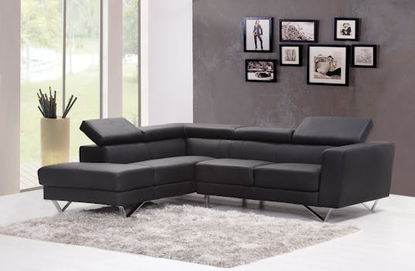
Furniture - Evolution
Evolution on Furniture:

Slide 5
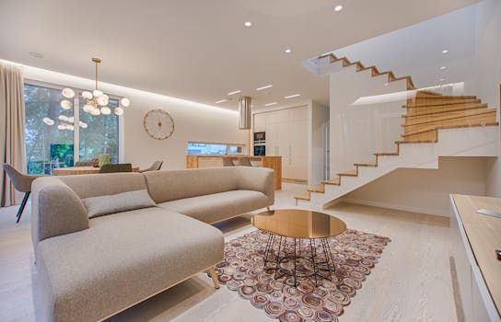
Furniture - Importance
Importance on Furniture:
- Furniture refers to objects intended to support various huma n activities such as seating (e.g., stools, chairs, and sofa s), eating (tables), storing items, working, and sleeping (e .g., beds and hammocks)
- Furniture is also used to hold objects at a convenient heigh t for work (as horizontal surfaces above the ground, such as tables and desks), or to store things (e.g., cupboards, she lves, and drawers)
- Furniture can be a product of design and can be considered a form of decorative art
- In addition to furniture's functional role, it can serve a s ymbolic or religious purpose
- It can be made from a vast multitude of materials, including metal, plastic, and wood.

Slide 6
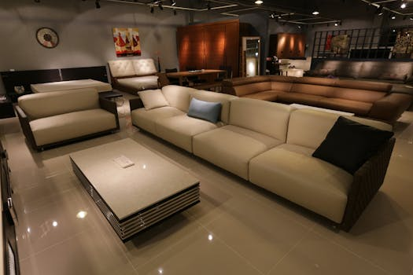
Furniture - Future Trends
Future Trends on Furniture:
- Furniture refers to objects intended to support various huma n activities such as seating (e.g., stools, chairs, and sofa s), eating (tables), storing items, working, and sleeping (e .g., beds and hammocks)
- Furniture is also used to hold objects at a convenient heigh t for work (as horizontal surfaces above the ground, such as tables and desks), or to store things (e.g., cupboards, she lves, and drawers)
- Furniture can be a product of design and can be considered a form of decorative art
- In addition to furniture's functional role, it can serve a s ymbolic or religious purpose
- It can be made from a vast multitude of materials, including metal, plastic, and wood.

