Slide 1
Goa
AI-Generated Presentation

Slide 2
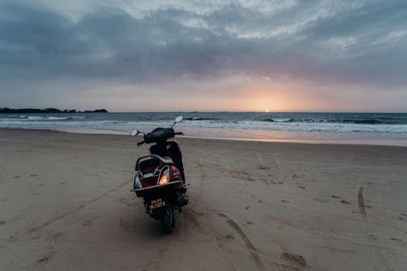
Goa - History
History on Goa:
- It shares a lot of similarities with Indian history, especially with regard to colonial influences and a multi-cultural aesthetic.
- The present-day state of Goa was established in 1987

Slide 3
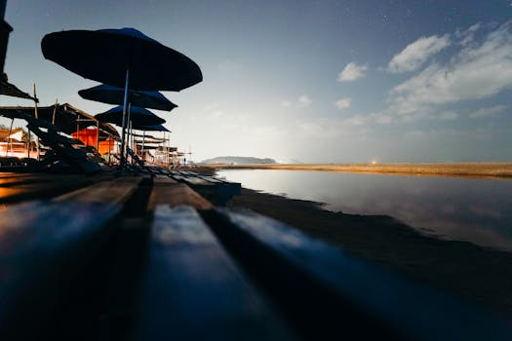
Goa - Culture
Culture on Goa:
- Goans are commonly said to be born with music and football in their blood because both are deeply entrenched in Goan culture. == Religion == According to the 1909 statistics in the Catholic Encyclopedia, the total Catholic population was 293,628 out of a total population 365,291 (80.33%).
- Goa is a state of India

Slide 4
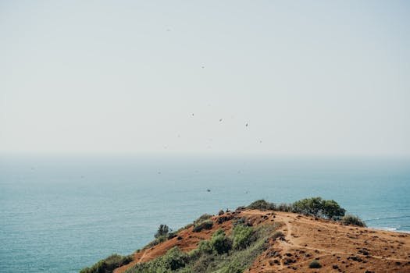
Goa - Tourism
Tourism on Goa:
- The state of Goa, in India, is famous for its beaches and places of worship
- Tourism is its primary industry, and is generally focused on the coastal areas of Goa, with decreased tourist activity inland. Foreign tourists, mostly from Europe, arrive in Goa in winter, whilst the summer and monsoon seasons see many Indian tourists.

Slide 5
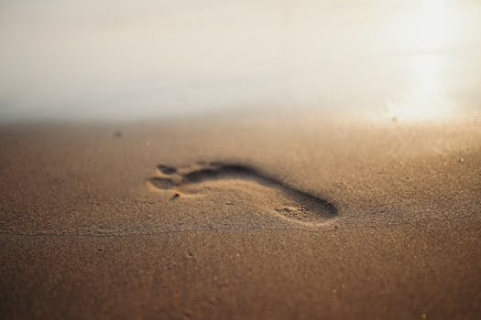
Goa - Famous Places
Famous Places on Goa:
- It is bound by the Indian states of Maharashtra to the north, and Karnataka to the east and south, with the Arabian Sea in the west
- It is India's smallest state by area and fourth-smallest by population.

Slide 6
Conclusion
Key Takeaways:
- History
- Culture
- Tourism
- Famous Places

