Slide 1
History of india
AI-Generated Presentation

Slide 2
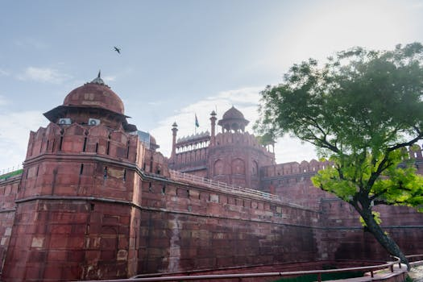
History of india - No relevant subtopics found.
No relevant subtopics found. on History of india:
- It is the host of Wikipedia, the seventh most visited website in the world
- It also hosts fourteen related open collaboration projects, and supports the development of MediaWiki, the wiki software which underpins them all.

Slide 3
Conclusion
Key Takeaways:
- No relevant subtopics found.

