Slide 1
Hockey
AI-Generated Presentation

Slide 2
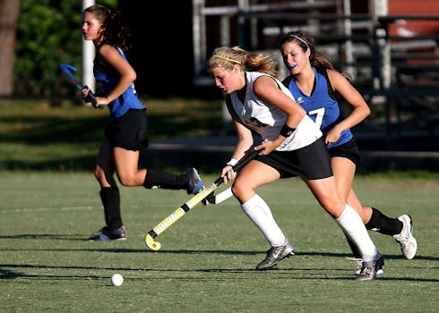
Introduction - Hockey
Introduction on Hockey:
- The National Hockey League (NHL) is a professional ice hockey league composed of 32 teams, founded in 1917
- Each team may select a captain, who has the "privilege of discussing with the referee any questions relating to interpretation of rules which may arise during the progress of a game." Each team is also permitted to select alternate captains, who serve when the captain is not on the ice
- Captains are required to wear the letter "C" on their uniform for identification while alternate captains wear the letter "A"; both letters are 3 inches (7.6 cm) in height.

Slide 3
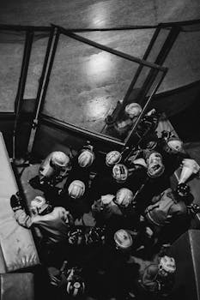
Key Features - Hockey
Key Features on Hockey:
- The Kraken compete in the National Hockey League (NHL) as a member of the Pacific Division in the Western Conference
- The Seattle Kraken are a professional ice hockey team based in Seattle
- The team was founded after the NHL approved a proposal by Seattle Hockey Partners to grant an expansion franchise to the city of Seattle, and the team began play during the league's 2021–22 season.

Slide 4
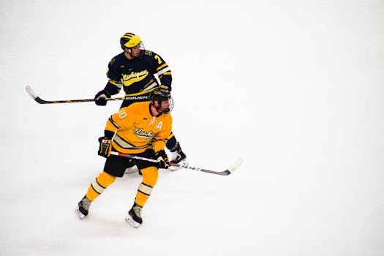
Benefits - Hockey
Benefits on Hockey:
- The Stanley Cup, the oldest professional sports trophy in North America, is awarded annually to the league playoff champion at the end of each season.
- The National Hockey League (NHL; French: Ligue nationale de hockey [liɡ nɑsjɔnal də ɔkɛ], LNH) is a professional ice hockey league in North America composed of 32 teams – 25 in the United States and 7 in Canada
- The NHL is one of the major professional sports leagues in the United States and Canada and is considered the premier professional ice hockey league in the world

Slide 5
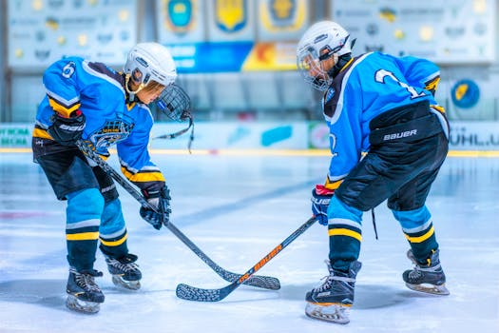
Challenges - Hockey
Challenges on Hockey:
- The World U-17 Hockey Challenge, originally known as the Quebec Esso Cup, is an international ice hockey tournament held annually in Canada
- As such, the World Under-17 Challenge was held three out of every four years.
- Prior to 2011, the tournament did not operate during years in which the Canada Winter Games were held

Slide 6
Future Scope - Hockey
Future Scope on Hockey:
- Nervi's design for the arena's reinforced concrete dome derived from the PalaLottomatica and the much smaller Palazzetto dello Sport, which were built in the 1950s for the 1960 Summer Olympics in Rome.
- Norfolk Scope is a multi-function complex in Norfolk, Virginia, comprising the 11,000-seat Scope Arena, a 2,500-seat theater known as Chrysler Hall, a 65,000-square-foot (6,000 m2) modular exhibition hall, and a 600-car parking garage. The arena was designed by Italian architect/engineer Pier Luigi Nervi in conjunction with the (now defunct) local firm Williams and Tazewell, which designed the entire complex

Slide 7
Conclusion
Key Takeaways:
- Introduction
- Key Features
- Benefits
- Challenges
- Future Scope

