Slide 1
Human Heart
AI-Generated Presentation

Slide 2

Introduction - Human Heart
Introduction on Human Heart:
- The heart is a muscular organ found in humans and other animals
- This organ pumps blood through the blood vessels
- Heart and blood vessels together make the circulatory system
- The pumped blood carries oxygen and nutrients to the tissue, while carrying metabolic waste such as carbon dioxide to the lungs

Slide 3

Key Features - Human Heart
Key Features on Human Heart:
- No relevant data found.

Slide 4
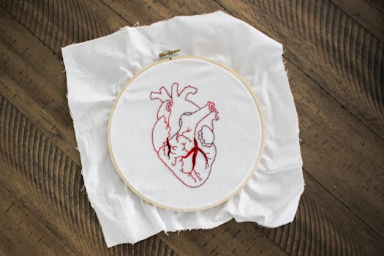
Benefits - Human Heart
Benefits on Human Heart:
- Of Human Hearts is a 1938 American Drama Western film directed by Clarence Brown and starring Walter Huston, James Stewart and Beulah Bondi
- Stewart plays a proud and ungrateful son who rebels against his preacher father and (after his father's death) neglects his poverty-stricken mother
- Bondi was nominated for the Academy Award for Best Supporting Actress. == Plot == Young Jason Wilkins has a stern but loving preacher father, Rev
- Ethan Wilkins, and a doting mother, Mary Wilkins.

Slide 5

Challenges - Human Heart
Challenges on Human Heart:
- No relevant data found.

Slide 6
Future Scope - Human Heart
Future Scope on Human Heart:
- The State of Tennessee v
- John Thomas Scopes, commonly known as the Scopes trial or Scopes Monkey Trial, was an American legal case from July 10 to July 21, 1925, in which a high school teacher, John T
- Scopes, was accused of violating Tennessee's Butler Act, which had made it illegal to teach human evolution in any state-funded school
- The trial was deliberately staged in order to attract publicity to the small town of Dayton, Tennessee, where it was held

Slide 7
Conclusion
Key Takeaways:
- Introduction
- Key Features
- Benefits
- Challenges
- Future Scope

