Slide 1
anime
Auto-generated PPT with Images and Theory Points

Slide 2

anime - Slide 1
Key Points:
- Animals are multicellular, eukaryotic organisms in the biological kingdom Animalia ()
- With few exceptions, animals consume organic material, breathe oxygen, have myocytes and are able to move, can reproduce sexually, and grow from a hollow sphere of cells, the blastula, during embryonic development
- Animals form a clade, meaning that they arose from a single common ancestor
- Over 1.5 million living animal species have been described, of which around 1.05 million are insects, over 85,000 are molluscs, and around 65,000 are vertebrates
- It has been estimated there are as many as 7.77 million animal species on Earth.

Slide 3
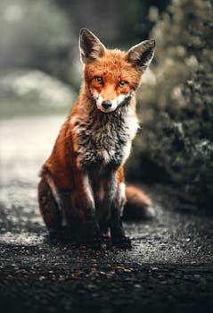
anime - Slide 2
Key Points:
- Animals are multicellular, eukaryotic organisms in the biological kingdom Animalia ()
- With few exceptions, animals consume organic material, breathe oxygen, have myocytes and are able to move, can reproduce sexually, and grow from a hollow sphere of cells, the blastula, during embryonic development
- Animals form a clade, meaning that they arose from a single common ancestor
- Over 1.5 million living animal species have been described, of which around 1.05 million are insects, over 85,000 are molluscs, and around 65,000 are vertebrates
- It has been estimated there are as many as 7.77 million animal species on Earth.

Slide 4
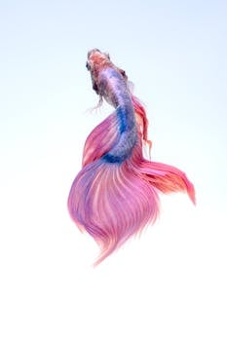
anime - Slide 3
Key Points:
- Animals are multicellular, eukaryotic organisms in the biological kingdom Animalia ()
- With few exceptions, animals consume organic material, breathe oxygen, have myocytes and are able to move, can reproduce sexually, and grow from a hollow sphere of cells, the blastula, during embryonic development
- Animals form a clade, meaning that they arose from a single common ancestor
- Over 1.5 million living animal species have been described, of which around 1.05 million are insects, over 85,000 are molluscs, and around 65,000 are vertebrates
- It has been estimated there are as many as 7.77 million animal species on Earth.

