Slide 1
cars
AI-Generated PPT with Images and Structured Information

Slide 2
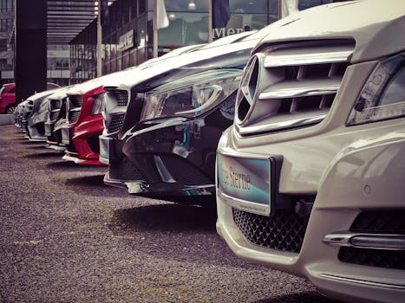
cars - Introduction
Introduction on cars:
- It is the only domesticated species of t he family Felidae
- It is valued by humans for companionship and its ability to kill vermin
- Its retractable claws are adapted to kil ling small prey species such as mice and rats
- It is a social species, but a solitary h unter and a crepuscular predator.

Slide 3
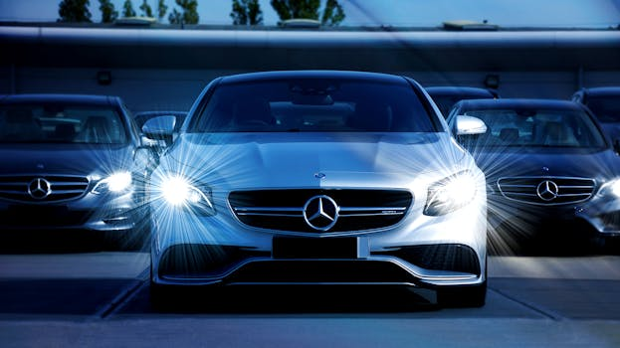
cars - Characteristics
Characteristics on cars:
- It secretes and perceives pheromones.

Slide 4
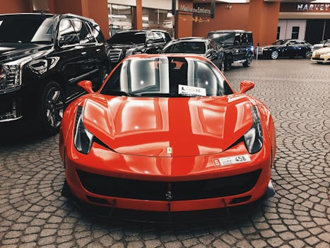
cars - Evolution
Evolution on cars:
- Domestic cats are bred and shown at cat fancy events as registered pedigreed cat s

Slide 5
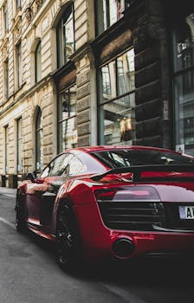
cars - Importance
Importance on cars:
- Domestic cats are found across the globe , though their popularity as pets varies by region
- In the United Kingdom, approximately 10. 9 million domestic cats are kept as pets .

Slide 6
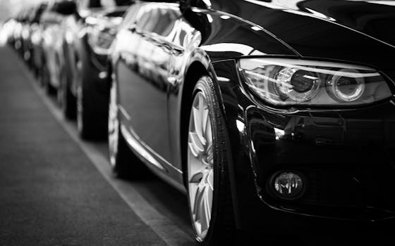
cars - Future Trends
Future Trends on cars:
- The Late Latin word may be derived from an unidentified African language
- The Nubian word kaddîska wildcat and Nob iin kadīs are possible sources or cognat es.

