Slide 1
cat
AI-Generated PPT with Comprehensive Information

Slide 2
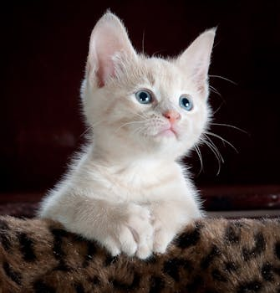
cat - Introduction
Introduction on cat:
- Error fetching Wikipedia data: "can" may refer to: ability probability canning Aluminum can Drink can Steel and tin can s Trash can Oil can Petrol can Can (band) Can (album) Can (S outh Korean band) Canada Cantoris Can (name) Can (verb) Cann ing River Can Tomato can (sports idiom) CAN (disambiguation) Cann (disambiguation) Cans (disambiguation) Kan (disambigua tion) Can-can (disambiguation)

Slide 3
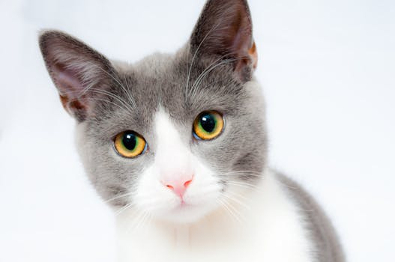
cat - Characteristics
Characteristics on cat:
- Error fetching Wikipedia data: "can" may refer to: ability probability canning Aluminum can Drink can Steel and tin can s Trash can Oil can Petrol can Can (band) Can (album) Can (S outh Korean band) Canada Cantoris Can (name) Can (verb) Cann ing River Can Tomato can (sports idiom) CAN (disambiguation) Cann (disambiguation) Cans (disambiguation) Kan (disambigua tion) Can-can (disambiguation)

Slide 4

cat - Evolution
Evolution on cat:
- Error fetching Wikipedia data: "can" may refer to: ability probability canning Aluminum can Drink can Steel and tin can s Trash can Oil can Petrol can Can (band) Can (album) Can (S outh Korean band) Canada Cantoris Can (name) Can (verb) Cann ing River Can Tomato can (sports idiom) CAN (disambiguation) Cann (disambiguation) Cans (disambiguation) Kan (disambigua tion) Can-can (disambiguation)

Slide 5

cat - Importance
Importance on cat:
- Error fetching Wikipedia data: "can" may refer to: ability probability canning Aluminum can Drink can Steel and tin can s Trash can Oil can Petrol can Can (band) Can (album) Can (S outh Korean band) Canada Cantoris Can (name) Can (verb) Cann ing River Can Tomato can (sports idiom) CAN (disambiguation) Cann (disambiguation) Cans (disambiguation) Kan (disambigua tion) Can-can (disambiguation)

Slide 6

cat - Future Trends
Future Trends on cat:
- Error fetching Wikipedia data: "can" may refer to: ability probability canning Aluminum can Drink can Steel and tin can s Trash can Oil can Petrol can Can (band) Can (album) Can (S outh Korean band) Canada Cantoris Can (name) Can (verb) Cann ing River Can Tomato can (sports idiom) CAN (disambiguation) Cann (disambiguation) Cans (disambiguation) Kan (disambigua tion) Can-can (disambiguation)

