Slide 1
Cricket
AI-Generated Presentation

Slide 2
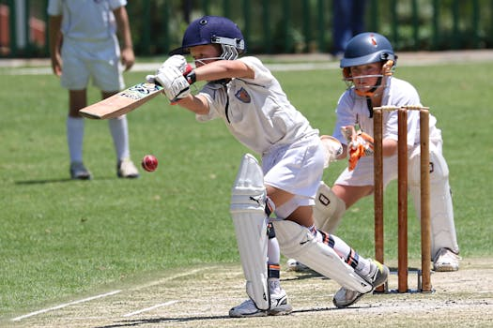
Cricket - Introduction
Introduction on Cricket:
- The league commenced in 2011.
- The Celebrity Cricket League (CCL) is an exhibition men's cricket league in India

Slide 3
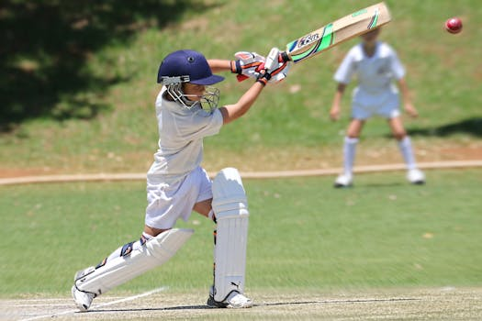
Cricket - Key Features
Key Features on Cricket:
- The event is organised by the sport's governing body, the International Cricket Council (ICC), every four years, with preliminary qualification rounds leading up to a finals tournament
- The ICC Men's Cricket World Cup is the quadrennial international championship of One Day International cricket

Slide 4
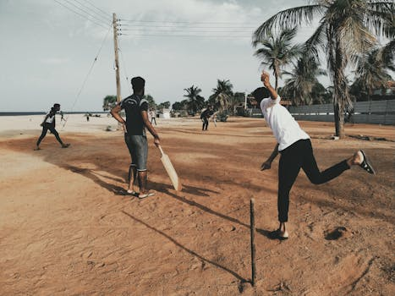
Cricket - Benefits
Benefits on Cricket:
- The Board of Control for Cricket in India (BCCI) is the principal national governing body of the sport of cricket in India
- Its headquarters are situated at the Cricket Centre in Churchgate, Mumbai

Slide 5
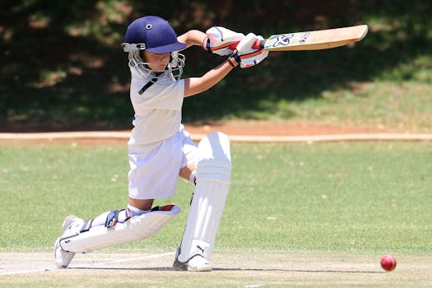
Cricket - Challenges
Challenges on Cricket:
- The 2024–2026 ICC Cricket World Cup Challenge League is the second edition of the ICC Cricket World Cup Challenge League and a cricket tournament which forms part of the 2027 Cricket World Cup qualification process. == Teams and qualification == The league features twelve teams: those finishing 2nd–4th in their respective league in the 2019–2022 ICC Cricket World Cup Challenge League, the top four finishers from 2024 ICC Cricket World Cup Challenge League Play-off and two teams from the 2023 Cricket World Cup Qualifier Play-off. That tournament saw Canada, winner of League A in the previous Challenge League being promoted to League 2 status, while Papua New Guinea was relegated.

Slide 6
Conclusion
Key Takeaways:
- Introduction
- Key Features
- Benefits
- Challenges

