Slide 1
forest
Auto-generated PPT with Images and Theory Points

Slide 2
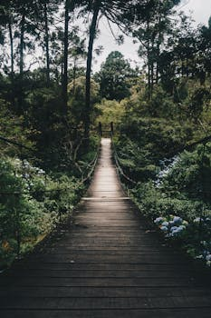
forest - Slide 1
Key Points:
- forest has multiple meanings. Try specifying a clearer topic.

Slide 3
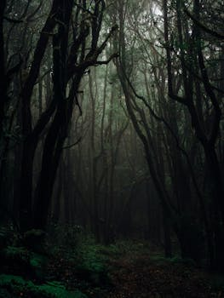
forest - Slide 2
Key Points:
- forest has multiple meanings. Try specifying a clearer topic.

Slide 4
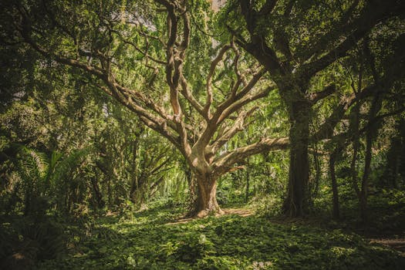
forest - Slide 3
Key Points:
- forest has multiple meanings. Try specifying a clearer topic.

