Slide 1
india gate
AI-Generated PPT with Images and Structured Information

Slide 2
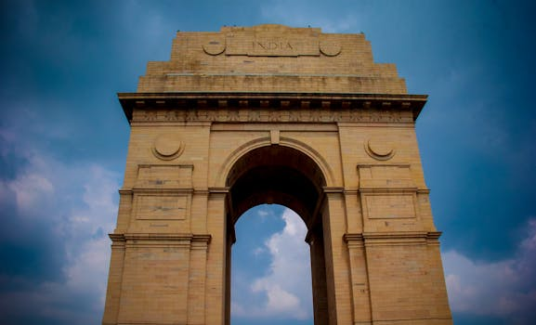
india gate - Introduction
Introduction on india gate:
- No information found for this topic on Wikipedia.

Slide 3

india gate - Characteristics
Characteristics on india gate:

Slide 4
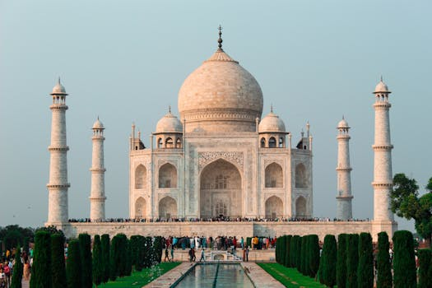
india gate - Evolution
Evolution on india gate:

Slide 5
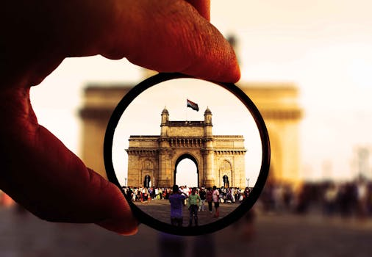
india gate - Importance
Importance on india gate:

Slide 6
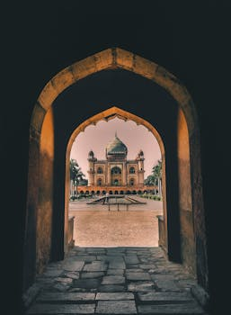
india gate - Future Trends
Future Trends on india gate:

