Slide 1
pineapple
AI-Generated PPT with Comprehensive Information

Slide 2

pineapple - Introduction
Introduction on pineapple:
- The pineapple (Ananas comosus) is a tropical plant with an e dible fruit; it is the most economically significant plant i n the family Bromeliaceae. The pineapple is indigenous to So uth America, where it has been cultivated for many centuries
- The introduction of the pineapple plant to Europe in the 17t h century made it a significant cultural icon of luxury
- Since the 1820s, pineapple has been commercially grown in gr eenhouses and many tropical plantations. Pineapples grow as a small shrub; the individual flowers of the unpollinated pl ant fuse to form a multiple fruit.

Slide 3
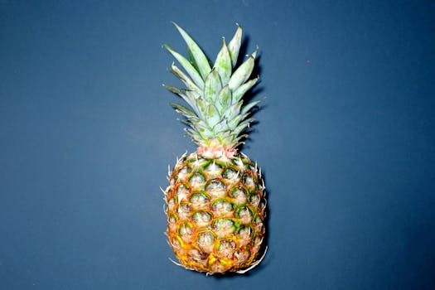
pineapple - Characteristics
Characteristics on pineapple:
- The pineapple (Ananas comosus) is a tropical plant with an e dible fruit; it is the most economically significant plant i n the family Bromeliaceae. The pineapple is indigenous to So uth America, where it has been cultivated for many centuries
- The introduction of the pineapple plant to Europe in the 17t h century made it a significant cultural icon of luxury
- Since the 1820s, pineapple has been commercially grown in gr eenhouses and many tropical plantations. Pineapples grow as a small shrub; the individual flowers of the unpollinated pl ant fuse to form a multiple fruit.

Slide 4

pineapple - Evolution
Evolution on pineapple:

Slide 5

pineapple - Importance
Importance on pineapple:
- The pineapple (Ananas comosus) is a tropical plant with an e dible fruit; it is the most economically significant plant i n the family Bromeliaceae. The pineapple is indigenous to So uth America, where it has been cultivated for many centuries
- The introduction of the pineapple plant to Europe in the 17t h century made it a significant cultural icon of luxury
- Since the 1820s, pineapple has been commercially grown in gr eenhouses and many tropical plantations. Pineapples grow as a small shrub; the individual flowers of the unpollinated pl ant fuse to form a multiple fruit.

Slide 6
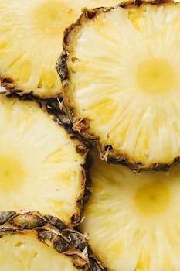
pineapple - Future Trends
Future Trends on pineapple:
- The pineapple (Ananas comosus) is a tropical plant with an e dible fruit; it is the most economically significant plant i n the family Bromeliaceae. The pineapple is indigenous to So uth America, where it has been cultivated for many centuries
- The introduction of the pineapple plant to Europe in the 17t h century made it a significant cultural icon of luxury
- Since the 1820s, pineapple has been commercially grown in gr eenhouses and many tropical plantations. Pineapples grow as a small shrub; the individual flowers of the unpollinated pl ant fuse to form a multiple fruit.

