Slide 1
school
AI-Generated PPT with Comprehensive Information

Slide 2

school - Introduction
Introduction on school:
- A school is the educational institution (and, in the case of in-person learning, the building) designed to provide learn ing environments for the teaching of students, usually under the direction of teachers
- Most countries have systems of formal education, which is so metimes compulsory
- In these systems, students progress through a series of scho ols that can be built and operated by both government and pr ivate organization
- The names for these schools vary by country (discussed in th e Regional terms section below) but generally include primar y school for young children and secondary school for teenage rs who have completed primary education
- An institution where higher education is taught is commonly called a university college or university.

Slide 3

school - Characteristics
Characteristics on school:
- A school is the educational institution (and, in the case of in-person learning, the building) designed to provide learn ing environments for the teaching of students, usually under the direction of teachers
- Most countries have systems of formal education, which is so metimes compulsory
- In these systems, students progress through a series of scho ols that can be built and operated by both government and pr ivate organization
- The names for these schools vary by country (discussed in th e Regional terms section below) but generally include primar y school for young children and secondary school for teenage rs who have completed primary education
- An institution where higher education is taught is commonly called a university college or university.

Slide 4
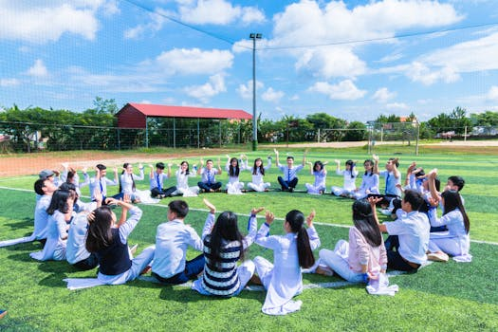
school - Evolution
Evolution on school:
- == History and development ==

Slide 5

school - Importance
Importance on school:
- A school is the educational institution (and, in the case of in-person learning, the building) designed to provide learn ing environments for the teaching of students, usually under the direction of teachers
- Most countries have systems of formal education, which is so metimes compulsory
- In these systems, students progress through a series of scho ols that can be built and operated by both government and pr ivate organization
- The names for these schools vary by country (discussed in th e Regional terms section below) but generally include primar y school for young children and secondary school for teenage rs who have completed primary education
- An institution where higher education is taught is commonly called a university college or university.

Slide 6

school - Future Trends
Future Trends on school:
- Critics of school often accuse the school system of failing to adequately prepare students for their future lives, of en couraging certain temperaments while inhibiting others, of p rescribing students exactly what to do, how, when, where and with whom, which would suppress creativity, and of using ex trinsic measures such as grades and homework, which would in hibit children's natural curiosity and desire to learn.

