Slide 1
social media
AI-Generated PPT with Comprehensive Information

Slide 2

social media - Introduction
Introduction on social media:
- Social media are interactive technologies that facilitate th e creation, sharing and aggregation of content (such as idea s, interests, and other forms of expression) amongst virtual communities and networks
- Common features include: Online platforms that enable users to create and share content and participate in social netwo rking. User-generated content—such as text posts or comments , digital photos or videos, and data generated through onlin e interactions. Service-specific profiles that are designed and maintained by the social media organization. Social medi a helps the development of online social networks by connect ing a user's profile with those of other individuals or grou ps.

Slide 3
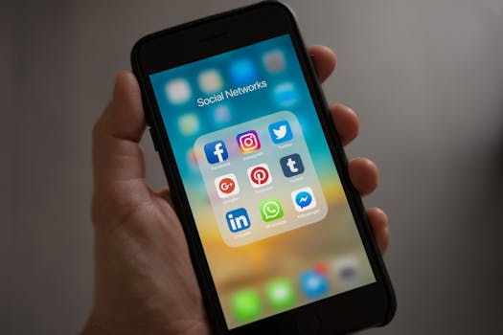
social media - Characteristics
Characteristics on social media:
- Social media are interactive technologies that facilitate th e creation, sharing and aggregation of content (such as idea s, interests, and other forms of expression) amongst virtual communities and networks
- Common features include: Online platforms that enable users to create and share content and participate in social netwo rking. User-generated content—such as text posts or comments , digital photos or videos, and data generated through onlin e interactions. Service-specific profiles that are designed and maintained by the social media organization. Social medi a helps the development of online social networks by connect ing a user's profile with those of other individuals or grou ps.

Slide 4
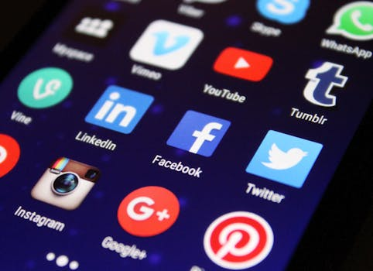
social media - Evolution
Evolution on social media:

Slide 5
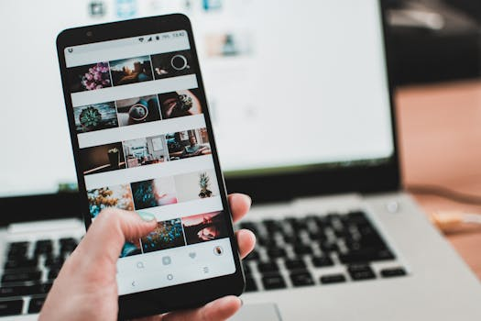
social media - Importance
Importance on social media:
- Social media has been criticized for a range of negative imp acts on children and teenagers, including exposure to inappr opriate content, exploitation by adults, sleep problems, att ention problems, feelings of exclusion, and various mental h ealth maladies
- Social media has also received criticism as worsening politi cal polarization and undermining democracy
- Major news outlets often have strong controls in place to av oid and fix false claims, but social media's unique qualitie s bring viral content with little to no oversight
- "Algorithms that track user engagement to prioritize what is shown tend to favor content that spurs negative emotions li ke anger and outrage

Slide 6
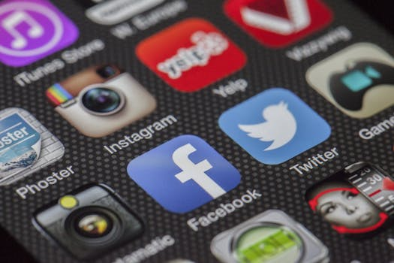
social media - Future Trends
Future Trends on social media:
- The hashtag was created to simplify searching for informatio n and to allow users to highlight topics of interest in the hope of attracting the attention of others
- Hashtags can be used to advocate for a movement, mark conten t for future use, and allow other users to contribute to a d iscussion.

