Slide 1
train
AI-Generated PPT with Comprehensive Information

Slide 2
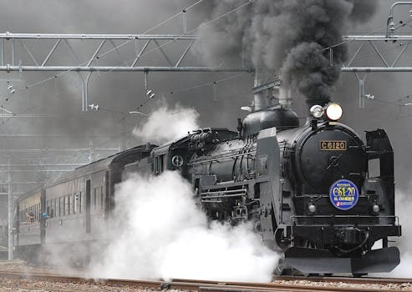
train - Introduction
Introduction on train:
- Error fetching Wikipedia data: "track" may refer to: Ancien t trackway Animal track Desire path Forest track Fossil trac kway Trackway Trail Vineyard track Tracks (1976 film) Tracks (2003 film) Tracks (2013 film) The Track (film) Tracks (nov el) Robyn Davidson J. Gabriel Gates Track Records Soundtrack Tracks (Oscar Peterson album) Tracks (Liverpool Express alb um) Tracks (Bruce Springsteen album) Tracks (Collin Raye alb um) Stinkfist The Pleasure Principle Wild Animals Backbone A udio signal Music track "Tracks" (Law & Order: UK) Zoboomafo o T.R.A.C.K.S. Tracks (magazine) Tracks (podcast) Tracks – T he Train Set Game Tracks (Transformers) Track (optical disc) Track (disk drive) magnetic stripe card running track Cinde r track winter sports List of bobsleigh, luge, and skeleton tracks Long track speed skating Race track Tartan track The Track Track and field Track cycling Velodrome Railway track Track gauge O-Bahn Axle track Continuous track Track (naviga tion) Ground track flight planning Conference track Green tr ack Tracks Inc song Sidetrack (disambiguation) Sidetracked ( disambiguation) TRAC (disambiguation) Track and trace Tracke r (disambiguation) Tracking (disambiguation) Transnational A ssociation of Christian Colleges and Schools Trek (disambigu ation)

Slide 3
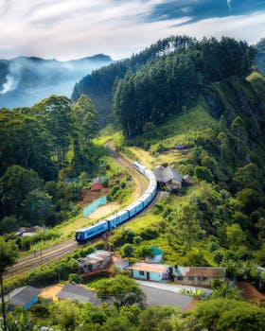
train - Characteristics
Characteristics on train:
- Error fetching Wikipedia data: "track" may refer to: Ancien t trackway Animal track Desire path Forest track Fossil trac kway Trackway Trail Vineyard track Tracks (1976 film) Tracks (2003 film) Tracks (2013 film) The Track (film) Tracks (nov el) Robyn Davidson J. Gabriel Gates Track Records Soundtrack Tracks (Oscar Peterson album) Tracks (Liverpool Express alb um) Tracks (Bruce Springsteen album) Tracks (Collin Raye alb um) Stinkfist The Pleasure Principle Wild Animals Backbone A udio signal Music track "Tracks" (Law & Order: UK) Zoboomafo o T.R.A.C.K.S. Tracks (magazine) Tracks (podcast) Tracks – T he Train Set Game Tracks (Transformers) Track (optical disc) Track (disk drive) magnetic stripe card running track Cinde r track winter sports List of bobsleigh, luge, and skeleton tracks Long track speed skating Race track Tartan track The Track Track and field Track cycling Velodrome Railway track Track gauge O-Bahn Axle track Continuous track Track (naviga tion) Ground track flight planning Conference track Green tr ack Tracks Inc song Sidetrack (disambiguation) Sidetracked ( disambiguation) TRAC (disambiguation) Track and trace Tracke r (disambiguation) Tracking (disambiguation) Transnational A ssociation of Christian Colleges and Schools Trek (disambigu ation)

Slide 4
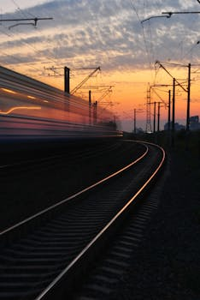
train - Evolution
Evolution on train:
- Error fetching Wikipedia data: "track" may refer to: Ancien t trackway Animal track Desire path Forest track Fossil trac kway Trackway Trail Vineyard track Tracks (1976 film) Tracks (2003 film) Tracks (2013 film) The Track (film) Tracks (nov el) Robyn Davidson J. Gabriel Gates Track Records Soundtrack Tracks (Oscar Peterson album) Tracks (Liverpool Express alb um) Tracks (Bruce Springsteen album) Tracks (Collin Raye alb um) Stinkfist The Pleasure Principle Wild Animals Backbone A udio signal Music track "Tracks" (Law & Order: UK) Zoboomafo o T.R.A.C.K.S. Tracks (magazine) Tracks (podcast) Tracks – T he Train Set Game Tracks (Transformers) Track (optical disc) Track (disk drive) magnetic stripe card running track Cinde r track winter sports List of bobsleigh, luge, and skeleton tracks Long track speed skating Race track Tartan track The Track Track and field Track cycling Velodrome Railway track Track gauge O-Bahn Axle track Continuous track Track (naviga tion) Ground track flight planning Conference track Green tr ack Tracks Inc song Sidetrack (disambiguation) Sidetracked ( disambiguation) TRAC (disambiguation) Track and trace Tracke r (disambiguation) Tracking (disambiguation) Transnational A ssociation of Christian Colleges and Schools Trek (disambigu ation)

Slide 5
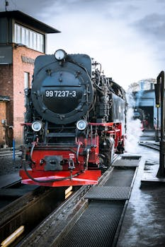
train - Importance
Importance on train:
- Error fetching Wikipedia data: "track" may refer to: Ancien t trackway Animal track Desire path Forest track Fossil trac kway Trackway Trail Vineyard track Tracks (1976 film) Tracks (2003 film) Tracks (2013 film) The Track (film) Tracks (nov el) Robyn Davidson J. Gabriel Gates Track Records Soundtrack Tracks (Oscar Peterson album) Tracks (Liverpool Express alb um) Tracks (Bruce Springsteen album) Tracks (Collin Raye alb um) Stinkfist The Pleasure Principle Wild Animals Backbone A udio signal Music track "Tracks" (Law & Order: UK) Zoboomafo o T.R.A.C.K.S. Tracks (magazine) Tracks (podcast) Tracks – T he Train Set Game Tracks (Transformers) Track (optical disc) Track (disk drive) magnetic stripe card running track Cinde r track winter sports List of bobsleigh, luge, and skeleton tracks Long track speed skating Race track Tartan track The Track Track and field Track cycling Velodrome Railway track Track gauge O-Bahn Axle track Continuous track Track (naviga tion) Ground track flight planning Conference track Green tr ack Tracks Inc song Sidetrack (disambiguation) Sidetracked ( disambiguation) TRAC (disambiguation) Track and trace Tracke r (disambiguation) Tracking (disambiguation) Transnational A ssociation of Christian Colleges and Schools Trek (disambigu ation)

Slide 6
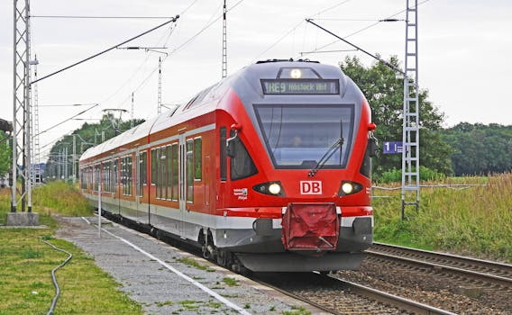
train - Future Trends
Future Trends on train:
- Error fetching Wikipedia data: "track" may refer to: Ancien t trackway Animal track Desire path Forest track Fossil trac kway Trackway Trail Vineyard track Tracks (1976 film) Tracks (2003 film) Tracks (2013 film) The Track (film) Tracks (nov el) Robyn Davidson J. Gabriel Gates Track Records Soundtrack Tracks (Oscar Peterson album) Tracks (Liverpool Express alb um) Tracks (Bruce Springsteen album) Tracks (Collin Raye alb um) Stinkfist The Pleasure Principle Wild Animals Backbone A udio signal Music track "Tracks" (Law & Order: UK) Zoboomafo o T.R.A.C.K.S. Tracks (magazine) Tracks (podcast) Tracks – T he Train Set Game Tracks (Transformers) Track (optical disc) Track (disk drive) magnetic stripe card running track Cinde r track winter sports List of bobsleigh, luge, and skeleton tracks Long track speed skating Race track Tartan track The Track Track and field Track cycling Velodrome Railway track Track gauge O-Bahn Axle track Continuous track Track (naviga tion) Ground track flight planning Conference track Green tr ack Tracks Inc song Sidetrack (disambiguation) Sidetracked ( disambiguation) TRAC (disambiguation) Track and trace Tracke r (disambiguation) Tracking (disambiguation) Transnational A ssociation of Christian Colleges and Schools Trek (disambigu ation)

