Slide 1


Introduction - Cyber Security
Computer security (also cybersecurity, digital security, or information technology (IT) security) is the protection of computer software, systems and networks from threats that can lead to unauthorized information disclosure, theft or damage to hardware, software, or data, as well as from the disruption or misdirection of the services they provide.
The significance of the field stems from the expanded reliance on computer systems, the Internet, and wireless network standards
Its importance is further amplified by the growth of smart devices, including smartphones, televisions, and the various devices that constitute the Internet of things (IoT)
Cybersecurity has emerged as one of the most significant new challenges facing the contemporary world, due to both the complexity of information systems and the societies they support
Security is particularly crucial for systems that govern large-scale systems with far-reaching physical effects, such as power distribution, elections, and finance.

Slide 2
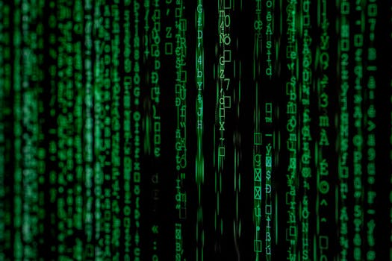
Key Features - Cyber Security
Computer security (also cybersecurity, digital security, or information technology (IT) security) is the protection of computer software, systems and networks from threats that can lead to unauthorized information disclosure, theft or damage to hardware, software, or data, as well as from the disruption or misdirection of the services they provide.
The significance of the field stems from the expanded reliance on computer systems, the Internet, and wireless network standards
Its importance is further amplified by the growth of smart devices, including smartphones, televisions, and the various devices that constitute the Internet of things (IoT)
Cybersecurity has emerged as one of the most significant new challenges facing the contemporary world, due to both the complexity of information systems and the societies they support
Security is particularly crucial for systems that govern large-scale systems with far-reaching physical effects, such as power distribution, elections, and finance.

Slide 3

Benefits - Cyber Security
Cyber threat intelligence (CTI) is a subfield of cybersecurity that focuses on the structured collection, analysis, and dissemination of data regarding potential or existing cyber threats
It provides organizations with the insights necessary to anticipate, prevent, and respond to cyberattacks by understanding the behavior of threat actors, their tactics, and the vulnerabilities they exploit.
Cyber threat intelligence sources include open source intelligence, social media intelligence, human Intelligence, technical intelligence, device log files, forensically acquired data or intelligence from the internet traffic and data derived for the deep and dark web.
In recent years, threat intelligence has become a crucial part of companies' cyber security strategy since it allows companies to be more proactive in their approach and determine which threats represent the greatest risks to a business
This puts companies on a more proactive front, actively trying to find their vulnerabilities and preventing hacks before they happen.

Slide 4

Challenges - Cyber Security
No relevant data found.

Slide 5
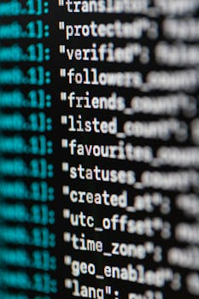
Future Scope - Cyber Security
No relevant data found.

