Slide 1


Introduction - Modi
Narendra Damodardas Modi (born 17 September 1950) is an Indian politician who has served as the prime minister of India since 2014
Modi was the chief minister of Gujarat from 2001 to 2014 and is the member of parliament (MP) for Varanasi
He is a member of the Bharatiya Janata Party (BJP) and of the Rashtriya Swayamsevak Sangh (RSS), a far-right Hindu nationalist paramilitary volunteer organisation
He is the longest-serving prime minister outside the Indian National Congress.
Modi was born and raised in Vadnagar in northeastern Gujarat, where he completed his secondary education.

Slide 2

Key Features - Modi
No relevant data found.

Slide 3
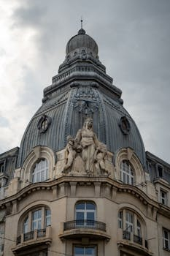
Benefits - Modi
No relevant data found.

Slide 4
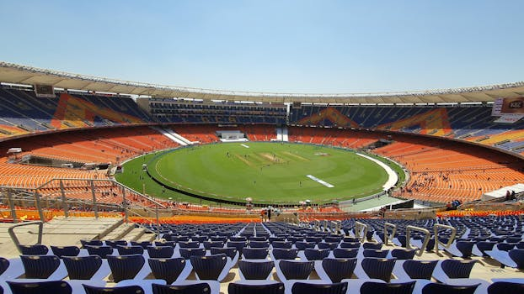
Challenges - Modi
No relevant data found.

Slide 5
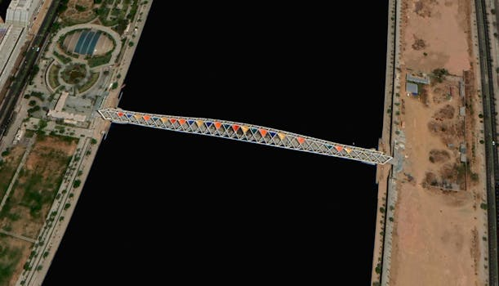
Future Scope - Modi
No relevant data found.

