Slide 1
Quantum Computer
AI-Generated Presentation

Slide 2
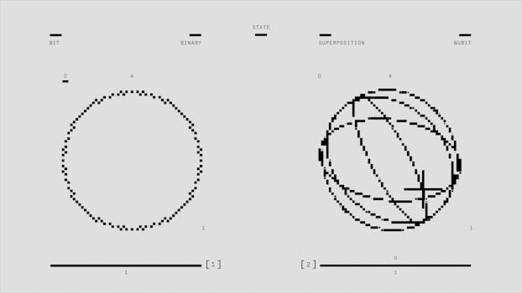
Introduction - Quantum Computer
Introduction on Quantum Computer:
- A quantum computer is a computer that exploits quantum mechanical phenomena
- On small scales, physical matter exhibits properties of both particles and waves, and quantum computing leverages this behavior using specialized hardware
- Classical physics cannot explain the operation of these quantum devices, and a scalable quantum computer could perform some calculations exponentially faster than any modern "classical" computer
- Theoretically a large-scale quantum computer could break some widely used encryption schemes and aid physicists in performing physical simulations; however, the current state of the art is largely experimental and impractical, with several obstacles to useful applications. The basic unit of information in quantum computing, the qubit (or "quantum bit"), serves the same function as the bit in classical computing.

Slide 3
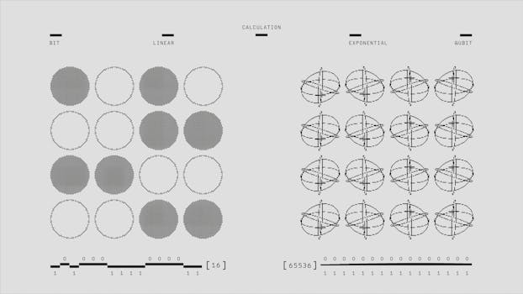
Key Features - Quantum Computer
Key Features on Quantum Computer:
- Quantum information is the information of the state of a quantum system
- It is the basic entity of study in quantum information theory, and can be manipulated using quantum information processing techniques
- Quantum information refers to both the technical definition in terms of Von Neumann entropy and the general computational term. It is an interdisciplinary field that involves quantum mechanics, computer science, information theory, philosophy and cryptography among other fields
- Its study is also relevant to disciplines such as cognitive science, psychology and neuroscience.

Slide 4
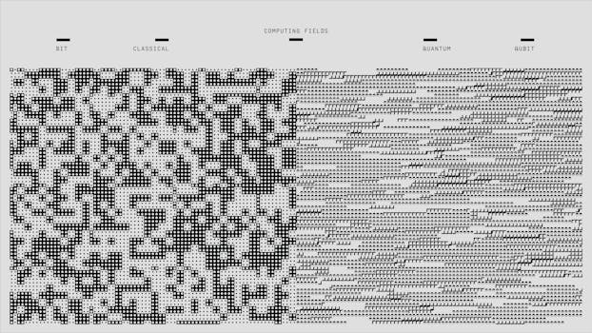
Benefits - Quantum Computer
Benefits on Quantum Computer:
- In quantum computing, quantum supremacy or quantum advantage is the goal of demonstrating that a programmable quantum computer can solve a problem that no classical computer can solve in any feasible amount of time, irrespective of the usefulness of the problem
- The term was coined by John Preskill in 2011, but the concept dates to Yuri Manin's 1980 and Richard Feynman's 1981 proposals of quantum computing. Conceptually, quantum supremacy involves both the engineering task of building a powerful quantum computer and the computational-complexity-theoretic task of finding a problem that can be solved by that quantum computer and has a superpolynomial speedup over the best known or possible classical algorithm for that task. Examples of proposals to demonstrate quantum supremacy include the boson sampling proposal of Aaronson and Arkhipov, and sampling the output of random quantum circuits
- The output distributions that are obtained by making measurements in boson sampling or quantum random circuit sampling are flat, but structured in a way so that one cannot classically efficiently sample from a distribution that is close to the distribution generated by the quantum experiment.

Slide 5

Challenges - Quantum Computer
Challenges on Quantum Computer:
- No relevant data found.

Slide 6

Future Scope - Quantum Computer
Future Scope on Quantum Computer:
- No relevant data found.

Slide 7
Conclusion
Key Takeaways:
- Introduction
- Key Features
- Benefits
- Challenges
- Future Scope

