Slide 1


Introduction - Quantum Computing
A quantum computer is a computer that exploits quantum mechanical phenomena
On small scales, physical matter exhibits properties of both particles and waves, and quantum computing leverages this behavior using specialized hardware
Classical physics cannot explain the operation of these quantum devices, and a scalable quantum computer could perform some calculations exponentially faster than any modern "classical" computer
Theoretically a large-scale quantum computer could break some widely used encryption schemes and aid physicists in performing physical simulations; however, the current state of the art is largely experimental and impractical, with several obstacles to useful applications.
The basic unit of information in quantum computing, the qubit (or "quantum bit"), serves the same function as the bit in classical computing.

Slide 2
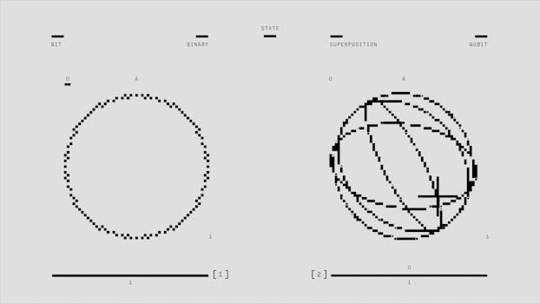
Key Features - Quantum Computing
Cloud-based quantum computing is the invocation of quantum emulators, simulators or processors through the cloud
Increasingly, cloud services are being looked on as the method for providing access to quantum processing
Quantum computers achieve their massive computing power by initiating quantum physics into processing power and when users are allowed access to these quantum-powered computers through the internet it is known as quantum computing within the cloud.
In 2016, IBM connected a small quantum computer to the cloud and it allows for simple programs to be built and executed on the cloud
In early 2017, researchers from Rigetti Computing demonstrated the first programmable cloud access using the pyQuil Python library.

Slide 3
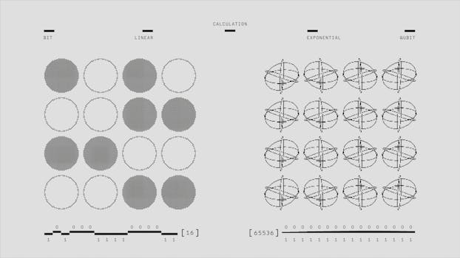
Benefits - Quantum Computing
This is a timeline of quantum computing
Each time shown is either less approximately or more approximately corresponding to the time of the event
In some cases the date corresponds either to the date a publication was first received at the publisher or the publication date.
== 1960s ==
=== 1968/69/70 ===
Stephen Wiesner invents conjugate coding
=== 1969 ===
13 June – James L
Park (Washington State University, Pullman)'s paper is received by Foundations of Physics in which he describes the non possibility of disturbance in a quantum transition state in the context of a disproof of quantum jumps in the concept of the atom described by Bohr

Slide 4
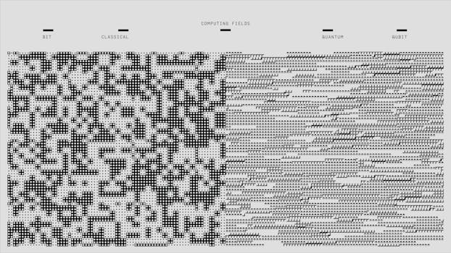
Challenges - Quantum Computing
A quantum computer is a computer that exploits quantum mechanical phenomena
On small scales, physical matter exhibits properties of both particles and waves, and quantum computing leverages this behavior using specialized hardware
Classical physics cannot explain the operation of these quantum devices, and a scalable quantum computer could perform some calculations exponentially faster than any modern "classical" computer
Theoretically a large-scale quantum computer could break some widely used encryption schemes and aid physicists in performing physical simulations; however, the current state of the art is largely experimental and impractical, with several obstacles to useful applications.
The basic unit of information in quantum computing, the qubit (or "quantum bit"), serves the same function as the bit in classical computing.

Slide 5
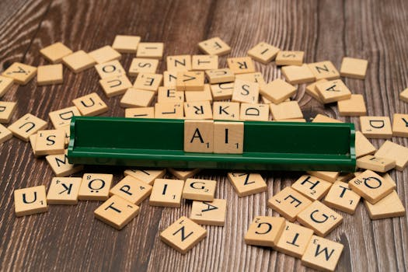
Future Scope - Quantum Computing
No relevant data found.

