Slide 1
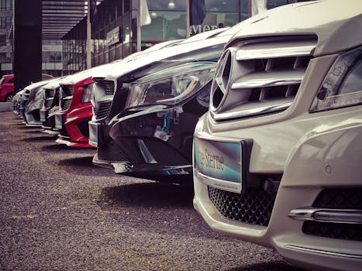

models - Cars
The model of a car is its design, in the context of the manufacturer's range or series of cars
Different models, variants are distinguishable by technology, components, underpinnings, and/or style and appearance.
The methods used to categorise cars into models differ significantly between manufacturers
Frequently, several different body variants are offered, depending on market demand; and when completing their 'production lifespan', sufficiently successful models are usually followed by a new 'generation' of that model.
The name of a model (range or series) is almost always trademarked, so that competing manufacturers cannot also use it (unless the owner permits it, for an agreed licence fee).

