Slide 1
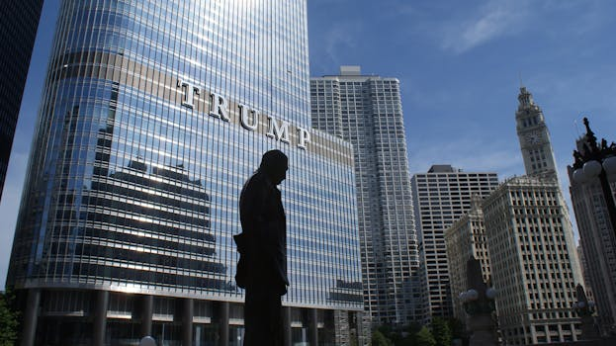

Introduction - trump
(born December 31, 1977), often nicknamed Don Jr., is an American businessman
He is the eldest child of U.S
president Donald Trump and his first wife Ivana Trump.
Trump serves as a trustee and executive vice president of the Trump Organization, running the company alongside his younger brother Eric
During their father's first presidency, the brothers continued to engage in deals and investments in foreign countries and collect payments at their U.S

Slide 2
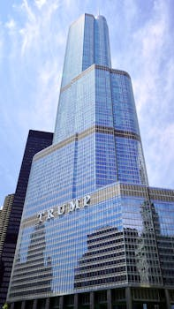
Key Features - trump
The second and current tenure of Donald Trump as the president of the United States began upon his inauguration on January 20, 2025
Trump, a Republican from New York City and resident of Florida, who previously served as president from 2017 to 2021, took office following his victory over Democratic incumbent vice president Kamala Harris in the 2024 presidential election after she replaced incumbent president Joe Biden as the Democratic Party's nominee
Alongside Trump's presidency, the Republican Party also holds their majorities in the House of Representatives under Speaker Mike Johnson and the Senate under Senate Majority Leader John Thune during the 119th U.S
On his first day, he pardoned about 1,500 people convicted of offenses in the January 6 Capitol Riot

Slide 3
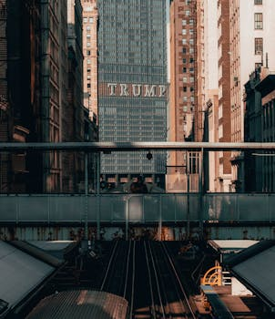
Benefits - trump
Frederick Crist Trump Jr
(October 14, 1938 – September 26, 1981) was an American airplane pilot and maintenance worker
The eldest son of real-estate businessman Fred Trump Sr., he fell out of his father's favor when he chose to become an airline pilot, leading to his younger brother Donald inheriting the family business.
Both Fred Sr
and Donald disparaged Fred Jr.

Slide 4
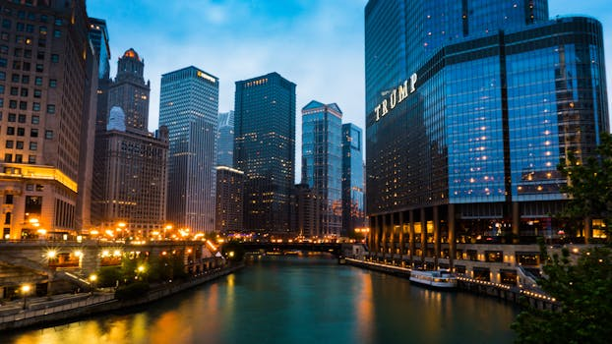
Challenges - trump
Donald Trump's eligibility to run in the 2024 U.S
presidential election was the subject of dispute due to his alleged involvement in the January 6 Capitol attack under Section 3 of the Fourteenth Amendment to the U.S
Constitution, which disqualifies insurrectionists against the United States from holding office if they have previously taken an oath to support the constitution
Courts or officials in three states—Colorado, Maine, and Illinois—ruled that Trump was barred from presidential ballots

Slide 5
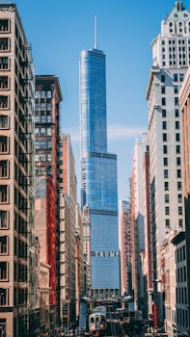
Future Scope - trump
No relevant data found.

