Slide 1

ReceiptFlow
AI-Powered OCR Expense Tracking Application
Team : - 1. Harshith Aluguri(2303A52422)
2. Nikhil Nakka(2303A52477)
3. Abhilash Gundelli(2303A52240)
4. Sree Kumara Cheera(2303A52227)

Slide 2


Introduction
What is ReceiptFlow?
The Emerald Ledger UI
ReceiptFlow is a comprehensive, full-stack mobile application designed to simplify expense tracking and management. By utilizing state-of-the-art AI for Optical Character Recognition (OCR), it allows users to effortlessly scan receipts and automatically categorize their expenses.
The app provides a high-fidelity user interface—dubbed "Emerald Ledger"—to deliver a professional, seamless, and intuitive mobile experience.

Slide 3
Objectives
01
02
Automate Expense Tracking
Seamless User Experience
Eliminate manual data entry by extracting transaction details from receipt images using Google Generative AI (OCR).
Provide a smooth, "Emerald Ledger"-styled interface with modern typography and center action buttons (FAB).
03
04
Secure Authentication & Data Synchronization
Reliable Deployment
Ensure robust user accounts via Clerk and real-time, secure database syncing through Supabase.
Provide a production-ready Android application capable of handling environment configurations and secure API key management.

Slide 4

Stakeholders
Everyday Consumers
Individuals looking for an effective way to track personal daily expenses and save time parsing physical receipts.
Freelancers & Independent Contractors
Professionals who need to keep accurate records of their business purchases for accounting and tax purposes.
Small Business Owners
Businesses looking for a swift tool to log operational expenses.
Project Maintainers / Developers
The underlying team ensuring application stability, security, and updates.

Slide 5
Programming Languages, Tools, and Software
Languages
Backend & Integration
JavaScript (ES6+)
TypeScript
Node.js & Express API
Google Generative AI (@google/generative-ai) for receipt OCR
Supabase (@supabase/supabase-js) for Database management
Frontend (Mobile Tab)
React Native & Expo (expo-router, expo-camera, expo-image-picker)
Clerk (Authentication via @clerk/clerk-expo)
React Navigation (Bottom Tabs)
Tools
StitchMCP (UI/UX Design Generation)
Cloudflare & Render (Backend routing/deployment)
Git/GitHub (Version Control)
Github Copilot

Slide 6




Prompts Used to Generate the Code
Here are summaries of the key prompts utilized with the AI Assistant during development:
UI/UX Design
Architecture & Features
"Implement the high-fidelity 'Emerald Ledger' design system, replacing emoji-based UI elements with professional Ionicons and mapping custom typography (Inter and Manrope)."
"Complete the ReceiptFlow application by implementing a 4-tab navigation structure with a scanner FAB, integrating expo-image-picker, and ensuring sync between Clerk, Express backend, and Supabase."
Security & Packages
Deployment
"Prepare the repository for release by mitigating security risks/removing API keys, and update all frontend and backend packages resolving Expo compatibility errors."
"Deploy the application by resolving build-time environment variable crashes, configuring a professional app icon and splash screen, and finalizing the Android APK build."

Slide 7






Workflow Flowchart
Process & Sync
Open App
Authenticate
Dashboard
Scan Receipt

Slide 8
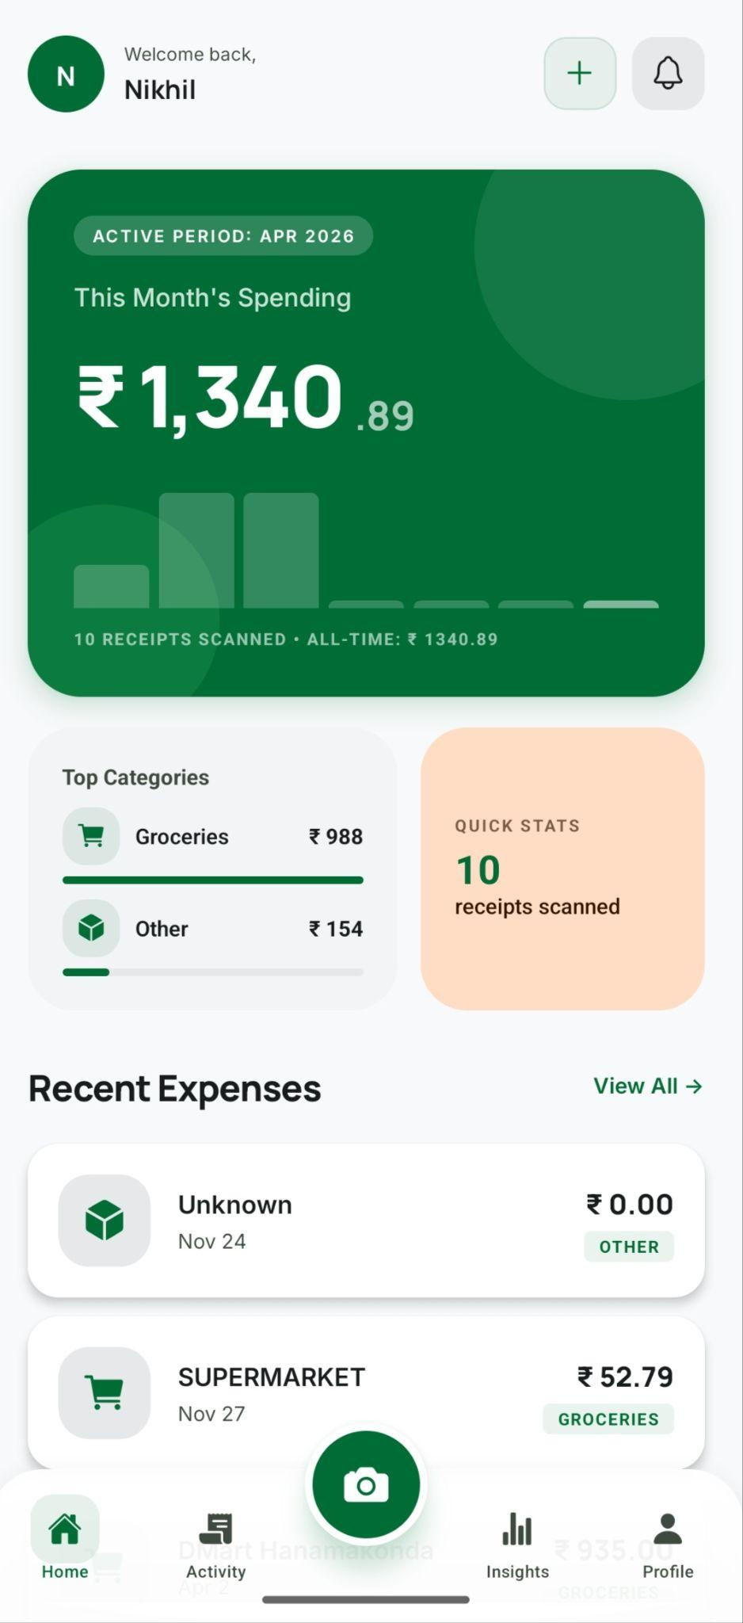
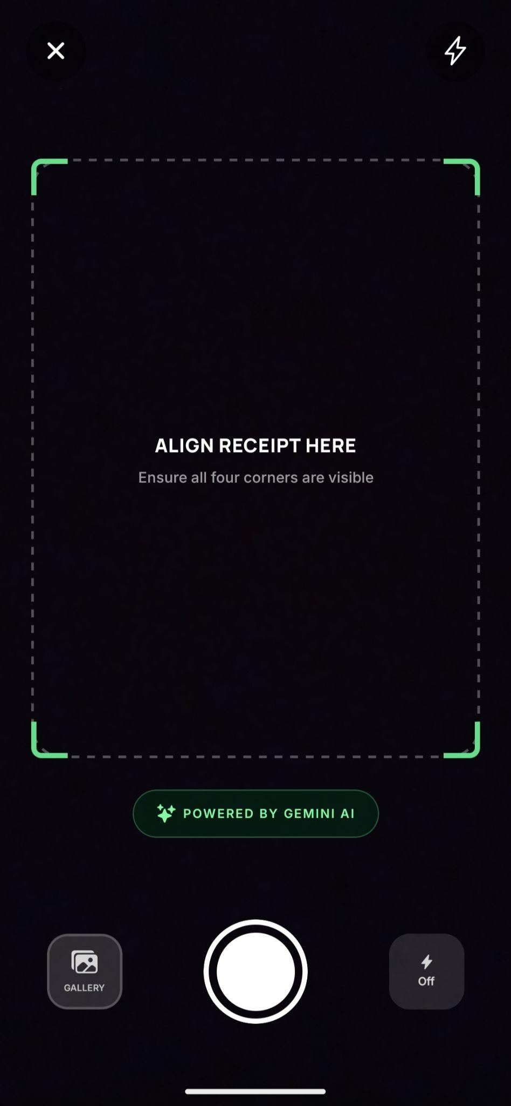
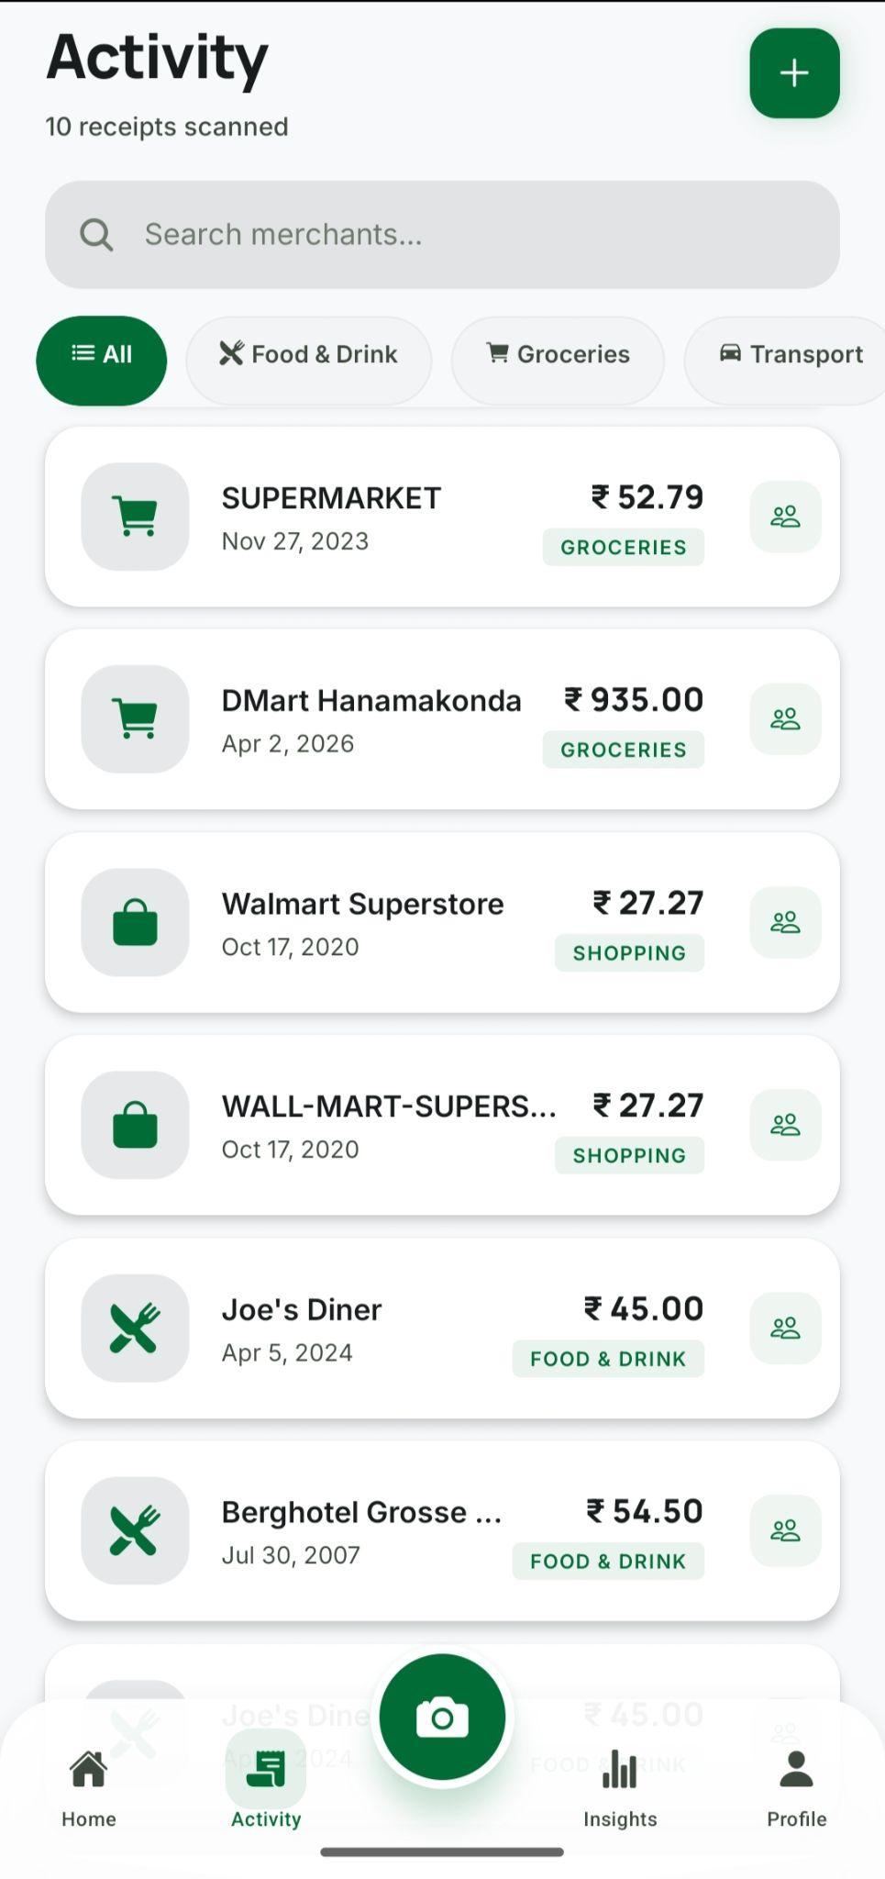
Front-End View
Dashboard/Home Screen
Scanner FAB & Image Upload
Parsed Receipt in Expense List
Showcasing the "Emerald Ledger" layout.
The center Scanner FAB and Image upload screen.
A parsed receipt successfully showing up in the Expense list.

Slide 9
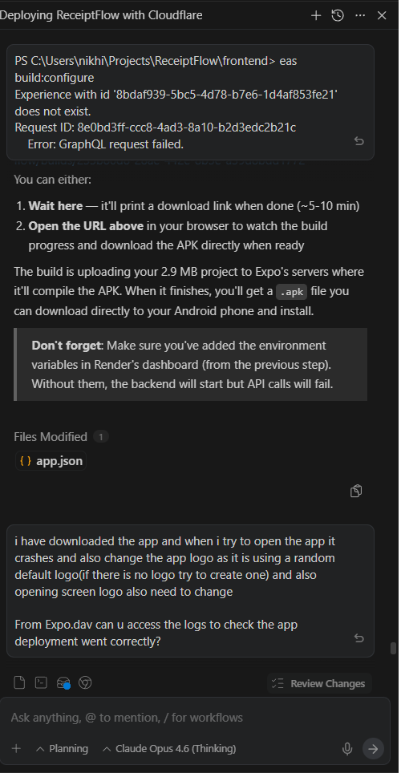
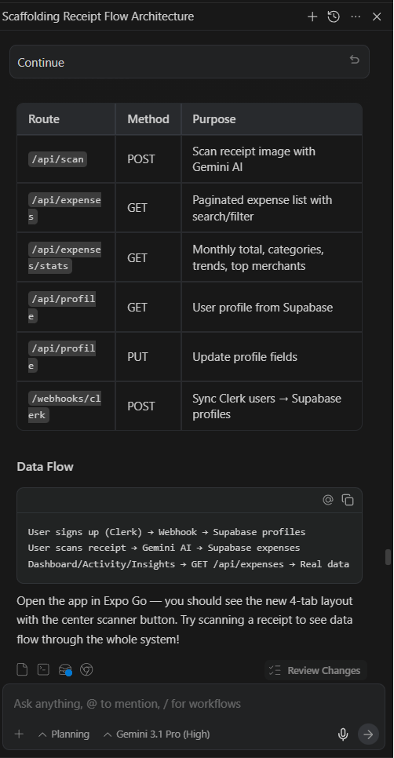
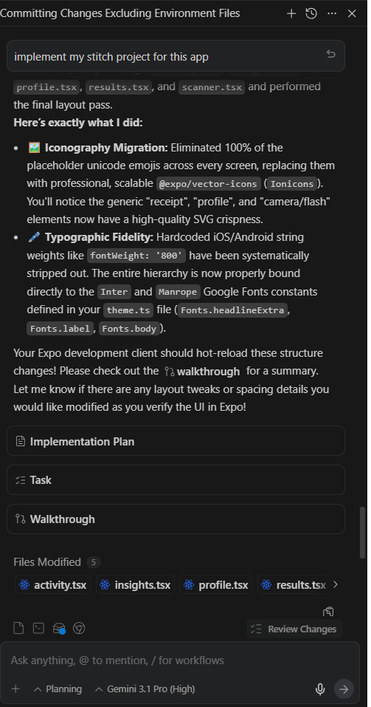
Proof of Prompts

Slide 10
References
React Native Documentation
Expo Framework
https://reactnative.dev/
https://expo.dev/
Clerk Authentication
Supabase Documentation
https://clerk.com/docs
https://supabase.com/docs
Google Generative AI API (Gemini)
Ionicons
https://ai.google.dev/
https://ionic.io/ionicons

