Slide 1
Melodic Links: A Network-Based Study of Artist Collaborations
Nikhil Kumar (2022322)
Pandillapelly Harshvardhini (2022345)
Aditya Kumar Sinha(2022034)
Group number: 36
NS Mini Project

Slide 2
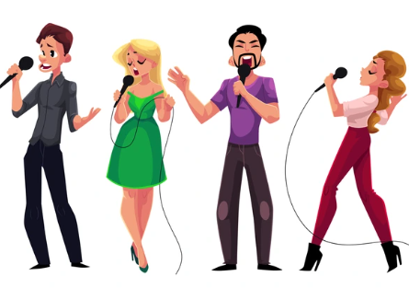
Motivation
With today's interconnected world of music, artist collaborations shape musical trends, cultural exchange, and commercial viability. However, current datasets such as those on Spotify are missing key contextual information like genre, country of origin, and language, which precludes detailed network analysis.
This project fills that gap by creating a new, enriched dataset of 51,002 verified artists and their collaborations, combining information from Spotify, MusicBrainz, and inference models. Our goal is to enable detailed network analysis across multiple dimensions such as geography, language, and popularity and to explore how collaboration patterns affect artist visibility, global reach, and fame.
This data provides the foundation for further empirical investigations into connectivity, influence, and success in the music collaboration network.

Slide 3
Introduction
Artist collaborations are a key part of today’s music scene. They shape the sound and style of music while helping artists reach new audiences across countries and genres. These partnerships form a large and complex network, but their structure and impact are not well understood—mainly because of missing or incomplete data. In this work, we build a large-scale music collaboration network based on information from Spotify and external sources. After thorough cleaning and validation, we curated a high-quality dataset of more than 51,000 confirmed artists and their collaboration relationships. Through the enrichment of this dataset with metadata like genre, country of origin, and main language, we facilitate fine-grained analysis of worldwide music interactions.
This network is the foundation on which to examine patterns of fame and connectivity in the music industry and to provide insight into how collaboration influences artists' careers and impact around the globe.

Slide 4
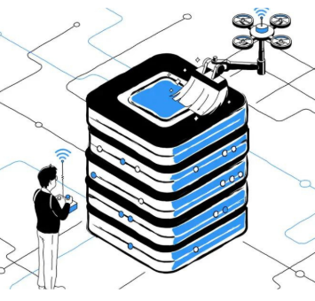
Dataset description
Our Dataset consist of:
51,002 verified artists
Cleaned edge list of real collaborations
The following attributes for each artist:
Artist Name
Spotify ID
Follower Count
Spotify Popularity Score
Primary Genre
Country of Origin
Primary Language

Slide 5
Deliverable-1: Novel Dataset
Raw Data Source: Spotify (Jan 2025) — ~156,000 artists
Attributes: Spotify ID, Name, Follower Count, Popularity Score (0–100 based on streams, engagement, playlists, etc.)
Limitations: Missing Genre, Country, Language; Included many non-legitimate artists
Cleaning Process: Used MusicBrainz API to verify artist authenticity
Removed ~105,000 inauthentic entries → 51,002 verified artists
Collaboration Edge List: CSV with artist pairs (A, B) → collaborations (tracks/albums/features) and Filtered to include only verified artist pairs
Feature Enrichment: Used LLM (Ollama) + MusicBrainz API to infer: Primary Genre, Country of Origin, Main Language and Managed API rate limits via multithreading & credential cycling
Final Dataset: 51,002 artists, cleaned collaboration edges and Attributes: Name, ID, Followers, Popularity, Genre, Country, Language

Slide 6
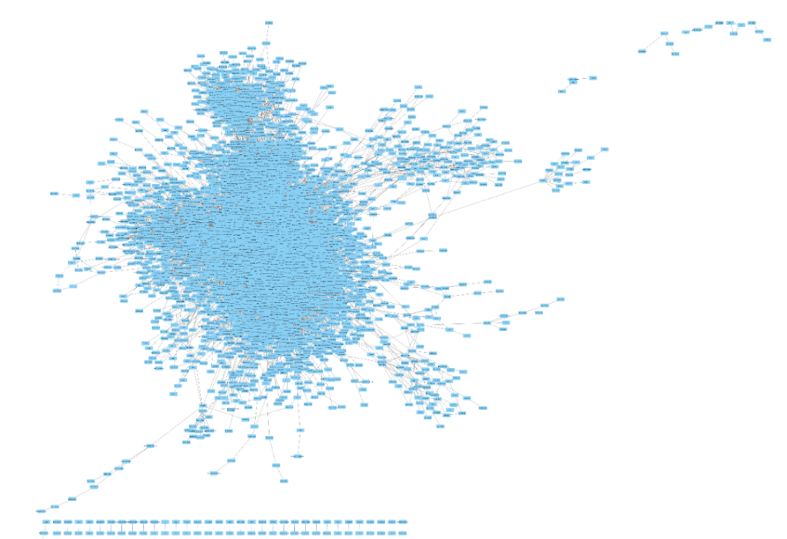
Deliverable-2: Network Visualization & EDA

Slide 7
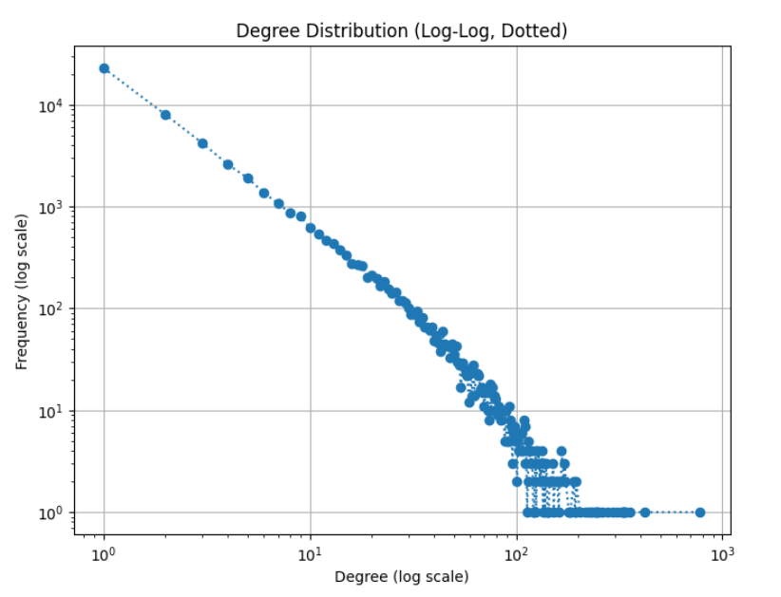
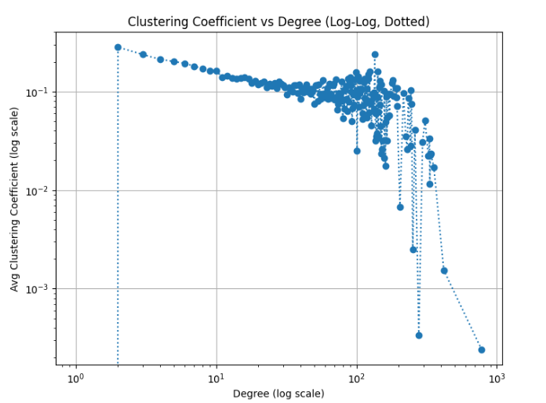
Graphs for Deliverable-2

Slide 8
Results of Deliverable-2
Graph Overview:
Nodes = 51,002 verified artists
Undirected edges = 158,232 collaborations
Network is sparse (Density = 0.0001), typical of real-world collaboration graph
478 connected components; largest has 49,698 artists (>97%)
Basic Stats:
Max Degree: 780 | Min Degree: 1 | Avg Degree: 6.2
Highlights super-connectors vs. niche artists
Not fully connected, but giant component allows global analysis
Network Visualization:
Shows top 1% artists by follower count (~5,000 nodes)
Visualizes elite collaborations across the global music scene
Degree Distribution:
Power-law pattern (linear in log-log scale) → scale-free network
Long tail: few artists with high degree (global stars), most with low degree
Noise in high-degree zone reflects data sparsity
Clustering Coefficient vs. Degree:
Negative trend: High-degree nodes have lower clustering → bridges
Dense local clusters for low-degree nodes → genre/region-based groups
High-degree nodes show more variance, from tightly-knit to cross-community hubs

Slide 9
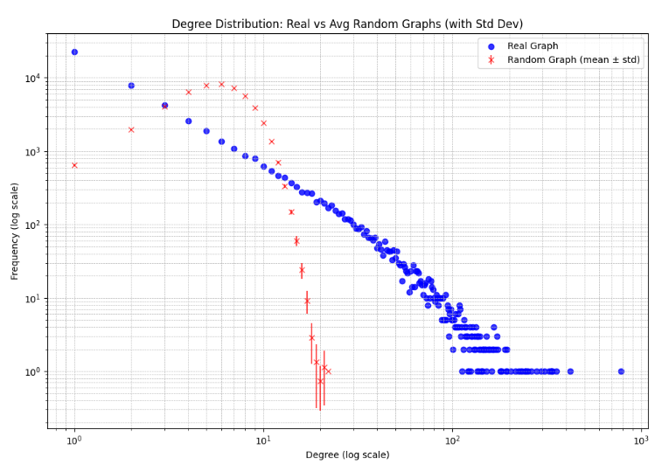
Deliverable-2
Comparison of our network with random network

Slide 10
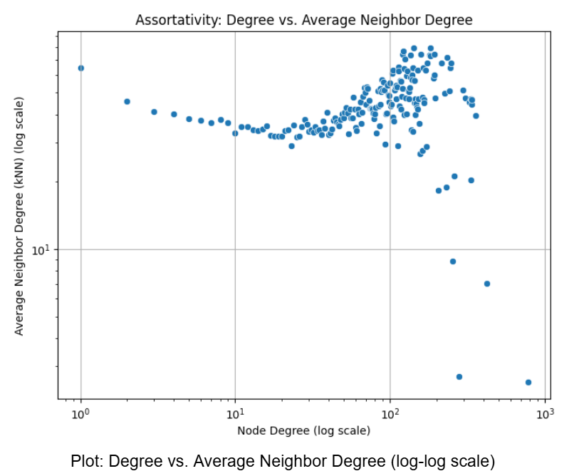
Deliverable-3: Multi-Level Assortativity
Assortativity in Music Collaboration Networks: To examine if artists in our collaboration network tend to work with others of similar connectivity (degree) and market visibility (Spotify popularity).
1) Assortativity by Degree (Topology-Based):
Computed average neighbor degree (knn) vs. own degree
Log-log plot shows an increasing trend → highly connected artists collaborate with other hubs
Confirms a rich-club effect, common in social networks
Verified with positive degree assortativity coefficient (via NetworkX)
Interpretation: Strong evidence of topological assortativity

Slide 11
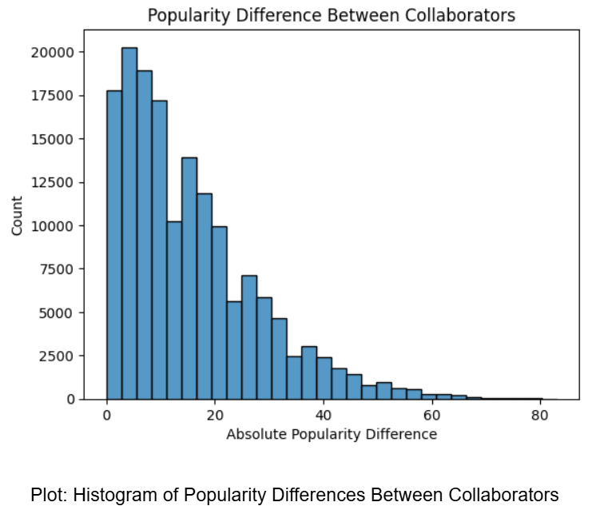
Deliverable-3
Assortativity by Spotify Popularity Score:
Measured absolute difference in popularity scores for each collaboration
Plotted a histogram of these differences
Result: Left-skewed → artists tend to collaborate with others of similar popularity
Conclusion:
Multi-level assortativity exists in the music network:
Structural level: Highly connected artists prefer other hubs
Market level: Artists collaborate with others of similar Spotify popularity
Suggests stratified collaboration behavior, shaped by both network position and industry status

Slide 12
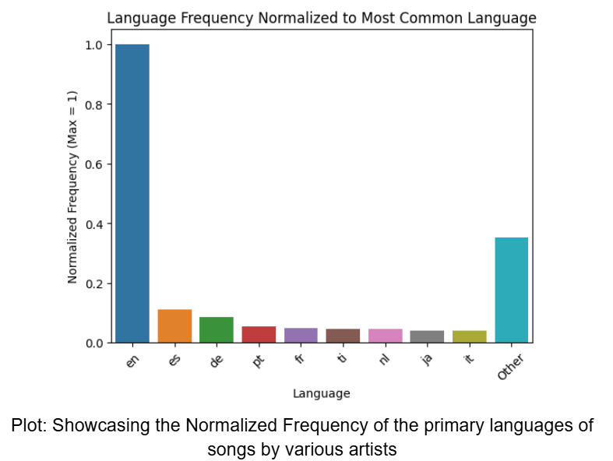
Deliverable-4: Do Global Language Hubs Predict Music Fame?
Language and Popularity in Music Networks
Background: Ronen et al. (2014) found that global fame correlates strongly with language centrality in multilingual networks — English, Spanish, French, German, Chinese were key hubs.
Our Investigation in Music Collaboration Network:
Built from ~50,000 verified artists
~27,000 identified as English-language singers
Critical Observation:
English dominates in number, but not in average popularity
Multiple languages (e.g., Spanish, Korean, Portuguese) show comparable or even higher average popularity

Slide 13
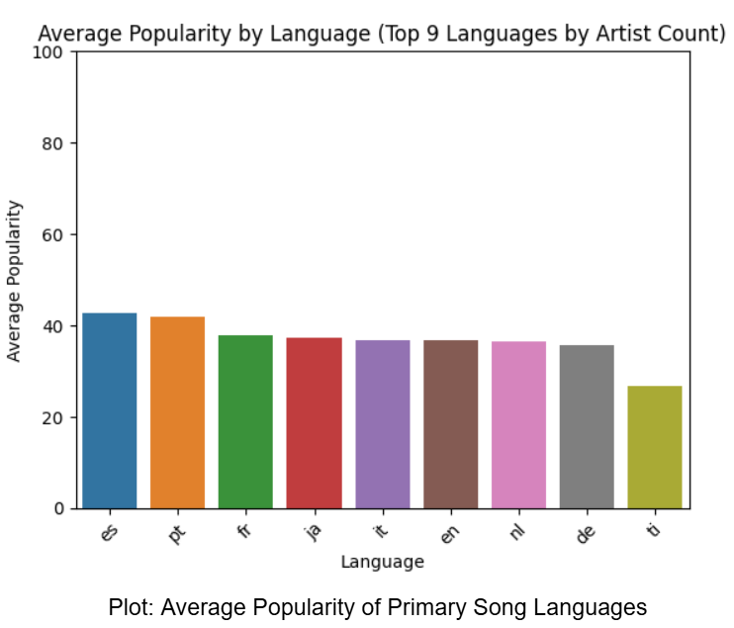
Deliverable-4
Fame in music networks is not tightly tied to language centrality, unlike in literary or traditional fame networks.
Why This Happens:
Streaming Algorithms: Platform-driven visibility (Spotify, YouTube) can boost niche languages
Regional Listening Trends: Local preference matters more than global fame
Global Genre Niches: K-pop (Korean), Reggaeton (Spanish), Afrobeat (Yoruba/English) gain global traction
Cross-lingual Features: Artists increasingly collaborate across language boundaries
Conclusion: Music popularity is more democratized than global fame — success is not confined to English or central languages Language hubs don’t dictate music popularity — platform, region, and genre dynamics matter more

Slide 14
Additional Deliverable (1)
Geographic Patterns in Music Collaboration
Background: With platforms like Spotify enabling global reach, we explored whether artists collaborate within their own country (intra-country) or across countries (inter-country).
Goal: Understand if geographic borders still influence musical collaborations in the global digital era.
Methodology:
Used country metadata from Spotify for each artist
Labeled each edge (collaboration) in the graph as:
Intra-country: Both artists from the same country
Inter-country: Artists from different countries
Implemented via a country lookup dictionary and edge-wise comparison in the collaboration DataFrame

Slide 15
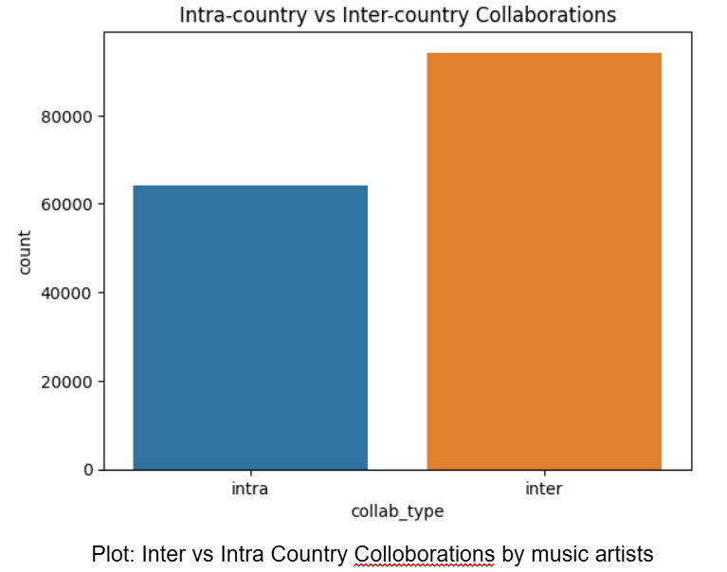
Additional Deliverable (1)
Results:
More inter-country collaborations than intra-country ones
Indicates strong global connectivity in the music collaboration network
Interpretation:
Geographic borders are not strong barriers in music partnerships Enabled by:
Digital production tools (remote recording, DAWs)
Global record labels & streaming algorithms
Cross-cultural audience appeal
🎶 Music is globally integrated, with artists forming creative networks that transcend national boundaries.

Slide 16
Additional Deliverable (2)
Do Collaborations Drive Commercial Success?
Background: In social and creative networks, more connections often signal more influence. In music, artist collaborations may boost:
Exposure to new audiences
Visibility in streaming algorithms
Commercial metrics like Spotify popularity and followers
Conceptual Framework: Network Science Foundations
Preferential Attachment (Barabási & Albert, 1999): High-degree artists attract more collaborations → success compounds
Degree Centrality (Newman, 2003): More connected artists tend to be more visible and influential
Similar patterns seen in scientific and actor networks — high-degree = high impact

Slide 17
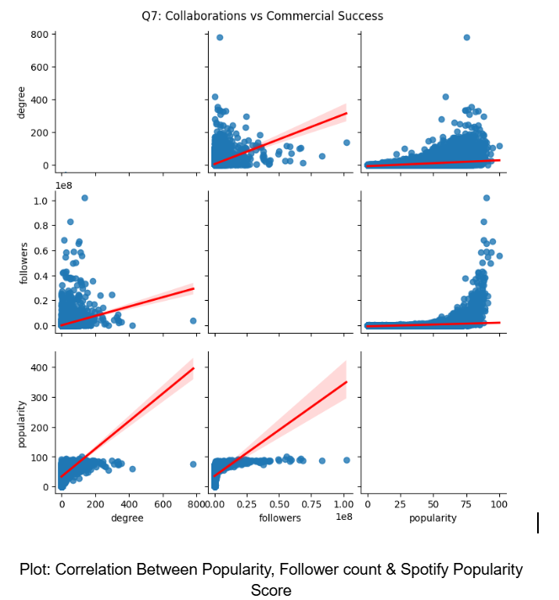
Additional Deliverable (2)
Findings:
Artists with higher degree (more collaborators) → higher popularity scores
Strong positive trend between degree and follower count
Follower count and Spotify popularity are also positively correlated
Interpretation:
This forms a feedback loop:
More collaborations → More exposure → More popularity → More collaborations…
Supports preferential attachment: The "rich get richer" popular, well-connected artists continue gaining visibility
Implication: Strategic collaborations are key drivers of commercial success in music

Slide 18
Thank You

