Slide 1

VARIANT ANALYSIS OF KNOWN BREAST CANCER GENES
GROUP MEMBERS
Aditya Kumar Sinha (2022034) Nikhil Kumar (2022322) Nikhil(2022321) Pandillapelly Harshavardhini(2022345) Harsh Vishwakarma(2022205)

Slide 2

INTRODUCTION
BREAST CANCER CLAIMS THE LIVES OF THOUSANDS ANNUALLY, PRESENTING A SEVERE THREAT TO GLOBAL HEALTH. ITS IMPACT IS PROFOUND, AFFECTING INDIVIDUALS AND FAMILIES WORLDWIDE. ADDRESSING THIS CRISIS DEMANDS CONCERTED EFFORTS, INCLUDING COMPREHENSIVE ANALYSIS OF GENETIC FACTORS. BREAST CANCER IS A COMPLEX DISEASE WITH VARIOUS GENETIC FACTORS CONTRIBUTING TO ITS DEVELOPMENT. WHILE NUMEROUS GENES HAVE BEEN IDENTIFIED AS POTENTIAL CONTRIBUTORS TO BREAST CANCER RISK, ANALYZING VARIANTS WITHIN THESE GENES CAN PROVIDE VALUABLE INSIGHTS INTO THEIR ROLE IN DISEASE SUSCEPTIBILITY.

Slide 3

PROBLEM STATEMENT
The objective is to distinguish between breast cancer patients and healthy individuals with high precision and recall. The ultimate goal is to provide clinicians with a reliable tool for early diagnosis, enabling prompt intervention and personalized treatment strategies, thereby improving patient outcomes and reducing mortality rates associated with breast cancer.

Slide 4
SOLUTION
Developing a machine learning model for early breast cancer detection involves integrating diverse genomic, proteomic, and clinical datasets to extract informative features. The model aims to accurately classify individuals as either breast cancer patients or healthy individuals, utilizing advanced algorithms and robust evaluation methods and provides visualisation over data.

Slide 5

WORKFLOW
DATA ACQUISITION AND PREPROCESSING
MODEL TRAINING
MODEL INTERPRETATION
VALIDATION
DEPLOYMENT

Slide 6
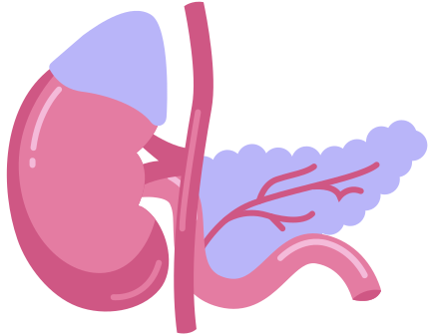
PLAN OF ACTION
1) Data collection - Gather a comprehensive dataset comprising genomic data (gene expression profiles, mutations, copy number variations). Collect the hundreds of data of healthy person and breast cancer person.
2) Data Preprocessing - Clean the dataset by normalizing features, removing any irrelevant or redundant features and converting the data into csv format for better readability.
3) Model training - Split the dataset into training and testing sets. Train the selected machine learning models on the training data and evaluate their performance on the testing data.

Slide 7
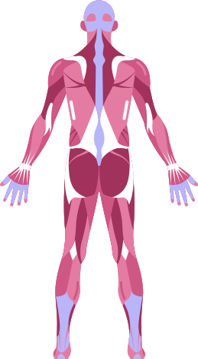
4) Model Interpretation - Analyze the trained models to understand the importance of different features in predicting breast cancer compared to healthy. Visualize decision boundaries, feature importance, and model predictions to gain insights into the underlying biological mechanisms associated with breast cancer development.
5) Validation - various performance metrics such as accuracy, recall, and F1-score are calculated to assess the model's accuracy in classifying breast cancer patients and healthy individuals.
6) Implementation - involves putting the trained machine learning model into practical use, making it accessible to healthcare professionals etc. for real-world application in early breast cancer detection. Like pickling of data or converting it into binary format.

Slide 8


Slide 9


Slide 10
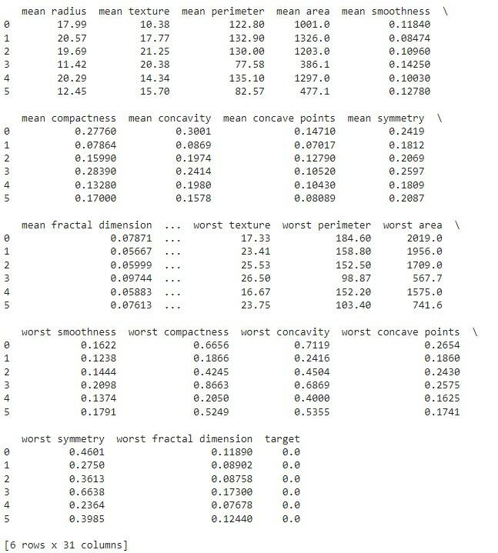
Data of 6 people containing 31 columns (attributes) like:
['mean radius' ,'mean texture', 'mean perimeter', 'mean area', 'mean smoothness', 'mean compactness' ,'mean concavity',
'mean concave points', 'mean symmetry' ,'mean fractal dimension', 'radius error' ,'texture error' , 'perimeter error', 'area error',
'smoothness error' ,'compactness error', 'concavity error', 'concave points error', 'symmetry error' ,'fractal dimension error',
'worst radius' ,'worst texture' ,'worst perimeter' , 'worst area', 'worst smoothness' ,'worst compactness', 'worst concavity',
'worst concave points', 'worst symmetry', 'worst fractal dimension']

Slide 11
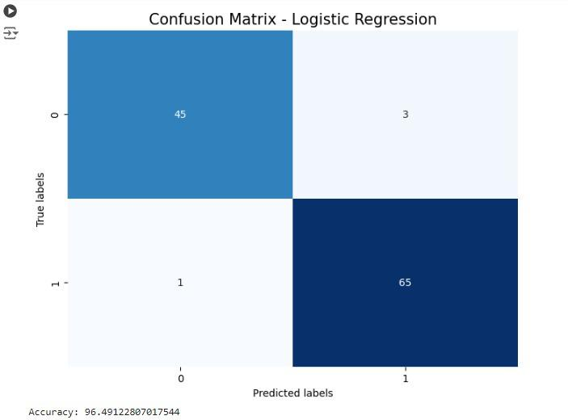
Confusion matrix and accuracy of trained model using logistic regression

Slide 12
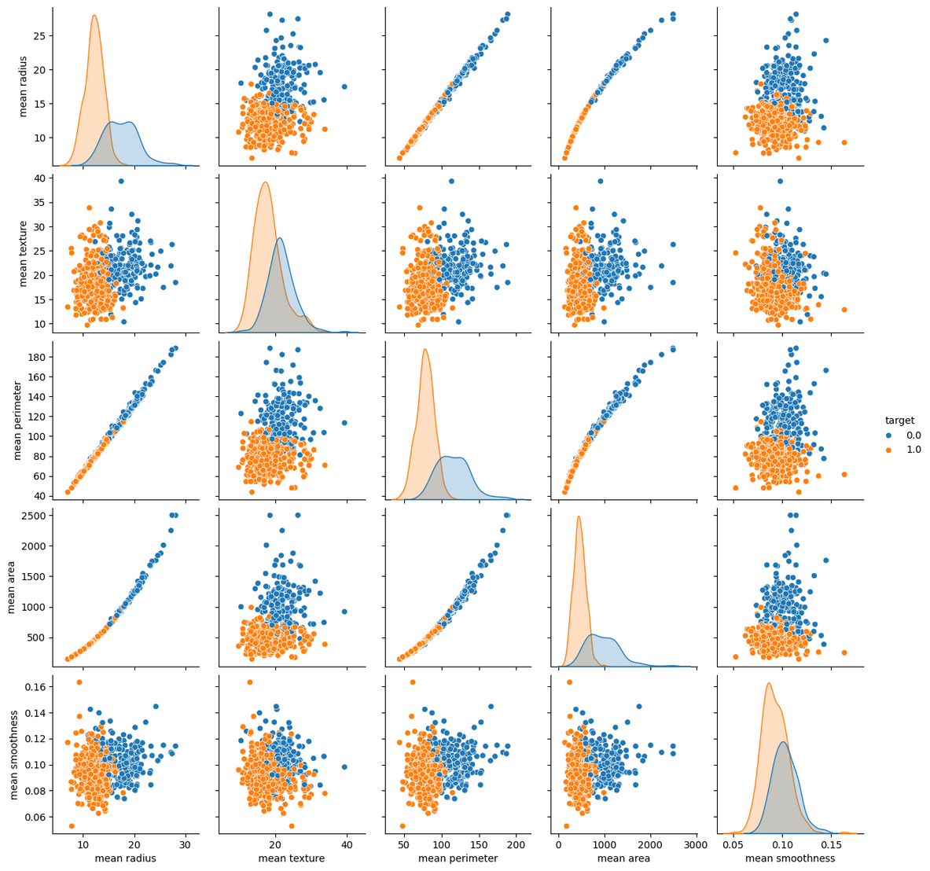


PAIR PLOT
PEOPLE
HAVING
TUMOR
PEOPLE
FREE OF
TUMOR

Slide 13
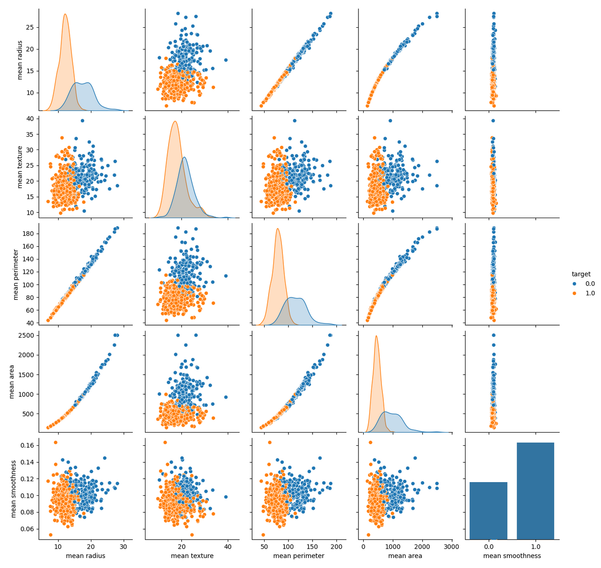
COUNTER PLOT
PEOPLE
HAVING
TUMOR
PEOPLE
FREE OF
TUMOR

Slide 14

REFERENCES:
https://www.cancer.gov/ccg/research/genome-sequencing/tcga/studied-cancers/breast-lobular-carcinoma-study
https://dcc.icgc.org/projects/BRCA-US

Slide 15
CONTRIBUTIONS :
GROUP MEMEBERS
Aditya Kumar Sinha (2022034)
Nikhil Kumar (2022322)- CODING WORK
Nikhil(2022321)
Pandillapelly Harshavardhini(2022345)- DATA GATHERING
Harsh Vishwakarma(2022205)

