Slide 1

Computer Networks And Security
19CS2109
CONGESTION CONTROL ALGORITHMS
© 2020-21 KL University – The contents of this presentation are an intellectual and copyrighted property of KL University. ALL RIGHTS RESERVED
1

Slide 2
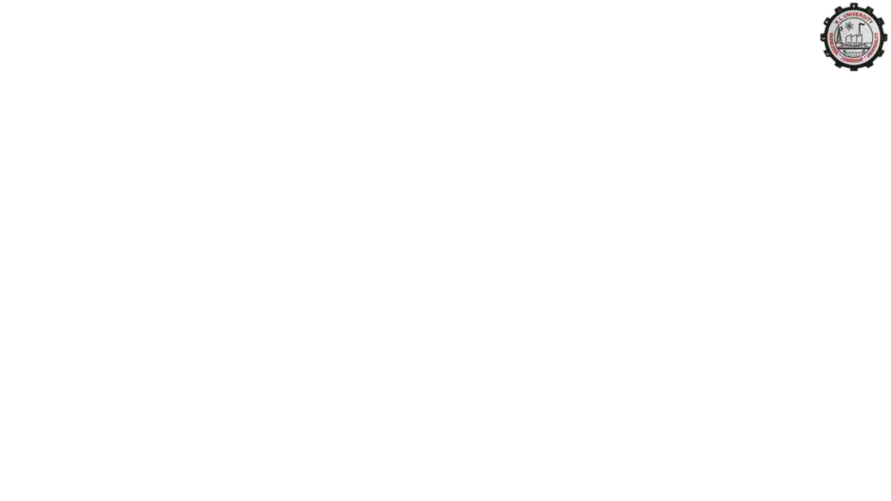
Congestion Control Algorithms
•General Principles of Congestion Control
•Congestion Prevention Policies
•Congestion Control in Virtual-Circuit Subnets
•Congestion Control in Datagram Subnets
•Load Shedding
•Jitter Control

Slide 3
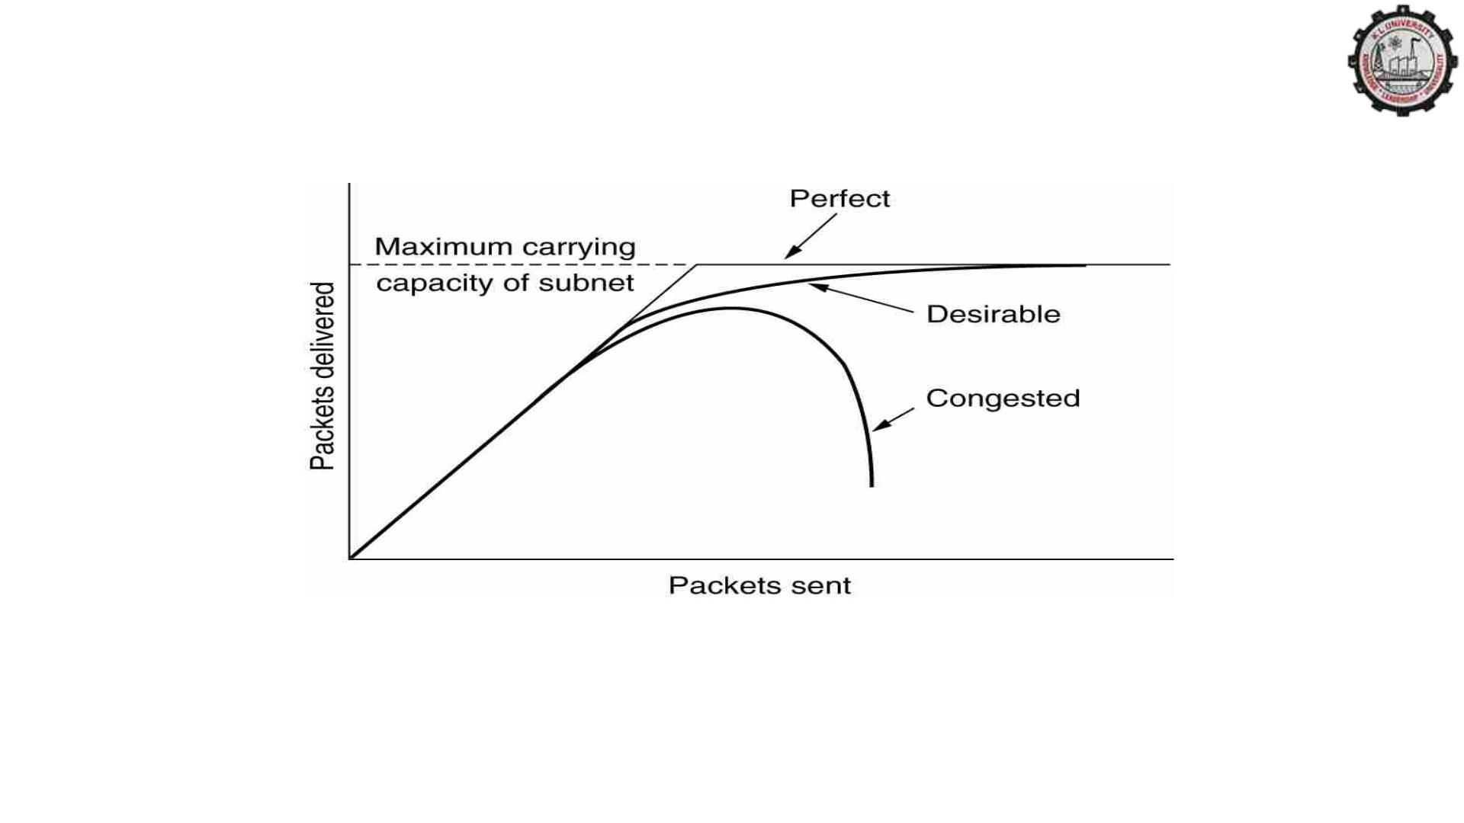
Congestion
When too much traffic is offered, congestion sets in and performance
degrades sharply.

Slide 4
General Principles of Congestion Control
1.Monitor the system .
• detect when and where congestion occurs.
2.Pass information to where action can be taken.
3.Adjust system operation to correct the problem.

Slide 5
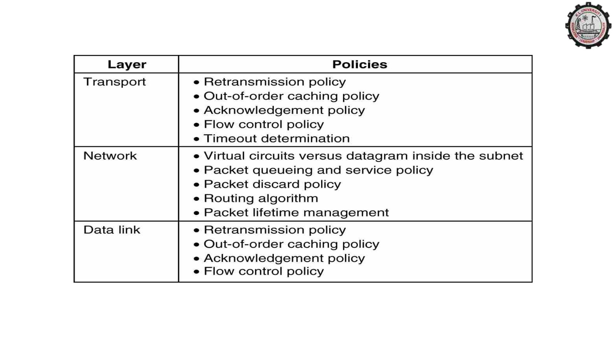
Congestion Prevention Policies

Slide 6
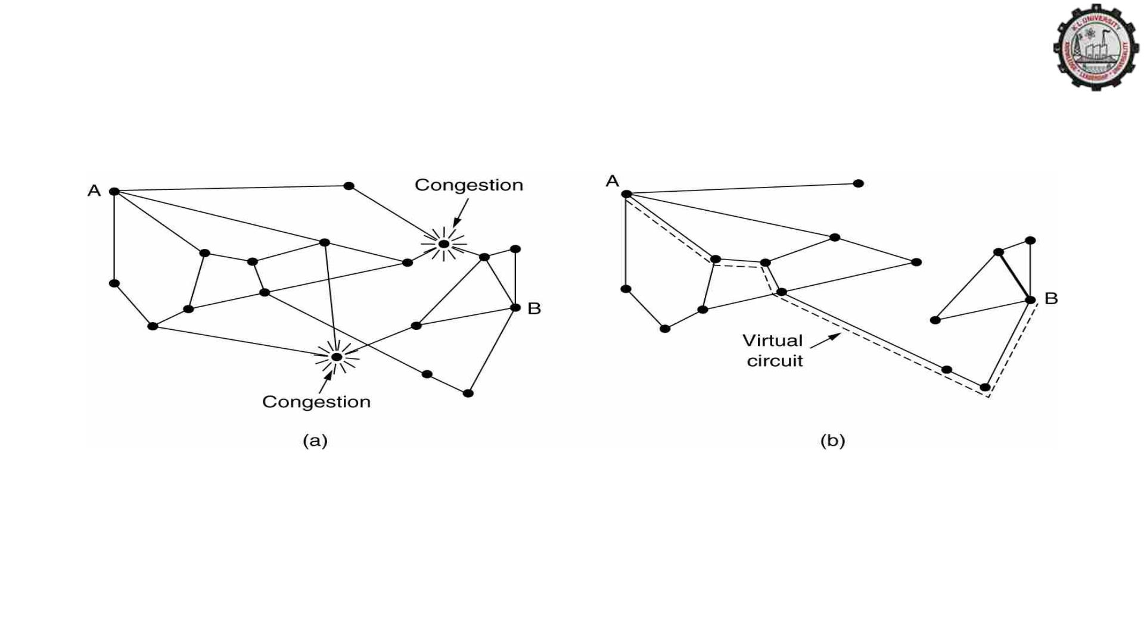
Congestion Control in Virtual-Circuit Subnets
(a) A congested subnet. (b) A redrawn subnet, eliminates
congestion and a virtual circuit from A to B.

Slide 7
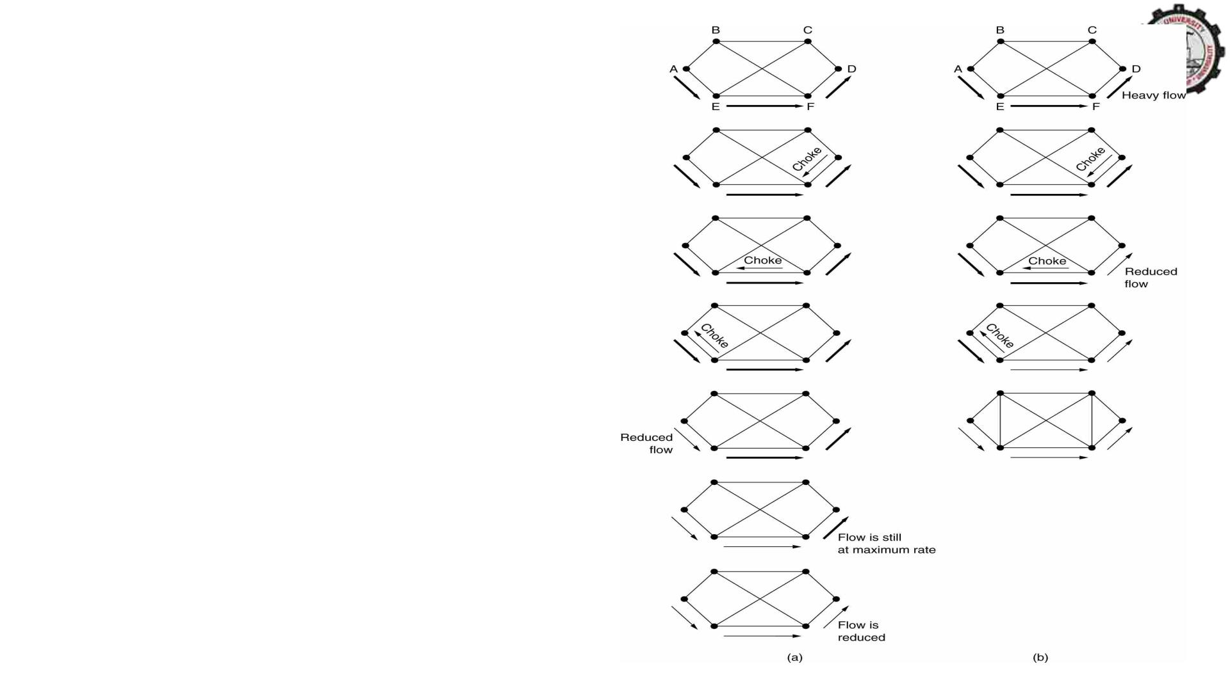
Hop-by-Hop Choke
Packets
(a) A choke packet that affects only the
source.
(b) A choke packet that affects each hop
it passes through.

Slide 8
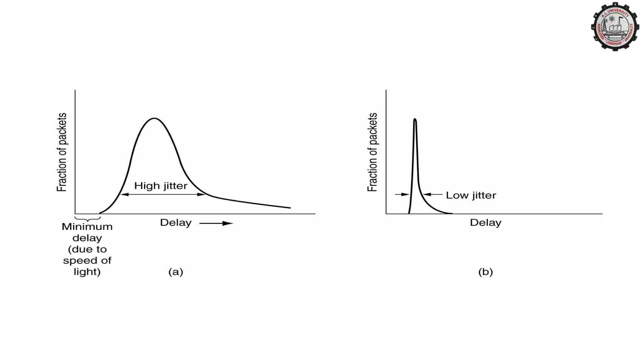
Jitter Control
(a) High jitter. (b) Low jitter.

Slide 9
Quality of Service
•Requirements
•Techniques for Achieving Good Quality of Service
•Integrated Services
•Differentiated Services
•Label Switching and MPLS

Slide 10
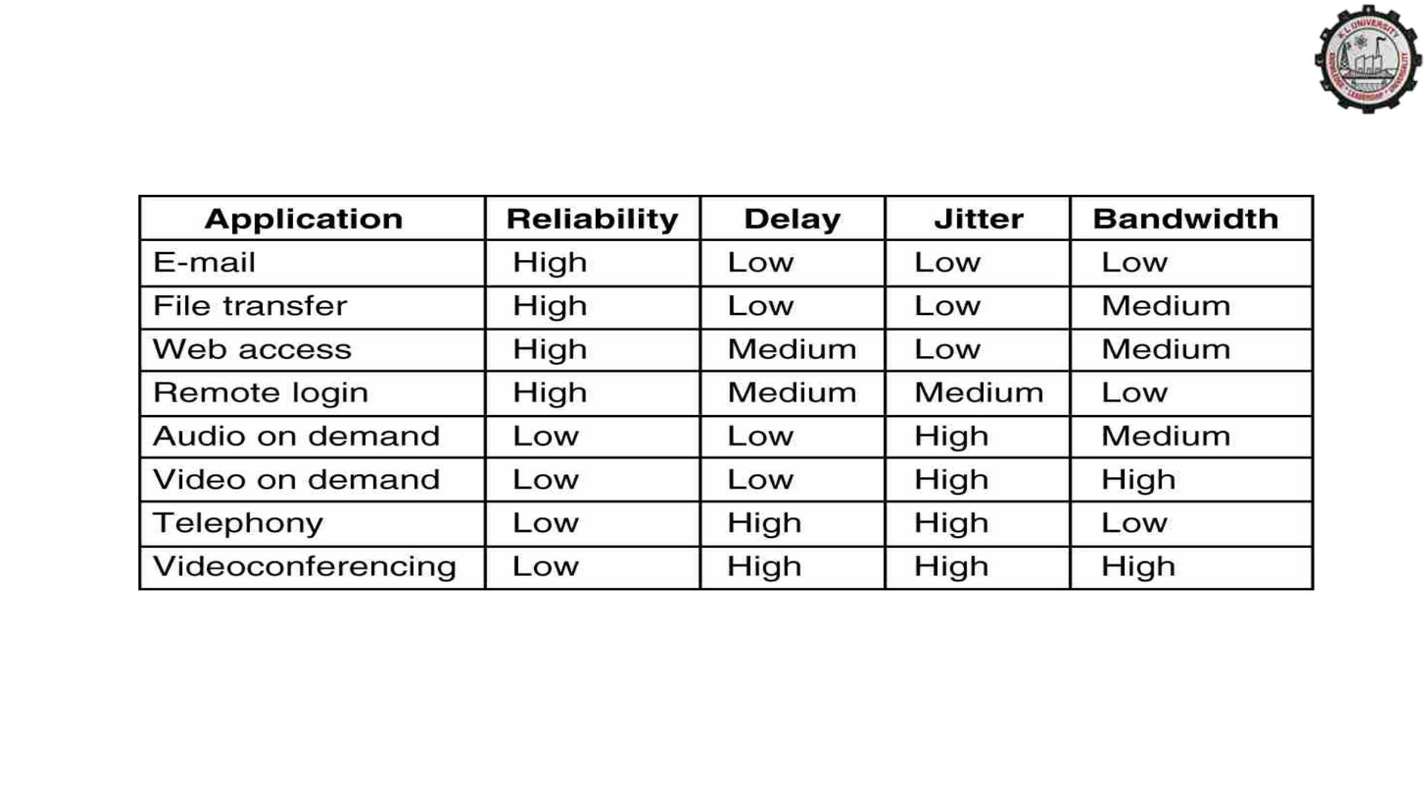
Requirements
How stringent the quality-of-service requirements are.

Slide 11
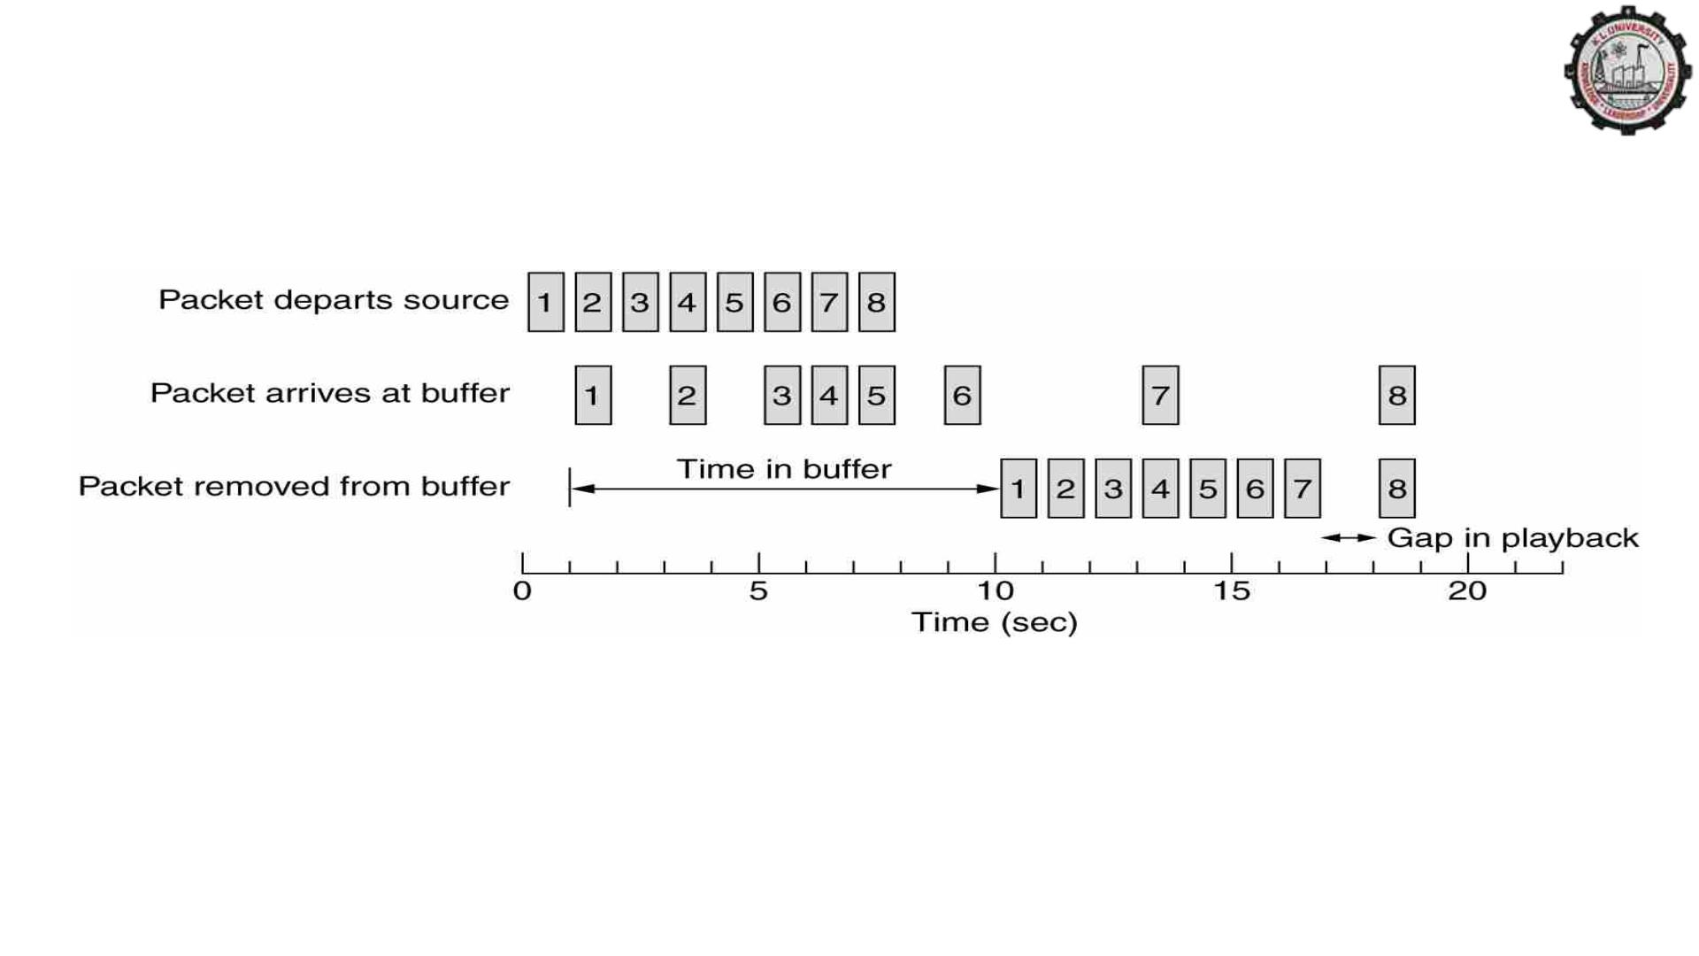
Buffering
Smoothing the output stream by buffering packets.

Slide 12
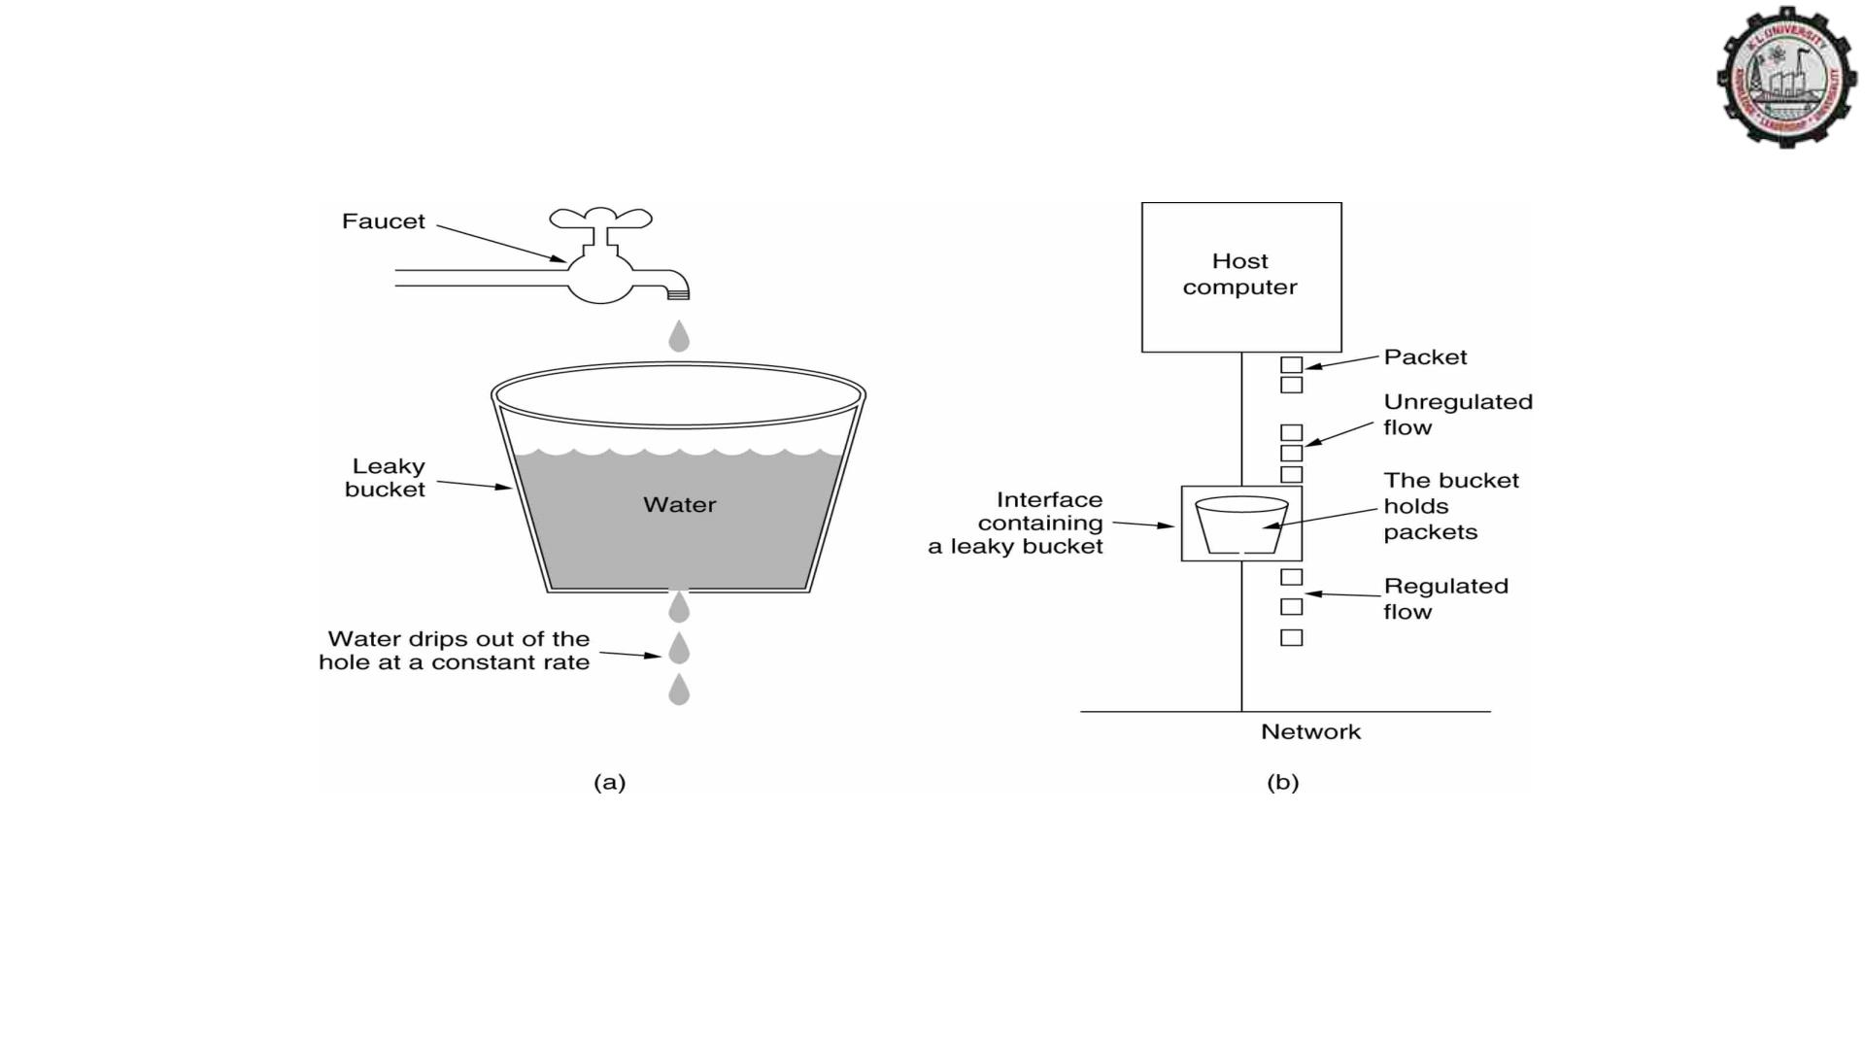
The Leaky Bucket Algorithm
(a) A leaky bucket with water. (b) a leaky bucket with packets.

Slide 13
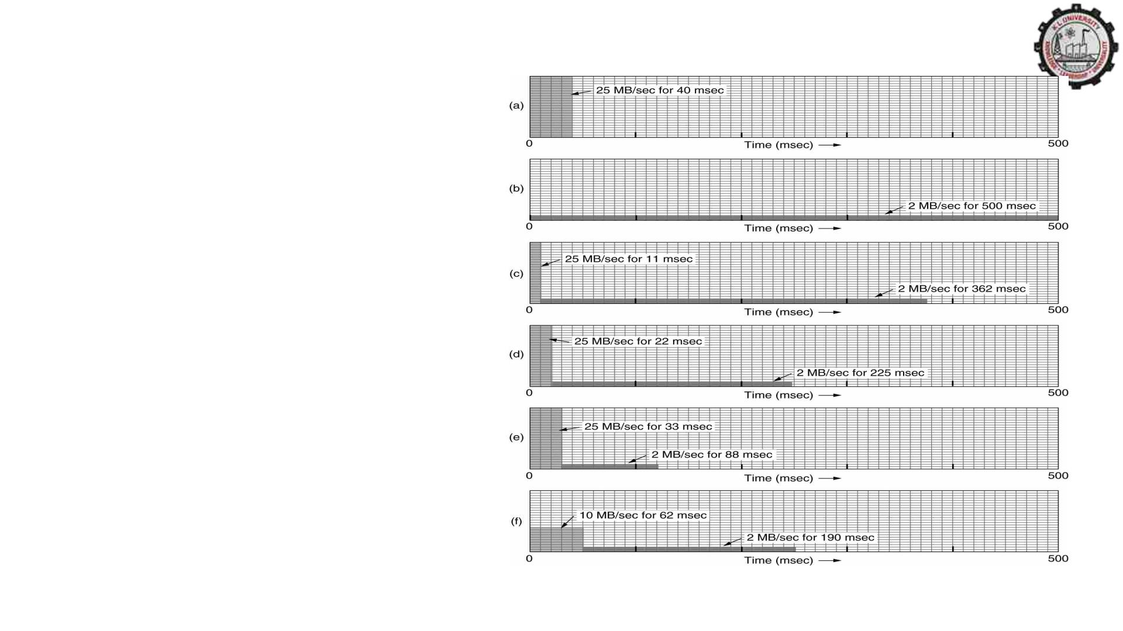
The Leaky Bucket
Algorithm
(a) Input to a leaky bucket. (b)
Output from a leaky bucket. Output
from a token bucket with capacities of
(c) 250 KB, (d) 500 KB, (e) 750 KB,
(f) Output from a 500KB token bucket
feeding a 10-MB/sec leaky bucket.

Slide 14
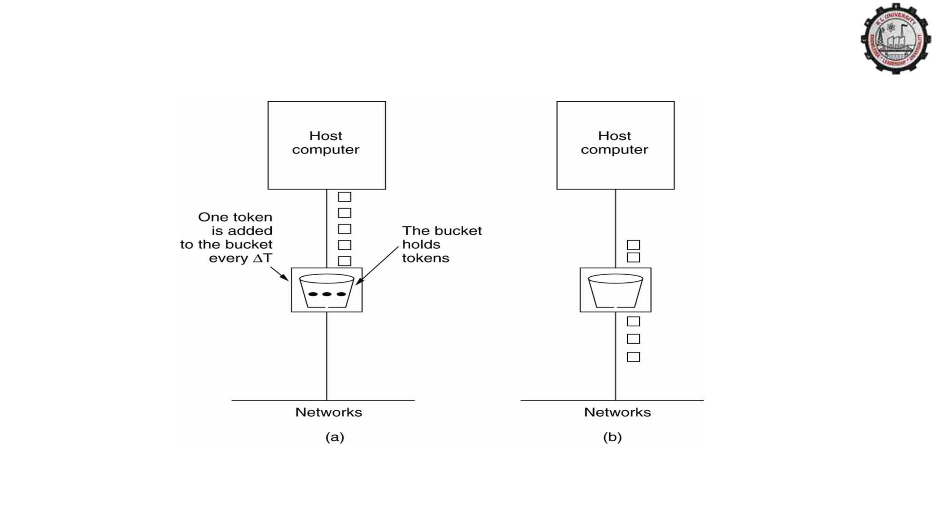
The Token Bucket Algorithm
(a) Before. (b) After.

Slide 15
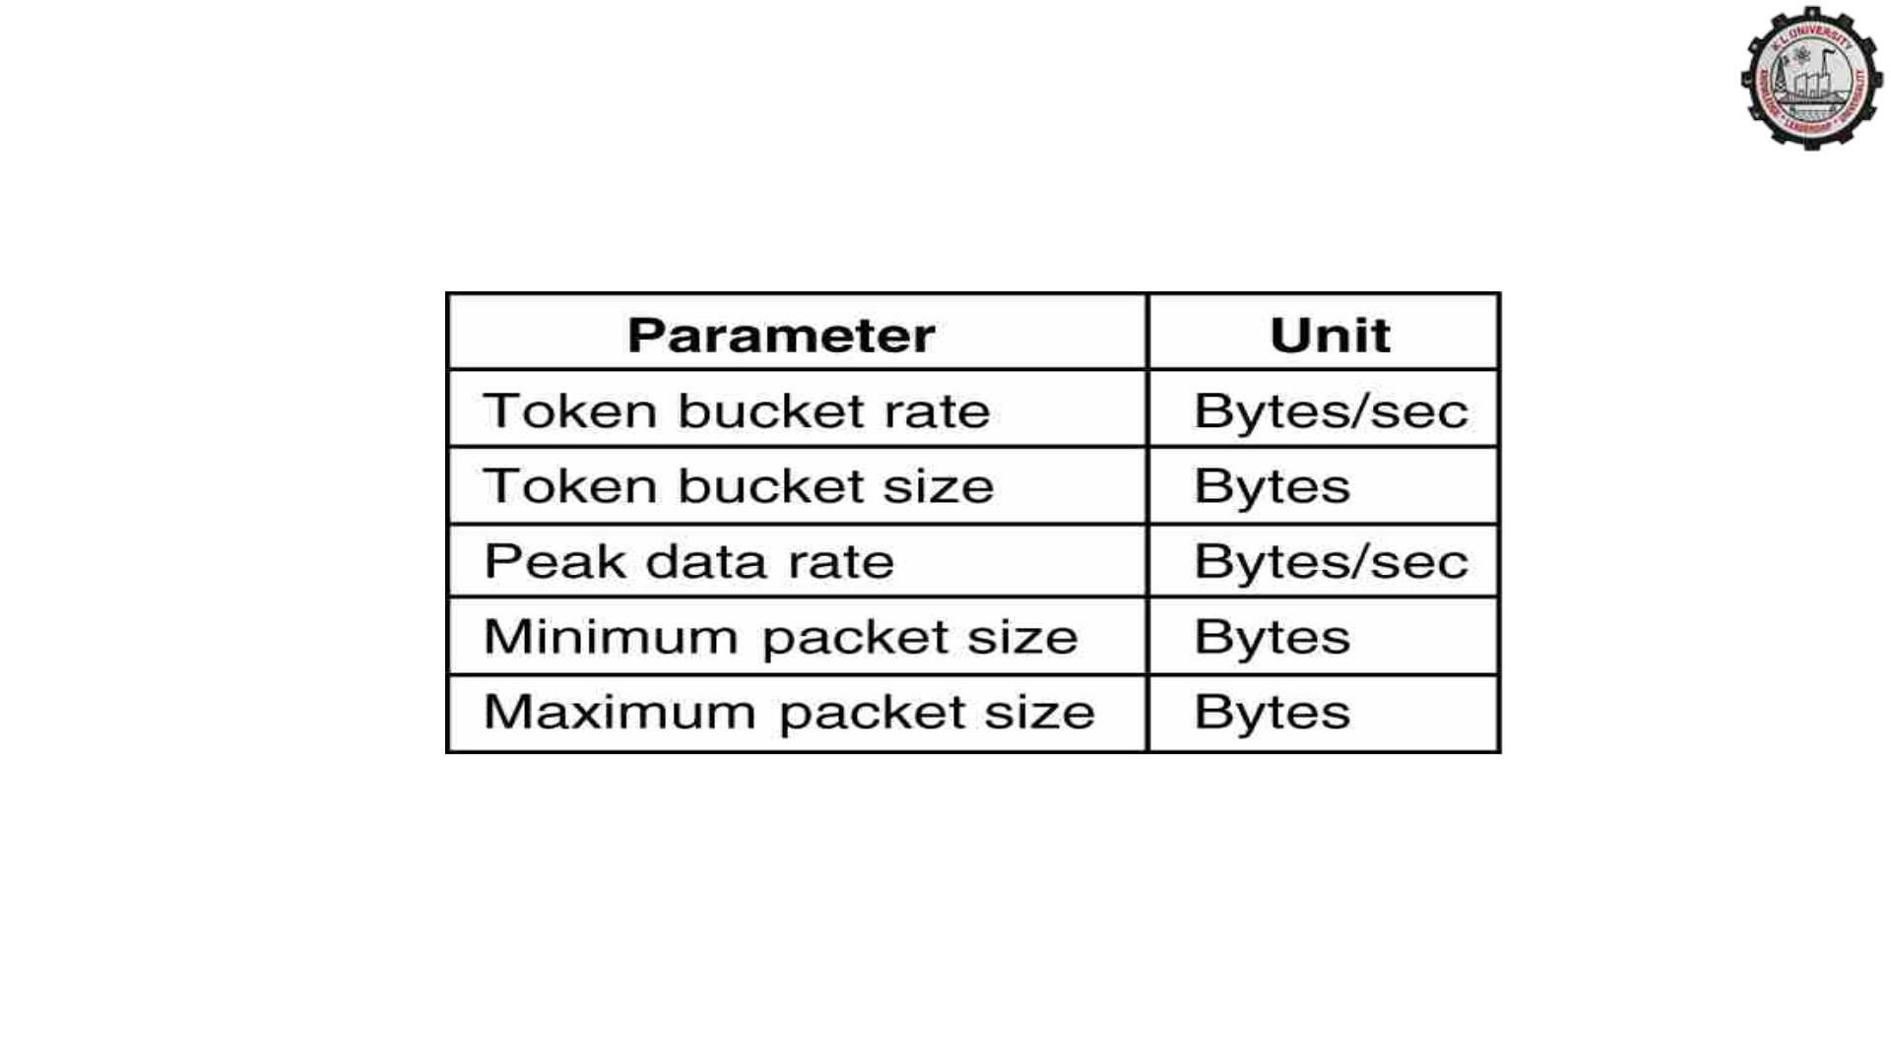
Admission Control
An example of flow specification.

Slide 16
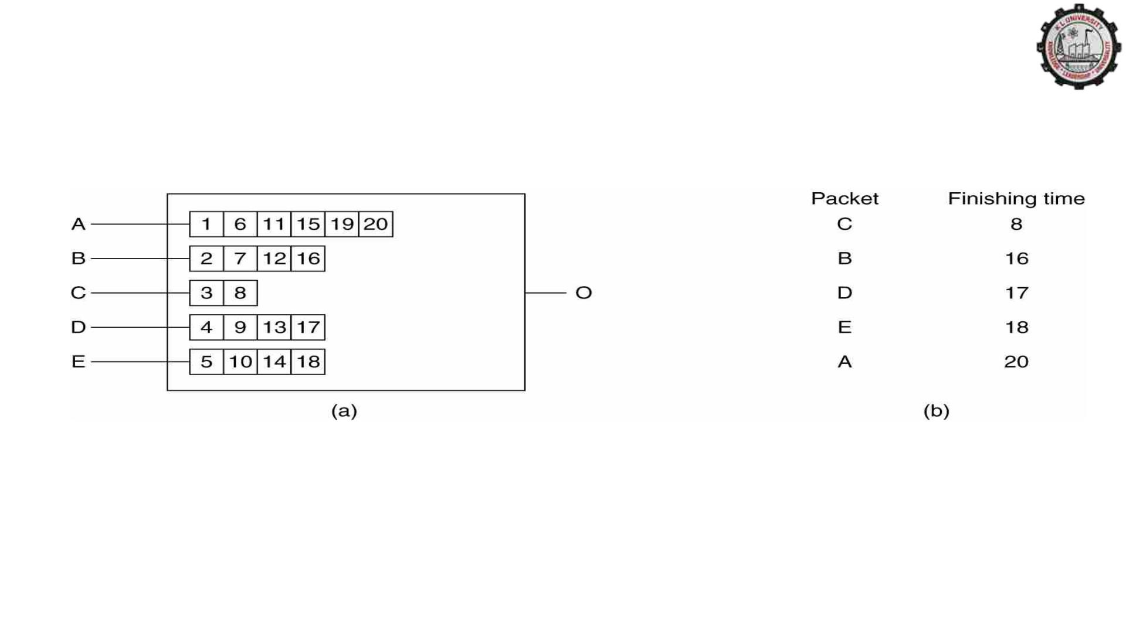
Packet Scheduling
(a) A router with five packets queued for line O.
(b) Finishing times for the five packets.

Slide 17
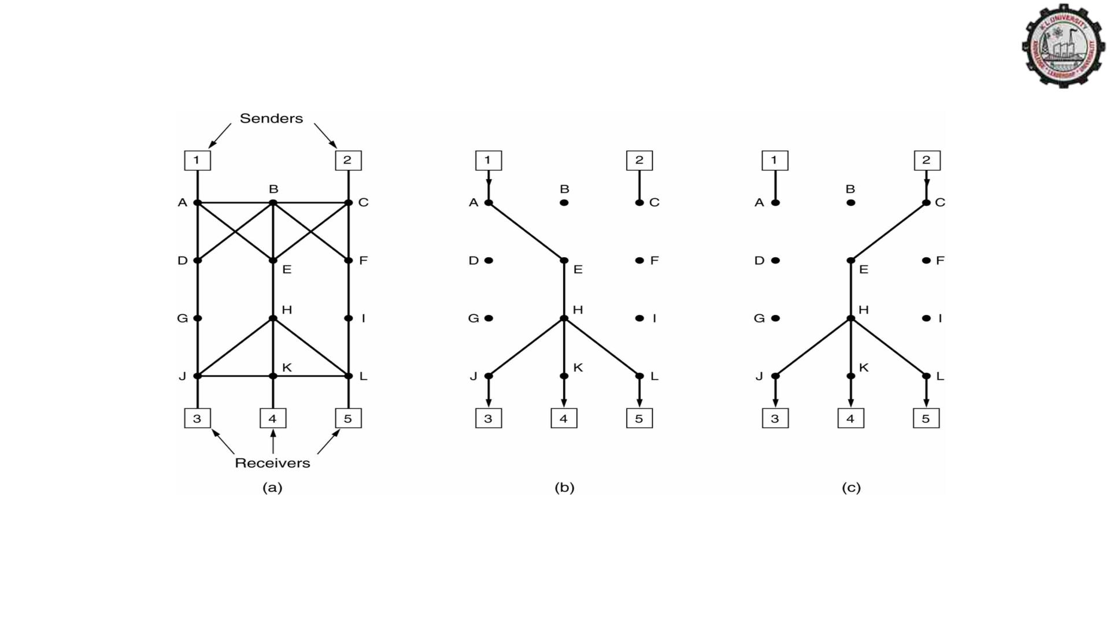
RSVP-The ReSerVation Protocol
(a) A network, (b) The multicast spanning tree for host 1.
(c) The multicast spanning tree for host 2.

Slide 18
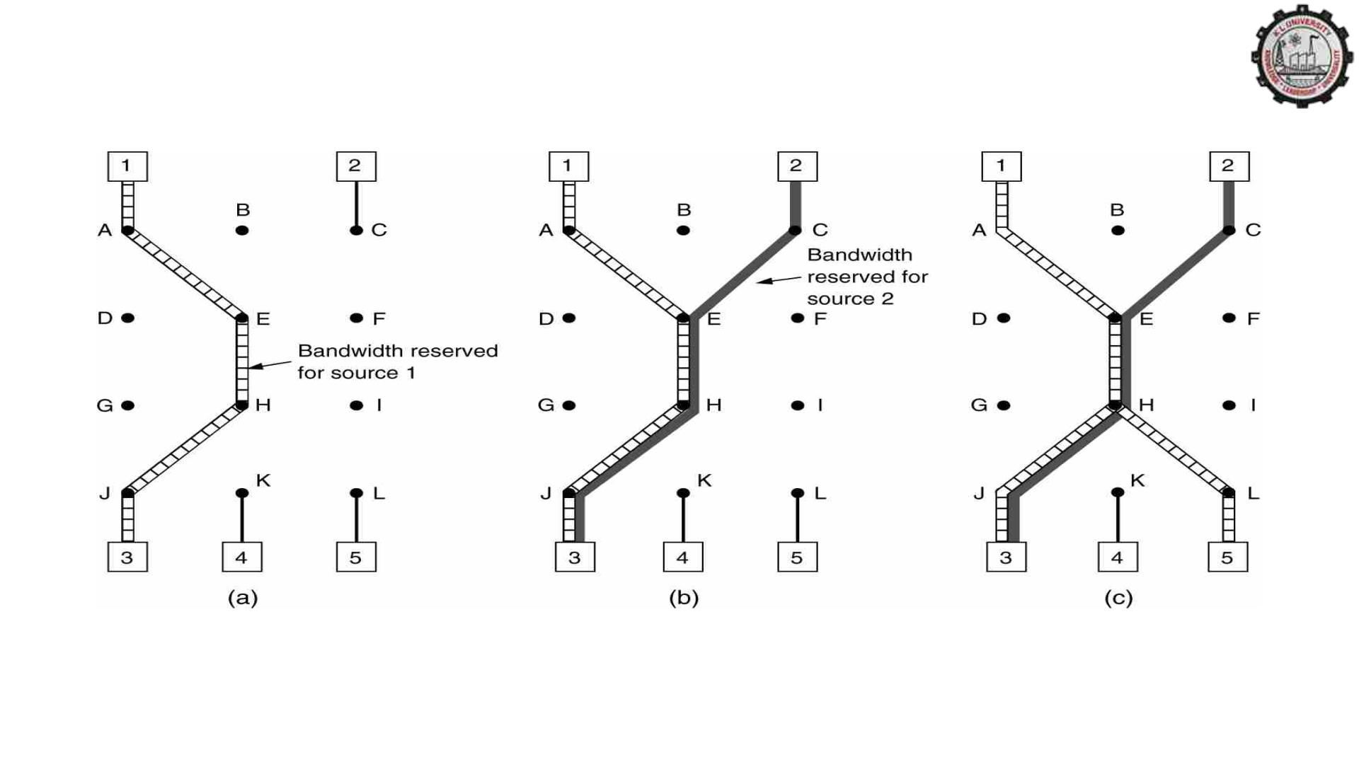
RSVP-The ReSerVation Protocol (2)
(a) Host 3 requests a channel to host 1. (b) Host 3 then requests a second channel, to
host 2. (c) Host 5 requests a channel to host 1.

Slide 19
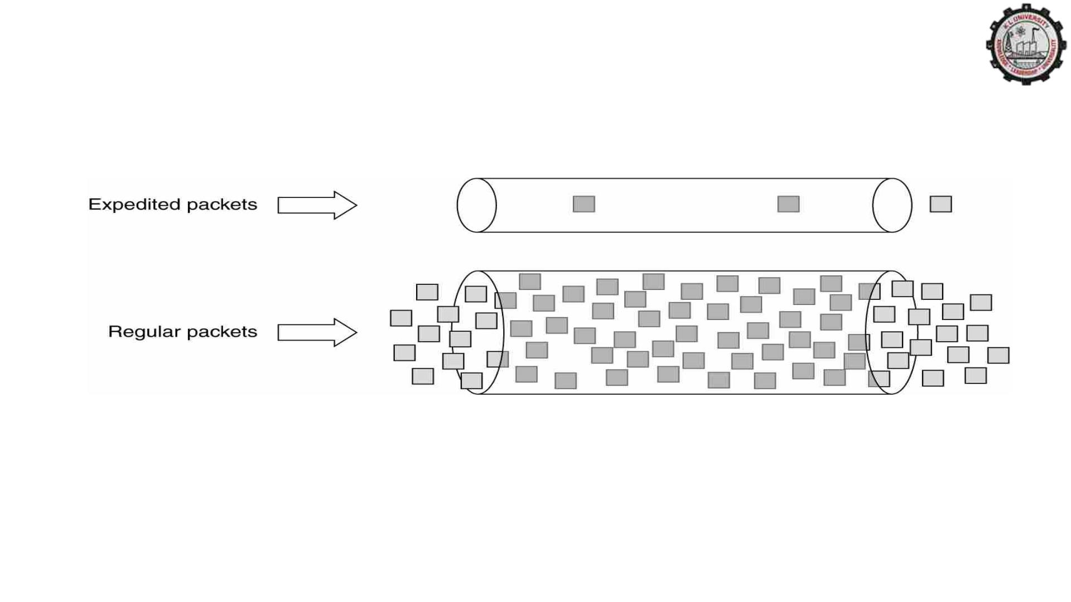
Expedited Forwarding
Expedited packets experience a traffic-free network.

Slide 20
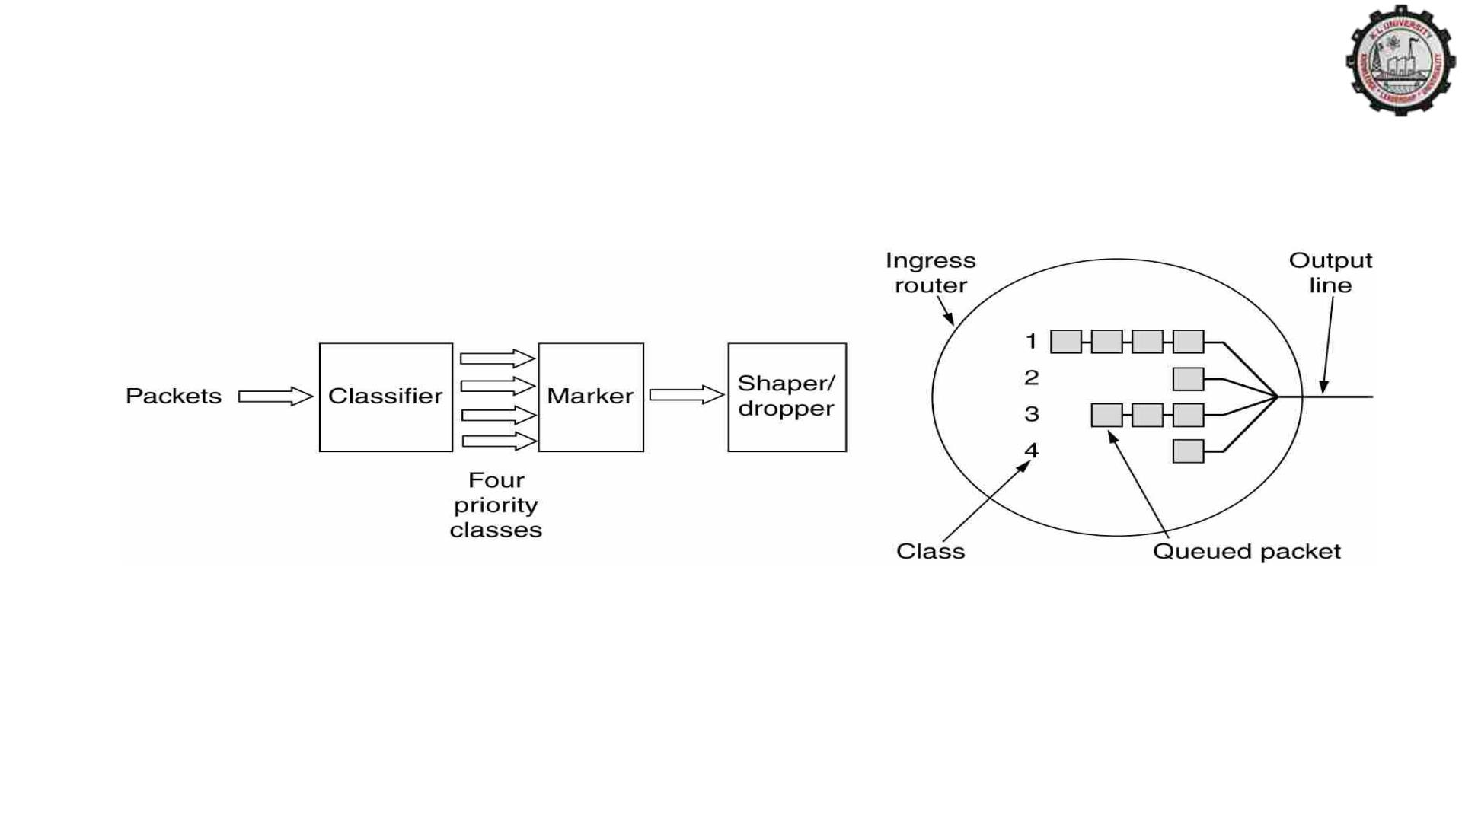
Assured Forwarding
A possible implementation of the data flow for assured forwarding.

