Slide 1

19CS2109
Computer Networks And Security
Internetworking

Slide 2
Internetworking
How Networks Differ
How Networks Can Be Connected
Concatenated Virtual Circuits
Connectionless Internetworking
Tunneling
Internetwork Routing
Fragmentation

Slide 3
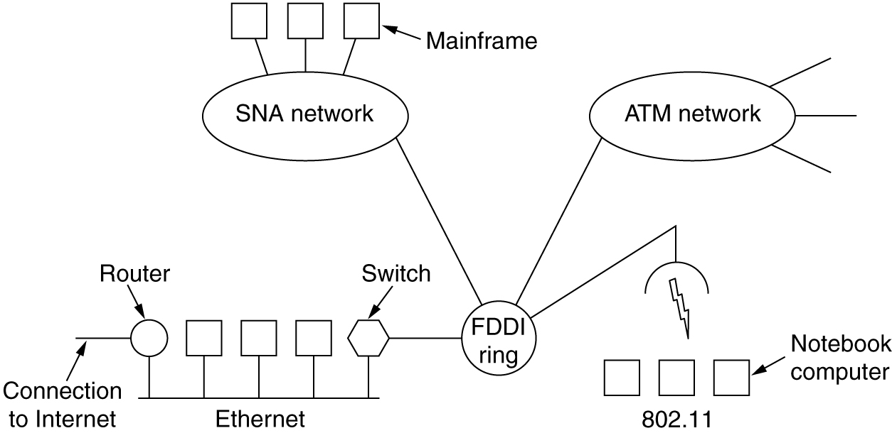
Connecting Networks
A collection of interconnected networks.

Slide 4
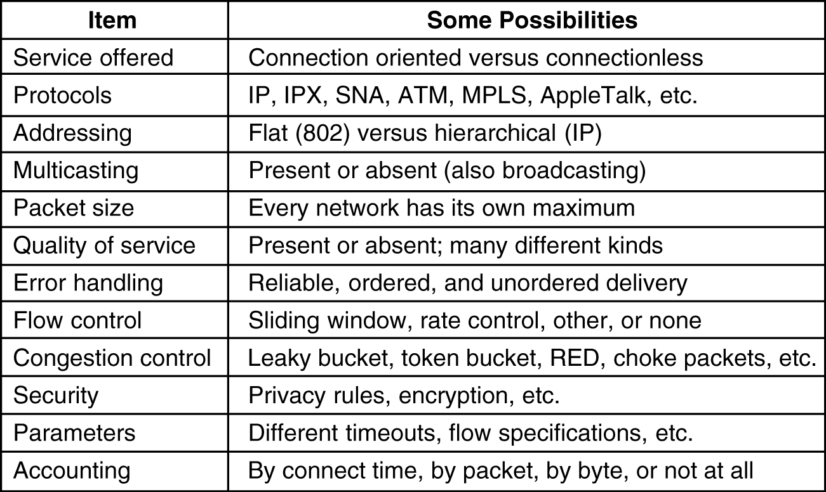
How Networks Differ
5-43
Some of the many ways networks can differ.

Slide 5
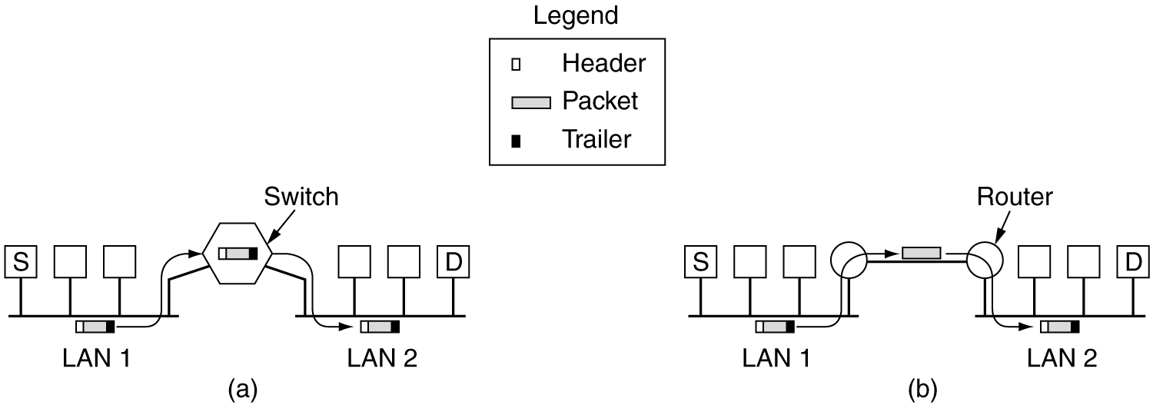
How Networks Can Be Connected
(a) Two Ethernets connected by a switch.
(b) Two Ethernets connected by routers.

Slide 6
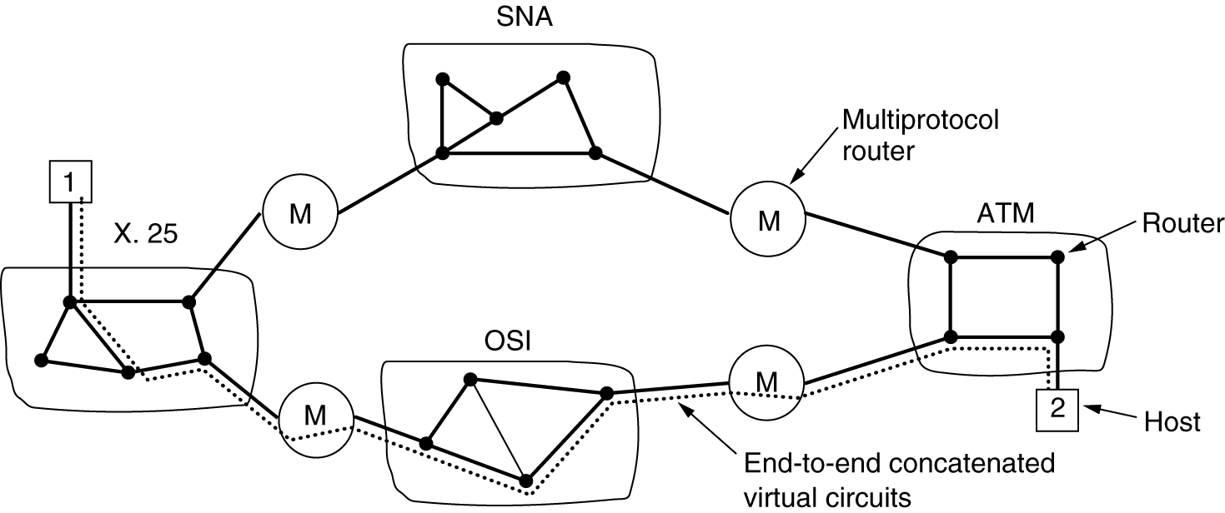
Concatenated Virtual Circuits
Internetworking using concatenated virtual circuits.

Slide 7
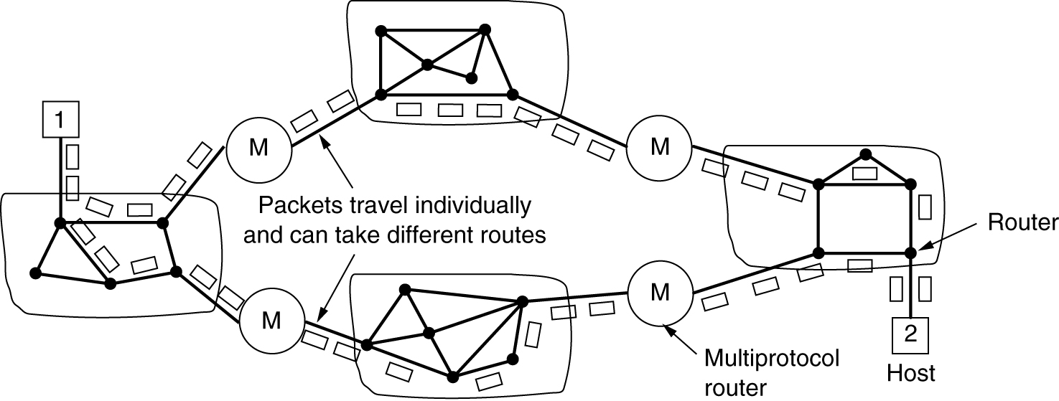
Connectionless Internetworking
A connectionless internet.

Slide 8
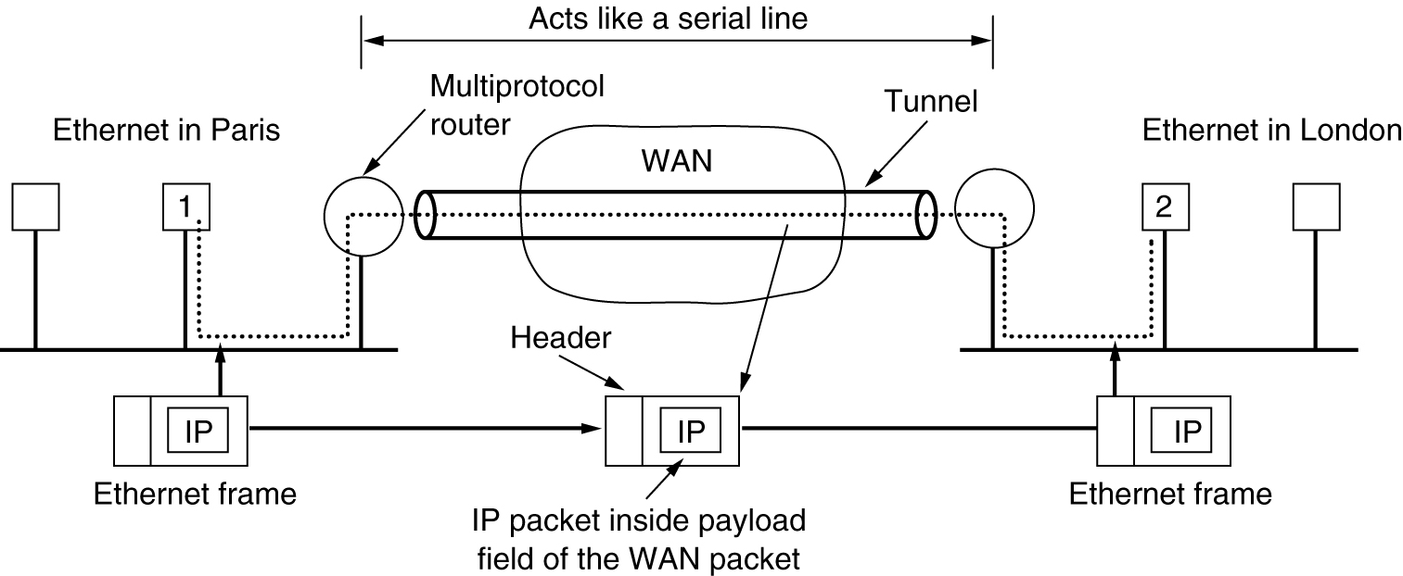
Tunneling
Tunneling a packet from Paris to London.

Slide 9
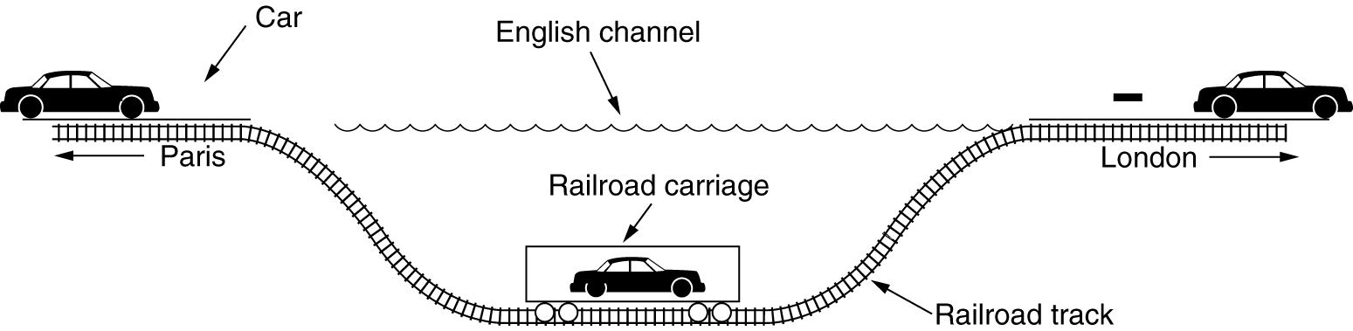
Tunneling (2)
Tunneling a car from France to England.

Slide 10
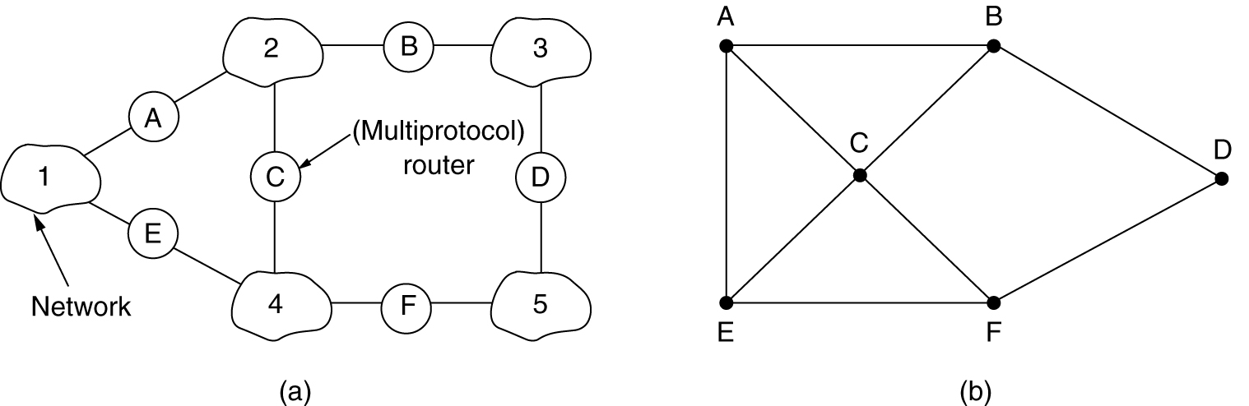
Internetwork Routing
(a) An internetwork. (b) A graph of the internetwork.

Slide 11
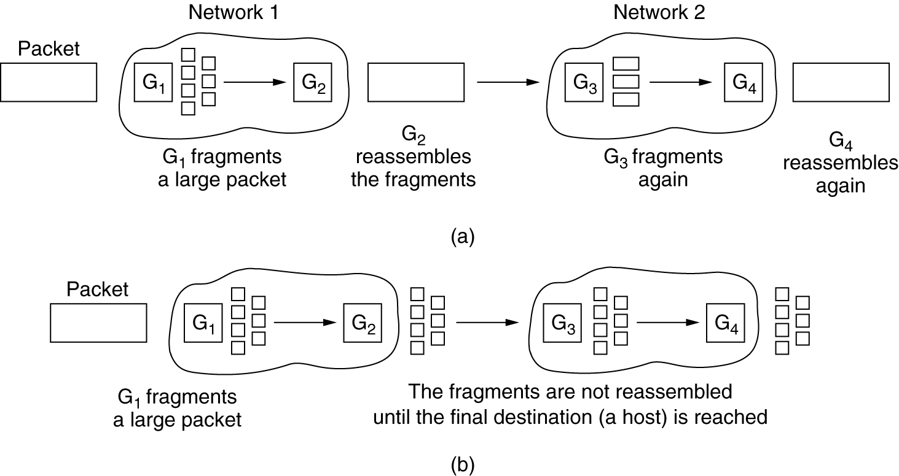
Fragmentation
(a) Transparent fragmentation. (b) Nontransparent fragmentation.

Slide 12
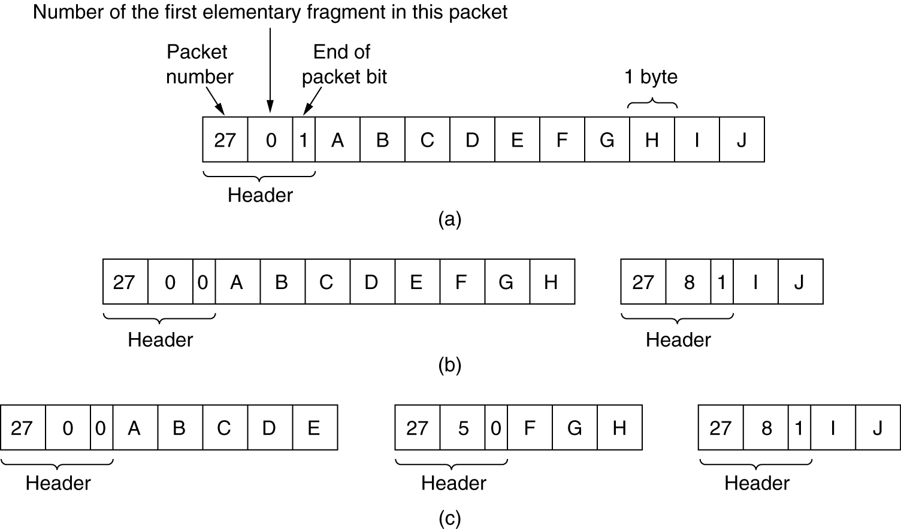
Fragmentation (2)
Fragmentation when the elementary data size is 1 byte.
(a) Original packet, containing 10 data bytes.
(b) Fragments after passing through a network with maximum packet size of 8 payload bytes plus header.
(c) Fragments after passing through a size 5 gateway.

