Slide 1

19CS2109
Computer Networks And Security
TRANSPORT SERVICE

Slide 2
The Transport Service
Services Provided to the Upper Layers
Transport Service Primitives
Berkeley Sockets
An Example of Socket Programming:
An Internet File Server

Slide 3
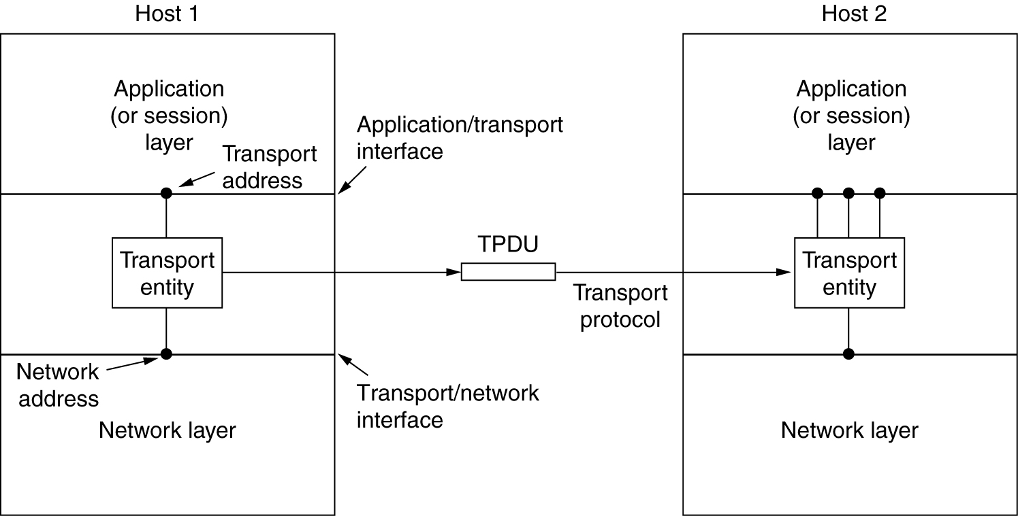
Services Provided to the Upper Layers
The network, transport, and application layers.

Slide 4
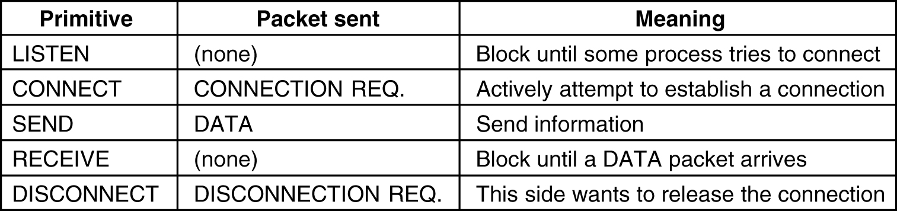
Transport Service Primitives
The primitives for a simple transport service.

Slide 5
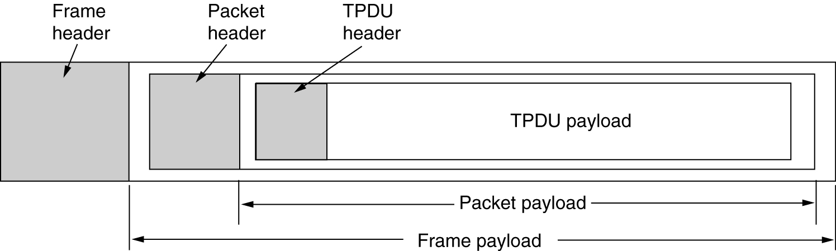
Transport Service Primitives (2)
The nesting of TPDUs, packets, and frames.

Slide 6
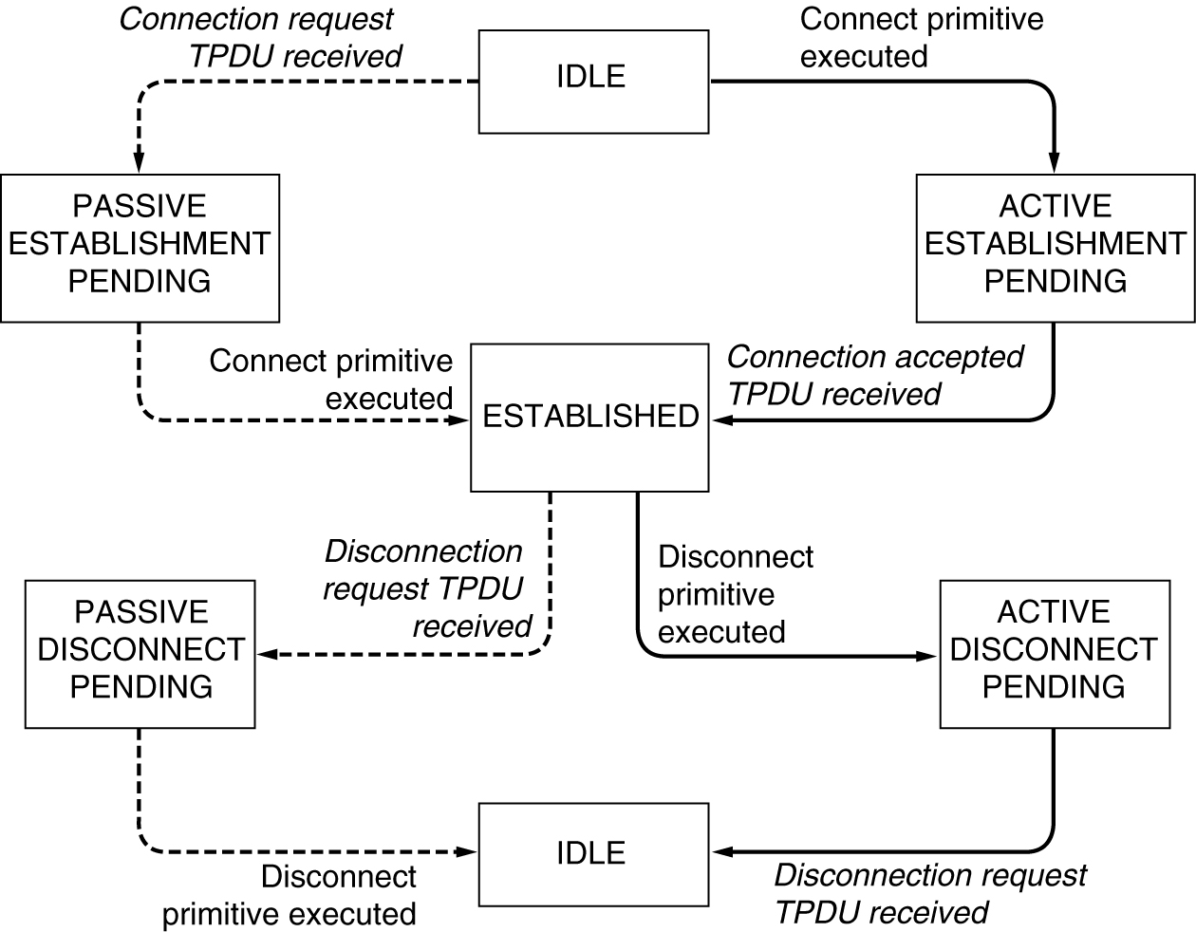
Transport Service Primitives (3)
A state diagram for a simple connection management scheme. Transitions labeled in italics are caused by packet arrivals. The solid lines show the client's state sequence. The dashed lines show the server's state sequence.

Slide 7
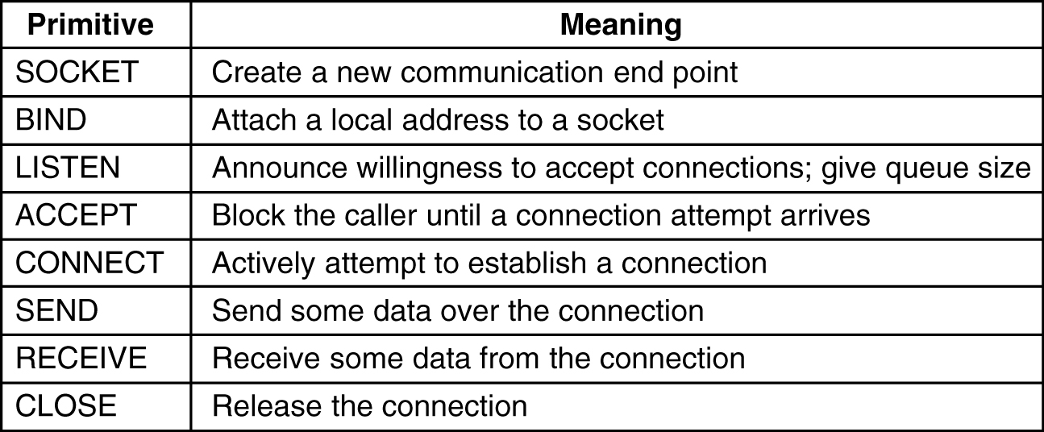
Berkeley Sockets
The socket primitives for TCP.

