Slide 1
Car Price Prediction Model
Nikhil Mogre

Slide 2
agenda
Introduction of Data
Data Cleaning
EDA(Exploratory data analysis)
Insights
Model

Slide 3

introduction
1. It is a car prediction data set that describes the car features and it consists of 205 rows and 26 columns.
2. It consists of 22 manufacturing car companies
3. It has high, medium, and low-cost cars
4. The data describe features of cars like mpg, fuel system, engine type, etc.
5. We need to make a model that is best and also wants to tell which parameter affects the most car price

Slide 4
Data Cleaning/EDA
1. Handle Noise values
2. In EDA univariate, Bivariate analyses on categorical and numeric features are to understand the dataset.
3. Through EDA find some insights for each feature to understand features in a better way
4. In the dataset there were multi-collinearity and also handle them

Slide 5
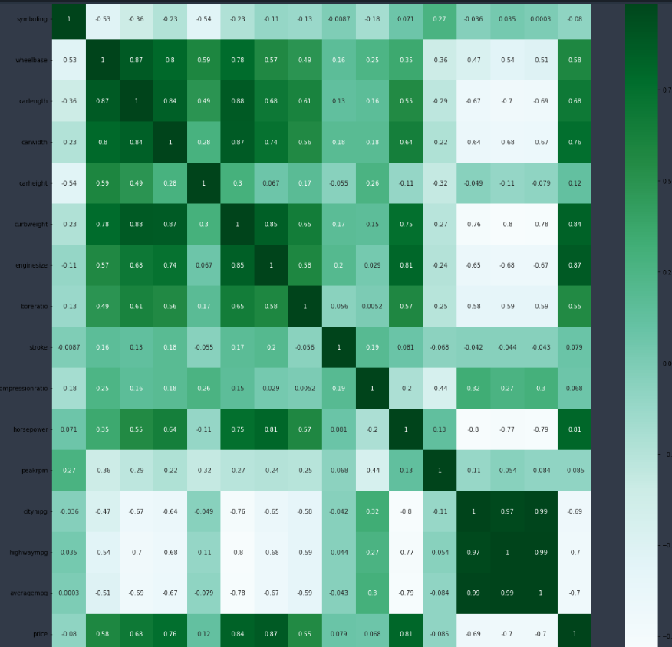
1. wheelbase has high positive correlation with carlength,carwidth and curbweight 2. carlength has high postive correlation with curbweight 3. carlength has negative correlation with highwaympg 4. carwidth has high postive correlation with curbweight and engine size 5. enginesize has high positive correlation with horsepower 6. curbweight has high positive correlation with engine size and horse power, negative correlation with highwaympg horsepower has negative correlation with citympg and highwaympg 7. citympg and highwaympg are highly correlated
Multi-collinearity

Slide 6
Model Accuracy
Used VIF to handle multi-collinearity features
Then use Linear Regression, Decision Tree, and Random Forest
Used Lasso and Ridge Regressor
And found out that Lasso is Performing Better compared to other models with a score of 0.89

Slide 7
Important Features are:
Enginelocation_rear
Fueltype_gas
Enginesize
Curbweight
Aspiration_turbo
Horsepower
Compressionratio
Carwidth
Enginetype_ohcf
Highwaympg

Slide 8
thank you

