Slide 1

Comparing time series with machine learning-based prediction approaches for violation management in Cloud SLAs
Supervised By:
Mr. Saurabh Singhal
(Assistant Professor)
Group Members:
Nikhil Bansal (161500353)
Nikunj Gupta (161500361)
Rishabh Agarwal (161500446)
Tushar Verma (161500588)

Slide 2
Our Problem Statement
We have to test and report the accuracy of time series based machine learning prediction approaches.We have to help the cloud service provider to choose an appropriate prediction approach and further utilize the best method depending on input data patterns to obtain an accurate prediction result and better manage their SLAs to avoid violation penalties.

Slide 3
Our Solution
We have developed a server and a client which is implemented by using Flask framework.
Client requests, server responds.
Whether server responds or fails to respond, in each case log file is created displaying whether the server was up or down.
Various machine learning algorithm will be used to predict violations in cloud SLAs.

Slide 4
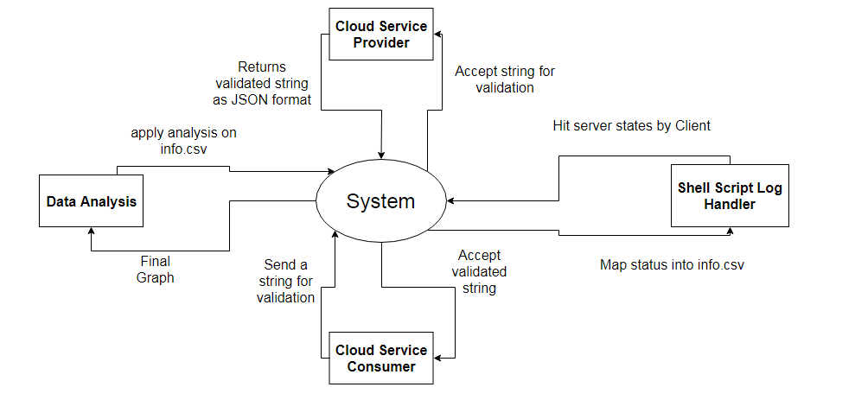
Level 0 Data Flow Diagram

Slide 5
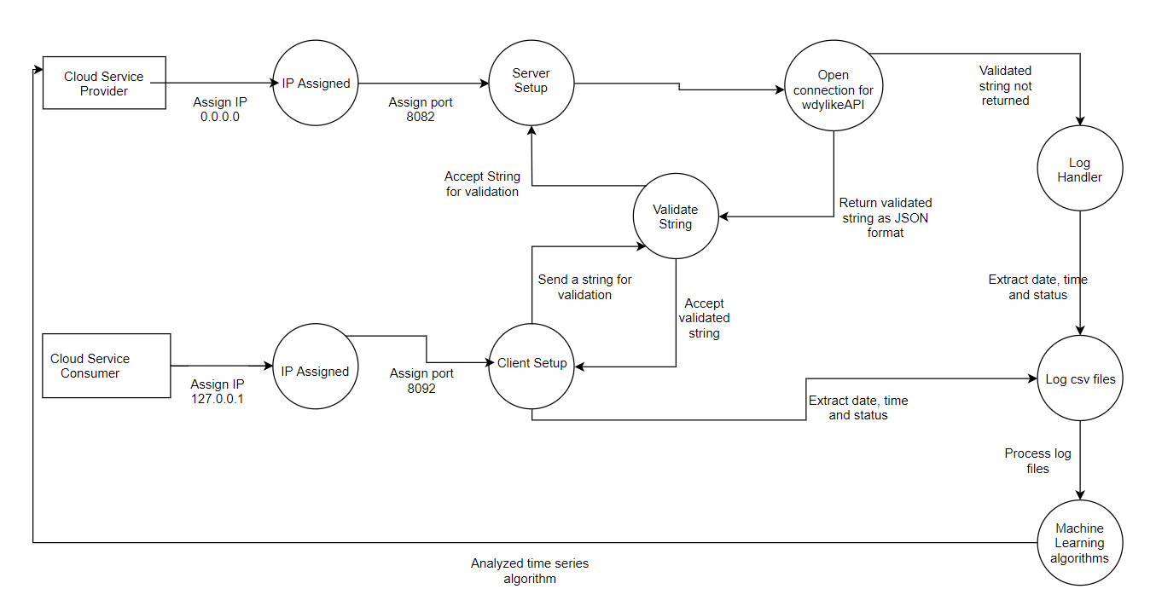
Level 1 Data Flow Diagram

Slide 6
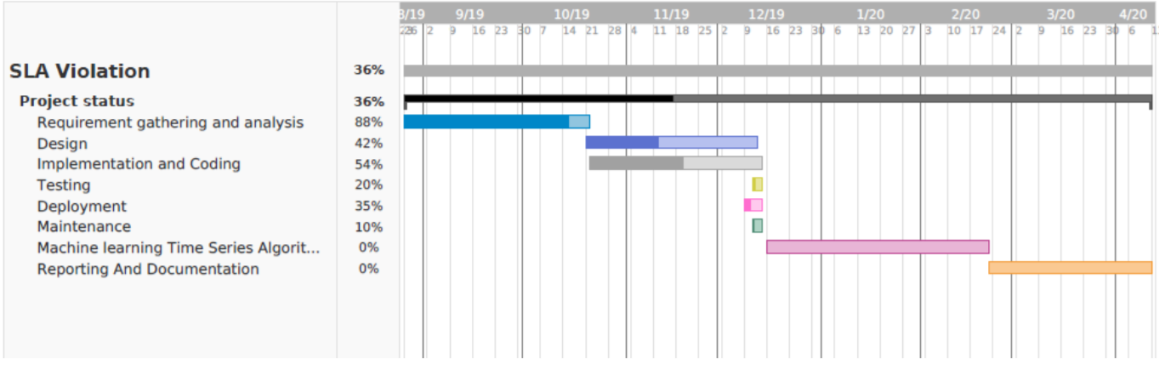
Gantt Chart

Slide 7
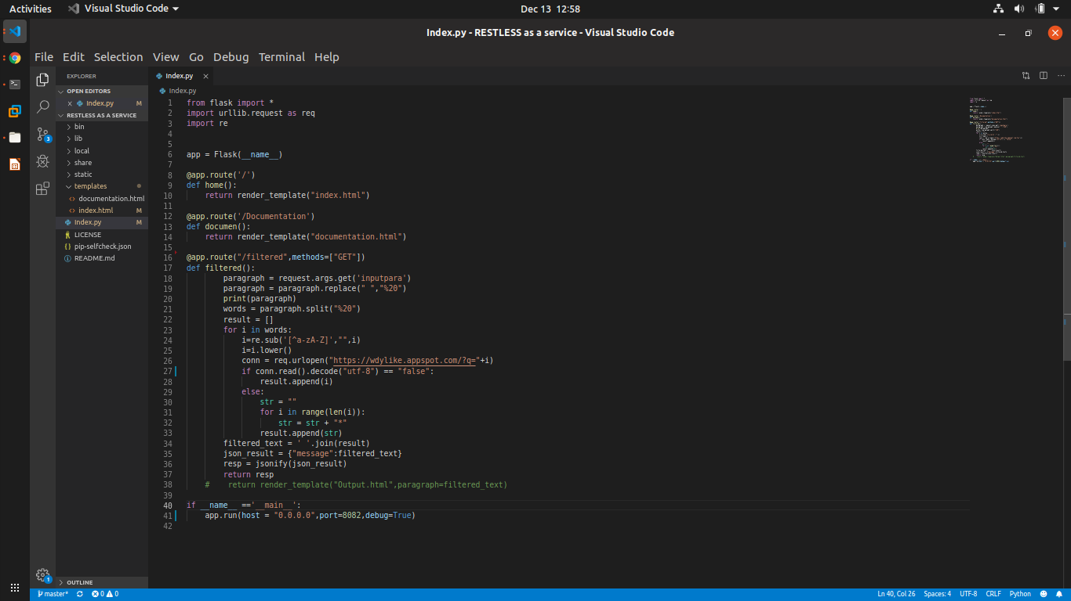
Server Setup

Slide 8
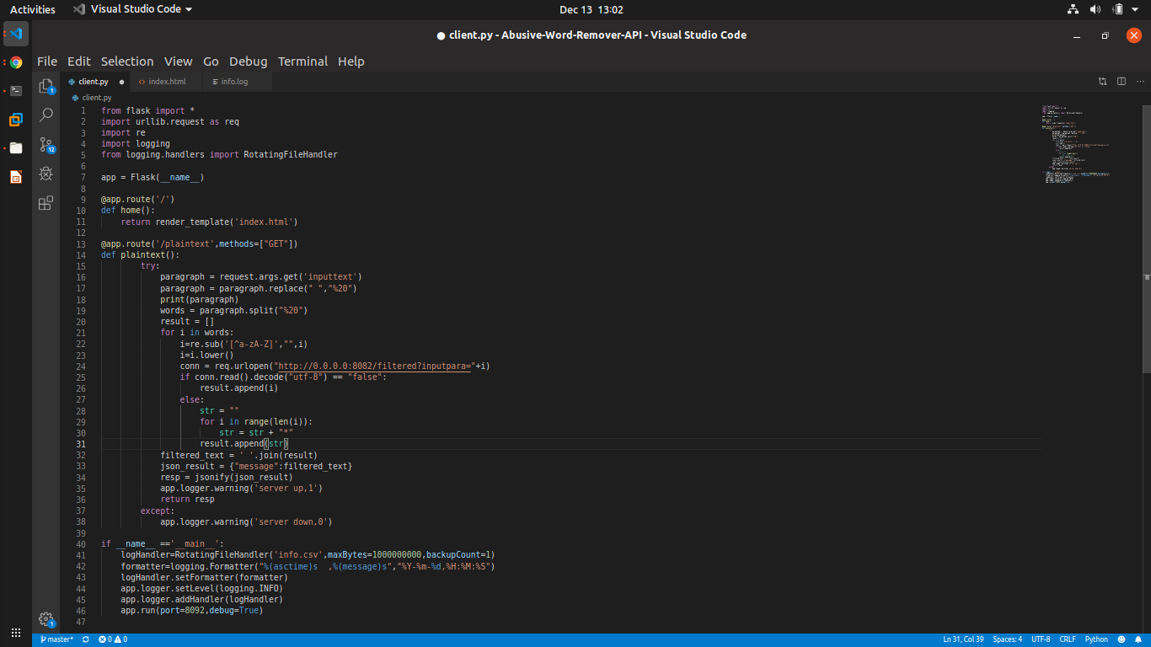
Client Setup

Slide 9
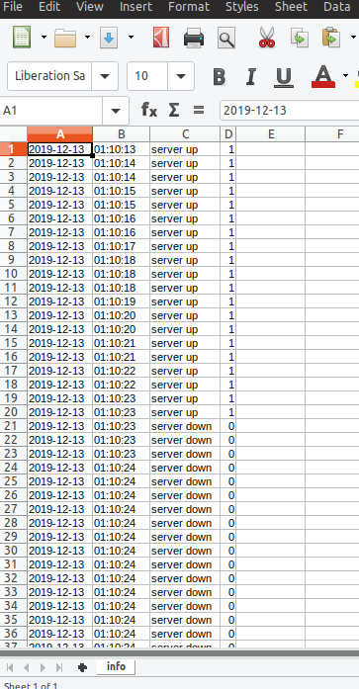
Log files

Slide 10
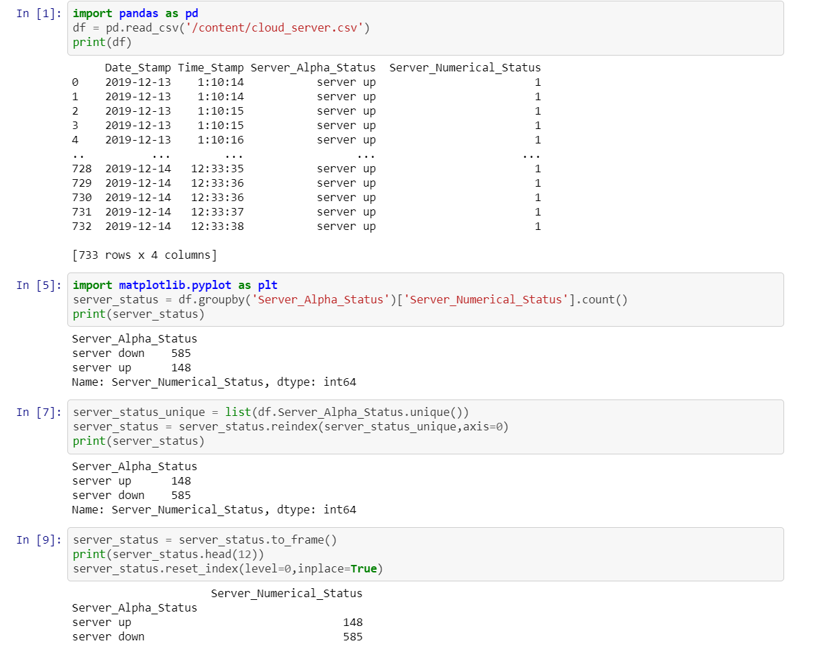
Data Analysis Code

Slide 11
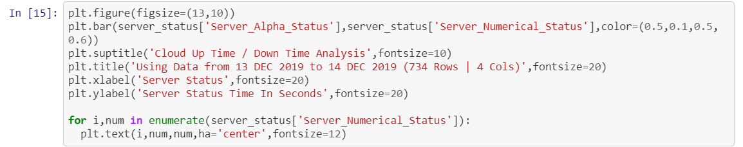
Data Analysis Code

Slide 12
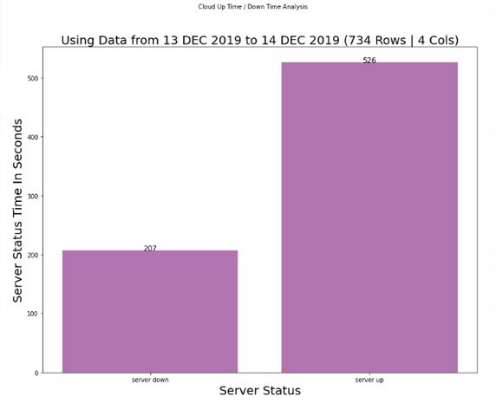
Data Analysis Graph

Slide 13
Explanation
Data Analysis Graph is depicting the server availability and server unavailability for a given period of time (1 Day i.e. 13 Dec 2019 - 14 Dec 2019) using Pandas Library of Python and on that basis violation , determination of SLA Violation can be made and Cloud Service Provider will have to pay specified penalties to its customer(end user) as per SLA Terms and Conditions

Slide 14
Thank You

