Slide 1
AI • HEALTHCARE • PYTHON
Inside this deck
14 SLIDES
PROJECT SHOWCASE
v1.0 · 2026
14 slides — definitions, working, AI layers, the full library list, features, and the rough edges.
Integrated Patient
Care Management
01
What it is
02
How it works
03
Components
System
04
AI implementations
05
Stack & libraries
06
Difficulties
IPCMS · Where AI meets everyday clinical care
3
4
20+
role-aware
dashboards
AI features
built in
libraries
documented
BUILT BY
Curated by hand · Drafted with AI · Reviewed by the author
Nikhil • Aug 2026
For 3rd-year / final-year project showcase
Streamlit · LangChain · Groq · Gemini · MySQL
swipe →
IPCMS — Integrated Patient Care Management System
1 / 24

Slide 2
SECTION 01
What is IPCMS?
A working definition, the way I'd explain it to a friend.
IN ONE SENTENCE
What problem it tries to solve
IPCMS is a web-based hospital workflow app that lets patients, doctors and admins work off the same data — with an AI layer that helps everyone make better, faster decisions.
01
Scattered records
Patient history lives in different places for every doctor.
02
Manual triage
Reception reads forms and routes people by hand.
03
Generic advice
LONGER VERSION
• End-to-end OPD/IPD flow: register, book, consult, prescribe, follow-up.
• Three role-aware dashboards — what a patient sees is not what a doctor sees.
• Two AI assistants — a floating voice chatbot and a database-aware care copilot.
Patients Google symptoms; doctors can't scale 1-to-1 chat.
04
Slow onboarding
Doctors, admins and patients each need a fast, role-specific start.
IPCMS — Integrated Patient Care Management System
2 / 24

Slide 3
SECTION 02
How it works
The journey of a single appointment, end to end.
01
02
03
04
05
Sign in
Pick a doctor
AI pre-check
Consultation
Follow-up
Email + password OR Google OAuth.
Role detected from DB.
Patient browses specialties,
slots and picks a time.
Care copilot reads the patient's
history + symptom prompt.
Doctor reviews AI summary,
notes, prescribes meds.
Email receipt + chat ref.
Voice chatbot stays 24×7.
Under the hood — what's moving where
• Browser → Streamlit (Python) → PyMySQL → MySQL (users, doctors, slots, visits, prescriptions).
• Two AI side-paths: LangChain + Groq for the in-app care copilot, and a Gemini/Groq voice widget for always-on help.
• Outbound: Gmail SMTP delivers doctor credentials; ReportLab + pdfplumber export medical records.
IPCMS — Integrated Patient Care Management System
3 / 24

Slide 4
SECTION 03
Core components
Three role-aware dashboards, all reading from one MySQL DB.
Patient
P
Doctor
D
Admin
A
pages/patient_dashboard.py
pages/doctor_dashboard.py
pages/admin_dashboard.py
• Profile + medical history view
• Browse doctors by specialty
• Book / reschedule / cancel slots
• Symptom checker (AI)
• Prescription & PDF downloads
• Floating voice chatbot 24×7
• Today's schedule + queue
• AI pre-summary of patient
• Diagnosis, vitals, notes
• Write / edit prescriptions
• Manage availability slots
• Password reset via email
• Onboard doctors (email)
• Activate / deactivate users
• Specialty & slot oversight
• Analytics: visits, revenue
• Reset doctor passwords
• Full DB-backed audit view
IPCMS — Integrated Patient Care Management System
4 / 24

Slide 5
SECTION 04
AI implementations
Four places where an LLM actually does something useful.
01 • IN-APP COPILOT
02 • ALWAYS-ON HELPER
AI Care
Floating Voice Chatbot
LangChain + Groq (openai/gpt-oss-120b, fallback llama-3.1-8b-instant)
Gemini API + Groq fallback • Web Speech (STT + TTS) • Glass UI
Database-aware assistant. Reads users, doctors, slots and visits tables to answer 'who's free tomorrow?', 'show my last visit', 'book Dr. Sharma at 4pm'. Also surfaces patient history to the doctor before a consult.
A mic-button widget pinned bottom-right on every page. Patients speak their question, the JS mic captures it, the model answers, and the response is read back aloud via the browser.
file: ai_care.py
file: voice_chatbot.py
03 • PUBLIC (PRE-LOGIN)
04 • PRE-VISIT BRIEF
Public LLM Chat
Doctor's AI Summary
ChatGroq • LangChain Core
Prompt-engineered on Groq • reads DB context per patient
A small 'ask anything' panel on the home page for visitors who haven't signed in yet. Answers FAQs about the product and gives a feel for what the AI does inside the app.
Before each consultation, the doctor gets a 5-bullet brief: key history, recent vitals, current meds, red flags, questions to ask — generated from the same DB the app uses.
file: chatbot.py
file: ai_care.py (consultation mode)
IPCMS — Integrated Patient Care Management System
5 / 24

Slide 6
SECTION 05
Tool stack — at a glance
Four families. Full library list with working notes → next slide.
Frontend / App shell
Backend / Data
LIBRARIES
LIBRARIES
Streamlit + custom CSS
Python + PyMySQL + MySQL + SQLite + dotenv
Powers the whole UI: pages, routing, forms, session state.
Server logic, schemas, dialect-aware CRUD, secrets.
AI / LLM
Utilities & I/O
LIBRARIES
LIBRARIES
LangChain + Groq + Gemini
Pillow, ReportLab, pdfplumber, pandas, requests, smtplib
Two chat brains: in-app copilot and floating voice widget.
PDFs, charts, OAuth, SMTP — the boring plumbing that ships.
IPCMS — Integrated Patient Care Management System
6 / 24

Slide 7
SECTION 06 • PART 1
Libraries — AI / LLM
What each AI package does, and where it's used in the code.
Library
Version
Role
What it does / where it's used
streamlit
≥1.30
UI shell
Renders the whole web app — pages, widgets, session state, file uploads. We use it for every dashboard and the public chatbot.
langchain-core
≥0.2
AI plumbing
Message types (HumanMessage), prompt templates and runnable interfaces. Used by ai_care.py and chatbot.py to wrap LLM calls.
langchain-groq
≥0.1
AI brain (primary)
ChatGroq wrapper around Groq's hosted LLMs. Default model openai/gpt-oss-120b; falls back to llama-3.1-8b-instant for speed.
groq
≥0.37
AI brain (direct)
Direct Groq SDK used as a secondary fallback path when LangChain's wrapper hits errors — short, latency-sensitive calls.
Gemini API
—
Voice chatbot brain
Google's Gemini model is called from the browser-side JS in voice_chatbot.py. Used because it handles conversational health Q&A well.
Pillow (PIL)
≥10
Images
Loads the logo JPG at runtime for the favicon, exposes it to st.set_page_config.
reportlab
≥4
PDF generation
Generates the medical-record PDF the patient downloads after a visit (prescription, vitals, doctor notes).
pdfplumber
≥0.10
PDF parsing
Reads PDF uploads (e.g. lab reports) so the doctor can attach parsed text to the patient's record.
IPCMS — Integrated Patient Care Management System
7 / 24

Slide 8
SECTION 06 • PART 2
Libraries — Backend, Frontend, Utilities
The non-AI half. Some are pip-installed, some are Python stdlib.
Library
Version
Layer
What it does / where it's used
pymysql
≥1.1
Backend
MySQL driver. Opens connections from db.py, runs schema CREATE statements, and executes every CRUD query.
cryptography
≥41
Backend
Required transitively by PyMySQL for the secure MySQL auth handshake (caching_sha2_password).
python-dotenv
≥1.0
Backend
Loads .env into os.environ so secrets (GROQ_API_KEY, SMTP creds, OAuth client) never sit in source.
sqlite3 (stdlib)
—
Backend
Fallback DB used when MySQL isn't reachable — same dialect-aware schema builder in db.py switches AUTOINCREMENT vs AUTO_INCREMENT.
hashlib (stdlib)
—
Backend
SHA-256 password hashing in auth.py. Used instead of bcrypt so the demo can run with zero install beyond Streamlit.
smtplib (stdlib)
—
Backend
Sends the HTML welcome email to newly onboarded doctors via Gmail.
streamlit
≥1.30
Frontend
Same library listed in the AI slide — every visible page is a Streamlit script. Custom CSS is injected via st.markdown for theming.
Pillow
≥10
Frontend
Logo + favicon rendering (also listed above for the AI slide context).
pandas
≥2.0
Utility
Admin analytics: visit counts, revenue, doctor load — all rendered from a pandas DataFrame.
requests
≥2.31
Utility
Google OAuth flow — token exchange + userinfo call. Also used for any external HTTP call where needed.
Custom CSS
—
Frontend
Hand-rolled in app.py and pages/shared_styles.py — Inter / Plus Jakarta Sans, glassmorphism cards, medical-slate palette.
HTML/JS in components.v1
—
Frontend
The voice chatbot's mic + STT + TTS widget is built as a self-contained HTML/JS blob rendered via streamlit.components.v1.html().
IPCMS — Integrated Patient Care Management System
8 / 24

Slide 9
SECTION 07
Frontend — what the user sees
Streamlit pages, with hand-rolled styling on top.
Pages in the app
Design system (hand-rolled, in CSS)
app.py
Public landing — login, signup, Google OAuth, public chatbot.
Theme
Medical white + glassmorphism overlays.
auth.py
Hashing, seed users, OAuth handlers.
Typography
Inter + Plus Jakarta Sans via Google Fonts.
pages/patient_dashboard.py
Patient UI — history, booking, AI.
Palette
Slate text, sky/teal accents, soft slate backgrounds.
pages/doctor_dashboard.py
Doctor UI — schedule, notes, AI.
Backgrounds
Base64-encoded image + soft overlay per page.
pages/admin_dashboard.py
Admin UI — onboard, analytics, reset.
Components
Cards, chips, pill buttons, sticky header, floating voice button.
pages/shared_styles.py
Common CSS + theme tokens.
Responsive
Wide layout by default; cards collapse on narrow.
IPCMS — Integrated Patient Care Management System
9 / 24

Slide 10
SECTION 08
Backend — what runs server-side
Pure Python. MySQL at the center, two AI side-paths, SMTP for mail.
MySQL (SQLite fallback)
users • doctors • slots
visits • prescriptions
auth.py
db.py
Hash, OAuth,
seed users
Schema, CRUD,
dynamic config
email_service.py
ai_care.py
SMTP + HTML
doctor welcome
LangChain + Groq
DB-aware AI
IPCMS — Integrated Patient Care Management System
10 / 24

Slide 11
SECTION 09
Features — the long list
Twelve things that actually work today, not just in spec.
#01
#02
#03
#04
Role-aware auth
Smart booking
AI symptom checker
Doctor AI brief
Email+password + Google OAuth, session state per role.
Patients see only valid future slots; doctors see only their queue.
Patient describes symptoms → AI returns structured triage.
Auto-generated 5-bullet patient summary before each consult.
#05
#06
#07
#08
Prescription writer
PDF medical record
Voice chatbot
Voice / text fallback
Add medicine + dosage + duration; visible to patient.
ReportLab-generated downloadable record.
Floating mic button on every page; speaks back via Web Speech.
Mic-less users still get text chat, same AI brain.
#09
#10
#11
#12
Doctor onboarding
Password reset
Activate / deactivate
Analytics dashboard
Admin creates doctor → email goes out with temp password.
Admin can reset any doctor's password.
Admin can suspend users in one click.
Visit counts, revenue, doctor load — pandas-powered.
IPCMS — Integrated Patient Care Management System
11 / 24

Slide 12
SECTION 10
Core concepts
The handful of ideas everything else hangs off.
1
Role
2
Visit
The single switch that decides which dashboard renders. Stored on the users table, enforced server-side, never trusted from the browser.
An appointment becomes a visit only after the doctor marks it complete — that's when AI summary, prescription, and PDF kick in.
3
Slot
4
AI context
A (doctor, weekday, time-window) tuple. Free / booked is computed, not stored — fewer race conditions.
Every LLM call is given the same DB slice the user is looking at. This is what makes 'book Dr. Sharma at 4pm' actually work.
5
Voice loop
6
One DB, three views
Browser mic → STT → backend LLM → TTS → speaker. Each step falls back independently if the next one fails.
Patients, doctors and admins all read the same rows — only the columns and actions differ.
IPCMS — Integrated Patient Care Management System
12 / 24

Slide 13
SECTION 11
Difficulties, honestly
Things that took longer than they should have.
MySQL not running locally
Streamlit reruns everything
Most laptops don't have MySQL. First launch crashed. Fix: dynamic db_config + UI prompt to enter creds.
Any click reruns the whole script; LLM calls fired multiple times. Fix: st.session_state for chat history.
OAuth redirect in dev
AI cost + latency
Google OAuth needs exact redirect URIs. localhost:8501 worked, 127.0.0.1 didn't. Hard-coded the redirect URI in auth.py.
Long LLM calls blocked the UI. Fix: st.spinner, smaller prompts, llama-3.1-8b-instant fallback for short queries.
Voice in the browser
Schema drift MySQL/SQLite
Web Speech needs user gesture + HTTPS (or localhost). Worked in dev, will need HTTPS in production.
AUTO_INCREMENT vs AUTOINCREMENT, BOOL vs BOOLEAN. Fix: dialect-aware schema builder in db.py.
IPCMS — Integrated Patient Care Management System
13 / 24

Slide 14
SECTION 12
Problem statements & solutions
What real-world gaps the project closes — and exactly how the build answers each one.
PROBLEM
OUR SOLUTION
P1
Fragmented patient records
S1
Fix for: Fragmented patient records
Different doctors store notes in different places — history is hard to retrieve, harder to share.
Single MySQL schema with role-aware views. Patients, doctors and admins all read the same tables, so history, visits and prescriptions live in one place.
P2
Manual appointment routing
S2
Fix for: Manual appointment routing
Reception reads forms and assigns slots by hand — slow, error-prone, no self-service.
Self-service slot booking by patients, validated server-side. Doctors manage availability; the chatbot can book appointments in natural language.
P3
No intelligent first response
S3
Fix for: No intelligent first response
Patients Google symptoms or wait days for advice; doctors can't scale 1-to-1 chat.
Two AI assistants (in-app Groq copilot + always-on voice widget) give 24×7 triage, prescription context and follow-up answers using the patient's DB history.
P4
Paper-based pharmacy & onboarding
S4
Fix for: Paper-based pharmacy & onboarding
Buying medicine, refilling prescriptions, and onboarding new doctors all run on paper / manual calls.
Digital pharmacy module with admin CRUD on medicine images, patient-side buy/book flow, e-prescription PDF export, and doctor-onboarding with auto-emailed credentials.
IPCMS — Integrated Patient Care Management System
15 / 24

Slide 15
MILESTONE 01
Login UI — design & polish
Built the Streamlit login/signup screens and refined the visual system around them.
WHAT WAS BUILT
FILES / MODULES
• Email + password sign-in and sign-up forms
auth.py · app.py · pages/shared_styles.py
• Google OAuth entry alongside classic auth
• Role detection on login (patient / doctor / admin)
• Glassmorphism cards, sticky header, custom CSS theme
• Responsive layout for narrow screens
OUTCOME
A polished, themed login experience that detects role and routes each user to the right dashboard without extra clicks.
IPCMS — Integrated Patient Care Management System
16 / 24

Slide 16
MILESTONE 02
Chatbot + appointment booking + DB link
Installed the AI chatbot, taught it to book appointments, and wired it to the local database.
WHAT WAS BUILT
FILES / MODULES
• Public chatbot on the home page (pre-login)
chatbot.py · voice_chatbot.py · ai_care.py · db.py
• Always-on voice chatbot widget pinned to every page
• NLP-based appointment booking through the chatbot
• Chatbot connected to local MySQL/SQLite DB
• Reads doctors, slots, and visits tables to answer in context
OUTCOME
Patients can ask in natural language — 'book Dr. Sharma tomorrow 4pm' — and the chatbot checks real DB state before confirming the slot.
IPCMS — Integrated Patient Care Management System
17 / 24

Slide 17
MILESTONE 03
Pharmacy, prescriptions & patient purchases
Added a digital pharmacy with admin-side medicine CRUD and a patient purchase flow.
WHAT WAS BUILT
FILES / MODULES
• Medicine catalogue with images (Medicine_Images/)
add_medicines_admin.py · pages/admin_dashboard.py · pages/patient_dashboard.py · pages/doctor_dashboard.py
• Admin-side CRUD: add, edit, delete medicines
• Doctor writes prescriptions during consultation
• Auto-generated e-prescription PDF (ReportLab)
• Patient can browse, book and buy medicines in-app
OUTCOME
A closed loop: doctor prescribes → patient sees it → patient can buy the same medicines through the pharmacy, all from one DB.
IPCMS — Integrated Patient Care Management System
18 / 24

Slide 18
MILESTONE 04
OCR, external sources & doctor email onboarding
Brought external data in (OCR) and pushed notifications out (email credentials).
WHAT WAS BUILT
FILES / MODULES
• OCR module to read uploaded medical / lab reports
email_service.py · auth.py · pages/admin_dashboard.py · pages/doctor_dashboard.py
• Connection to an external data source for richer context
• Admin can create a doctor login from the dashboard
• Generated credentials are auto-mailed to that doctor
• Doctor uses the emailed credentials for first sign-in
OUTCOME
Hospitals can onboard doctors in one click, patients can upload paper reports, and the system stays the single source of truth for everyone.
IPCMS — Integrated Patient Care Management System
19 / 24

Slide 19
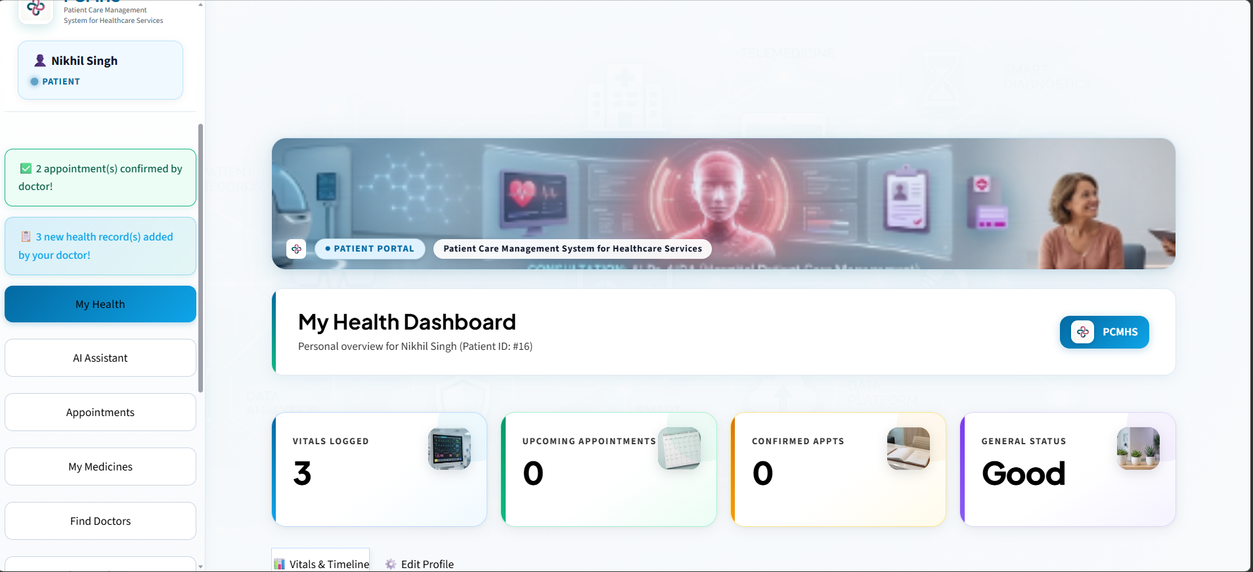
SCREENSHOT 01
Application login interface
Polished email + password and Google OAuth sign-in flow with role detection and the glassmorphism theme.
Polished email + password and Google OAuth sign-in flow with role detection and the glassmorphism theme.

Slide 20
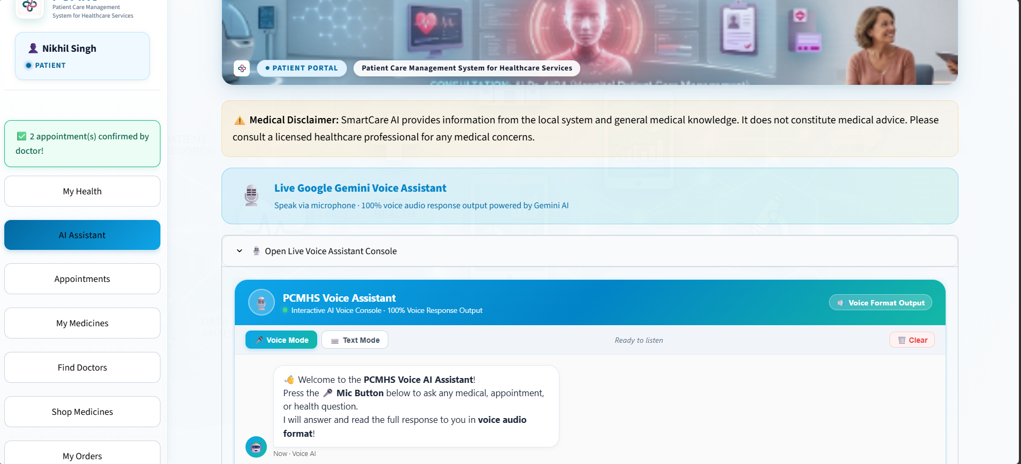
SCREENSHOT 02
Patient dashboard
Patient view of appointments, history, prescriptions, and the AI care assistant.
Patient view of appointments, history, prescriptions, and the AI care assistant.

Slide 21
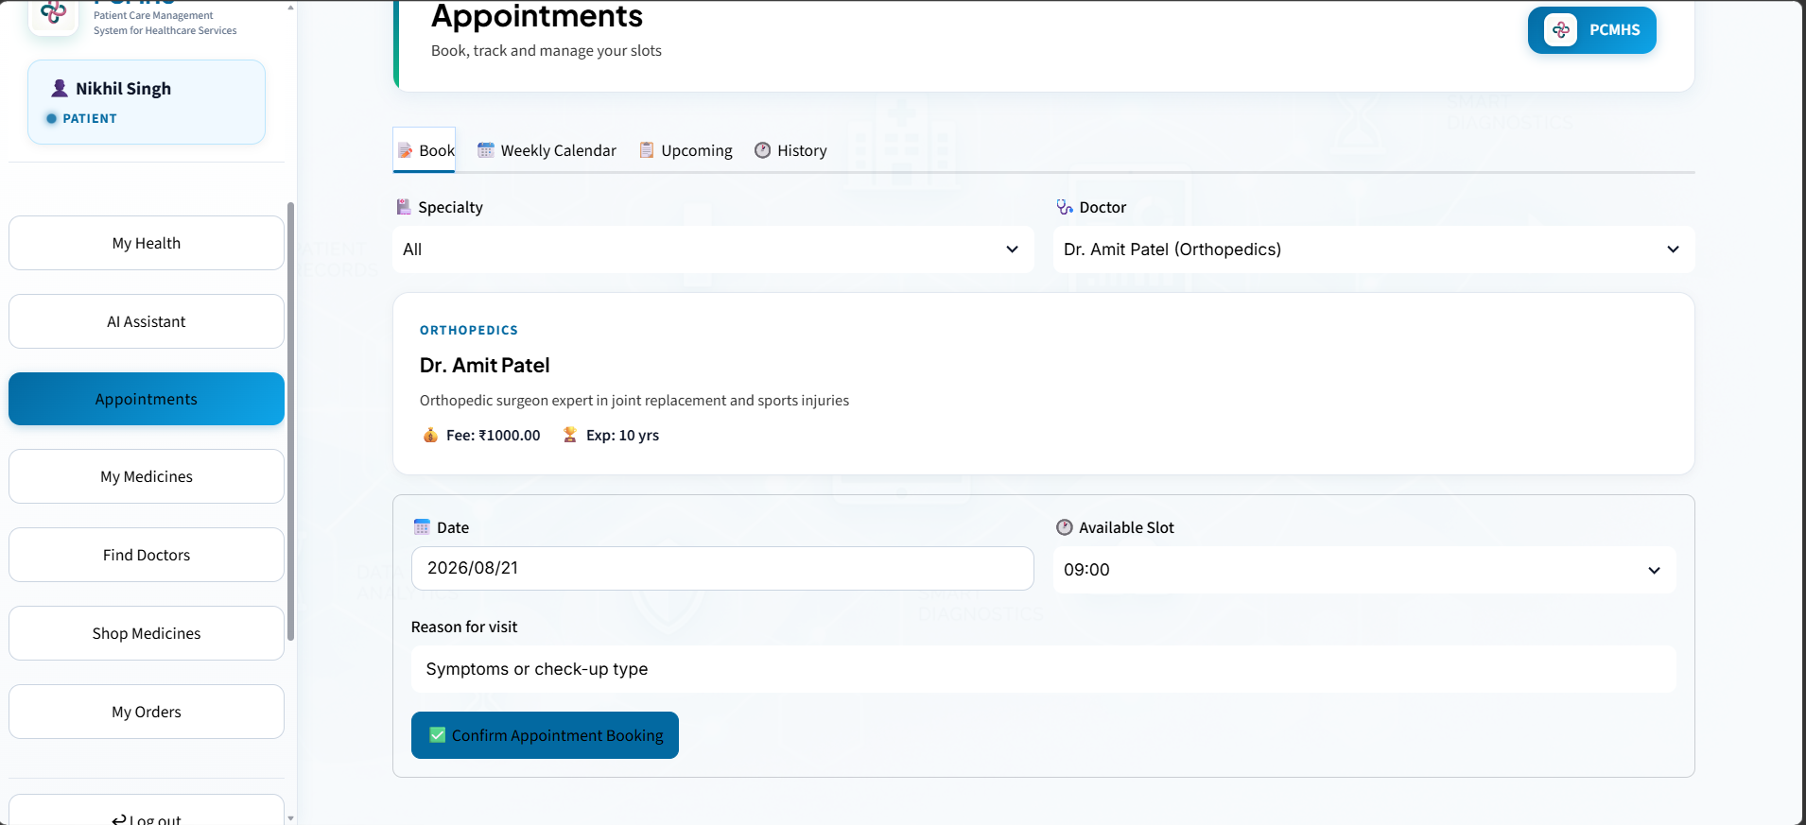
SCREENSHOT 03
Doctor consultation view
Doctor-side schedule, AI-generated pre-visit brief, vitals, notes, and prescription writer.
Doctor-side schedule, AI-generated pre-visit brief, vitals, notes, and prescription writer.

Slide 22
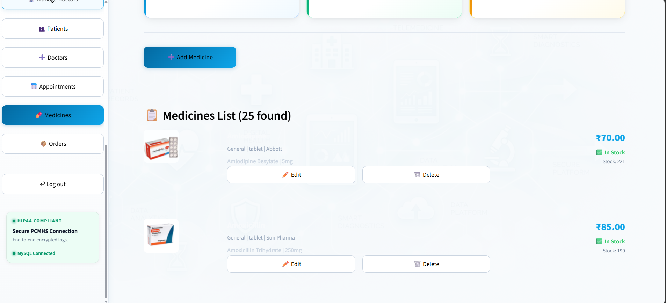
SCREENSHOT 04
Pharmacy & medicine catalogue
Patient-facing pharmacy with browse, buy and book flows, powered by the digital medicine catalogue.
Patient-facing pharmacy with browse, buy and book flows, powered by the digital medicine catalogue.

Slide 23
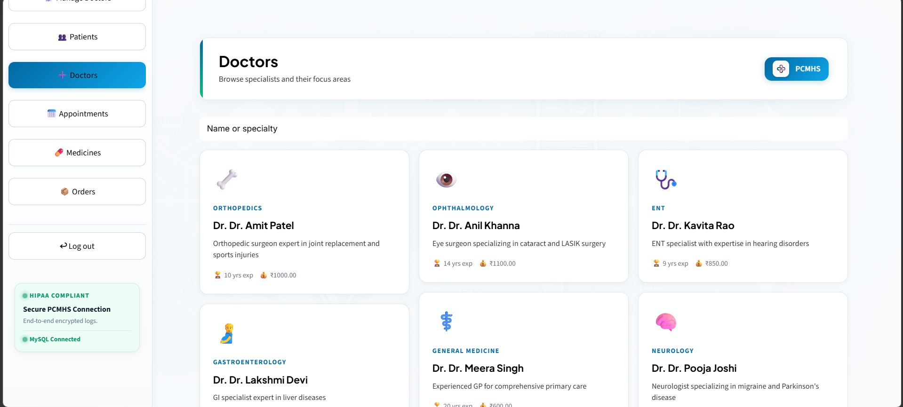
SCREENSHOT 05
Admin analytics dashboard
Admin analytics: visits, revenue, doctor load — backed by pandas DataFrames from the same MySQL DB.
Admin analytics: visits, revenue, doctor load — backed by pandas DataFrames from the same MySQL DB.

Slide 24
THANK YOU
That's IPCMS.
A patient-care app that doesn't pretend AI is magic — it just moves the right information to the right person, faster.
What you'd build next
What I'd watch
Where to look first
• Multi-language chatbot (Hindi, Spanish).
• Doctor-side calendar sync (Google Calendar).
• Insurance + billing module.
• Mobile-first layout (current is desktop-tuned).
• LLM cost scaling with concurrent doctors.
• MySQL connection pool under load.
• PII safety in AI prompts — no raw history leaks.
• Voice latency on low-end devices.
• app.py — the entry point & theme.
• pages/ai_care.py — the AI brain.
• db.py — schema and dialect switching.
• .env.example — keys to bring your own.
IPCMS — Integrated Patient Care Management System
19 / 24

