Slide 1

Impact of AI Usage on DeveloperProductivity
Team Members: Nitul Patel
Nikhil Patel

Slide 2
Project overview
The project focuses on studying the impact of AI tools, especially ChatGPT, on developer productivity. The main aim is to understand how the use of AI influences the way developers work and perform their tasks in real-world situations. To achieve this, we used two different datasets: one containing sentiment data from tweets about ChatGPT, and another containing developer productivity data such as AI usage hours, coding hours, sleep hours, and commits.
We analyzed real-world developer behavior by combining insights from both datasets. Before performing the analysis, we applied data preprocessing techniques such as cleaning the data, handling missing values, and standardizing the format to ensure accuracy. After preprocessing, we performed exploratory data analysis to identify patterns, trends, and relationships between different variables.
We also applied machine learning models to better understand and predict developer productivity based on different factors. Finally, we created an interactive Power BI dashboard to visualize the results and generate meaningful insights. This overall approach helps us understand how AI tools like ChatGPT affect productivity and efficiency in modern development environments.

Slide 3
Milestone 1 – Planning & Data Collection
Project Planning and Objective Definition
In the first milestone, we focused on planning and data collection for the project. We started by selecting a topic related to AI tools and their impact on developer productivity. After choosing the topic, we clearly defined the project objective, which is to understand how AI usage and user sentiment influence developer performance. We also identified the main research problem, which is to analyze whether the use of AI tools like ChatGPT leads to improved productivity.
Dataset Selection
Next, we selected two datasets for our analysis. The primary dataset consists of tweets related to ChatGPT, which includes user opinions and sentiment labels such as positive, negative, and neutral. The secondary dataset contains developer productivity data, including variables like AI usage hours, coding hours, sleep hours, and commits.
Hypothesis and Project Planning
We then defined a hypothesis stating that positive sentiment toward ChatGPT is associated with higher productivity and better performance. In addition, we identified the target audience, which includes developers, students, and organizations interested in AI tools. Finally, we planned the overall project structure, including data preprocessing, analysis, machine learning, and visualization steps to ensure a smooth workflow throughout the project.

Slide 4
Dataset
Primary Dataset (Sentiment Data)
In this project, we used a primary dataset that consists of tweets related to ChatGPT and other AI tools. These tweets include sentiment labels such as positive, negative, and neutral, which help us understand user opinions and perceptions about AI technologies. This dataset is useful for analyzing how people feel about ChatGPT and how their sentiment may influence its usage.
Secondary Dataset (Developer Productivity Data)
The secondary dataset contains developer productivity metrics, which provide information about how developers work and perform their tasks. It includes important variables such as AI usage hours, coding hours, sleep hours, and the number of commits, which is used as a measure of productivity. These features help us analyze how different factors affect developer performance.
Data Source and Importance
Both datasets were collected using APIs, which allowed us to gather real-world data. By combining these datasets, we can analyze trends, identify relationships, and understand how user sentiment and AI usage impact developer productivity in practical scenarios.

Slide 5
Data Prepocessing
Data Cleaning Process
Handling Missing and Incorrect Data
In this stage, we focused on improving the quality of the dataset by handling missing and incorrect values. We identified null values and removed or replaced them to ensure the dataset is complete and reliable. We also checked for incorrect or inconsistent entries and corrected them to maintain accuracy.
Removing Duplicates and Noise
We removed duplicate records from the dataset to avoid repeated information that could affect the analysis. This step helps in reducing bias and ensures that each data point is unique and meaningful.
Cleaning Text Data (Tweets)
For the primary dataset, we cleaned the tweet text by removing unnecessary characters such as symbols, links, and extra spaces. This helps in making the text data more structured and suitable for analysis.

Slide 6
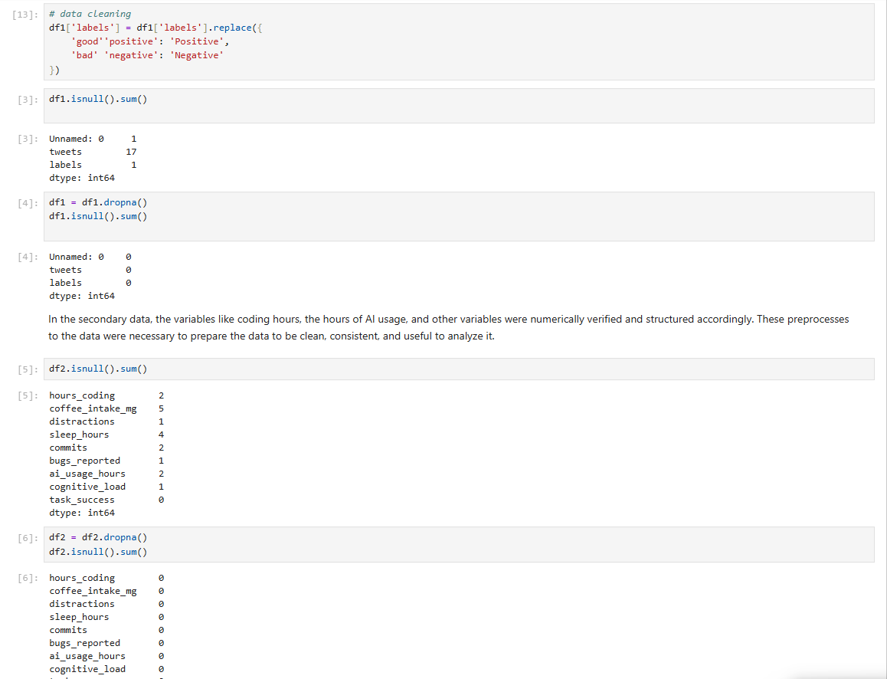
Data Cleaning Process

Slide 7
Data Preparation and Transformation
Standardizing Sentiment Labels
We converted sentiment labels into a consistent format such as Positive, Negative, and Neutral. This ensures uniformity in the dataset and helps in accurate analysis.
Data Formatting and Conversion
We converted the data into the correct format, ensuring that numerical columns are properly structured and text data is organized. This step is important for applying machine learning models.
Feature Selection
We selected only the most relevant columns such as AI usage hours, coding hours, sleep hours, and commits. This helps in focusing on important factors that directly impact productivity.
Preparing Data for Analysis
Finally, we prepared the dataset for further analysis and modeling. These preprocessing steps improve data quality, increase accuracy, and ensure better results in both analysis and machine learning models.

Slide 8
Exploratory Data Analysis (EDA)
Understanding the Dataset
In this stage, we performed exploratory data analysis to understand the structure and characteristics of the dataset. We examined different variables such as AI usage hours, coding hours, sleep hours, and commits to get an overall idea of developer behavior.
Analyzing Sentiment Distribution
We analyzed the distribution of sentiment labels in the primary dataset. This helped us understand how users feel about ChatGPT, whether the overall opinion is positive, negative, or neutral.
Exploring Productivity Patterns
We explored how productivity changes based on different factors such as AI usage and coding hours. This helped us identify which variables have a strong impact on developer performance.
Identifying Trends in Data
We observed trends in coding behavior, such as how increased AI usage is related to higher commits. This helped us understand patterns in real-world developer activity.

Slide 9
Data Visualization and Insights
Creating Visual Representations
We created multiple charts and graphs such as bar charts, pie charts, and scatter plots to visually represent the data. These visuals make it easier to understand complex information.
Comparing AI Usage with Performance
We compared AI usage hours with commits to analyze how AI tools affect productivity. The visuals showed a positive relationship between AI usage and performance.
Studying Relationships Between Variables
We used scatter plots and other visuals to study relationships between variables such as coding hours, sleep hours, and productivity. This helped in understanding how different factors interact with each other.
Generating Insights from Visuals
From the visualizations, we generated meaningful insights such as higher AI usage leads to better productivity, and balanced sleep improves performance. These insights are important for answering our research questions.

Slide 10
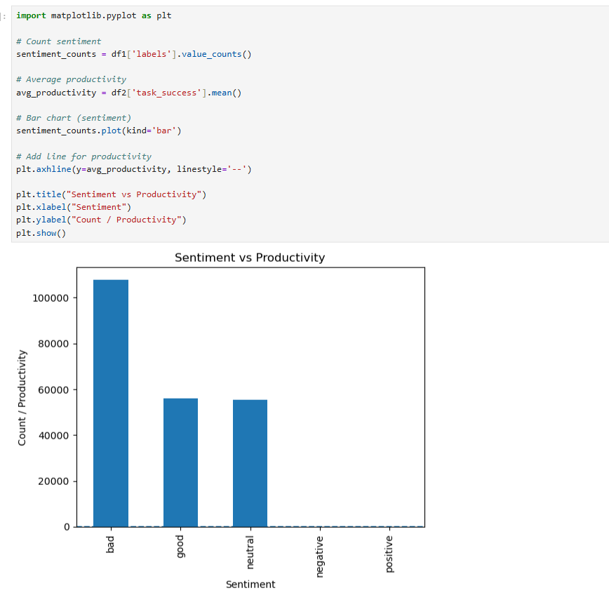
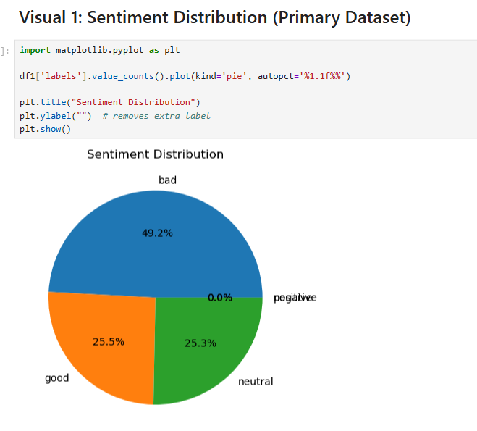
Visualization result

Slide 11
Machine Learning Models (Milestone 4)
Model Selection and Purpose
In this stage, we applied machine learning techniques to predict developer productivity and understand the relationship between different variables. The goal was to identify which factors most strongly influence productivity and to compare the performance of different models.
Applied Machine Learning Models
We implemented three different models: Linear Regression, Decision Tree, and Random Forest. Linear Regression was used to understand the linear relationship between variables, while Decision Tree and Random Forest were used to capture more complex patterns in the data.
Feature and Target Variable Selection
We selected important features such as AI usage hours, coding hours, and sleep hours as input variables. The number of commits was chosen as the target variable because it directly represents developer productivity.
Training and Testing Process
The dataset was split into training and testing sets to evaluate model performance. The models were trained using the training data and tested on unseen data to ensure accurate and reliable predictions.

Slide 12
Model Results and Evaluation
Evaluation Metric (RMSE)
We used RMSE (Root Mean Squared Error) to evaluate the performance of the models. RMSE measures the difference between actual and predicted values, where a lower RMSE indicates better model accuracy.
Model Performance Comparison
The results showed that Linear Regression achieved the lowest RMSE, indicating the best performance. Random Forest performed moderately well, while Decision Tree showed the highest error, making it the least accurate model.
Interpretation of Results
The results suggest that the dataset has a relatively simple and linear relationship between variables, which makes Linear Regression more suitable. More complex models like Decision Tree and Random Forest did not perform as well.
Best Model Selection
Based on the evaluation results, Linear Regression was selected as the best-performing model. It provides more accurate predictions and helps in clearly understanding the relationship between AI usage and productivity.

Slide 13
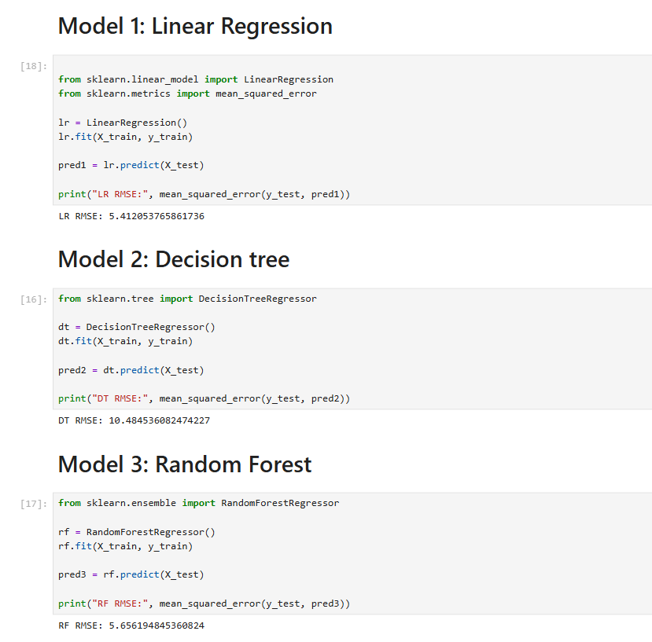
ML Model Result

Slide 14
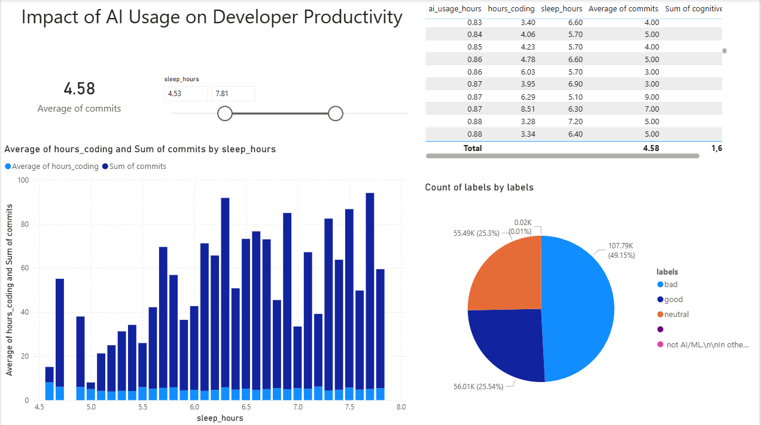
Dashboard

Slide 15
Dashboard Insights
Impact of AI Usage on Productivity
The dashboard clearly shows that AI usage has a positive impact on developer productivity. Developers who use AI tools more frequently tend to have a higher number of commits, which indicates increased activity and better performance. This suggests that AI tools help developers complete tasks more efficiently and quickly.
Role of Sleep and Coding Hours
The analysis also highlights that balanced sleep plays an important role in improving performance. Developers who maintain proper sleep patterns are more focused and productive. Additionally, coding hours directly impact productivity, as developers who spend more time coding generally produce more output.
User Sentiment and AI Adoption
The sentiment analysis shows that most users have a positive opinion about ChatGPT. This indicates strong acceptance of AI tools, which encourages more frequent usage and contributes to improved productivity.
Overall Insights from Dashboard
The dashboard combines multiple factors such as AI usage, coding hours, sleep, and sentiment to provide a complete view of developer performance. It allows users to interact with the data and explore relationships between variables, making it easier to understand key insights.

Slide 16
Conclusion
Summary of Key Findings
The project demonstrates that AI tools like ChatGPT significantly improve developer efficiency and productivity. Developers who use AI tools are able to complete tasks faster and with greater accuracy.
Impact of AI on Developer Performance
The analysis shows that increased AI usage leads to higher productivity, while balanced sleep and consistent coding hours further enhance performance. These factors together create a positive impact on developer output.
Role of Sentiment and Machine Learning
Positive user sentiment supports the adoption of AI tools, which leads to increased usage and better results. Machine learning models also confirm the relationship between AI usage and productivity, validating our findings.
Final Conclusion
Overall, the data shows strong relationships between AI usage, developer behavior, and productivity. AI tools play an important role in modern software development and are becoming essential for improving efficiency and performance.

