Slide 1

Project Presentation Text-to-Image Generation using Stable Diffusion
Presented by
Nikhil Kumar
2311AI67
Department of Computer Science
IIT Patna

Slide 2
1. Project Overview
Project Objective:
Transform natural language prompts into high-quality images using the Stable Diffusion model.
🧰 Tools & Frameworks
🤗 Hugging Face diffusers – For loading and using pre-trained text-to-image models
🖼️ Gradio – For building an interactive user interface in Colab
💻 Platform – Google Colab (GPU-enabled)
Evaluation Criteria
Efficient parameter utilization (guidance scale, inference steps)
Demonstrated understanding of diffusers library architecture
Quality, diversity, and relevance of generated images

Slide 3
2. Model Setup
Installed Libraries:
diffusers – Load and run Stable Diffusion models
transformers – Backbone library for model architecture
accelerate – Optimizes GPU performance
safetensors – Secure model loading format
Model Details:
Model ID: runwayml/stable-diffusion-v1-5 (from Hugging Face)
Purpose: Pre-trained text-to-image generation
Key Configurations:
Torch dtype = torch.float16 → Enables faster GPU processing
use_safetensors = True → Enhances model loading safety
Execution device: CUDA (NVIDIA GPU)
generate_image(prompt, num inferencesteps=50, guidance_scale=7.5)
prompt → Text description
num_inference_steps → Controls quality/detail (default: 50)
guidance_scale → Controls prompt adherence (default: 7.5)

Slide 4
Slide 4: Gradio UI (ui.ipynb)
Purpose: Real-time text-to-image frontend in Colab.
Inputs:
Prompt (Textbox)
Inference Steps (Slider: 10–100, default 50)
Guidance Scale (Slider: 1.0–15.0, default 7.5)
Output:
Generated Image displayed below inputs
Implementation: Built with gr.Blocks() for a clean, modular layout

Slide 5
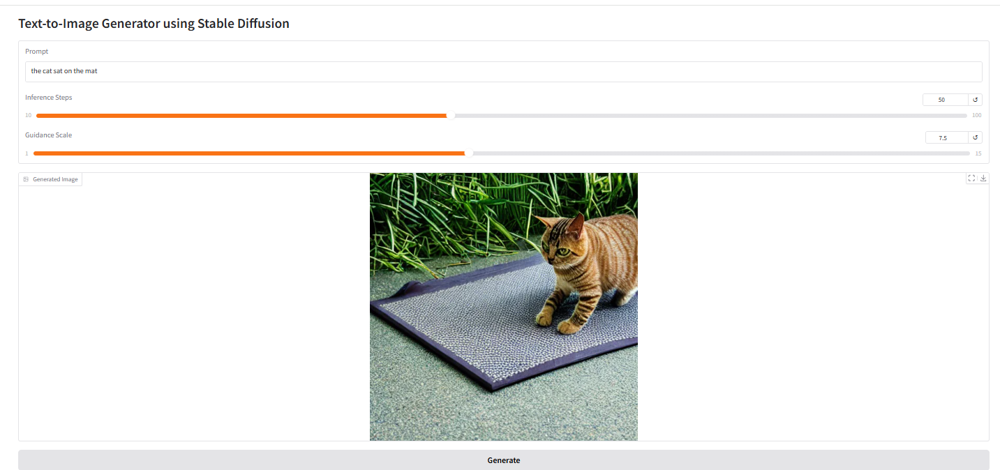
RESULTS:

Slide 6
Conclusion & Learnings:
Achievements
Text-to-image generation fully functional with Stable Diffusion
Interactive, GPU-accelerated pipeline running in Google Colab
Key Learnings
Seamless integration of Hugging Face’s diffusers library for inference
Building and deploying a Gradio-based UI in Colab for real-time demos
Future Work
Web Deployment: Host as a standalone web app (e.g., Streamlit, FastAPI + Docker)
Enhanced Features:
Downloadable image output
User history/log of past prompts and images
Customizable model parameters (e.g., sampler type, random seed)
“This project demonstrates how cutting-edge generative AI can be prototyped and shared quickly using cloud notebooks and simple interfaces.”

