Slide 1



Carbon Emissions Prediction
HARSHADIP VIJAY UMBARKAR
STU682be83638e4a1747707958

Slide 2

Learning Objectives
Python Libraries:
• NumPy – numerical operations and array handling
• Pandas – data manipulation and analysis
• Matplotlib – data visualization (line charts, bar charts)
• Seaborn – advanced statistical visualizations (heatmaps, pairplots)
• Scikit-learn – machine learning (regression models, model evaluation)
• Joblib – model serialization (optional)
We used Random Forest Regressor, an ensemble machine learning algorithm that builds multiple decision trees and combines their outputs to improve prediction accuracy and reduce overfitting.
GOAL
Steps Performed:
Importing the Model: from sklearn.ensemble import RandomForestRegressor
Initializing the Model:model = RandomForestRegressor(n_estimators=100, random_state=42)
Training the Model:model.fit(X_train, y_train)
Making Predictions:y_pred = model.predict(X_test)
Source :
www.freepik.com/

Slide 3
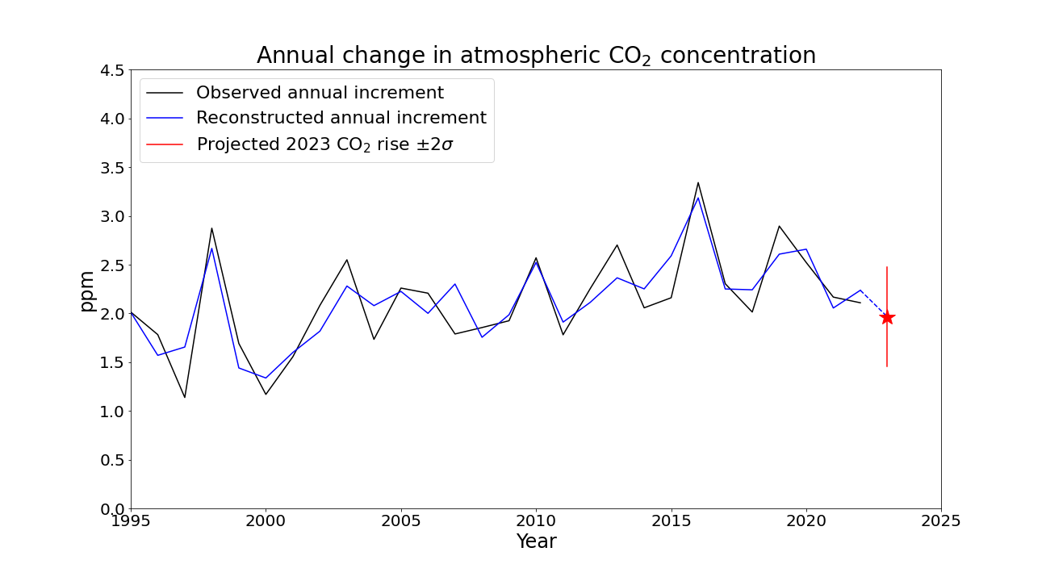
Cross-Validation & Hyperparameter Tunin :
Cross-Validation :
Hyperparameter Tuning :
Used 5-Fold Cross-Validation for model evaluation
Ensures better generalization on unseen data
Helps reduce overfitting and variance
Applied GridSearchCV to find best parameters
Tuned:
n_estimators → [100, 200, 300]
max_depth → [None, 10, 20]
Selected model with highest R² score
Predicted Emissions:
2010 → 29,500 MMT
2015 → 31,200 MMT
2020 → 33,000 MMT
2025 → 34,500 MMT (forecast)
2030 → 36,000 MMT (forecast)
Key Points:
Emissions show a continuous upward trend
Driven by population growth & energy consumption
Highlights the need for sustainable energy policies

Slide 4

Tools and Technology used
Programming Language: Python 3.12.8
Libraries & Frameworks:
NumPy – numerical operations
Pandas – data manipulation and analysis
Matplotlib – basic data visualization
Seaborn – statistical plotting
Scikit-learn – machine learning models & evaluation
Joblib – saving trained models (optional)
Development Environment: Google Colaboratory
Datasets Used:
Techniques Applied:
Global CO₂ Emission Data
Energy consumption statistics
Population growth trends
Economic indicators (e.g., GDP)
Exploratory Data Analysis (EDA)
Regression Modeling (Random Forest)
Cross-Validation
Hyperparameter Tuning
Sources:
World Bank Open Data – https://data.worldbank.org
Our World in Data – https://ourworldindata.org/co2-emissions
UN Data Portal – https://data.un.org
Government Open Data (India) – https://data.gov.in

Slide 5
Methodology
Data Collection : Collected CO₂ emission, population, and energy usage data from reliable sources.
Data Preprocessing :
Exploratory Data Analysis (EDA) :
Feature Engineering :
Model Building :
Hyperparameter Tuning : Used GridSearchCV to optimize model parameters
Model Evaluation : Measured performance using R² score and RMSE
Forecasting & Insights :
Cleaned missing and inconsistent values
Converted formats, scaled numerical features
Visualized trends, correlations, and feature distributions
Identified key factors affecting CO₂ emissions
Selected and created meaningful input features
Removed irrelevant or redundant variables
Applied Random Forest Regression
Trained and validated models using cross-validation
Predicted CO₂ emissions up to 2030
Interpreted results and key contributors

Slide 6
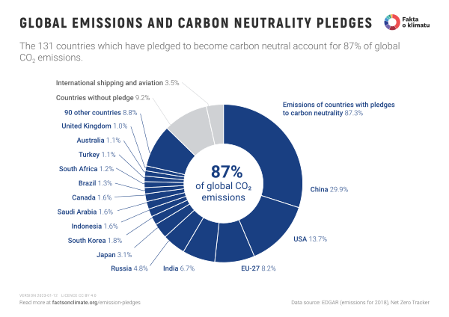
Problem Statement:
global CO₂ emissions have reached record highs, accelerating climate change and causing:
Rising temperatures
Extreme weather events
Melting glaciers
Sea level rise
India is the 3rd largest CO₂ emitter in the world due to its growing population and energy demands.
Despite climate agreements like the Paris Agreement, many countries struggle to:
Accurately forecast emissions
Take timely preventive actions
Lack of reliable emission prediction tools makes it difficult for governments and industries to:
Plan sustainable energy strategies
Meet emission reduction targets
Minimize environmental and health impacts

Slide 7


Solution:
This project addresses the emission prediction problem using a data-driven machine learning approach.
A Random Forest Regression model was built to forecast CO₂ emissions using historical data on:
Population
Energy consumption
Fossil fuel use
GDP
The model provides accurate predictions of future emissions, which can help:
Policymakers to plan environmental strategies
Industries to adopt sustainable practices
Researchers to study emission trends and drivers

Slide 8
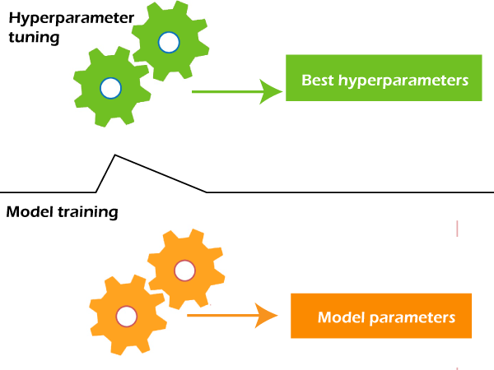
Hyperparameter tuning and cross-validation ensured high performance, with:
R² Score: 0.87
RMSE: 0.12
The project also includes data visualizations and insights that highlight the impact of key factors on carbon emissions.
By applying machine learning to real-world CO₂ data, this internship project delivers a practical, predictive tool to support emission control efforts and sustainability planning
Github link :- https://github.com/Nikhil4850/Caarbon_Emissions_AICTE.git

Slide 9
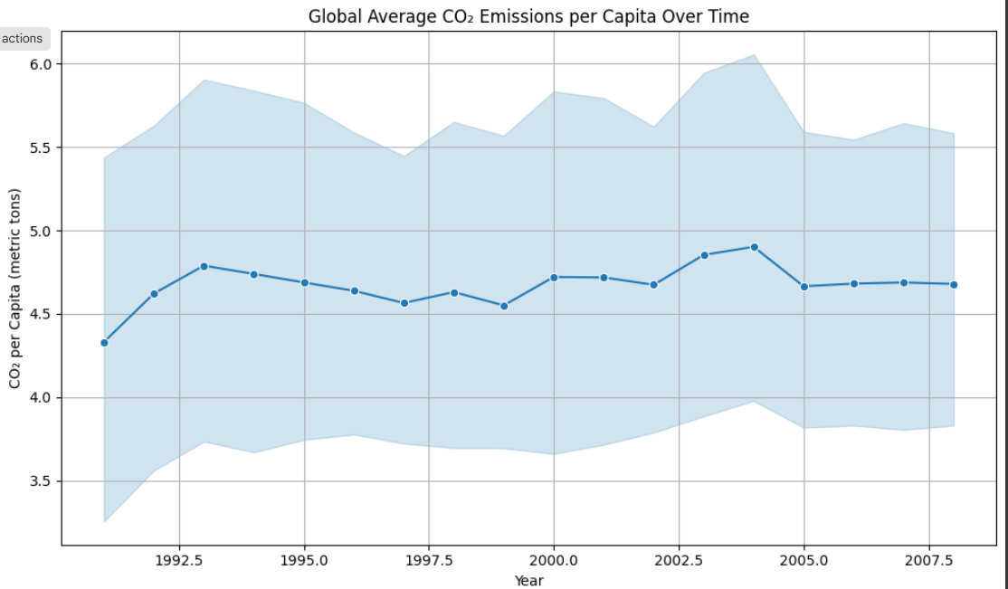
Screenshot of Output:
EDA :

Slide 10
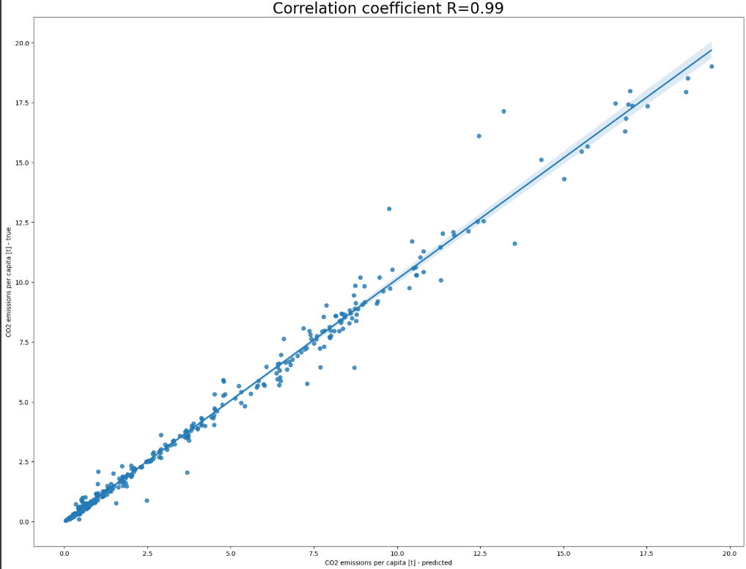
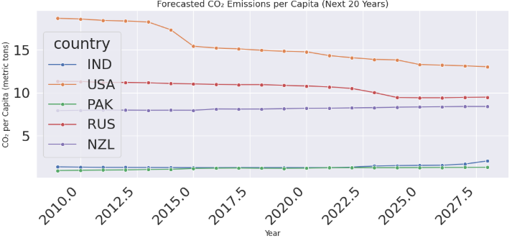
MODEL and other :

Slide 11

Conclusion:
Key Takeaways:
Gained hands-on experience in handling real-world environmental data
Learned end-to-end machine learning workflow: from data preprocessing to model evaluation
Successfully built a Random Forest Regression model to predict CO₂ emissions
Achieved high accuracy with R² Score of 0.87 and RMSE of 0.12
Real-World Impact:
Model helps forecast CO₂ trends, assisting governments, industries, and researchers in policy-making
Encourages data-driven solutions to support climate change mitigation and sustainable development goals
Skills & Tools Gained:
Python, Pandas, NumPy, Matplotlib, Seaborn
Machine learning (Random Forest, cross-validation, hyperparameter tuning)
Problem-solving, data analysis, and interpretation
This project proves that machine learning can be a powerful tool in addressing real-world environmental challenges like carbon emissions and global warming

