Slide 1
RoomieMatch: Finding Your Perfect Matchmate (for Your Apartment)
By:
N.Nikhil
2023tm93644

Slide 2
ABOUT:
RoomieMatch is a mobile application that connects potential roommates seeking to share flats or apartments.
What it is: A mobile app for finding compatible roommates and shared housing.
Who it's for: Young professionals, students, and anyone seeking affordable shared living.
What it does: Connects users based on preferences, facilitates communication, and promotes trust through profiles and reviews.

Slide 3
PURPOSE OF THE PROPOSED SYSTEM(GOAL)
Specifically, it aims to:
Facilitate efficient and reliable connections: By streamlining the search process and connecting users based on compatibility criteria, the app reduces the time and effort involved in finding potential roommates.
Promote trust and transparency: Through features like detailed profiles, secure communication, and review systems, RoomieMatch fosters trust and transparency between potential roommates, leading to more informed decisions and successful living arrangements.
Provide a safe and secure platform: The app prioritizes user safety by incorporating features like secure communication channels and the potential for background check integration (depending on future development).
Overall, RoomieMatch aims to improve the roomsharing experience by addressing the common pain points experienced by individuals seeking affordable and compatible living situations.

Slide 4
Survey form:
https://forms.office.com/r/cKxHxZ2Uxx
Response Form
https://forms.office.com/Pages/DesignPageV2.aspx?origin=NeoPortalPage&subpage=design&id=lMBK4tjva0qY1aEpsyqMmkhtoBFH1GNCkMhhNJ3SyLRUOVNXUTlaNTBZSzVUNTFJOTQyMlFGN0JTTy4u&branchingelementid=r998819164a954809b575d93c78ae7ff2&analysis=true&tab=0

Slide 5
PAIN POINT:
Difficulty finding compatible roommates: Traditional methods like online forums and personal networks can be inefficient, unreliable, and lack transparency, leading to incompatible matches and potential conflicts.
Inefficient search process: Traditional methods can be time-consuming and require significant effort to find suitable roommates, often involving sifting through numerous options without clear compatibility criteria.
Lack of trust and transparency: Difficulty assessing the personalities, habits, and expectations of potential roommates, leading to uncertainty and potential roommate problems.

Slide 6
Value Proposition:
Efficient and streamlined search: RoomieMatch provides a user-friendly platform that simplifies the search process by connecting users based on compatibility criteria like interests, habits, and lifestyle preferences.
Improved matching: The app's matching algorithm helps users find roommates who share similar values and living preferences, increasing the likelihood of successful cohabitation.
Enhanced trust and transparency: Detailed profiles, secure communication, and a potential review system (depending on development) allow users to assess potential roommates better, fostering trust and confidence in their choices.

Slide 7
Target Market:
Young professionals: Individuals starting their careers, often seeking affordable housing options in urban areas.
Students: College and university students looking for shared apartments near their campuses.
Anyone seeking affordable shared living: Individuals of any age who desire a more cost-effective and potentially social living arrangement.

Slide 8
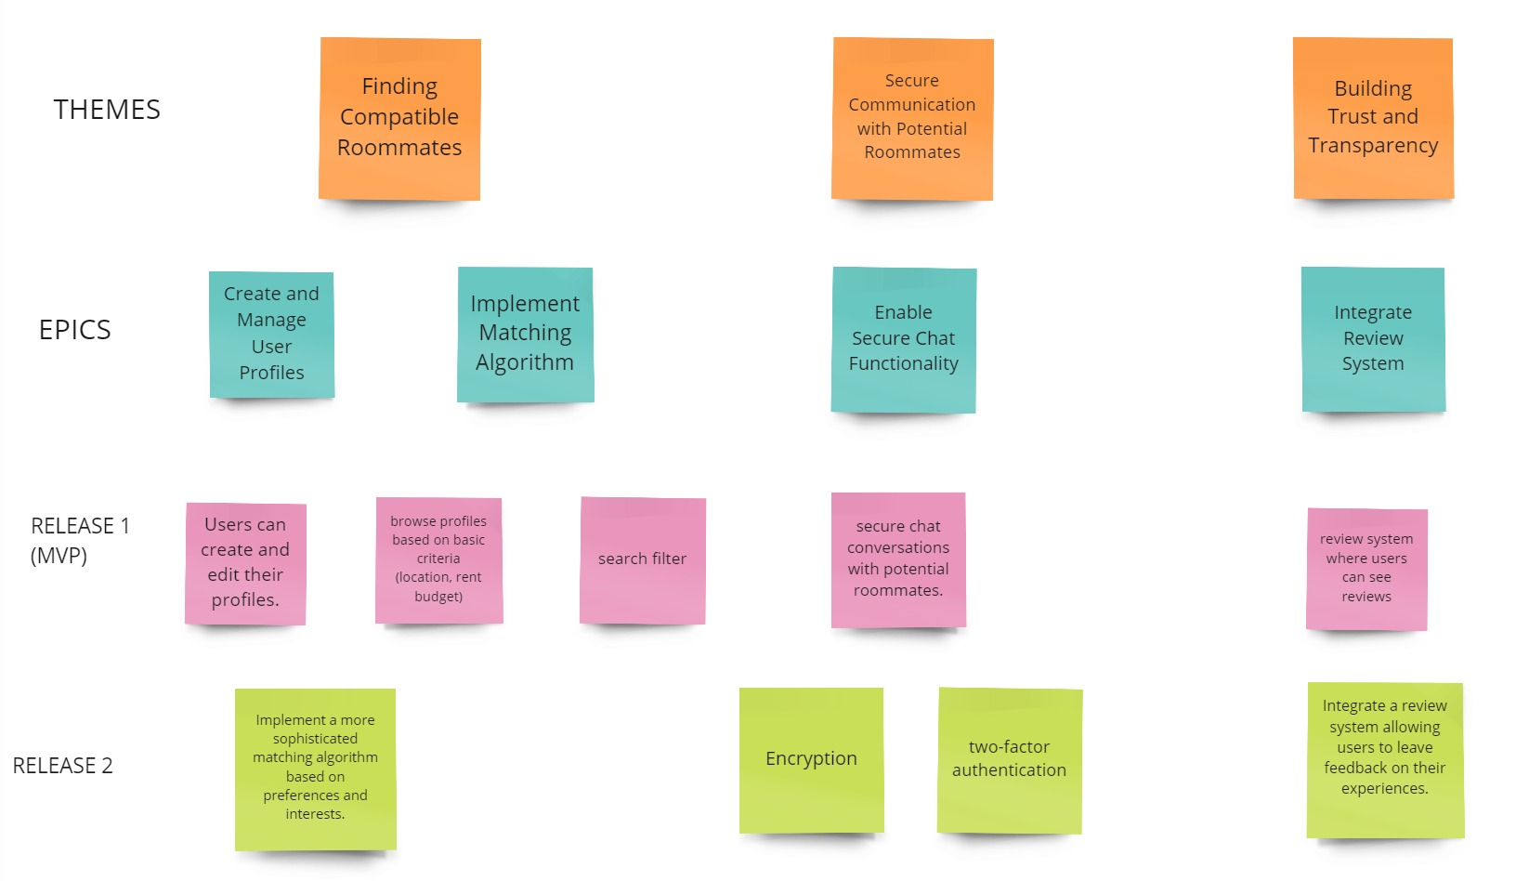
Story map:

Slide 9
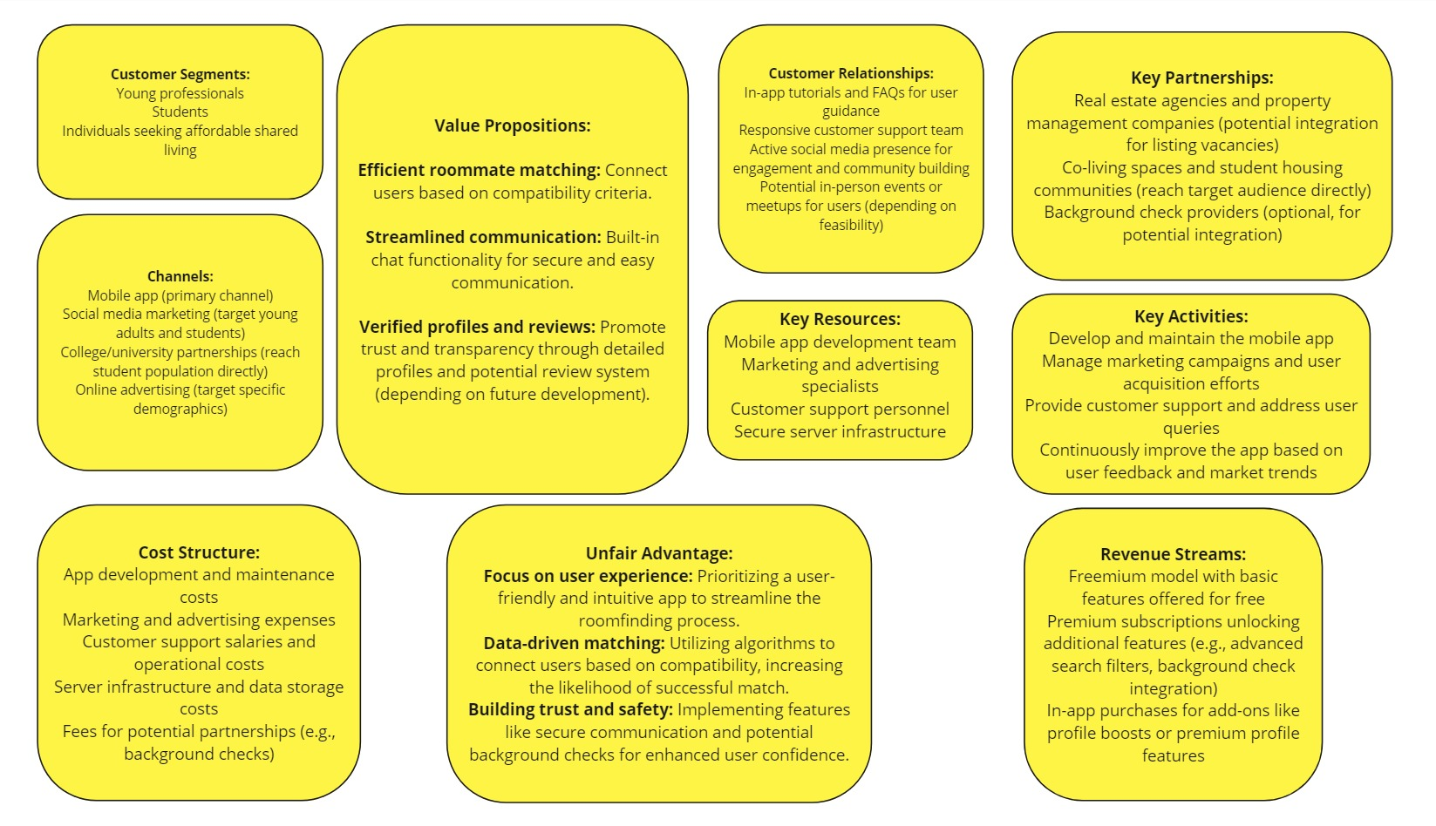
RoomieMatch Business Plan: Start-Up Canvas

Slide 10
KEY LEARNINGS: (2023tm93644)
There is a significant demand for affordable and convenient housing solutions, particularly among young adults and students.
Traditional methods for finding roommates are inefficient, unreliable, and lack transparency. This creates an opportunity for a platform that addresses these shortcomings.
RoomieMatch addresses the pain points of its target market by providing an efficient, reliable, and transparent platform for finding compatible roommates.
The app offers features like matching algorithms, detailed profiles, secure communication, and potential review systems (depending on development) to enhance the user experience and build trust.
RoomieMatch can utilize a freemium model with premium features and in-app purchases to generate revenue.
Partnerships with relevant organizations like real estate agencies, co-living spaces, and student housing communities can help reach the target audience and potentially generate additional revenue streams.

Slide 11





Thank You
Group AY
+91 8328508111
2023tm93644@wilp.bits-pilani.ac.in
RoomieMatch

