Slide 1
CASE STUDY :
DATA ENGINEERING SERVICES FOR TSP.
Team 1[Learners ]
Adarsh T D
Nikhil Srivastava
Rode Yashawini Ramesh

Slide 2
UNDERSTANDING PROBLEM STATEMENT:
Requirements :
Generating monthly billing report from the previous month reports
Visualizations needs to be generated as dashboards containing bar charts and other graphs as appropriate for the metrics being presented

Slide 3
The dataset includes several types of data related to a telecom services provider.
Generate a monthly billing report for the current month.
Create visualizations and dashboards using network metrics and caller complaints data.
Data cleaning, data integration, report generation, and visualization using azure services.

Slide 4
BUSINESS REQUIREMENTS:

Slide 5
Data Quality Assurance
Unified Billing Reports
Complaints Analysis
Network Performance Metrics
Data Storage and Accessibility
Data Integration and Processing Efficiency
Billing Transparency

Slide 6
PROPOSED SOLUTION: Madelain approach

Slide 7
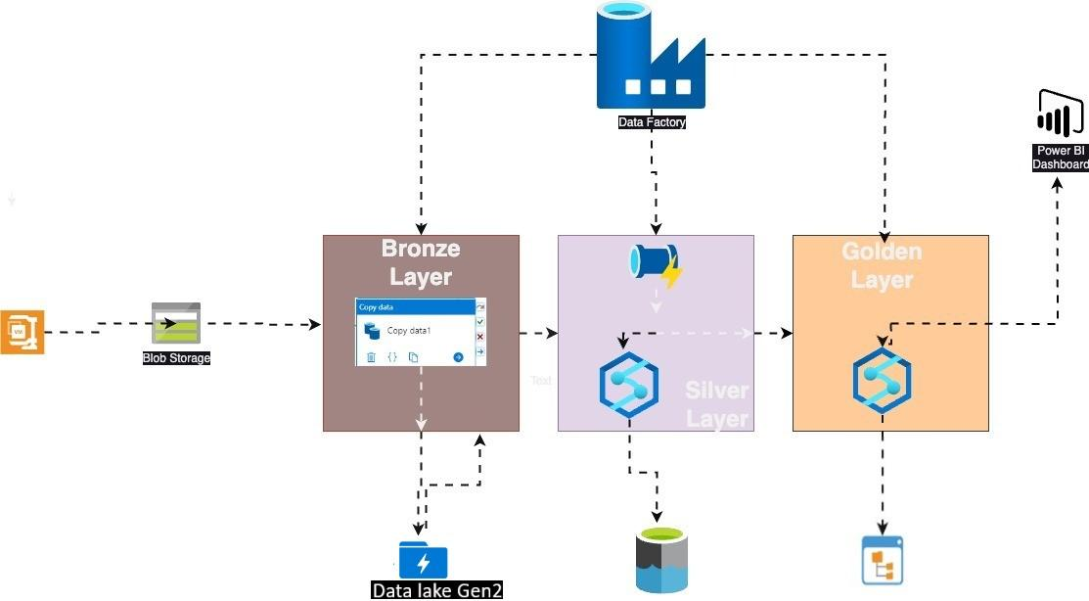
ARCHITECTURE FLOW

Slide 8
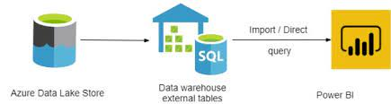

Slide 9
CHALLENGES FACED IN THE CASE STUDY:
Cleaning and pre-processing data to ensure quality.
Designing scalable solutions beyond our basic knowledge.
Choosing the right tools and technologies for a specific task.
Maintaining data consistency across various services and pipelines.

Slide 10
LEARNING OUTCOMES:
Data Proficiency, Cleaning, Transformation, ETL.
Data Pipeline Development.
Visualization and Reporting.
Collaboration Skills.
Cross-Functional Knowledge about roles and responsibilities.
Efficient Workflow

Slide 11


Slide 12


