Slide 1

Unit-5 Introduction to Web API
Web Programming using .NET
#2305CS311
Prof. Madhuresh R Fichadiya
Computer Science & Engineering Department
madhuresh.fichadiya@darshan.ac.in
8866961282

Slide 2

Looping
Outline
Why API?
Problems Without Web APIs
Advantages of Web APIs
Key Characteristics of Web APIs
Usage of Web APIs
Understanding HTTP Protocol(s)
HTTP Request and Response Components
HTTP Methods
HTTP Status Codes
JSON
Creating a Web API project in Visual Studio
Consuming Web API

Slide 3
Why API?
Section - 1

Slide 4

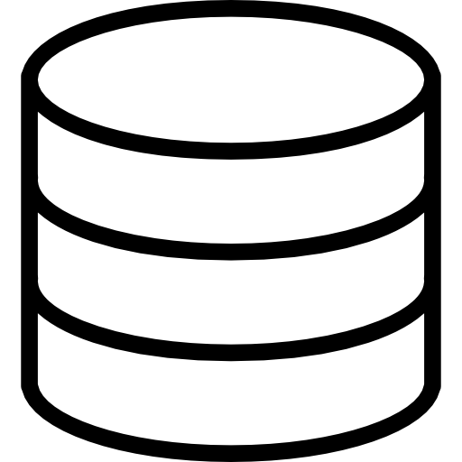
Why API?
Example
Suppose you have an idea to develop and launch your business.
For this, what you need is, you need to develop a website and launch your business/product.
Then what will you do? You will develop a website using any technologies like ASP.NET MVC, PHP, ASP.NET Core, JSP, etc., that are available in the market.
Of course, you will need a database, such as NoSQL, MySQL, Oracle, SQL Server, etc., to store the entire business data of your products.
Website
Database

Slide 5



Why API? Cont..
So, by combining the website and the database, you will have a fully functional, dynamic website that interacts with the database & users.
Now, after some time, your business grows.
Now, along with the website, you also want Android and iOS apps.
That means you want three different applications (Website, Android, and iOS) for your business.
But remember, you only have one database in the backend, which stores the entire business data.
So, we have three different applications and one database.
Application
Database

Slide 6
Problems Without Web APIs
Section - 2

Slide 7
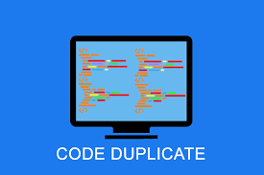

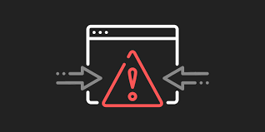

Problems Without Web APIs
1. Duplicate logic for each Application
The business should have some business logic. We will write the same logic for each application type, which means repeating the same logic for each type of application. This will duplicate our code.
3. Some Front-end frameworks cannot communicate directly with the Database
If you are developing the website (i.e., front-end) using the angular framework, then the angular framework cannot communicate with the database directly. Angular is a front-end framework.
2. Error-Prone Code
The business logic has been written in each type of application. We have to write the code in three different applications in our example. So, you might miss some code or logic in some applications. This will add more errors to your application.
4. Hard to Maintain
This type of structure is hard to maintain. This is because we have written the code in many places, and if we want to improve something in our application, we need to do the same thing in many places.

Slide 8
Need of API
We aim to establish communication between all these three applications and the database.
So, what will we do? We will create a new Web API Project.
This Web API Project will interact with the database & all three applications will only interact with the Web API Project, as shown in the image.
Web API
Database

Slide 9
Need of API Cont..
So, these websites, Android and iOS applications, do not have direct access to the database.
They only need to communicate with the Web API Project, and it is the Web API project’s responsibility to interact with the database.
The entire business logic will be written in the Web API project only.
So, Web API acts as a mediator between the Front-End and Back-End.
Web API
Database

Slide 10
Advantages Web APIs
Section - 3

Slide 11
Advantages Web APIs
Using Web API, we can avoid code duplication
We can write the logic in one place, i.e., in our Web API project, and all applications will use that logic.
Extend Application Functionality
Suppose, first, we develop one website.
Then, we can extend and develop an Android App.
Again, in the future, if you want to add another type of application, we don’t have to write any logic.
Abstraction
We have added an extra abstraction layer as we have written all the business logic in our Web API project.
The logic we wrote in the Web API project will not be visible to the front-end developers.
Security
None of the applications can access the database directly, and hence it provides security.

Slide 12
Introduction to Web APIs
Section - 4

Slide 13
Introduction to Web APIs
API stands for Application Programming Interface.
Web API is a concept (not a technology) that works on the HTTP Protocol, and it is used to extend the functionality of an application.
A Web API, or Web Application Programming Interface, is a set of rules and protocols that allows different software applications to communicate with each other over the internet or a network.
It enables the exchange of data and functionality between various systems, often using HTTP (Hypertext Transfer Protocol) as the communication protocol.
Web APIs are a fundamental building block of modern web applications and services and are commonly used to enable integration and interaction between different software components.

Slide 14
Key Characteristics of Web APIs
Section - 5

Slide 15
Key Characteristics of Web APIs
HTTP-based Communication:
Most Web APIs are designed to work over HTTP, the same protocol used for web browsing.
This means APIs can be accessed using standard HTTP methods like GET, POST, PUT, DELETE, etc.
The API endpoints are typically represented as URLs (Uniform Resource Locators).
Data Exchange Formats:
Web APIs use standardized data exchange formats such as JSON (JavaScript Object Notation) and XML (eXtensible Markup Language) to structure and transmit data between the client and server.
JSON has become the most popular format due to its simplicity and ease of use.
RESTful Architecture:
Many Web APIs are designed following Representational State Transfer (REST) principles.
A RESTful API is stateless, uses standard HTTP methods, and organizes resources into a hierarchy with unique URLs for each resource.
Authentication and Authorization:
Web APIs often implement security mechanisms for authentication and authorization to ensure that only authorized clients can access certain resources or perform specific actions.
Common authentication methods include API Keys, OAuth, and JWT (JSON Web Tokens).

Slide 16
Use of Web APIs
Section - 6

Slide 17
Use of Web APIs
Accessing and retrieving data from remote servers, such as fetching weather information or stock prices.
Integrating third-party services, like social media logins or payment gateways.
Exposing functionalities of a web application, allowing other applications to interact with it programmatically.
Building mobile apps that need to communicate with a server for data synchronization.

Slide 18
HTTP (HyperText Transport Protocol)
Section - 7

Slide 19
HTTP (HyperText Transport Protocol)
How Browser and Server Communicate with Each Other?
What is HTTP?
HTTP Request/Response Components
HTTP Verbs or HTTP Methods
HTTP Status Codes

Slide 20
1. How Browser and Server Communicate with Each Other?
Suppose, we open the web browser, type the URL in the browser and press the enter button.
As soon as you press enter, a request is going to the server (called a web server).
Whatever data you are sending from the web browser to the web server is called a Request and whatever data you are receiving from the web server is called a Response & this type of communication is only possible by using HTTP Protocol.
So, the request can be termed an HTTP Request and the response can be called HTTP Response.
For example, if you are using a mobile application, then your mobile is a client.
If you are calling APIs using tools like Postman, then Postman are also the clients.
https://darshan.ac.in/
HTTP Request
Server
HTTP Response
Web Browser
Web Server

Slide 21
2. What is HTTP?
HTTP stands for HyperText Transfer Protocol.
It is an application-layer protocol used for communication on the World Wide Web.
It is also called as communication protocol.
It is used to send and receive web pages and files on the internet.
It serves as a foundation for exchanging information between a web server and a client, typically a web browser.
HTTP enables the retrieval of resources such as HTML documents, images, videos, and other media files, allowing users to access websites and navigate the internet.
It follows a request-response model, where a client sends an HTTP request to a server, and the server responds with an HTTP response containing the requested information.

Slide 22
3. HTTP Request Components
An HTTP request is made by the client to request a resource from the server, and the server responds with an HTTP response containing the requested resource or an error message.
When we send something from the client (browser, mobile, postman etc.) to the server (webserver) is called a Request.
The request is formed with a couple of components, are as follows.
Component | Description
URL | Each Request must have a unique URL
Verb (Method) | Each Request must have an HTTP Verb
Header(s) | Each Request can contain one or more Headers
Body | Each request can have a body. The body contains the data that we want to send to the server.
Web Browser, Mobile App, Postman
HTTP Request
Server
Clients
Web Server
URL, Verb, Header, Body

Slide 23
3. HTTP Response Components
Whatever we get from the webserver to the clients is called HTTP Response.
The HTTP response contains the following components.
Component | Description
HTTP Status Code | It must have a Status Code
Response Headers | It can have one or more response headers
Data | Response can have data i.e. return to the client
Web Browser, Mobile App, Postman
HTTP Response
Server
Clients
Web Server
Http Status Code, Response Header(s), Data

Slide 24
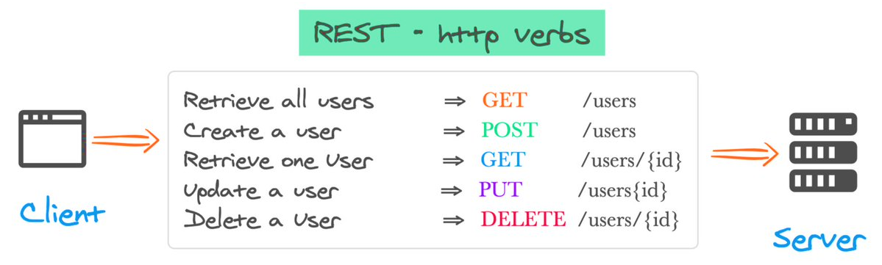
4. HTTP Verbs or HTTP Methods
HTTP verbs, also known as HTTP methods, are a set of standardized actions that can be performed on resources using the HTTP (Hypertext Transfer Protocol) protocol.
Each HTTP request typically includes a verb/method to indicate the desired action to be taken.
The primary or most-commonly-used HTTP verbs are POST, GET, PUT, and DELETE.

Slide 25
4. HTTP Verbs or HTTP Methods Cont..
Method | Description
GET | Used fetch or retrieve data from the server Requests using GET should only be used to request data (they shouldn’t include data) For example, you want to search for something like you want to get a list of employees, a list of products, you want to retrieve a book by id, etc. It is idempotent
POST | It is used to make a new entry in the database It is not only specific to a database, whenever you want to create a new resource in your application It often results in the creation of a new resource or a change in the state of an existing resource It is not idempotent
PUT | The PUT method is used to update all the properties of the current resource in the database If we want to update all properties of a particular product (i.e. current resource) then we need to use PUT HTTP Request So, whenever you want to update all the properties (column) of a resource (existing record in the database) It is idempotent

Slide 26
4. HTTP Verbs or HTTP Methods Cont..
Method | Description
PATCH | There are some situations where you don’t want to update all the properties of an existing resource instead you want to update a few of the properties, then you need to use the PATCH method So, the PATCH method is similar to the PUT method, but it is used to update a few properties of the current resource in the database. For example, if you want to update a few properties (columns) of an existing product then you need to use the PATCH method. That means if your Product table contains 10 columns, and you want to update only four columns of an existing product, then you need to use the PATCH method. So, it applies partial modifications to a resource. It is used to update only specific parts of a resource, rather than replacing the entire resource.
DELETE | The DELETE method is used to delete the resource from the database It removes a specified resource. In modern applications, we use two concepts for deletion. One is Soft Delete[PATCH] and the other one is Hard Delete.[DELETE]

Slide 27
5. HTTP Status Codes
The HTTP status code is also one of the important components of HTTP Response.
The Status code is issued from the server and they give information about the response.
Whenever we get any response from the server to the client, in that HTTP Response, we must have one HTTP Status code.
Status codes are three-digit numbers that are returned by servers to provide information about the outcome of a request made by a client.
These codes are grouped into different categories based on their first digit, which helps in understanding the general class of the response.
All the HTTP Status codes are divided into five categories.
They are as follows. Here, XX will represent the actual number. (1XX, 2XX, 3XX, 4XX, 5XX)

Slide 28
5. HTTP Status Codes Cont..
1XX: Informational Response (Example: 100, 101, 102, etc.)
Status codes in the 1xx range indicate that the server has received the client’s request and is continuing the process.
These codes are primarily used for informational purposes and do not typically require any action from the client.
2XX: Successful Response (Example. 200, 201, 203, 204, etc.)
Whenever you get 2XX as the response code, it means the request is successful.
Status codes in the 2xx range indicate that the client’s request was successfully received, understood, and accepted by the server.
These codes typically indicate that the requested action was successfully completed.
3XX: Redirection Response (Example. 301, 302, 304, etc.)
Whenever you get 3XX as the response code, it means it is re-directional i.e. some re-directional is happening on the server.
Status codes in the 3xx range indicate that further action is needed by the client to complete the request.
These codes are used when a resource has been moved or is temporarily unavailable, and the client needs to take additional steps to access the resource.

Slide 29
5. HTTP Status Codes Cont..
4XX: Client Error Response (Example: 400, 401, 404, 405, etc.)
Whenever you get 4XX as the response code, it means there is some problem with your request.
Status codes in the 4xx range indicate that the client’s request was not successful due to an error on the client’s side.
These codes are often associated with issues such as invalid requests, unauthorized access, or missing resources.
5XX: Server Error Response (Example: 500, 502, 503, 504, etc.)
Whenever you get 5XX as the response code, it means there is some problem in the server.
Status codes in the 5xx range indicate that the server encountered an error while processing the client’s request.
These codes are typically associated with issues on the server side, indicating that the requested action could not be completed due to server-related problems.

Slide 30
JSON (JavaScript Object Notation)
Section - 8

Slide 31
What is JSON?
JSON (JavaScript Object Notation) is a lightweight data-interchange format that is easy for humans to read and write and for machines to parse and generate.
Many different programming languages use JSON which is a great way to ensure that different systems can work together and understand each other’s data.
It uses human-readable text to store and transmit data objects consisting of attribute–value pairs and arrays (or other serializable values).
JSON is a language-independent data format.
JSON is “name/value” assembly. Its structure is made up with {}, [], comma, colon and double quotation marks.
Valid data types in JSON are Object, Number, Boolean, String, Array, Null.
JSON filenames use the extension .json.
It is commonly used for transmitting data between a server and a web application as an alternative to XML, and has many business applications.

Slide 32
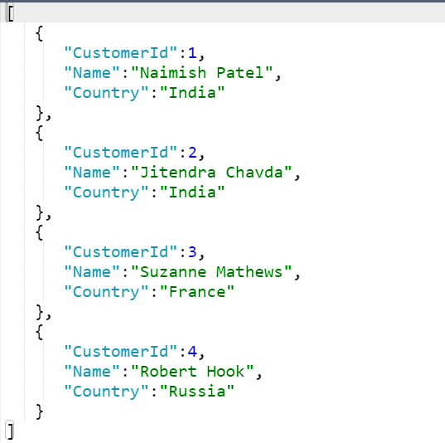
Example: JSON string returned from the API
Sample JSON
In .NET, we have two most common libraries to handle JSON:
Newtonsoft.Json
Third-party powerful library with many features, including support for complex object graphs, custom converters, and more.
System.Text.Json
High-performance JSON serialization and deserialization library introduced by Microsoft.
using System.Text.Json;
//To serialize
var jsonStr = JsonSerializer.Serialize(MyObject);
//To Deserialize
var weather = JsonSerializer.Deserialize<MyObject>(jsonStr);

Slide 33
Different styles of JSON
Object
An unordered “name/value” assembly.
An object begins with “{“ and ends with “}”.
Behind each “name”, there is a colon. And comma is used to separate much “name/value”.
Array
Value order sets, an array begins with “[“ and end with “]”.
Values are separated with commas.
String
Any quantity Unicode character assembly which is enclosed with quotation marks.
It uses a backslash to escape.

Slide 34
Difference between JSON serialize and JSON deserialize?
Serialization
Serialization means to convert an object into that string. (Object → String)
Serialization is the process of converting the state of an object, that is, the values of its properties, into a form that can be stored or transmitted.
The serialized form doesn't include any information about an object's associated methods.
So, serialization converts the object into a shareable format.
Deserialization
Deserialization is its inverse operation (String → Object).
Deserialization is the process of converting the serialized stream of data into the original object state.
This ensures that the original state is not altered and is recreated when we need it.

Slide 35
JSON Serialization Example
//Student.cs
namespace SerializeDemo
{
public class Student
{
public int StudentID { get; set;} public string Name { get; set; }
public string City { get; set; }
}
}
//Program.cs
using SerializeDemo;
using Newtonsoft.Json;
Student std = new Student()
{
StudentID = 101,
Name = "Naimish",
City = "Rajkot"
};
string jsonData = JsonConvert.SerializeObject(std);
Console.WriteLine(jsonData);
Output

Slide 36
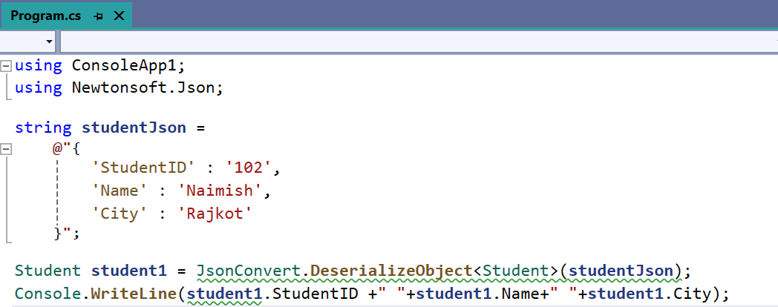
JSON Deserialization Example
Output

Slide 37
Creating a Web API Project in Visual Studio
Section - 9

Slide 38
Creating a Web API Project
Steps
Open Visual Studio 2019 or 2022
Select Template “ASP.NET Core Web API” → Press Next
Give Project Name & Choose the Location Where you want to store your project → Press Next
Select Framework (.NET 8.0 Long term support) & must select Enable OpenAPI Support → Press Next
Press Create.

Slide 39
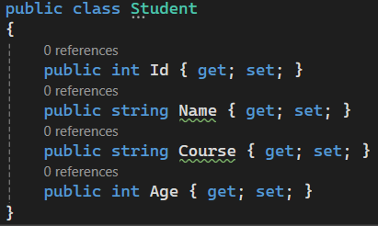
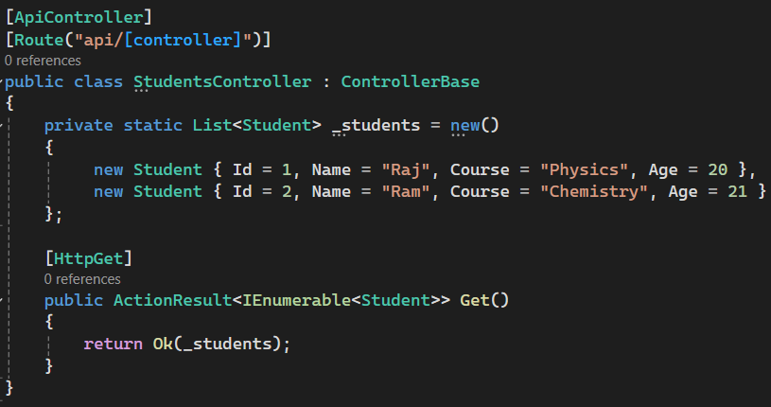
Building a Web API
Step 1: Create Model Class
Step 2: Add Controller with initial data and a basic get method

Slide 40
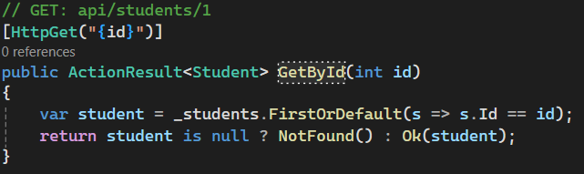
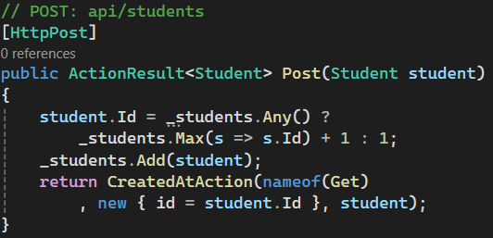
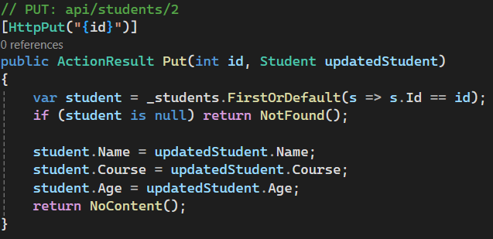
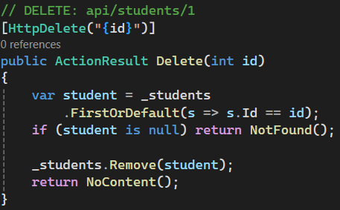
Building a Web API
Step 3: Add methods inside controller as required (GetById, Post, Update, Delete)

Slide 41
Consuming Web API
Section - 10

Slide 42
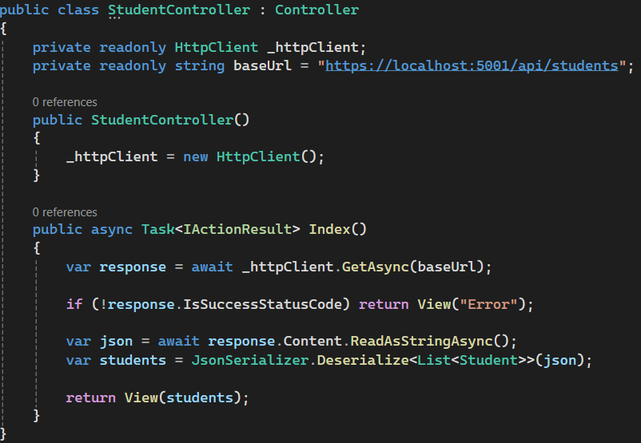
Consuming Web API
Step 1: Create Model Class
Step 2: Add Student Controller with Index method

Slide 43
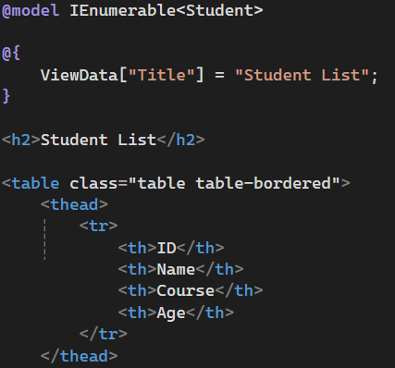
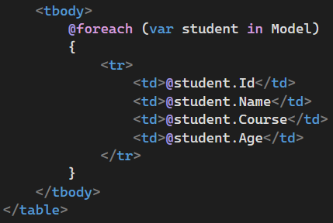
Consuming Web API
Step 3: View Page Design

Slide 44
Summary
Section - 10

Slide 45
Summary: Introduction to Web API
What is Web API?
A framework for building RESTful services over HTTP using .NET Core.
Understanding HTTP Protocol
Foundation of Web API communication.
Stateless, request-response based model.
HTTP Request Components
URL, Method, Headers, Body
HTTP Response Components
Status Code, Headers, Body (Data/Message)

Slide 46
Summary: HTTP Methods & Status Codes
Common HTTP Methods
GET – Retrieve data
POST – Create new resource
PUT – Update entire resource
PATCH – Update part of resource
DELETE – Remove resource
Common HTTP Status Codes
200 OK – Success, 201 Created – Resource added
400 Bad Request – Validation failure, 401 Unauthorized – Auth error, 404 Not Found – Resource missing
500 Internal Server Error – Server-side issue
JSON Serialization and Deserialization
Serialization is the process of converting an object into a JSON string.
Deserialization is the reverse—converting JSON data back into a .NET object.

Slide 47


Web Programming Using .NET
#2305CS311
Prof. Naimish R. Vadodariya
Computer Science & Engineering Department
Naimish.vadodariya@darshan.ac.in
8866215253

