Slide 1

Unit-5
Object-Oriented Programming
2305CS102
Prof. Swati R Sharma
Computer Engineering Department
swati.sharma@darshan.ac.in

Slide 2
Unit-5.0(Part-1) IO Programming
Object-Oriented Programming
2305CS102
Prof. Swati R Sharma
Computer Engineering Department
swati.sharma@darshan.ac.in

Slide 3
Unit-5.0

Looping
What we will learn
File Class
Byte Stream
Character Stream
Exploring classes/interfaces from the java.io package

Slide 4
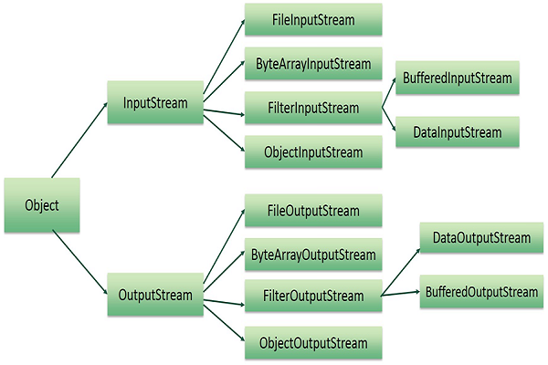

Slide 5
File class
Java File class represents the files and directory pathnames in an abstract manner. This class is used for creation of files and directories, file searching, file deletion etc.
The File object represents the actual file/directory on the disk. Below given is the list of constructors to create a File object.
Constructors :
Sr. | Constructor
1 | File(String pathname) Creates a new File instance by converting the given pathname string into an abstract pathname.
2 | File(String parent, String child) Creates a new File instance from a parent pathname string and a child pathname string.
3 | File(URI uri) Creates a new File instance by converting the given file: URI into an abstract pathname.

Slide 6
Methods of File Class
Sr. | Method
1 | public boolean isAbsolute() Tests whether this abstract pathname is absolute. Returns true if this abstract pathname is absolute, false otherwise
2 | public String getAbsolutePath() Returns the absolute pathname string of this abstract pathname.
3 | public boolean canRead() Tests whether the application can read the file denoted by this abstract pathname. Returns true if and only if the file specified by this abstract pathname exists and can be read by the application; false otherwise.
4 | public boolean canWrite() Tests whether the application can modify to the file denoted by this abstract pathname. Returns true if and only if the file system actually contains a file denoted by this abstract pathname and the application is allowed to write to the file; false otherwise.
5 | public boolean exists() Tests whether the file or directory denoted by this abstract pathname exists. Returns true if and only if the file or directory denoted by this abstract pathname exists; false otherwise

Slide 7
Methods of File Class (Cont.)
Sr. | Method
6 | public boolean isDirectory() Tests whether the file denoted by this abstract pathname is a directory. Returns true if and only if the file denoted by this abstract pathname exists and is a directory; false otherwise.
7 | public boolean isFile() Tests whether the file denoted by this abstract pathname is a normal file. A file is normal if it is not a directory and, in addition, satisfies other system-dependent criteria
8 | public long lastModified() Returns the time that the file denoted by this abstract pathname was last modified. Returns a long value representing the time the file was last modified, measured in milliseconds since the epoch (00:00:00 GMT, January 1, 1970).
9 | public long length() Returns the length of the file denoted by this abstract pathname.
10 | public boolean delete() Deletes the file or directory.
11 | public String[] list() Returns an array of strings naming the files and directories in the directory denoted by this abstract pathname.

Slide 8
File Class Example
import java.io.File;
class FileDemo {
public static void main(String args[]) {
File f1 = new File("FileDemo.java");
f1.createNewFile();
System.out.println("File Name: " + f1.getName());
System.out.println("Path: " + f1.getPath());
System.out.println("Abs Path: " + f1.getAbsolutePath());
System.out.println("Parent: " + f1.getParent());
System.out.println(f1.exists() ? "exists" : "does not exist");
System.out.println(f1.canWrite() ? "is writeable" : "is not writeable");
System.out.println (f1.canRead () ? "is readable" : "is not readable");
System.out.println ("is " + (f1.isDirectory() ? "" : "not" + " a directory"));
System.out.println(f1.isFile() ? "is normal file" : "might be a named pipe");
System.out.println(f1.isAbsolute() ? "is absolute" : "is not absolute");
System.out.println("File last modified: " + f1.lastModified());
System.out.println("File size: " + f1.length() + " Bytes");
}}

Slide 9
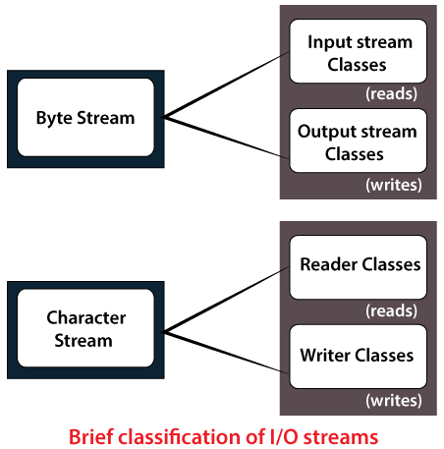
Stream
A stream can be defined as a sequence of data.
All streams represent an input source and an output destination.
There are two kinds of Streams
Byte Stream
Character Stream
The java.io package contains all the classes required for input-output operations.
The stream in the java.io package supports all the datatype including primitive.

Slide 10
Byte Streams
Byte streams provide a convenient means for handling input and output of bytes.
Byte streams are used, for example, when reading or writing binary data.

Slide 11
FileOutputStream
Java FileOutputStream is an output stream for writing data to a file.
FileOutputStream will create the file before opening it for output.
On opening a read only file, it will throw an exception.
Java Application
1011011101 ….
File
Sr. | Method
1 | void write(byte[] b) This method writes b.length bytes from the specified byte array to this file output stream.
2 | void write(byte[] b, int off, int len) This method writes len bytes from the specified byte array starting at offset off to this file output stream.
3 | void write(int b) This method writes the specified byte to this file output stream.
4 | void close() This method closes this file output stream and releases any system resources associated with this stream.

Slide 12
FileOutputStream Example
class FileOutDemo {
public static void main(String args[]) {
try {
FileOutputStream fout = new FileOutputStream("abc.txt");
String s = “Virat Kohli is my favorite player";
byte b[] = s.getBytes();
fout.write(b);
fout.close();
System.out.println("Success...");
} catch (Exception e) {
System.out.println(e);
}
}
}

Slide 13
FileInputStream
FileInputStream class is used to read bytes from a file.
It should be used to read byte-oriented data for example to read image, audio, video etc.
Sr. | Method
1 | public int read() the next byte of data, or -1 if the end of the file is reached.
2 | public int read(byte[] b) b - the buffer into which the data is read. Returns: the total number of bytes read into the buffer, or -1.
3 | public int read(byte[] b, int off, int len) b - the buffer into which the data is read. off - the start offset in the destination array b len - the maximum number of bytes read. Returns: the total number of bytes read into the buffer, or -1
Java Application
4 | public long skip(long n) n - the number of bytes to be skipped. Returns: the actual number of bytes skipped.
1011011101 ….
5 | public int available() an estimate of the number of remaining bytes that can be read
File
6 | public void close() Closes this file input stream and releases any system resources associated.

Slide 14
FileInputStream Example
class SimpleRead {
public static void main(String args[]) {
try {
FileInputStream fin = new FileInputStream("abc.txt");
int i = 0;
while ((i = fin.read()) != -1) {
System.out.println((char) i);
}
fin.close();
} catch (Exception e) {
System.out.println(e);
}
}
}

Slide 15
Example of Byte Streams
import java.io.*;
public class CopyFile {
public static void main(String args[]) throws IOException {
FileInputStream in = null;
FileOutputStream out = null;
try {
in = new FileInputStream("input.txt");
out = new FileOutputStream("output.txt");
int c;
while ((c = in.read()) != -1) {
out.write(c);
}
} finally {
if (in != null) {
in.close();
}
if (out != null) {
out.close();
}
}
} }

Slide 16
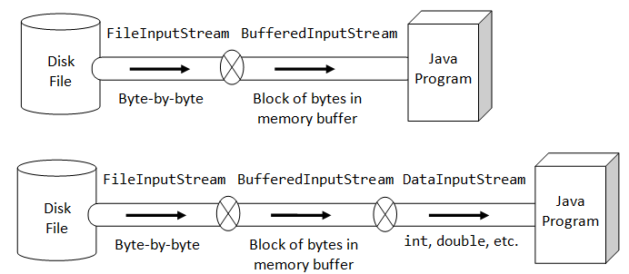
I/O Stream

Slide 17
Character Streams
Character Streams provide a convenient means for handling input and output of characters.
Internationalization is possible as it uses Unicode.
For character streams we have two base classes
Writer
Reader

Slide 18
Writer
The Java Writer class is the base class of all Writers in the I-O API.
Subclasses include BufferedWriter, PrintWriter, StringWriter and several others.
Here is a simple Java IO Writer example:
Combining Writers With OutputStreams
Writer writer = new FileWriter("c:\\data\\file-output.txt");
writer.write("Hello World Writer");
writer.close();
Writer writer = new OutputStreamWriter("c:\\data\\file-output.txt");

Slide 19
Reader
The Java Reader class is the abstract class of all Reader's in the IO API.
Subclasses include a FileReader, BufferedReader, InputStreamReader, StringReader and several others.
Here is a simple Java IO Reader example:
Combining Readers with InputStream
Reader reader = new FileReader("c:\\data\\myfile.txt");
int i = 0;
while ((i=reader.read())!=-1) {
System.out.print((char)i);
}
Reader reader = new InputStreamReader("c:\\data\\myfile.txt");

Slide 20
BufferedReader
The java.io.BufferedReader class reads text from a character-input stream, buffering characters so as to provide for the efficient reading of characters, arrays, and lines.
Following are the important points about BufferedReader:
The buffer size may be specified, or the default size may be used.
Each read request made of a Reader causes a corresponding read request to be made of the underlying character or byte stream.
Constructors :
Sr. | Constructor
1 | BufferedReader(Reader in) This creates a buffering character-input stream that uses a default-sized input buffer.
2 | BufferedReader(Reader in, int sz) This creates a buffering character-input stream that uses an input buffer of the specified size.

Slide 21
BufferedReader (Methods)
Sr. | Methods
1 | void close() This method closes the stream and releases any system resources associated with it.
2 | int read() This method reads a single character.
3 | int read(char[] cbuf, int off, int len) This method reads characters into a portion of an array.
4 | String readLine() This method reads a line of text.
5 | void reset() This method resets the stream.
6 | long skip(long n) This method skips characters.

Slide 22
BufferedReader – Example
import java.io.BufferedReader;
import java.io.FileReader;
import java.io.IOException;
class BufferedReaderDemo {
public static void main(String[] args) throws IOException {
FileReader fr = new FileReader("input.txt");
BufferedReader br = new BufferedReader(fr);
char c[] = new char[20];
br.skip(8);
if (br.ready()) {
System.out.println(br.readLine());
br.read(c);
for (int i = 0; i < 20; i++) {
System.out.print(c[i]);
}
}
}
}

Slide 23
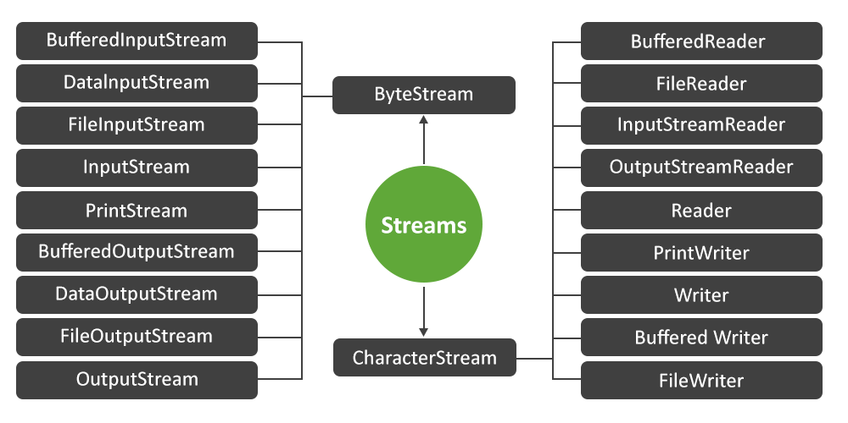

Slide 24
Unit-5.1(Part-2) Collection Framework
Object-Oriented Programming
2305CS102
Prof. Swati R Sharma
Computer Engineering Department
swati.sharma@darshan.ac.in

Slide 25

Outline
Collection
List Interface
Iterator
Comparator
Vector Class
Stack
Queue
List v/s Sets
Map Interfaces
Looping

Slide 26
Collection
The Collection in Java is a framework that provides an architecture to store and manipulate the group of objects.
Java Collections can achieve all the operations that you perform on a data such as searching, sorting, insertion, manipulation, and deletion.
Java Collection means a single unit of objects. Java Collection framework provides many interfaces (Set, List, Queue, Deque) and classes (ArrayList, Vector, LinkedList, PriorityQueue, HashSet, LinkedHashSet, TreeSet).

Slide 27
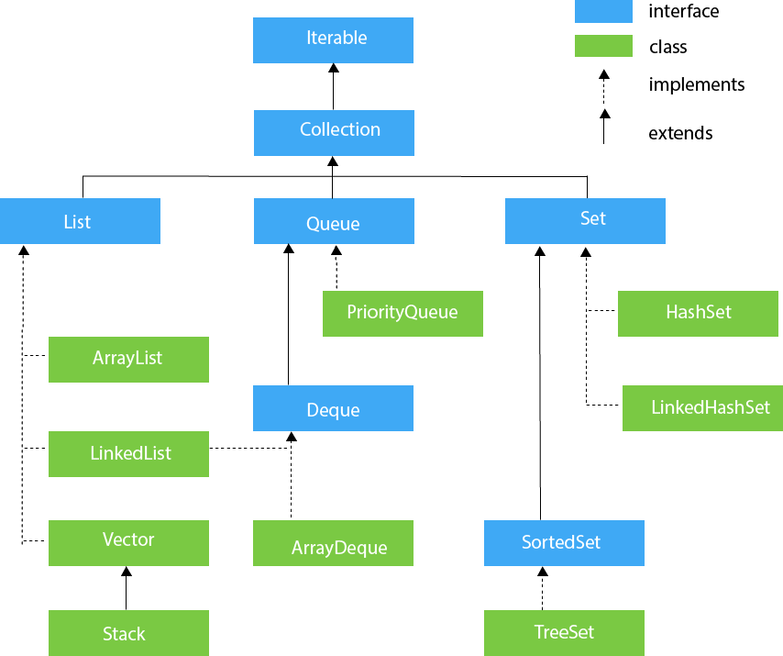
Hierarchy of Collection Framework

Slide 28
Collection Interface - Methods
Sr. | Method & Description
1 | boolean add(E e) It is used to insert an element in this collection.
2 | boolean addAll (Collection<? extends E> c) It is used to insert the specified collection elements in the invoking collection.
3 | void clear() It removes the total number of elements from the collection.
4 | booelan contains (Object element) It is used to search an element.
5 | boolean containsAll (Collection<?> c) It is used to search the specified collection in the collection.
6 | boolean equals (Object obj) Returns true if invoking collection and obj are equal. Otherwise returns false.
7 | int hashCode() Returns the hashcode for the invoking collection.

Slide 29
Collection Interface – Methods (Cont.)
Sr. | Method & Description
8 | boolean isEmpty() Returns true if the invoking collection is empty. Otherwise returns false.
9 | Iterator iterator() It returns an iterator.
10 | boolean remove (Object obj) Removes one instance of obj from the invoking collection. Returns true if the element was removed. Otherwise, returns false.
11 | boolean removeAll (Collection<?> c) It is used to delete all the elements of the specified collection from the invoking collection.
12 | boolean retainAll (Collection<?> c) It is used to delete all the elements of invoking collection except the specified collection.
13 | int size() It returns the total number of elements in the collection.

Slide 30
List Interface
The List interface extends Collection and declares the behavior of a collection that stores a sequence of elements.
Elements can be inserted or accessed by their position in the list, using a zero-based index.
A list may contain duplicate elements.
List is a generic interface with following declaration
interface List<E>
where E specifies the type of object.

Slide 31
List Interface - Methods
Sr. | Method & Description
1 | void add(int index, Object obj) Inserts obj into the invoking list at the index passed in index. Any pre-existing elements at or beyond the point of insertion are shifted up. Thus, no elements are overwritten.
2 | boolean addAll(int index, Collection c) Inserts all elements of c into the invoking list at the index passed in index. Any pre-existing elements at or beyond the point of insertion are shifted up. Thus, no elements are overwritten. Returns true if the invoking list changes and returns false otherwise.
3 | Object get(int index) Returns the object stored at the specified index within the invoking collection.
4 | int indexOf(Object obj) Returns the index of the first instance of obj in the invoking list. If obj is not an element of the list, -1 is returned.
5 | int lastIndexOf(Object obj) Returns the index of the last instance of obj in the invoking list. If obj is not an element of the list, -1 is returned.

Slide 32
List Interface – Methods (Cont.)
Sr. | Method & Description
6 | ListIterator listIterator( ) Returns an iterator to the start of the invoking list.
7 | ListIterator listIterator(int index) Returns an iterator to the invoking list that begins at the specified index.
8 | Object remove(int index) Removes the element at position index from the invoking list and returns the deleted element. The resulting list is compacted. That is, the indexes of subsequent elements are decremented by one
9 | Object set(int index, Object obj) Assigns obj to the location specified by index within the invoking list.
10 | List subList(int start, int end) Returns a list that includes elements from start to end-1 in the invoking list. Elements in the returned list are also referenced by the invoking object.

Slide 33
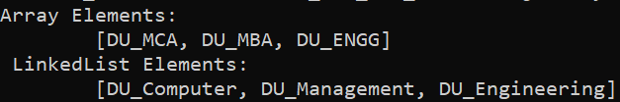
List Interface (example)
import java.util.*;
public class CollectionsDemo {
public static void main(String[] args) {
List<String> a1 = new ArrayList<String>();
a1.add("DU_MCA");
a1.add("DU_MBA");
a1.add("DU_ENGG");
System.out.println("ArrayList Elements");
System.out.print("\t" + a1);
List<String> l1 = new LinkedList<String>();
l1.add("DU_Computer");
l1.add("DU_Management");
l1.add("DU_Engineering");
System.out.println();
System.out.println("LinkedList Elements");
System.out.print("\t" + l1);
}
}
Here ArrayList & LinkedList implements List Interface

Slide 34
Iterator
Iterator interface is used to cycle through elements in a collection, eg. displaying elements.
ListIterator extends Iterator to allow bidirectional traversal of a list, and the modification of elements.
Each of the collection classes provides an iterator( ) method that returns an iterator to the start of the collection. By using this iterator object, you can access each element in the collection, one element at a time.
To use an iterator to cycle through the contents of a collection, follow these steps:
Obtain an iterator to the start of the collection by calling the collection's iterator( ) method.
Set up a loop that makes a call to hasNext( ). Have the loop iterate as long as hasNext( ) returns true.
Within the loop, obtain each element by calling next( ).

Slide 35
Iterator - Methods
Sr. | Method & Description
1 | boolean hasNext() Returns true if there are more elements. Otherwise, returns false.
2 | E next() Returns the next element. Throws NoSuchElementException if there is not a next element.
3 | void remove() Removes the current element. Throws IllegalStateException if an attempt is made to call remove() that is not preceded by a call to next()

Slide 36
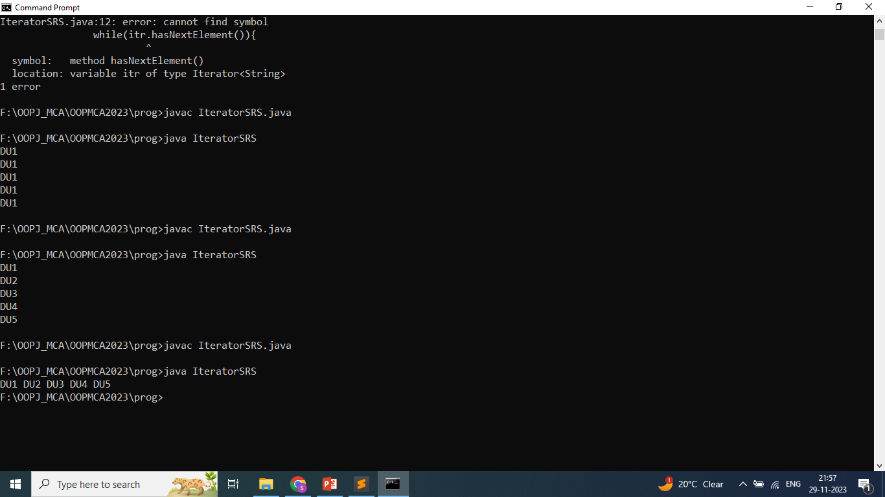
Iterator - Example
import java.util.*;
public class IteratorDemo {
public static void main(String args[]) {
ArrayList<String> al = new ArrayList<String>();
al.add("DU1");
al.add("DU2");
al.add("DU3");
al.add("DU4");
al.add("DU5");
System.out.print("Contents of list: ");
Iterator<String> itr = al.iterator();
while(itr.hasNext()) {
Object element = itr.next();
System.out.print(element + " ");
}
}
}

Slide 37
Comparator
Comparator interface is used to set the sort order of the object to store in the sets and lists.
The Comparator interface defines two methods: compare( ) and equals( ).
int compare(Object obj1, Object obj2)
obj1 and obj2 are the objects to be compared. This method returns zero if the objects are equal. It returns a positive value if obj1 is greater than obj2. Otherwise, a negative value is returned.
boolean equals(Object obj)
obj is the object to be tested for equality. The method returns true if obj and the invoking object are both Comparator objects and use the same ordering. Otherwise, it returns false.

Slide 38
Comparator Example
class AgeComparator implements Comparator<Object>{
public int compare(Object o1,Object o2){
Student s1=(Student)o1;
Student s2=(Student)o2;
if(s1.age==s2.age) return 0;
else if(s1.age>s2.age) return 1;
else return -1;
}
}
public class ComparatorDemo {
public static void main(String args[]){
ArrayList<Student> al=new ArrayList<Student>();
al.add(new Student("Vijay",23));
al.add(new Student("Ajay",27));
al.add(new Student("Jai",21));
System.out.println("Sorting by age");
Collections.sort(al,new AgeComparator());
Iterator<Student> itr2=al.iterator();
while(itr2.hasNext()){
Student st=(Student)itr2.next();
System.out.println(st.name+" "+st.age);
}
}
}
import java.util.*;
class Student {
String name;
int age;
Student(String name, int age){
this.name = name;
this.age = age;
}
}

Slide 39
Vector Class
Vector implements a dynamic array.
It is similar to ArrayList, but with two differences:
Vector is synchronized.
Vector contains many legacy methods that are not part of the collection framework
Vector proves to be very useful if you don't know the size of the array in advance or you just need one that can change sizes over the lifetime of a program.
Vector is declared as follows:
Vector<E> = new Vector<E>;

Slide 40
Vector - Constructors
Sr. | Constructor & Description
1 | Vector( ) This constructor creates a default vector, which has an initial size of 10
2 | Vector(int size) This constructor accepts an argument that equals to the required size, and creates a vector whose initial capacity is specified by size:
3 | Vector(int size, int incr) This constructor creates a vector whose initial capacity is specified by size and whose increment is specified by incr. The increment specifies the number of elements to allocate each time that a vector is resized upward
4 | Vector(Collection c) creates a vector that contains the elements of collection c

Slide 41
Vector - Methods
Sr. | Method & Description
7 | boolean containsAll(Collection c) Returns true if this Vector contains all of the elements in the specified Collection.
8 | Enumeration elements() Returns an enumeration of the components of this vector.
9 | Object firstElement() Returns the first component (the item at index 0) of this vector.
10 | Object get(int index) Returns the element at the specified position in this Vector.
11 | int indexOf(Object elem) Searches for the first occurence of the given argument, testing for equality using the equals method.
12 | boolean isEmpty() Tests if this vector has no components.

Slide 42
Vector – Method (Cont.)
Sr. | Method & Description
13 | Object lastElement() Returns the last component of the vector.
14 | int lastIndexOf(Object elem) Returns the index of the last occurrence of the specified object in this vector.
15 | Object remove(int index) Removes the element at the specified position in this Vector.
16 | boolean removeAll(Collection c) Removes from this Vector all of its elements that are contained in the specified Collection.
17 | Object set(int index, Object element) Replaces the element at the specified position in this Vector with the specified element.
18 | int size() Returns the number of components in this vector.

Slide 43
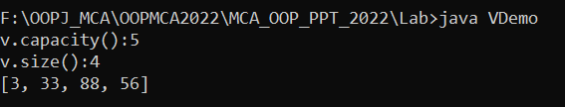
Vector: Example
import java.util.*;
class VectorDemo{
public static void main(String[] args) {
Vector<Integer> v=new Vector<Integer>(3,2);
v.add(3);
v.add(33);
v.add(88);
v.add(56);
System.out.println("v.capacity():"+v.capacity());
System.out.println("v.size():"+v.size());
System.out.println(v);
}
}

Slide 44
Stack
Stack is a subclass of Vector that implements a standard last-in, first-out stack.
Stack only defines the default constructor, which creates an empty stack.
Stack includes all the methods defined by Vector and adds several of its own.
Stack is declared as follows:
Stack<E> st = new Stack<>();
where E specifies the type of object.

Slide 45
Stack - Methods
Stack includes all the methods defined by Vector and adds several methods of its own.
Sr. | Method & Description
1 | boolean empty() Returns true if the stack is empty, and returns false if the stack contains elements.
2 | E peek() Returns the element on the top of the stack, but does not remove it.
3 | E pop() Returns the element on the top of the stack, removing it in the process.
4 | E push(E element) Pushes element onto the stack. Element is also returned.
5 | int search(Object element) Searches for element in the stack. If found, its offset from the top of the stack is returned. Otherwise, -1 is returned.

Slide 46
Queue
Queue interface extends Collection and declares the behaviour of a queue, which is often a first-in, first-out list.
LinkedList and PriorityQueue are the two classes which implements Queue interface
Queue is declared as follows:
Queue<E> q = new LinkedList<E>();
Queue<E> q = new PriorityQueue<E>();
where E specifies the type of object.

Slide 47
Queue - Methods
Sr. | Method & Description
1 | E element() Returns the element at the head of the queue. The element is not removed. It throws NoSuchElementException if the queue is empty.
2 | boolean offer(E obj) Attempts to add obj to the queue. Returns true if obj was added and false otherwise.
3 | E peek() Returns the element at the head of the queue. It returns null if the queue is empty. The element is not removed.
4 | E poll() Returns the element at the head of the queue, removing the element in the process. It returns null if the queue is empty.
5 | E remove() Returns the element at the head of the queue, returning the element in the process. It throws NoSuchElementException if the queue is empty.

Slide 48
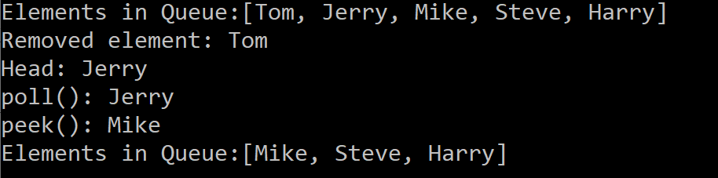
Queue Example
import java.util.*;
public class QueueDemo {
public static void main(String[] args) {
Queue<String> q = new LinkedList<String>();
q.add("Tom");
q.add("Jerry");
q.add("Mike");
q.add("Steve");
q.add("Harry");
System.out.println("Elements in Queue:"+q);
System.out.println("Removed element: "+q.remove());
System.out.println("Head: "+q.element());
System.out.println("poll(): "+q.poll());
System.out.println("peek(): "+q.peek());
System.out.println("Elements in Queue:"+q);
}
}

Slide 49
PriorityQueue
PriorityQueue extends AbstractQueue and implements the Queue interface.
It creates a queue that is prioritized based on the queue's comparator.
PriorityQueue is declared as follows:
PriorityQueue<E> = new PriorityQueue<E>;
It builds an empty queue with starting capacity as 11.

Slide 50
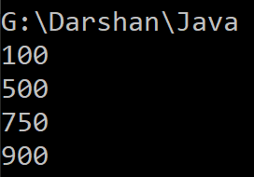
PriorityQueue - Example
import java.util.*;
public class PriorityQueueExample {
public static void main(String[] args) {
PriorityQueue<Integer> numbers = new PriorityQueue<>();
numbers.add(750);
numbers.add(500);
numbers.add(900);
numbers.add(100);
while (!numbers.isEmpty()) {
System.out.println(numbers.remove());
}
}
}

Slide 51
List v/s Sets
List | Set
Lists allow duplicates. | Sets allow only unique elements.
List is an ordered collection. | Sets is an unordered collection.
Popular implementation of List interface includes ArrayList, Vector and LinkedList. | Popular implementation of Set interface includes HashSet, TreeSet and LinkedHashSet.
When to use List and Set?
Lists - If insertion order is maintained during insertion and allows duplicates.
Sets – If unique collection without any duplicates without maintaining order.

Slide 52
Maps
A map is an object that stores associations between keys and values, or key/value pairs.
Given a key, you can find its value. Both keys and values are objects.
The keys must be unique, but the values may be duplicated. Some maps can accept a null key and null values, others cannot.
Maps don't implement the Iterable interface. This means that you cannot cycle through a map using a for-each style for loop. Furthermore, you can’t obtain an iterator to a map.

Slide 53
Map Interfaces
Interface | Description
Map | Maps unique keys to values.
Map.Entry | Describes an element (a key/value pair) in a map. This is an inner class of Map.
NavigableMap | Extends SortedMap to handle the retrieval of entries based on closest-match searches.
SortedMap | Extends Map so that the keys are maintained in ascending order.

Slide 54
Map Classes
Class | Description
AbstractMap | Implements most of the Map interface.
EnumMap | Extends AbstractMap for use with enum keys.
HashMap | Extends AbstractMap to use a hash table.
TreeMap | Extends AbstractMap to use a tree.
WeakHashMap | Extends AbstractMap to use a hash table with weak keys.
LinkedHashMap | Extends HashMap to allow insertion-order iterators.
IdentityHashMap | Extends AbstractMap and uses reference equality when comparing documents.

Slide 55
HashMap Class
The HashMap class extends AbstractMap and implements the Map interface.
It uses a hash table to store the map. This allows the execution time of get() and put() to remain constant even for large sets.
HashMap is a generic class that has declaration:
class HashMap<K,V>
import java.util.*;
class HashDemo{
public static void main(String[] args) {
HashMap<Integer,String> h=new HashMap<Integer,String>();
h.put(1,"aa");
h.put(2,"bb");
System.out.println(h);
}
}

Slide 56
HashMap - Constructors
Sr. | Constructor & Description
1 | HashMap() Constructs an empty HashMap with the default initial capacity (16) and the default load factor (0.75).
2 | HashMap(int initialCapacity) Constructs an empty HashMap with the specified initial capacity and the default load factor (0.75).
3 | HashMap(int initialCapacity, float loadFactor) Constructs an empty HashMap with the specified initial capacity and load factor.
4 | HashMap(Map<? extends K,? extends V> m) Constructs a new HashMap with the same mappings as the specified Map.

Slide 57
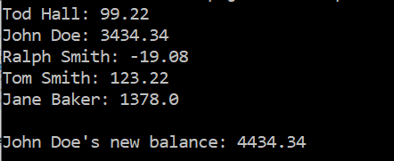
import java.util.*;
class HashMapDemo {
public static void main(String args[]) {
// Create a hash map.
HashMap<String, Double> hm = new HashMap<String, Double>();
// Put elements to the map
hm.put("John Doe", new Double(3434.34));
hm.put("Tom Smith", new Double(123.22));
hm.put("Jane Baker", new Double(1378.00));
hm.put("Tod Hall", new Double(99.22));
hm.put("Ralph Smith", new Double(-19.08));
// Get a set of the entries.
Set<Map.Entry<String, Double>> set = hm.entrySet();
// Display the set.
for(Map.Entry<String, Double> me : set) {
System.out.print(me.getKey() + ": ");
System.out.println(me.getValue());
}
System.out.println();
//Deposit 1000 into John Doe's account.
double balance = hm.get("John Doe");
hm.put("John Doe", balance + 1000);
System.out.println("John Doe's new balance: " +
hm.get("John Doe"));
}
}

Slide 58
Thank You

