Slide 1
Final Accounts and Types of Expenditure in Accounting
Presented By :
Ajay Sankaliya , Hitesh Chau,
Nikhil Rathod , Vivek Raja ,
Sumra Karan

Slide 2
Objectives
To understand final accounts as per company laws.To learn about different types of
expenditures in accounting with examples.

Slide 3
Profit & Loss Account (P&L)
What is the P&L Account?
A statement showing income and expenses of a company during a specific period.
Helps understand the company’s profitability.
Key Components
Income:
Sales Revenue
Other Income (e.g., interest earned)
Expenses:
Cost of Goods Sold (COGS)
Administrative Expenses (e.g., salaries, rent)
Financial Costs (e.g., loan interest)
Taxes

Slide 4
Profit:
Profit Before Tax (PBT) = Income - Expenses
Profit After Tax (PAT) = PBT – Taxes
Why Important?
Shows if the business is making a profit or loss.
Helps investors and management in decision-making.

Slide 5
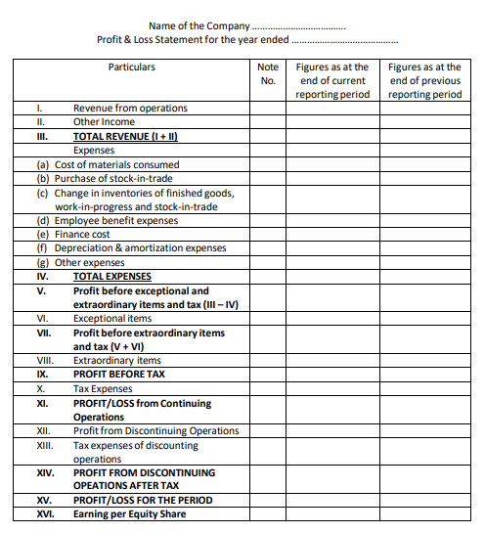

Slide 6
Final Accounts (As per Companies Act, 2013)
What Are Final Accounts?
A complete set of financial reports prepared at the end of a financial year.
Includes
Balance Sheet:
Shows what the company owns (assets) and owes (liabilities).
Profit & Loss Account:
Shows income and expenses for the year.
Cash Flow Statement:
Tracks money coming in and going out.
Notes to Accounts:
Provides additional details about the accounts.

Slide 7
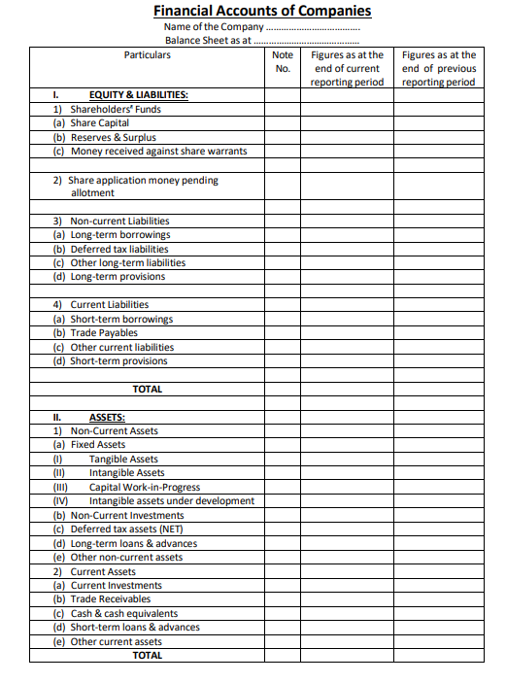

Slide 8
Types of Expenditure
What is Expenditure?
Money spent by a business to run and grow.
Types:
Capital Expenditure
Revenue Expenditure
Deferred Revenue Expenditure

Slide 9
Capital Expenditure (For Long-Term Use)
Definition: Money spent to buy or improve assets.
Impact:
Shown in the Balance Sheet as an asset.
Depreciated over time
(e.g., machinery loses value gradually).
Purpose:
To increase the capacity or efficiency of the business or add to its value.

Slide 10
Capital Expenditure
Shown In:
Balance Sheet.
Examples:
Buying land, machinery, or a new office.

Slide 11
Revenue Expenditure (For Daily Use)
Definition:
Money spent for day-to-day activities.
Impact:
Shown in the Profit & Loss Account as an expense.
Directly reduces the company’s profit for the period.
Purpose:
To maintain the business without creating new assets.

Slide 12
Revenue Expenditure (For Daily Use)
Examples:
Paying salaries, rent, or utility bills.
Shown In:
Profit & Loss Account.

Slide 13
Deferred Revenue Expenditure (For Future Use)
Definition:
Big expenses that benefit the company over many years.
Purpose:
To spread out the cost of significant expenses across the periods that benefit from it.
Impact:
Part of the expense is shown in the Profit & Loss Account each year.
The remaining balance is shown in the Balance Sheet as an asset until it is fully used.

Slide 14
Deferred Revenue Expenditure (For Future Use)
Examples:
Advertising campaigns or product launches.
Shown In:
Partly in the Profit & Loss Account and partly as an asset.

Slide 15
Simple Comparison
Type | Purpose | Examples | Shown In
Capital Expenditure | Long-term investments | Buying machines | Balance Sheet
Revenue Expenditure | Day-to-day operations | Paying salaries | Profit & Loss Account
Deferred Expenditure | Long-term benefits | Advertising campaigns | Both

Slide 16
Conclusion
Final accounts show a company’s financial health.
Understanding expenditure types helps to manage money wisely.

