Slide 1

Unit-1 Introduction to Data Structure
Data Structures (DS)
DU# 2305CS201
Prof. Nidhi K Chitroda
Computer Engineering Department
Nidhi.chitroda@darshan.ac.in

Slide 2
Teaching & Examination Scheme
Teaching Scheme |  |  | Credits | Examination Marks |  |  |  | Total Marks
L | T | P | C | Theory Marks |  | Practical Marks
 |  |  |  | SEE (E) | CIA (T) | SEE (P) | CIA (I)
4 | - | 4 | 6 | 40 | 30 | 20 | 10 | 100

Slide 3
Syllabus
SR No. | Topics
1 | Introduction to Data Structure Data Management concepts, Data Types (Primitive & Non-primitive), Performance Analysis and Measurement (Time and Space Analysis of Algorithms - Average, Best- and Worst-Case Analysis), Types of Data Structures (Linear & Non-Linear Data Structures) Array: Representation of Array, Sparse Matrix and its Representation, Pointer Overview, Applications of Array
2 | Linear Data Structures: Stack and Queue Stack: Definitions & Concepts, Operations on Stack, Applications of Stack: Polish Expression and their Compilation, Conversion of Infix Expression to Polish Notations, Evaluation of Polish Expressions, Recursion Queue: Representation of Queue, Operations on Queue, Circular Queue, Priority Queue, Double Ended Queue, Applications of Queue

Slide 4
Syllabus
SR No. | Topics
3 | Linear Data Structure: Linked List Singly Linked List: Representation of Singly Linked List, Operations on Singly Linked List, Insert a node at the beginning of the list, Insert a node at the end of the list, Insert a node at the specific location, Insert a node such that it preserves the ordering of data in the increasing order, Delete the first node, Delete the last node, Delete the specified node, Search the particular element, Sort the list, Traverse the list Doubly Linked List: Representation of Doubly Linked List, Operations of Doubly Linked List, Insert a node at the beginning of the list, Insert a node at the end of the list, Insert a node at the specific location, Insert a node such that it preserves the ordering of data in the increasing order, Delete the first node, Delete the last node, Delete the specified node, Search the particular element Circular Linked List: Representation of Circular Linked List, Insertion and Deletion of the node in the list Implementation of Stack using Linked list, Implementation of Queue using Linked list, Applications of Linked List

Slide 5
Syllabus
SR No. | Topics
4 | Nonlinear Data Structures: Tree and Graph Tree: Definitions and Concepts, Representation of Binary Tree, Binary Tree Traversal (In order, Post order & Preorder Traversal), Threaded Binary Tree, Binary Search Tree (BST), Conversion of General Tree to Binary Tree, Balanced Trees - Height Balanced Tree (AVL Tree, 2-3 Tree), Weight Balance Tree, Multiway Search Tree (B-Tree), Applications of Tree Graph: Matrix Representation of Graph, Graph Traversals - Breadth First Search (BFS) & Depth First Search (DFS), Spanning Trees, Minimum Spanning Tree - Prim’s Algorithm, Kruskal’s Algorithm, Finding the Shortest Path - Dijkstra’s Algorithm
5 | Hashing, Sorting and Searching Hashing: The Hash Table, Hashing Functions, Collision-Resolution Techniques Searching: Sequential Search, Binary Search Sorting: Bubble sort, Insertion sort, Selection sort, Quick sort, Merge sort, Heap sort

Slide 6

Looping
Outline
Data Management concepts
Data types
Primitive
Non-primitive
Types of Data Structures
Linear Data Structures
Non Linear Data Structures
Performance Analysis and Measurement
Time analysis of algorithms
Space analysis of algorithms

Slide 7

Looping
Outline
Array
Representation of arrays
One dimensional array
Two dimensional array
Address Calculation of 1-D and 2-D Array
Applications of arrays
Symbol Manipulation (matrix representation of polynomial equation)
Sparse matrix
Sparse matrix and its representation
Pointer Overview
Dynamic Memory Allocation

Slide 8

What is Data?
Data is the basic fact or entity that is utilized in calculation or manipulation.
There are two different types of data Numeric data and Alphanumeric data.
When a programmer collects such type of data for processing, he would require to store them in computer’s main memory.
The process of storing data items in computer’s main memory is called representation.
Data to be processed must be organized in a particular fashion
These organization leads to structuring of data, and hence the mission to study the Data Structures.

Slide 9

What is Data Structure?
A Data Structure is a way of storing and organizing data in to computer memory, so that data can be accessed easily and efficiently.
A Data Structure is a representation of the logical relationship existing between individual elements of data.
A data structure is a way of organizing all data items that considers elements stored and also relationship to each other.
Data structure can also be defined as a mathematical or logical model of a particular organization of data items.

Slide 10



What is Data Structure? Cont..
The representation of a particular data structure in the memory of a computer is called Storage Structure.
Algorithm
Data Structure
Program

Slide 11
Classification of Data Structure
Data Structure
Primitive Data Structure
Non-Primitive Data Structure
Integer
Characters
Arrays
Lists
Files
Floating
Point
Pointers
Linear List
Non-linear List
Stack
Queue
Graphs
Trees

Slide 12
Primitive / Non-primitive data structures
Primitive data structures
Primitive data structures are basic structures and are directly operated upon by machine instructions.
Integers, floats, character and pointers are examples of primitive data structures.
Non primitive data structure
These are derived from primitive data structures.
The non-primitive data structures emphasize on structuring of a group of homogeneous or heterogeneous data items.
Examples of Non-primitive data type are Array, List, and File.

Slide 13
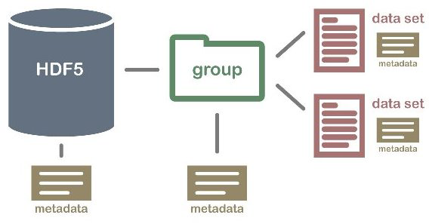
Non primitive Data Structure
Array: An array is a fixed-size sequenced collection of elements of the same data type.
List: An ordered set containing variable number of elements is called as Lists.
File: A file is a collection of logically related information. It can be viewed as a large list of records consisting of various fields.
Array
File
List

Slide 14
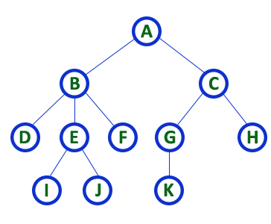
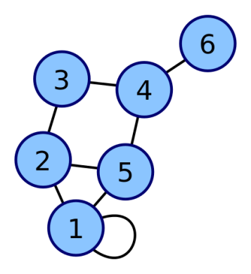
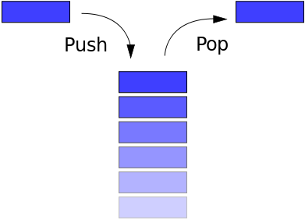
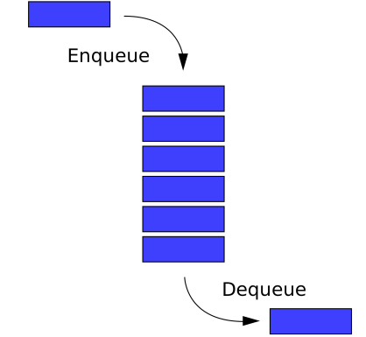
Linear / Non-Linear data structure
Linear data structures
A data structure is said to be Linear, if its elements are connected in linear fashion by means of logically or in sequence memory locations.
Examples of Linear Data Structure are Stack and Queue.
Nonlinear data structures
Nonlinear data structures are those data structure in which data items are not arranged in a sequence.
Examples of Non-linear Data Structure are Tree and Graph.
Stack
Queue
Tree
Graph

Slide 15
Differences between Linear and Non-Linear Data Structures
Sr.No. | Linear Data Structure | Non-Linear Data Structure
1 | Elements are arranged in a linear order where each and every element is attached to its previous and next adjacent. | Elements are attached in hierarchically manner.
2 | Single level is involved. | Multiple levels are involved.
3 | Its implementation is easy in comparison to non-linear data structure. | Its implementation is complex in comparison to linear data structure.
4 | Data elements can be traversed in a single run only. | Data elements can’t be traversed in a single run only.
5 | Memory is not utilized in an efficient way. | Memory is utilized in an efficient way.
6 | Its examples are: array, stack, queue, linked list, etc. | Its examples are: trees and graphs.
7 | Applications of linear data structures are mainly in application software development. | Applications of non-linear data structures are in Artificial Intelligence and image processing.

Slide 16
Operations of Data Structure
Create: It results in reserving memory for program elements.
Destroy: It destroys memory space allocated for specified data structure.
Selection: It deals with accessing a particular data within a data structure.
Updation: It updates or modifies the data in the data structure.
Searching: It finds the presence of desired data item in the list of data items.
Sorting: It is a process of arranging all data items in a data structure in a particular order.
Merging: It is a process of combining the data items of two different sorted list into a single sorted list.
Splitting: It is a process of partitioning single list to multiple list.
Traversal: It is a process of visiting each and every node of a list in systematic manner.

Slide 17
Time and space analysis of algorithms
Sometimes, there are more than one way to solve a problem.
We need to learn how to compare the performance of different algorithms and choose the best one to solve a particular problem.
While analysing an algorithm, we mostly consider time complexity and space complexity.
Time complexity of an algorithm quantifies the amount of time taken by an algorithm to run as a function of the length of the input.
Space complexity of an algorithm quantifies the amount of space or memory taken by an algorithm to run as a function of the length of the input.
Time & space complexity depends on lots of things like hardware, operating system, processors, etc.
However, we don't consider any of these factors while analysing the algorithm. We will only consider the execution time of an algorithm.

Slide 18
Worst-Best-Average Case Time Complexity
Worst-Case Analysis:
In Worst Case analysis upper bound on the running time of an algorithm is calculated.
This is the case that causes a maximum number of operations to be executed.
For Linear Search, the worst case happens when the element to be searched (x) is not present in the array.
When x is not present, the search() function compares it with all the elements of arr[] one by one.
Therefore, having the knowledge of worst-case running time gives us an assurance that the algorithm will never go beyond this time limit.

Slide 19
Worst-Best-Average Case Time Complexity
Best-Case Analysis:
In Best Case analysis lower bound on the running time of an algorithm is calculated.
This is the case that causes a minimum number of operations to be executed.
In the Linear Search problem, the best case occurs when x is present at the first location.

Slide 20
Worst-Best-Average Case Time Complexity
Average-Case Analysis:
In Average Case analysis, we take all possible inputs and calculate the computing time for all of the inputs.
Sum all the calculated values and divide the sum by the total number of inputs.
It specifies the expected behavior of the algorithm when the input is randomly drawn from a given distribution.
For Linear Search, this case happens when the search element is present somewhere in the middle of the array.

Slide 21
Notations in Complexity Analysis of Algorithm
Big-O Notation:
An algorithm’s worst-case time complexity is defined by the Big-O notation.
This notation gives the maximum amount of time an algorithm requires to consider all input values.
Notation used: (O)
Omega Notation:
An algorithm’s best-case time complexity is defined by the Omega notation.
This notation gives the minimum amount of time an algorithm requires to consider all input values.
Notation used: (Ω)
Theta Notation:
An algorithm’s average-case time complexity is defined by the Theta notation.
This notation gives the estimated average amount of time an algorithm requires to consider all input values.
Notation used: (Ꝋ)

Slide 22
Calculate Time Complexity of Algorithm
Time Complexity is most commonly estimated by counting the number of elementary functions performed by the algorithm.
Since the algorithm's performance may vary with different types of input data,
hence for an algorithm we usually use the worst-case Time complexity of an algorithm because that is the maximum time taken for any input size.

Slide 23
Calculating Time Complexity
Calculate Time Complexity of Sum of elements of List (One dimensional Array)
A is array, n is no of elements in array
SumOfList(A,n)
{
Line 1 total = 0
Line 2 for i = 0 to n-1
Line 3 total = total + A[i]
Line 4 return total
}
Line
Cost
No of Times
1
1
1
2
2
n + 1
3
2
n
4
1
1
TSumOfList = 1 + 2 (n+1) + 2n + 1
= 4n + 4
We can neglate constant 4
= n
Time complexity of given algorithm is n unit time

Slide 24
One Dimensional Array
Simplest data structure that makes use of computed address to locate its elements is the one-dimensional array or vector.
Number of memory locations is sequentially allocated to the vector.
A vector size is fixed and therefore requires a fixed number of memory locations.

Slide 25
Address calculation of 1-D array elements
The address of other data elements can be calculated using the base address.
The formula to perform the calculation:
Address of data element,
A[k] = BA(A) + w(k – LowerBound)
A is the array
k is the index of the element of which we want to calculate the address
BA is the base address of the array A
w is the size of one element in the memory (in bytes)

Slide 26
EXAMPLE : Address calculation of 1-D Array
Given an array int marks[] = {99, 67, 78, 56, 88, 90, 34, 85}, calculate the address of marks[4], if the base address is 1000.
k = 4
BA(A) = 1000
Storing an integer value requires 2 bytes. So w=2.
Lower bound = 0
Formula:
A[k] = BA(A) + w(k – LowerBound)
marks[4] = 1000 + 2 (4-0)
= 1000 + 8
= 1008

Slide 27
Two Dimensional Array
Although the rectangular picture of two-dimensional array is shown, but in memory these elements will actually be stored in sequential manner.
There are two ways to store them in memory:
Row major order :
The elements of first row are stored first before the elements of second and third rows.
The elements of the array are stored row by row where n elements of the first row will occupy the first n location.
(0,0) | (0,1) | (0,2) | (0,3) | (1,0) | (1,1) | (1,2) | (1,3) | (2,0) | (2,1) | (2,2) | (2,3)

Slide 28
Two Dimensional Array
Column major order :
The elements of first column are stored first before the elements of second and third column.
The elements of the array are stored column by column where m elements of the first column will occupy first m locations.
(0,0) | (1,0) | (2,0) | (3,0) | (0,1) | (1,1) | (2,1) | (3,1) | (0,2) | (1,2) | (2,2) | (3,2)

Slide 29
Two Dimensional Array
In 2-D array also computer stores the base address, and the address of the other elements is calculated using the following formulas.
If the array elements are stored in row-major order:
Address(A[i][j]) = Base_Address + w {N (i-LB_{r}) + (j-LB_{c})}
If the array elements are stored in column-major order:
Address(A[i][j]) = Base_Address + w {(i-LB_{r}) + M (j-LB_{c})}
Where,
w = no. of bytes required to store one element
N = no. of columns
M = no. of rows
i and j = subscripts of array element

Slide 30
EXAMPLE : Address calculation of 2-D Array
Consider 20 x 5 two dimensional array marks which has its base address = 1000 and the size of an element = 2. Now compute the address of the element, marks[18][4] assuming that the elements are stored in row major order. (Assume LB_{r}=LB_{c} =1)
Here,
w=2, N=5, M=20, i=18, j=4, Base_Address=1000
If the array elements are stored in row-major order:
Address(A[i][j]) = Base_Address + w {N (i-LB_{r}) + (j-LB_{c})}
Address(marks[18][4]) = 1000 + 2 {5(18-1) + (4-1)}
= 1000 + 2 {5(17) + 3}
= 1000 + 2(88)
= 1176

Slide 31
EXAMPLE : Address calculation of 2-D Array
Consider 15 x 20 two dimensional array A which has its base address = 4000 and the size of an element is 4 bytes. Now compute the address of the element A[10][10], assuming that the elements are stored in row major order and column major order. (Assume LB_{r}=LB_{c} =1)

Slide 32
Applications of Array
Symbol Manipulation (matrix representation of polynomial equation)
Sparse Matrix
Matrix representation of polynomial equation
We can use array for different kind of operations in polynomial equation such as addition, subtraction, division, differentiation etc…
We are interested in finding suitable representation for polynomial so that different operations like addition, subtraction etc… can be performed in efficient manner.
Array can be used to represent Polynomial equation.

Slide 33
Representation of Polynomial equation
 | Y | Y² | Y³ | Y⁴
X | XY | XY² | XY³ | XY⁴
X² | X³Y | X²Y² | X²Y³ | X²Y⁴
X³ | X³Y | X³Y² | X³Y³ | X³Y⁴
X⁴ | X⁴Y | X⁴Y² | X⁴Y³ | X⁴Y⁴
2X² + 5XY + Y²
X² + 3XY + Y²+Y-X
Y
Y²
Y³
Y⁴
Y
Y²
Y³
Y⁴
0 | 0 | 0 | 0 | 0
0 | 0 | 0 | 0 | 0
0 | 0 | 0 | 0 | 0
0 | 0 | 0 | 0 | 0
0 | 0 | 0 | 0 | 0
0 | 0 | 0 | 0 | 0
0 | 0 | 0 | 0 | 0
0 | 0 | 0 | 0 | 0
0 | 0 | 0 | 0 | 0
0 | 0 | 0 | 0 | 0
1
1
1
X
5
X
-1
3
X²
2
X²
1
X³
X³
X⁴
X⁴

Slide 34
Sparse matrix
An m x n matrix is said to be sparse if “many” of its elements are zero.
A matrix that is not sparse is called a dense matrix.
We can device a simple representation scheme whose space requirement equals the size of the non-zero elements.
Column - 1
Column - 2
Column - 3
Column - 4
Column - 5
Column - 6
Column - 7
Column - 8
0
1
2
3
4
5
6
7
8
Row - 1
0 | 0 | 0 | 2 | 0 | 0 | 1 | 0
0 | 6 | 0 | 0 | 7 | 0 | 0 | 3
0 | 0 | 0 | 9 | 0 | 8 | 0 | 0
0 | 4 | 5 | 0 | 0 | 0 | 0 | 0
Terms
Row
Column
Value
1
1
2
2
2
3
3
4
4
Row - 2
4
7
2
5
8
4
6
2
3
Row - 3
2
1
6
7
3
9
8
4
5
Row - 4
Linear Representation of given matrix
4x8

Slide 35
Sparse matrix Cont…
1
2
3
4
5
6
7
Linear representation of Matrix
1
0 | 0 | 6 | 0 | 9 | 0 | 0
2 | 0 | 0 | 7 | 8 | 0 | 4
10 | 0 | 0 | 0 | 0 | 0 | 0
0 | 0 | 12 | 0 | 0 | 0 | 0
0 | 0 | 0 | 0 | 0 | 0 | 0
0 | 0 | 0 | 3 | 0 | 0 | 5
Row
Column
A
2
A =
1
3
6
3
4
1
5
9
5
2
1
2
6
2
4
7
6x7
2
5
8
Memory Space required to store
6x7 matrix
2
7
4
3
1
10
42 x 2 = 84 bytes
4
12
3
6
4
3
Memory Space required to store
Linear Representation
6
7
5
30 x 2 = 60 bytes
Space Saved = 84 – 60 = 24 bytes

Slide 36
Overview of Pointer
Every variable in c language has a name and a value associated with it. When a variable is declared, a specific block of memory within the computer is allocated to hold the value of that variable.
The size of the allocated block depends on the type of the data.
A Pointer is a variable that points to or references a memory location in which data is stored.
A pointer is declared using the indirection (*) operator.
General declaration of a pointer is:
data-type *pointer-name;
Since a pointer is a variable, its value is also stored in another memory location. So in computation even the address of the pointer can be used.

Slide 37
Overview of Pointer
The location of a variable in memory is system dependent and therefore the address of a variable is not known directly.
The address operator (&) allows us to retrieve the address from a variable associated with it.
For Example :
int *p , x = 5;
p = &x;
An operator (*) is also called the value at address operator. It returns the value stored at the particular address.

Slide 38
Dynamic Memory Allocation
The process of allocating memory to the variables during execution of the program or at run time is known as dynamic memory allocation.
The size of array declared initially can be sometimes insufficient and sometimes more than required.
Dynamic memory allocation allows a program to obtain more memory space, while running or to release space when no space is required.
There are 4 library functions under stdlib.h for dynamic memory allocation:
malloc()
calloc()
free()
realloc()

Slide 39
malloc()
The name malloc stands for "memory allocation".
The function malloc() reserves a block of memory of specified size and returns a pointer of type void which can be casted into pointer of any form.
Syntax of malloc():
ptr=(cast-type*)malloc(byte-size)
Here, ptr is pointer of cast-type.
If the space is insufficient, allocation fails and returns NULL pointer.
For Example:
int *ptr;
ptr=(int*)malloc(100*sizeof(int));

Slide 40
calloc()
The name calloc stands for "contiguous allocation”.
The only difference between malloc() and calloc() is that, malloc() allocates single block of memory whereas calloc() allocates multiple blocks of memory each of same size and sets all bytes to zero.
Syntax of calloc():
ptr=(cast-type*)calloc(n,element-size);
For Example:
float *ptr;
ptr=(float*)calloc(25,sizeof(float));

Slide 41
realloc()
If the previously allocated memory is insufficient or more than sufficient then previously allocated memory size can be changes using realloc().
Syntax of realloc():
ptr=realloc(ptr,new-size);
For Example:
float *ptr;
ptr=(float*)malloc(25*sizeof(float));
ptr=realloc(ptr,5*sizeof(float));

Slide 42
free()
Dynamically allocated memory with either calloc() or malloc() does not get return on its own.
The programmer must use free() explicitly to release space.
Syntax of free():
free(ptr);
For Example:
float *ptr;
ptr=(float*)malloc(25*sizeof(float));
free(ptr);

Slide 43
Data Structures (DS)
DU #2305CS201
Prof. Nidhi K Chitroda
Computer Engineering Department
Nidhi.chitroda@darshan.ac.in

