Slide 1
Amazon Recommender System
ADS project by team ML_DATA
Dhruv Panchal(001055844)
Nikhil Joshi(001029458)
Sourav Sharma(001374865)
Vinod Kumar Mullangi(001057553)

Slide 2
What is a recommendation system
A recommendation engine is a system that suggests products, services, information to users based on analysis of data. Notwithstanding, the recommendation can derive from a variety of factors such as the history of the user and the behaviour of similar users.

Slide 3
Our Project
We have build a robust recommender system for Amazon Products. We have used various Machine Learning algorithms and tested them. We have used Electronics dataset. This dataset has product id, which is a unique identifier for all products on amazon.com. It also contains the star rating given by each user identified by the user id.

Slide 4
Algorithms in our system
1. Popularity based
2. Collaborative filtering using Singular value decomposition
3. Collaborative filtering using KNN With means (user-user similarity)
4. Collaborative filtering using KNN With means (item-item similarity)
5. Hybrid Recommendation System

Slide 5
Popularity based
This is the simplest method. In this method we suggest products to users based on popularity.
Example: In shopping store we can suggest popular dresses by purchase count

Slide 6
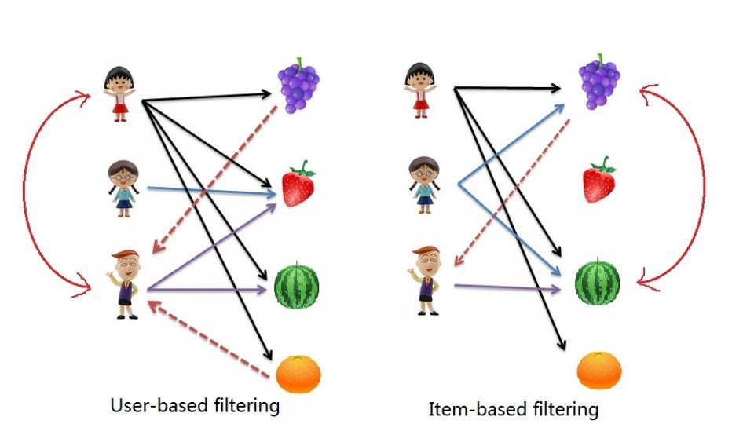
Collaborative filtering
These models are built based on assumption that people like things similar to other things they like, and things that are liked by other people with similar taste. There are two types, user based and item based.

Slide 7
Hybrid recommender system
These models are built by combining collaborative and content-based recommendation. They can be more effective. Hybrid approaches can be implemented by making content-based and collaborative-based predictions separately and then combining them.

Slide 8
Conclusion
We performed data cleaning and removed any and all inconsistencies in the dataset which was relatively clean. To get a better understand of it, we performed statistical analysis of the data and observed it using graphs and plots.
We trained 5 different recommendation models and tested them. We evaluated their performance and quality using evaluation metrics.
We served the recommendations for various products based on the user review and item type.

Slide 9
References
https://towardsdatascience.com/web-scraping-recommender-systems-project-1d360fa678e4
https://towardsdatascience.com/how-to-build-a-model-based-recommendation-system-using-python-surprise-2df3b77ab3e5
https://towardsdatascience.com/deep-learning-based-recommender-systems-3d120201db7e
https://www.cs.umd.edu/~samir/498/Amazon-Recommendations.pdf
https://medium.com/@madasamy/introduction-to-recommendation-systems-and-how-to-design-recommendation-system-that-resembling-the-9ac167e30e95
https://towardsdatascience.com/product-recommender-using-amazon-review-dataset-e69d479d81dd

