Slide 1
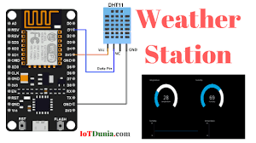

RASPBERRY PI BASED WEATHER REPORTING AND POLLUTION MONITORING SYSTEM
Team Members:
  Vijay Dubhalkar
  Vaibhav Kamble
  Nikhil Ingale
        Under Guidance of
        Dr. Nikita Kulkarni

Slide 2
OUTLINE
Introduction
Problem Formulation
Objective
Proposed Design
Block Diagram
Results
Comparison with Previous Work
Conclusion
Future Scope
References

Slide 3
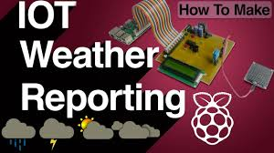
INTRODUCTION
A weather Reporting station is that facility on land or sea, which has the instruments and devices for observing and measuring atmospheric parameters to provide the information for weather forecasts.
Weather monitoring has been very important to man over centuries. Weather parameters are the basic tools which can be used to predict the weather.

Slide 4
INTRODUCTION
Typical weather stations have the following instruments:
Thermometer for measuring air temperature
Barometer for measuring atmospheric pressure
Hygrometer for measuring humidity
Anemometer for measuring wind speed
Ultra Sound Sensor for sensing Excessive Noise
Advance Gas Sensor for detecting pollution in Air

Slide 5
INTRODUCTION
Automatic wireless weather stations make use of digital sensors and microcontroller technology to take the measurements.
Automatic wireless weather stations are small in size and easy to install and they also save the manpower.

Slide 6
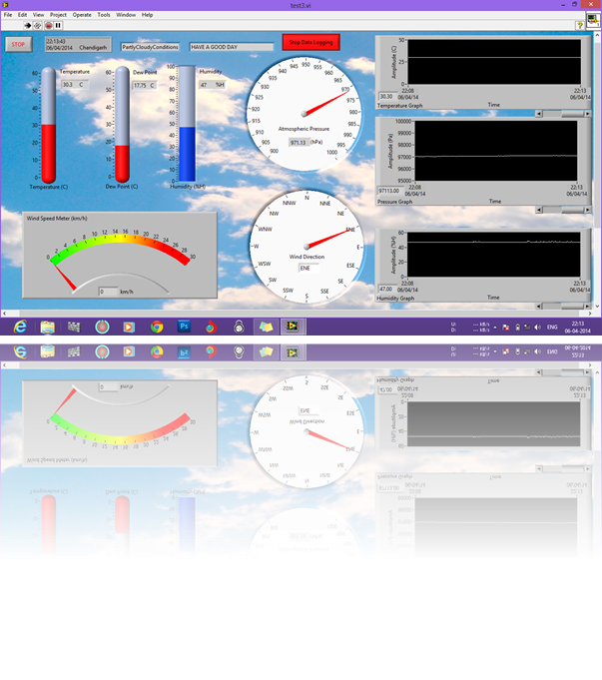
INTRODUCTION
The proposed system measures the real time weather parameters automatically.
It uses low cost high precision calibrated digital sensors for accurate data measurements.
This system can record the data and host it on the internet for remote viewing of weather conditions.
And it generates the short term local alerts based on current weather and pollution conditions.

Slide 7
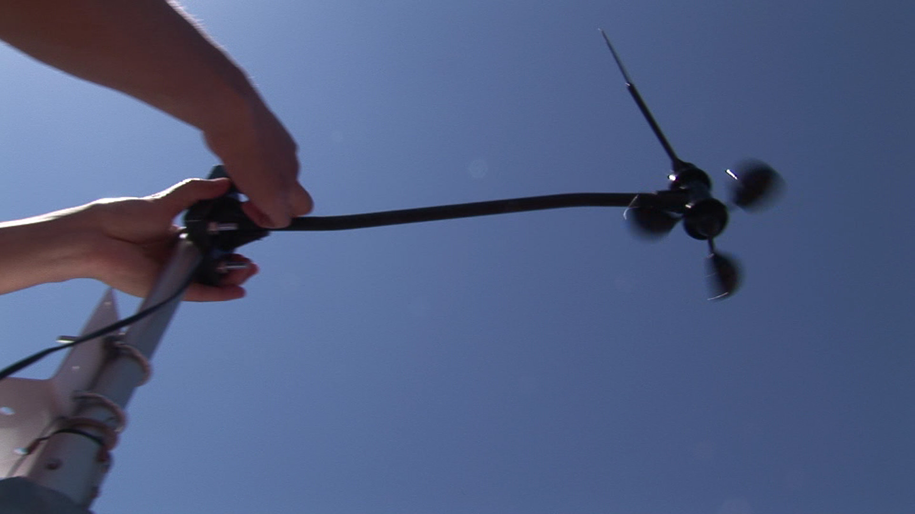
PROBLEM FORMULATION
Meteorological instruments are very expensive in India, resulting in low resolution of stations.
There is a need of low cost and high accuracy systems which can be used to improve the monitoring over a wide area with high resolution.
Today in hospitals, agriculture and for learnings purposes, the accurate local environmental parameters are needed. Hence a low cost high precision model can solve this problem.

Slide 8
OBJECTIVE
Objective of this work is :
The aim of this project is to achieve a completely automatic low cost weather station with IOT and Raspberry Pi.
To achieve a good accuracy of results we will be comparing the outputs of the sensors with the readings of some weather stations established in India.
Weather monitoring, pollution monitoring and warning the Officials about the pollution.

Slide 9
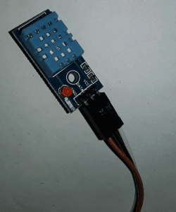
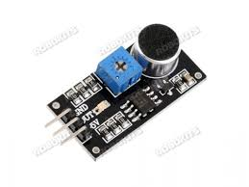
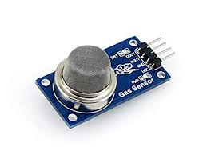
PROPOSED DESIGN
Hardware Specifications
List of Sensors:
Temperature Sensor: DHT11
Humidity Sensor: DHT11
Sound Sensor:
Gas Sensor:

Slide 10
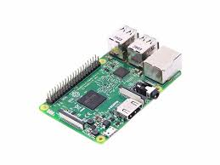
PROPOSED DESIGN
Hardware Specifications
Components:
Raspberry Pi
DHT11 Sensor
Rain-Drop Sensor
MQ-7 Sensor
Sound Sensor
Wires

Slide 11
CONCLUSION
We have developed and set-up a low cost IOT and Raspberry-Pi based automatic weather & Pollution monitoring system with high accuracy.
Data logging facility is working and it saves the data in a file compatible with MS Excel.
System is able to generate short term alerts and web hosting is successfully tested.

Slide 12
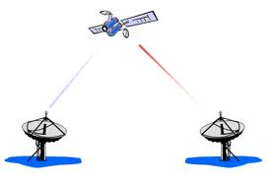
FUTURE SCOPE
The features which can be developed in the future are:
One can implement a few more sensors and connect it to the satellite as a global feature of this system.
Long time (> 7days) weather forecasting by using IoT with Machine Learning Technology.
It can also be implemented in hospitals or medical institutes for the research & study in “Effect of Weather on Health and Diseases”, hence to provide better precaution alerts.
It can also proved to be useful in Agriculture for prediction of weather to avoid any loss of farmers.

