Slide 1


S V Institute of Computer Studies, Gandhinagar
(a constituent Colleges of Kadi Sarva Vishwavidyalaya)
BCA PROGRAMME
SEMESTER- VI
ROBOPEDIA-III
BCA 606 (A)
PROJECT WORK –IV
TITLE
GROUP NUMBER :
Sr. No. | Student Name | Enrollment No. | Exam No.
01 | Ansari Mohmed parvez | 21BCA53001 | 756002
02 | Gounder Nikhil | 21BCA53028 | 756027
03 | Patel Himanshu | 21BCA53078 | 756074
04 | Ranavaya Harshal | 21BCA53108 | 756103
05 | Vasiwala Anfal | 21BCA53138 | 756128

Slide 2
Table of Contents
SR. NO. | Particular | Slide No.
1 | TITLE | 1
2 | PROTOTYPE DEFINITION | 2
3 | PROTOTYPE OVERVIEW | 6
4 | PROTOTYPE COMPONENTS COST SPECIFICATION | 7-8
5 | PROTOTYPE BLOCK CIRCUIT DIAGRAM | 9
6 | PROTOTYPE SCHEMATIC CIRCUIT DIAGRAM | 9
7 | PROTOTYPE HARDWARE COMPONENTS ASSEMBLED LABELLED DISPLAY | 10
8 | PROTOTYPE CODE | 11-14
9 | PROTOTYPE CODE UPLOADING STEPS | 15
10 | PROTOTYPE GHANTT CHART | -
11 | ADVANTAGES | 16
12 | DISADVANTAGES | 17
13 | REAL LIFE APPLICATION | 18
14 | CONCLUSION(PROTOTYPE DEVELOPMEMT LEARNING) | 19
15 | FUTURE ENHANCEMENT | 20
16 | REFERENCES | 21

Slide 3

GUARDED LATCH

Slide 4
TITLE
A small lock that can fit in any door or locker room.
A door has 2 levels of security to access.
1). Keypad Lock
2). RFID Lock

Slide 5
Prototype Definition
An electrical and mechanical locking device that opens wirelessly as well as manually with an
authorized user authentication.

Slide 6
Prototype Overview
In this project we are using a Keypad lock and a RFID lock
,which we need to enter in order to grant the access.
We can use this project in our day-to-day routine.

Slide 7
Prototype Components Specification
Components For RFID Lock
RFID Module
Arduino Nano
12v Solenoid Lock
Relay Module
LCD display
Jumper wires

Slide 8
Components For Keypad Lock
Keypad Lock
Arduino Nano
12v Solenoid Lock
Relay Module
LCD display
Jumper wires

Slide 9
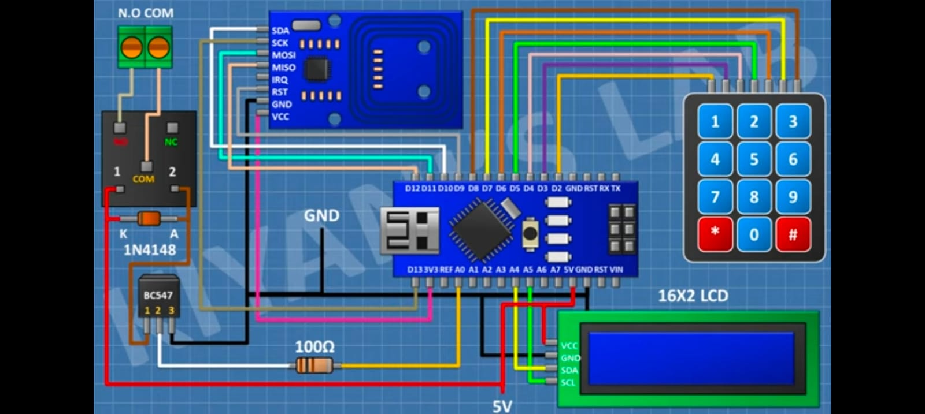
Prototype Block Circuit Diagram

Slide 10
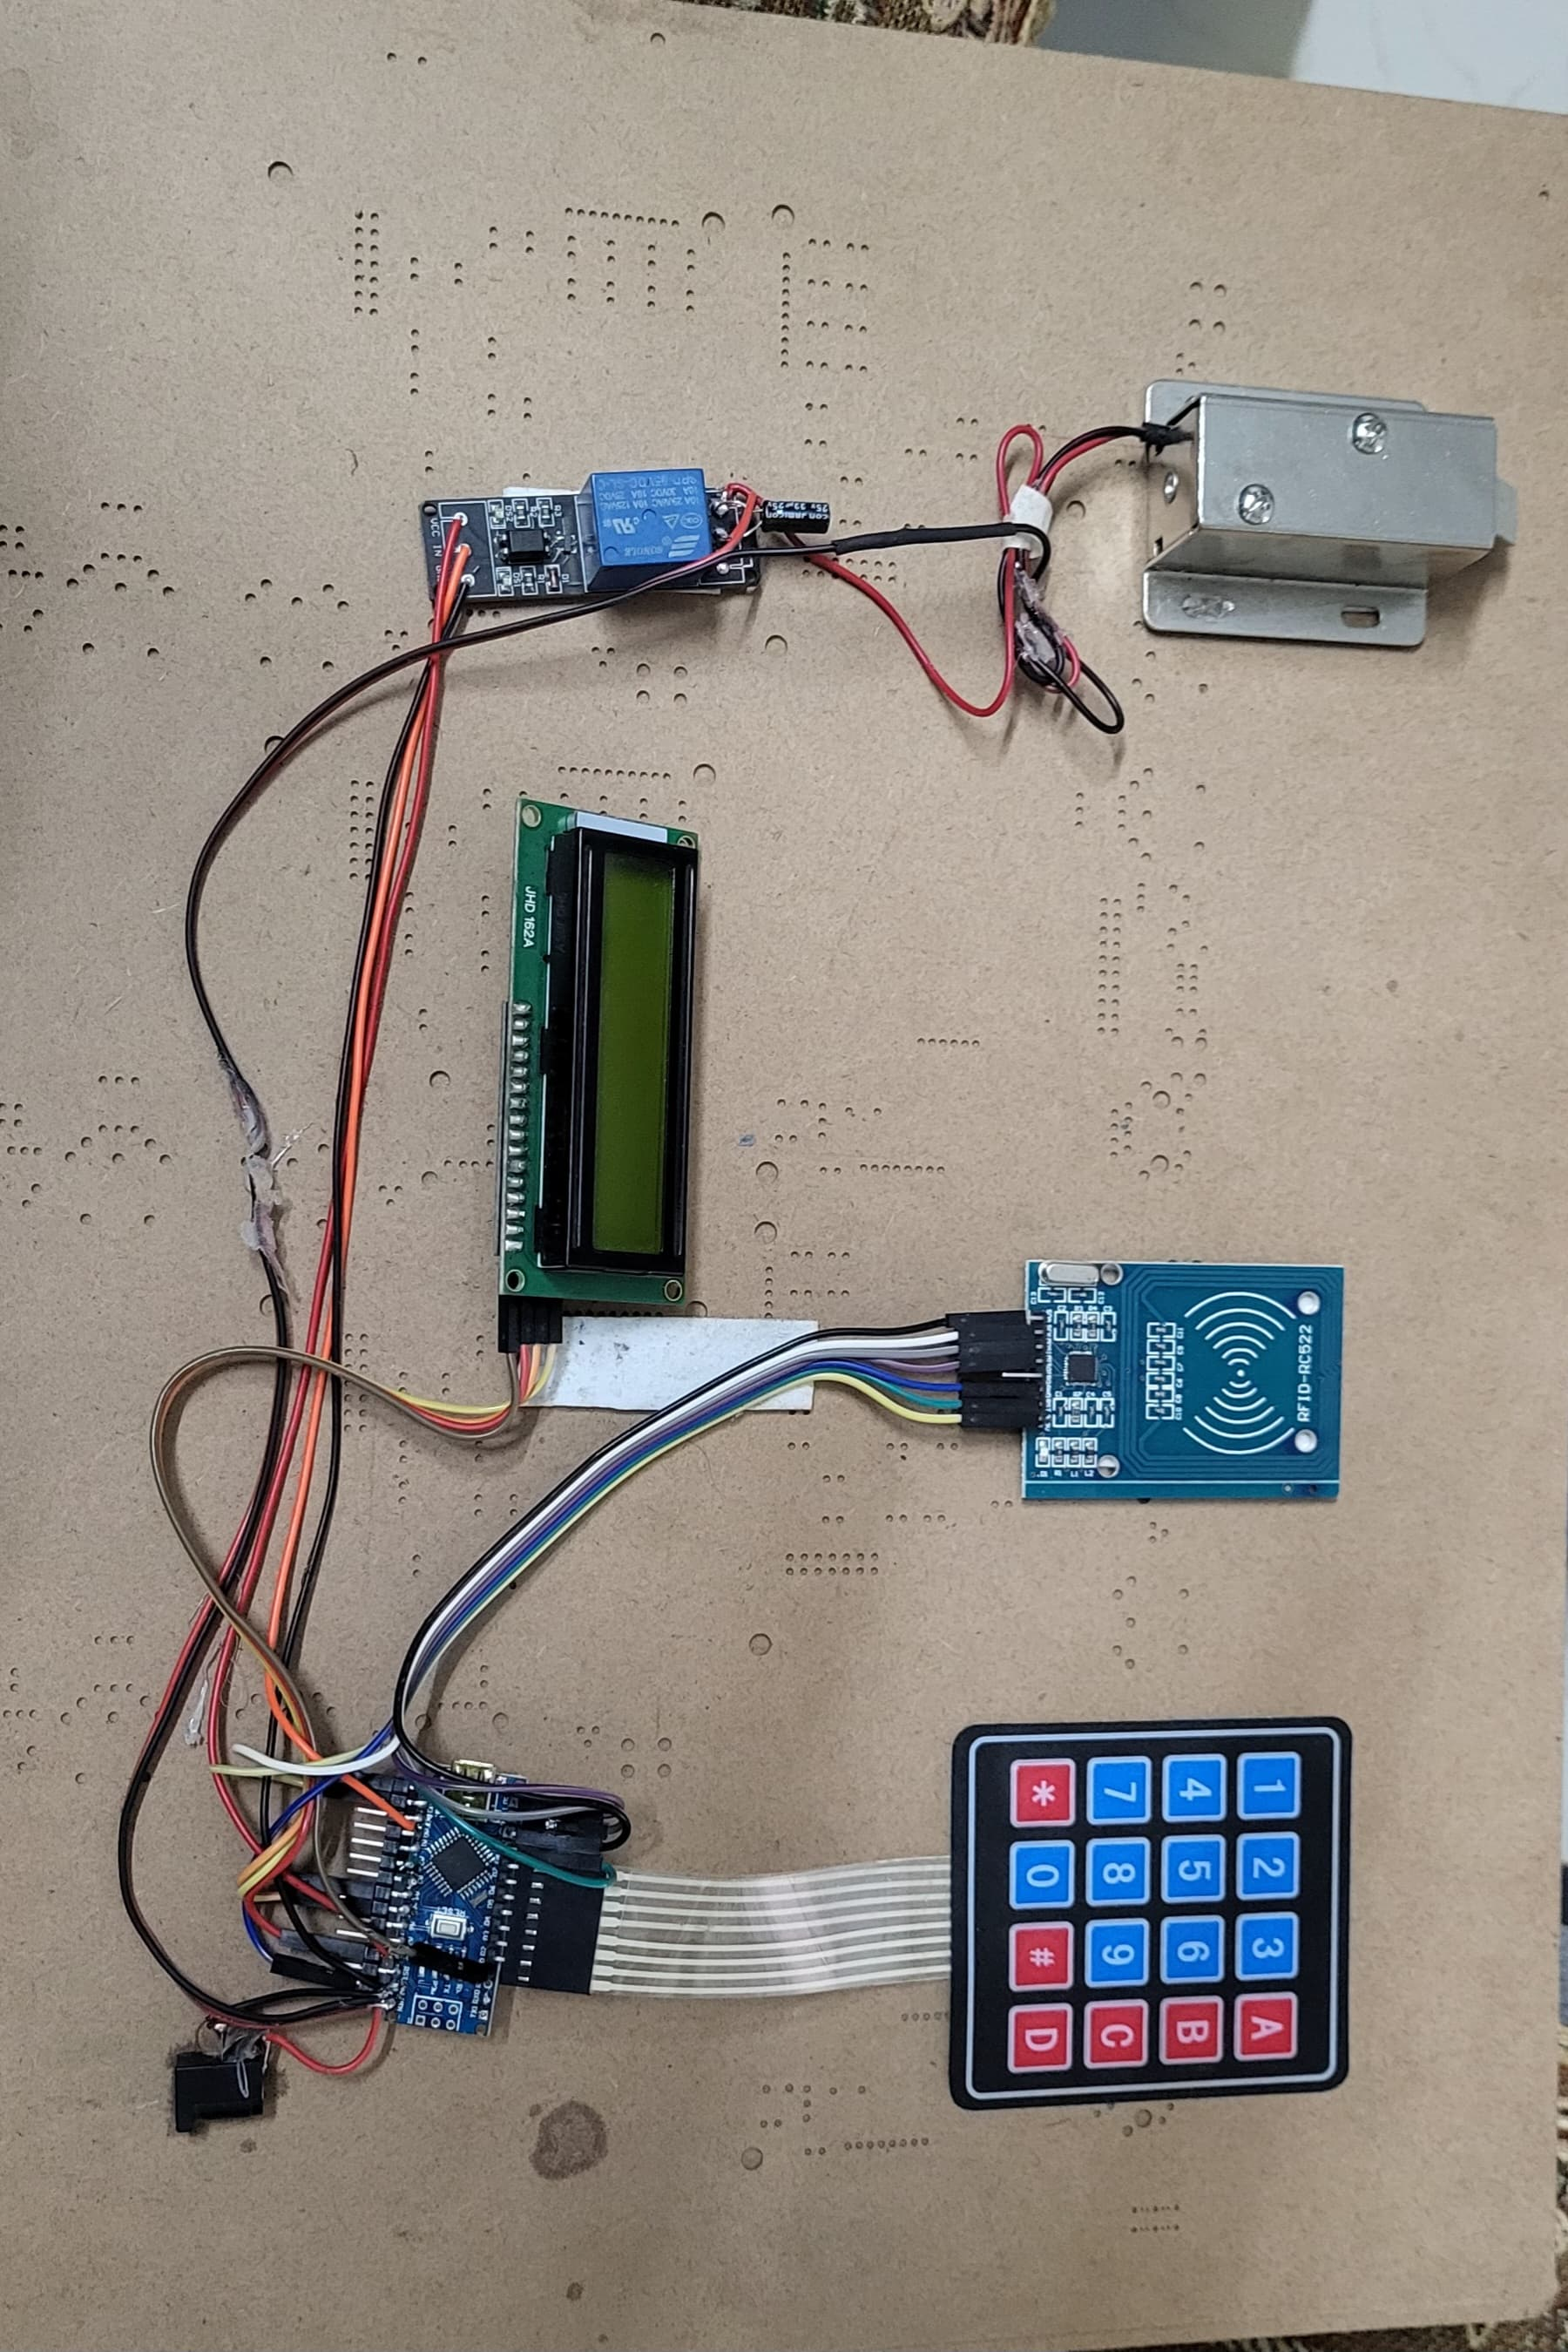
Prototype Hardware Components Assembled Labelled Display
RFID Module
Solenoid Lock
Keypad
LCD display
Relay Module
Arduino Nano

Slide 11
Prototype Code
#include <SPI.h>
#include <MFRC522.h>
// #include <LiquidCrystal.h>
#include <Keypad.h>
#include <EEPROM.h>
#include <Wire.h>
#include <LiquidCrystal_I2C.h>
LiquidCrystal_I2C lcd(0x26, 16, 2);
#define SS_PIN 10
#define RST_PIN 9MFRC522 rfid(SS_PIN, RST_PIN);
// Instance of the classMFRC522::
MIFARE_Key mkey;
char d,d1,d2,d3,d10,d11,d12,d13;
int c,cpa,tag;bool cp,np,ok,m;
// Init array that will store new NUID byte nuidPICC[4];
//-------keypad setting-----------------const byte rows[4] = {A3, 2, 3, 4};
//connect to the row pinouts of the keypadconst byte cols[4] = {5, 6, 7, 8}; //connect to the column pinouts of the keypad char keys[4][4] = { //create 2D arry for keys {'D', 'C', 'B', 'A'}, {'#', '9', '6', '3'}, {'0', '8', '5', '2'}, {'*', '7', '4', '1'},};
Keypad mykeypad = Keypad(makeKeymap(keys), rows, cols, 4, 4);
//-------------lcd function declaration---------------------
void setup() { Serial.begin(9600); pinMode(14, OUTPUT);
lcd.begin(); lcd.backlight();
lcd.print("SCAN YOUR ID TAG");
lcd.setCursor(0, 1); SPI.begin();
// Init SPI bus rfid.PCD_Init();
// Init MFRC522 for (byte i = 0; i < 6; i++) { mkey.keyByte[i] = 0xFF; } Serial.println(F("This code scan the MIFARE Classsic NUID."));
//--set def pass if(EEPROM.read(0)>1|EEPROM.read(0)<1){ EEPROM.update(0, 1);
EEPROM.update(1, '1');
EEPROM.update(2, '2');
EEPROM.update(3, '3');
EEPROM.update(4, '4'); }
d= EEPROM.read(1);d1= EEPROM.read(2);d2= EEPROM.read(3);d3= EEPROM.read(4); }

Slide 12
void loop()
{//--------------------------keypad sec code----------------------char k = mykeypad.getKey();
if (k){ c++; Serial.println(k);
lcd.print("*");
if(c==1)
{ d10=k; }
if(c==2)
{ d11=k; }
if(c==3){ d12=k; }
if(c==4){ d13=k; } }
if (k=='#'){m=c=cp=np=tag=0; lcd.clear(); lcd.print("SCAN YOUR ID TAG");}
if(c==4&np==0)
{ c=0; if(d10=='*'&d11=='0'&d12=='0'){ m=1; lcd.clear();
lcd.print("ENTER PASSWORD ");
switch(d13)
{ case '0':
cp=1;
break;
case '1':
tag=1;
break;
case '2':
tag=2;
break;
case '3':
tag=3;
break;
case '4':
tag=4;
break;
case '5’:
tag=5;
break;;
} d10=d11=d12=d13=0; } if(d==d10&d1==d11&d2==d12&d3==d13){ if(cp==0&m==0)
{ lcd.setCursor(0, 1);
lcd.print("PASSWORD ACCEPTED"); digitalWrite(14,HIGH);
delay(3000);
digitalWrite(14,LOW);
d10=d11=d12=d13=0;
lcd.setCursor(0, 1);
lcd.print(" "); lcd.setCursor(0, 1); }if(cp==1&tag==0){ lcd.clear(); lcd.print("NEW PASSWORD"); lcd.setCursor(0, 1); np=1; }

Slide 13
if(tag>0)
{ lcd.clear();
lcd.print("SCAN ID TAG # ");
lcd.print(tag);
lcd.setCursor(0, 1); } m=0; }
else{ if(!m){ lcd.setCursor(0, 1);
lcd.print("WRONG PASSWORD");delay(3000);} d10=d11=d12=d13=0;
lcd.setCursor(0, 1);
lcd.print(" ");
lcd.setCursor(0, 1); } }
if(c==4&np==1)
{ m=0; d=d10; d1=d11; d2=d12; d3=d13; EEPROM.update(1, d);
EEPROM.update(2, d1);
EEPROM.update(3, d2);
EEPROM.update(4, d3); np=0; cp=0; c=0; d10=d11=d12=d13=0;
lcd.clear();
lcd.print("SCAN YOUR ID TAG");
lcd.setCursor(0, 1); }
//---rfid----------------------
// Reset the loop if no new card present on the sensor/reader
. This saves the entire process when idle.
if ( ! rfid.PICC_IsNewCardPresent()) return;
// Verify if the NUID has been readed
if ( ! rfid.PICC_ReadCardSerial())
return;
printDec(rfid.uid.uidByte, rfid.uid.size);
Serial.println();
if(tag>0){ switch(tag){ case 1: EEPROM.update(5, rfid.uid.uidByte[0] ); EEPROM.update(6, rfid.uid.uidByte[1] ); EEPROM.update(7, rfid.uid.uidByte[2] ); EEPROM.update(8, rfid.uid.uidByte[3] );
break;
case 2:EEPROM.update(9, rfid.uid.uidByte[0] ); EEPROM.update(10, rfid.uid.uidByte[1] ); EEPROM.update(11, rfid.uid.uidByte[2] ); EEPROM.update(12, rfid.uid.uidByte[3] );
break;
case 3: EEPROM.update(13, rfid.uid.uidByte[0] ); EEPROM.update(14, rfid.uid.uidByte[1] ); EEPROM.update(15, rfid.uid.uidByte[2] ); EEPROM.update(16, rfid.uid.uidByte[3] );
break;

Slide 14
case 4: EEPROM.update(17, rfid.uid.uidByte[0] ); EEPROM.update(18, rfid.uid.uidByte[1] ); EEPROM.update(19, rfid.uid.uidByte[2] ); EEPROM.update(20, rfid.uid.uidByte[3] );
break;
case 5: EEPROM.update(21, rfid.uid.uidByte[0] ); EEPROM.update(22, rfid.uid.uidByte[1] ); EEPROM.update(23, rfid.uid.uidByte[2] ); EEPROM.update(24, rfid.uid.uidByte[3] );
break; } tag=0;d10=d11=d12=d13=0; lcd.setCursor(0, 1);
lcd.print(" TAG ID SAVED "); delay(2000);
lcd.clear();
lcd.print("SCAN YOUR ID TAG");
cp=0; c=0; }
else for (int i = 1; i < 6; i++)
{ if (rfid.uid.uidByte[0] == EEPROM.read((i*4)+1)& rfid.uid.uidByte[1] == EEPROM.read((i*4)+2) & rfid.uid.uidByte[2] == EEPROM.read((i*4)+3) & rfid.uid.uidByte[3] == EEPROM.read((i*4)+4) ) ok=1;} if(ok==1){ ok=0; Serial.println(F("A new card has been detected.")); lcd.setCursor(0, 1); lcd.print("ID TAG ACCEPTED ");digitalWrite(14,HIGH);
delay(3000);
lcd.setCursor(0, 1);
lcd.print(" ");
digitalWrite(14,LOW);
return; }
else { lcd.setCursor(0, 1); lcd.print(" ACCESS DENIED ");
delay(2000);
lcd.setCursor(0, 1);
lcd.print(" "); }
// Halt PICC rfid.PICC_HaltA();
// Stop encryption on PCD
rfid.PCD_StopCrypto1(); }
//------------------loop end function start---------------------void printDec(byte *buffer, byte bufferSize)
{ for (byte i = 0; i < bufferSize; i++)
{ Serial.print(buffer[i] < 0x10 ? " 0" : " "); Serial.print(buffer[i], DEC); }}
---------------------------------------------------------------------------

Slide 15
Code Uploading Steps
Step 1 − First you must have your Arduino board and USB Cable
Step 2 − Download Arduino IDE Software.
Step 3 − Power up your board.
Step 4 − Launch Arduino IDE.
Step 5 − Open your first project.
Step 6 − Select your Arduino board.
Step 7 − Select your serial port.
Step 8 − Upload the program to your board
Step 9 − Great

Slide 16
Advantages
Lock and unlock your door from your phone.
Assign individual passcodes.
Know who's coming in and out.
No more hideaway keys.
Enhanced security.
Smart home automation.
Integrates with other smart devices.

Slide 17
Disadvantages
High-Cost. Generally electronic door lock costs are higher
than the traditional door locks....
High Installation Effort. ...
Jamming and Hacking. ...
Power Failure. ...
Same Access Code. ...
Forgetting Your Password. ...
Non-Recognition.

Slide 18
Prototype Real Life Applications
Burglary is the common threat for all home owners. Any unwelcome guest can easily break into your home, no matter how strong your lock is.
But a smart locking system is the hard nut to crack for them, since it is without any keys. Their mechanism is based on the security protocols deployed in bank system.

Slide 19
Prototype Conclusion
In this project, We are making a Smart Door lock
system which has Keypad lock and RFID Lock…
This Smart Door locks provide additional security
as compared to the normal locks…
This locks can only be opened by the persons who
has already registered their id’s or know the passcode,
so high security is there…

Slide 20
Prototype Future Enhancements
In future, we can give this lock an upgrade by adding fingerprint lock and face lock.
We can provide smarter access if we can combine it with 5g technology which will eventually provide increased security.

Slide 21
Prototype References
https://www.electroniclinic.com
https://circuitdigest.com/

Slide 22

Thank You

