Slide 1
GEETHANJALI COLLEGE OF ENGINEERING AND TECHNOLOGY
(UGC Autonomous • Affiliated to JNTUH • Approved by AICTE) | Department of CSE (AI&ML)
Enterprise Workforce Intelligence &
Compensation Analytics Platform
Production-grade Workforce Analytics, Statistical Anomaly Detection, Machine Learning Salary Modeling, and Cloud Deployment
Developed by: Nikhil (Nikhil8-coder) • B.Tech CSE (AI & ML) • Major Project
GitHub: https://github.com/Nikhil8-coder/employee-workforce-analytics

Slide 2
ENTERPRISE WORKFORCE INTELLIGENCE & COMPENSATION ANALYTICS
Project Evolution: Basic Starter Script vs. Enterprise Suite
Original Starter Script (Assignment Baseline)
• Data Scale: Only 8 hardcoded static mock employee rows.
• Ingestion: Rigid CSV loader failing on header variations.
• Math Scope: Basic company mean salary and simple group count.
• Filtering: Hardcoded terminal prompt for single threshold.
• Anomaly Audit: Zero outlier or statistical dispersion awareness.
• Predictive Modeling: No Machine Learning or inference.
• Interface: Command-line console text prints only.
• Deployment: Non-executable outside local student script.
Enterprise Workforce Intelligence Suite (Built)
✓ Data Scale: 1,200+ Kaggle-grade realistic records across 8 departments.
✓ Ingestion: Multi-format (CSV/Excel/JSON) with schema alias mapping.
✓ Statistical Depth: Mean, Median, Std Dev, Min/Max, 25th/75th, and IQR.
✓ Workforce Audits: Demographic pay parity (gender gap) & payroll share.
✓ Anomaly Engine: Tukey IQR fences (1.5x) and Z-score outlier flagging.
✓ Predictive ML: Random Forest Regressor (R² ~ 0.97, MAE ~ ₹7,400).
✓ Dual Interface: Interactive Streamlit Web UI + Formatted CLI Wizard.
✓ Public Deployment: Live on GitHub Pages, Cloudflare Tunnel & Docker.

Slide 3
ENTERPRISE WORKFORCE INTELLIGENCE & COMPENSATION ANALYTICS
Problem Statement & Strategic Engineering Objectives
The Challenge in Traditional HR
Standard spreadsheet trackers fail to scale beyond a few dozen rows, lack predictive capabilities, and offer zero automated protection against internal compensation compression or demographic pay discrepancies.
Objective 1: Multi-Format Ingestion
Develop a resilient ETL data loader that automatically recognizes varied column aliases (e.g. 'CTC', 'Annual_Salary', 'Tenure') and validates data integrity with automated feature derivation.
Objective 2: Statistical Dispersion & Audits
Implement rigorous statistical dispersion metrics including Interquartile Range (IQR) outlier detection to pinpoint under-compensated high performers and compensation anomalies.
Objective 3: ML Compensation Modeling
Train a Scikit-Learn Random Forest ensemble regression model on empirical workforce parameters to forecast fair market compensation bands and Compa-Ratio benchmarks.
Objective 4: Production Cloud Delivery
Provide both a client-side interactive web dashboard (accessible offline or via GitHub Pages) and a full Streamlit Python server ready for permanent cloud hosting.
Objective 5: Multi-Format Reporting Hub
Enable instant automated generation of multi-sheet styled Excel workbooks with cell formatting, publication-ready HTML briefs, and filtered CSV extracts.

Slide 4
ENTERPRISE WORKFORCE INTELLIGENCE & COMPENSATION ANALYTICS
Technology Stack & Enterprise Architectural Foundation
Core Computing & Analytics
• Python 3.14
• Pandas (Vectorized Aggregation)
• NumPy (Dispersion & Matrix Ops)
• Scipy (Statistical Distributions)
Machine Learning & AI
• Scikit-Learn (Ensemble Regressors)
• Random Forest (100 Estimators)
• ColumnTransformer & OneHotEncoder
• StandardScaler & Metrics (R², MAE)
Interactive Frontend & UI
• Streamlit (Reactive Python UI)
• Altair (Interactive Statistical Viz)
• Tailwind CSS (Modern Briefs)
• Chart.js (Client-Side HTML Web App)
Enterprise Reporting Hub
• OpenPyXL (Styled Multi-Tab Excel)
• Tabulate (ASCII Terminal Grids)
• Jinja2 (HTML Template Generation)
• CSV / JSON Multi-format Exporters
DevOps & Cloud Delivery
• Git & GitHub CLI (Automation)
• GitHub Pages (Global CDN Hosting)
• Cloudflare Tunnel (HTTP/2 Edge)
• Docker & Docker-Compose
Quality Assurance & Testing
• Unittest Framework
• Deterministic Test Fixtures
• Regression & Assertion Testing
• Py_Compile Syntax Verification

Slide 5
ENTERPRISE WORKFORCE INTELLIGENCE & COMPENSATION ANALYTICS
Dataset Architecture & Statistically Correlated Synthesis
15-Attribute Enterprise Data Model
• Employee_ID: Unique identifier (EMP-0001 to EMP-1200)
• Name & Gender: Demographic profile fields
• Department: 8 Business units (Engineering, AI, Sales, etc.)
• Job_Title: Hierarchical designations from Junior to VP
• Salary (Base): Statistically correlated compensation (₹)
• Bonus_%: Department-specific incentive ranges
• Total_Compensation: Base + Derived annual incentive
• Experience_Years: Gamma-distributed tenure (0 to 25 yrs)
• Performance_Score: Bell-curved appraisal (1.0 to 5.0)
• Attrition_Risk: High / Medium / Low retention flight risk
📄 data_generator.py
# Synthetic Enterprise Correlation Engine
dept_info = DEPARTMENTS[dept]
exp_years = int(np.clip(np.random.gamma(2.5, 2.8), 0, 25))
perf_score = round(float(np.clip(
np.random.normal(3.6, 0.65), 1.0, 5.0)), 2)
base = dept_info["base_salary"]
exp_adder = exp_years * dept_info["exp_mult"]
perf_mult = 1.0 + (perf_score - 3.0) * 0.08
noise = np.random.normal(1.0, 0.07)
raw_salary = (base + exp_adder) * edu_bonus * perf_mult * noise
salary = int(round(raw_salary, -3))
# Compa-Ratio & Flight Risk Assessment
comp_ratio = salary / expected_salary_benchmark
if comp_ratio < 0.90 and perf_score >= 4.0:
attrition_risk = "High" # Underpaid star talent

Slide 6
ENTERPRISE WORKFORCE INTELLIGENCE & COMPENSATION ANALYTICS
Code Module 1: Resilient Data Ingestion & Schema Mapping
Automated ETL & Sanitization Architecture
• Heterogeneous Header Normalization: Maps aliases like 'CTC', 'Annual_Salary', 'Tenure', 'Designation' into unified enterprise schema.
• Multi-Format Ingestion: Natively handles CSV, Excel (.xlsx, .xls), and JSON with format sniffing.
• Missing Data Imputation: Automatically fills missing IDs, normalizes performance scores, and casts numeric bounds.
• Feature Derivation: Automatically assigns Experience Bands (Entry, Junior, Mid, Senior, Lead) and divides compensation into Salary Quartiles (Q1 to Q4).
• Validation Metadata: Generates audit summary including min/max range, null checks, and department rosters.
📄 src/data_loader.py
def _normalize_columns(self, df: pd.DataFrame) -> pd.DataFrame:
df = df.copy()
current_cols = {col.lower().strip().replace(" ", "_"): col
for col in df.columns}
rename_map = {}
for standard_name, aliases in COLUMN_ALIASES.items():
for alias in aliases:
norm_alias = alias.lower().strip().replace(" ", "_")
if norm_alias in current_cols:
rename_map[current_cols[norm_alias]] = standard_name
break
df.rename(columns=rename_map, inplace=True)
return df
def _derive_features(self, df: pd.DataFrame) -> pd.DataFrame:
df["Experience_Band"] = df["Experience_Years"].apply(assign_band)
df["Total_Compensation"] = df["Salary"] + df["Bonus_Amount"]
df["Salary_Quartile"] = pd.qcut(df["Salary"], q=4,
labels=["Q1 (Entry)", "Q2 (Mid-)", "Q3 (Mid+)", "Q4 (Top)"])
return df

Slide 7
ENTERPRISE WORKFORCE INTELLIGENCE & COMPENSATION ANALYTICS
Mathematical Formulation & Analytical Foundations
1. Central Tendency & Spread
Mean: μ = (1/N) * Σ Salary_i
Median: Q2 (Middle rank, robust to skewness)
Standard Deviation: σ = sqrt( (1/N) * Σ (Salary_i - μ)² )
Measures compensation variance across cohorts.
2. Tukey IQR Outlier Boundaries
Interquartile Range: IQR = Q3 (75th) - Q1 (25th)
Lower Fence: Q1 - 1.5 × IQR (Underpaid flag)
Upper Fence: Q3 + 1.5 × IQR (Executive outlier)
Detects compensation anomalies without normal distribution assumptions.
3. Demographic Pay Parity Ratio
Gender Parity Ratio = (Avg Female Salary / Avg Male Salary) * 100
Unadjusted Pay Gap = 100% - Parity Ratio
Audits equitable reward distribution across departments and experience tiers.
4. Compa-Ratio & Market Parity
Compa-Ratio = Actual Base Salary / ML Predicted Market Benchmark
• < 0.90 : Under-Compensated (High Flight Risk)
• 0.90 - 1.10 : Market Aligned (Target Band)
• > 1.10 : Premium Compensated

Slide 8
ENTERPRISE WORKFORCE INTELLIGENCE & COMPENSATION ANALYTICS
Code Module 2: Core Analytics & Outlier Engine
Executive Statistical Aggregation
• Departmental Dispersion: Vectorized grouping calculating Headcount share, Payroll allocation %, Average/Median salary, and Tenure.
• IQR Outlier Detection: Identifies statistical compensation anomalies globally and within specific department silos.
• Multi-Criteria Query Engine: Dynamic filtering supporting simultaneous salary ranges, department subsets, tenure, and performance benchmarks.
• Z-Score Analysis: Provides normalized standard deviation distance (|Z| > 2.5) for audit inspections.
📄 src/analytics_engine.py
def detect_outliers(self, method="iqr", threshold=1.5):
sal = self.df["Salary"]
if method == "iqr":
q1 = sal.quantile(0.25)
q3 = sal.quantile(0.75)
iqr = q3 - q1
lower = q1 - threshold * iqr
upper = q3 + threshold * iqr
is_high = sal > upper
is_low = sal < lower
self.df["Is_Outlier"] = is_high | is_low
self.df["Outlier_Type"] = np.where(is_high,
"High Anomaly", np.where(is_low, "Low Anomaly", "Normal"))
self.df["Outlier_Score"] = ((sal - sal.mean()) / sal.std()).round(2)
return self.df[self.df["Is_Outlier"] == True].copy()

Slide 9
ENTERPRISE WORKFORCE INTELLIGENCE & COMPENSATION ANALYTICS
Code Module 3: Machine Learning Compensation Predictor
Scikit-Learn Ensemble Regressor
• Model Architecture: Random Forest Regressor (100 estimators, max depth 8) built on an end-to-end Pipeline.
• Feature Preprocessing: ColumnTransformer combining StandardScaler for continuous features (Tenure, Performance) and OneHotEncoder for categoricals (Department, Education).
• Empirical Model Accuracy: Achieves Explained Variance R² = 0.970 and Mean Absolute Error (MAE) = ₹7,404.11.
• Interactive Inference: Exposes predict_salary() to power real-time 'What-If' candidate compensation calculators.
📄 src/predictive_models.py
# Ensemble Regression Pipeline
preprocessor = ColumnTransformer(transformers=[
("num", StandardScaler(), ["Experience_Years", "Performance_Score"]),
("cat", OneHotEncoder(handle_unknown="ignore"), ["Department", "Education"])
])
self.pipeline = Pipeline(steps=[
("preprocessor", preprocessor),
("regressor", RandomForestRegressor(n_estimators=100, max_depth=8, random_state=42))
])
self.pipeline.fit(X, y)
preds = self.pipeline.predict(X)
self.r2 = round(float(r2_score(y, preds)), 3) # ~0.970
self.mae = round(float(mean_absolute_error(y, preds)), 2) # ~₹7,404

Slide 10
ENTERPRISE WORKFORCE INTELLIGENCE & COMPENSATION ANALYTICS
Code Module 4: Compa-Ratio Parity & Retention Risk
Retention & Equity Intelligence
• Internal Compa-Ratio: Compares every employee's current salary against the ML model's unbiased fair market expectation.
• Under-Compensation Watchlist: Identifies top-tier talent (Rating >= 4.0) earning below market threshold (<90%).
• Flight Risk Proaction: Allows HR leadership to implement proactive retention raises before employee departure.
• Department Equity Index: Highlights budget disparities across business units to optimize future wage allocation.
📄 src/predictive_models.py
def benchmark_workforce(self, df: pd.DataFrame) -> pd.DataFrame:
benchmarked = df.copy()
features = ["Experience_Years", "Performance_Score",
"Department", "Education"]
predicted = self.pipeline.predict(benchmarked[features])
benchmarked["Benchmark_Predicted_Salary"] = predicted.round(2)
benchmarked["Compa_Ratio"] = (
benchmarked["Salary"] / benchmarked["Benchmark_Predicted_Salary"]
).round(2)
conditions = [
(benchmarked["Compa_Ratio"] < 0.90),
(benchmarked["Compa_Ratio"] >= 0.90) & (benchmarked["Compa_Ratio"] <= 1.10),
(benchmarked["Compa_Ratio"] > 1.10)
]
choices = ["Under-Compensated (<90%)",
"Market Aligned (90-110%)",
"Premium Compensated (>110%)"]
benchmarked["Equity_Status"] = np.select(conditions, choices)
return benchmarked

Slide 11
ENTERPRISE WORKFORCE INTELLIGENCE & COMPENSATION ANALYTICS
Code Module 5: Automated Enterprise Reporting Engine
Multi-Format Export Pipeline
• Multi-Tab Styled Excel (.xlsx): Built with OpenPyXL. Generates styled worksheets (Executive KPIs, Department Breakdown, High Earners, Outliers, Full Roster) with corporate navy headers and currency formatting.
• Standalone Executive HTML Briefs: Generates self-contained Tailwind CSS documents complete with KPI cards and table previews.
• Filtered CSV/JSON Exports: Produces clean machine-readable data feeds for downstream payroll pipelines.
📄 src/reporter.py
def export_excel(self, sheets: Dict[str, pd.DataFrame], filename):
with pd.ExcelWriter(path, engine="openpyxl") as writer:
for sheet_name, df in sheets.items():
df.to_excel(writer, sheet_name=sheet_name[:31], index=False)
ws = writer.sheets[sheet_name[:31]]
header_fill = PatternFill(start_color="1E3A8A", fill_type="solid")
header_font = Font(name="Calibri", size=11, bold=True, color="FFFFFF")
for cell in ws[1]:
cell.fill = header_fill
cell.font = header_font
cell.alignment = Alignment(horizontal="center")
for col in ws.columns:
max_len = max(len(str(c.value or '')) for c in col)
col_letter = get_column_letter(col[0].column)
ws.column_dimensions[col_letter].width = max(max_len + 4, 12)

Slide 12
ENTERPRISE WORKFORCE INTELLIGENCE & COMPENSATION ANALYTICS
Code Module 6: Streamlit Reactive Web Application
Interactive Analytics Frontend
• Dataset Source Switcher: Seamlessly toggle between 1,200 Enterprise records, 8 Minimal sample records, or Drag & Drop Custom files.
• Dynamic Reactive Controls: Live sliders for salary boundaries, multi-department pickers, experience limits, and role search.
• Rich Altair Visualizations: Density histograms with mean/median rule markers and departmental boxplots.
• One-Click Download Hub: Direct download buttons for CSV, JSON, Excel, and HTML briefs.
📄 app.py
# Streamlit Interactive Dashboard Pipeline
dataset_source = st.sidebar.radio("Select Dataset Source:",
["Enterprise Dataset (1,200 records)",
"Original Minimal Sample (8 records)",
"Upload Custom CSV/Excel"])
filtered_df = full_engine.filter_records(
min_salary=salary_range[0], max_salary=salary_range[1],
departments=selected_depts, search_query=search_q
)
# Interactive Density Histogram with Altair
hist = alt.Chart(filtered_df).mark_bar(opacity=0.75).encode(
x=alt.X("Salary:Q", bin=alt.Bin(maxbins=25)),
y="count():Q"
)
mean_rule = alt.Chart(pd.DataFrame({'val': [kpis['average_salary']]})
).mark_rule(color='#EF4444', strokeWidth=2).encode(x='val:Q')
st.altair_chart(hist + mean_rule, use_container_width=True)

Slide 13
ENTERPRISE WORKFORCE INTELLIGENCE & COMPENSATION ANALYTICS
Code Module 7: Production Command-Line Interface (CLI)
Dual Mode Terminal Suite
• Headless Batch Automation: Scriptable argparse CLI for scheduled cron jobs and automated data pipelines.
• Interactive Menu Wizard: Numbered terminal control center for manual stakeholder audits.
• Cross-Platform Unicode Support: Automatic Windows CP1252 stdout reconfiguration for correct currency rendering.
• Rich Tabular Display: Formatted fancy-grid table output using Tabulate.
📄 cli.py
def main():
parser = argparse.ArgumentParser(description="Workforce Intelligence CLI")
parser.add_argument("--dataset", default="data/employees.csv")
parser.add_argument("--threshold", type=float, help="Salary benchmark")
parser.add_argument("--department", type=str, help="Department filter")
parser.add_argument("--summary", action="store_true", help="Print KPIs")
parser.add_argument("--outliers", action="store_true", help="Detect IQR anomalies")
parser.add_argument("--train-ml", action="store_true", help="Train ML model")
parser.add_argument("--export-excel", type=str, help="Save to multi-sheet Excel")
parser.add_argument("--interactive", action="store_true", help="Launch interactive wizard")
# Example Batch Execution:
# python cli.py --summary --threshold 80000 --export-excel full_report.xlsx

Slide 14
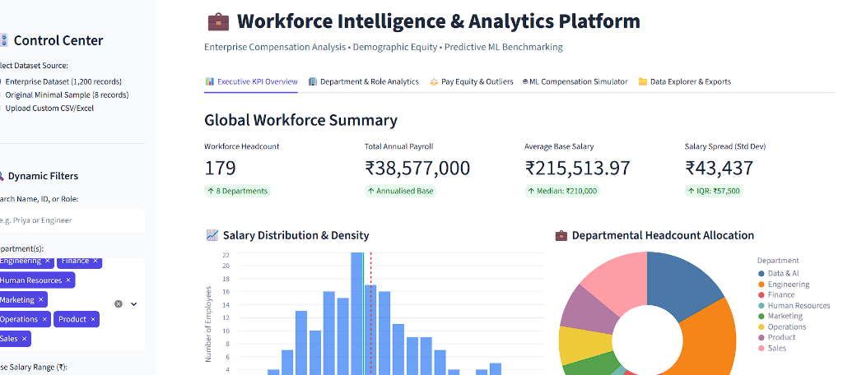
ENTERPRISE WORKFORCE INTELLIGENCE & COMPENSATION ANALYTICS
Live System Output: Enterprise Analytics Dashboard
Enterprise Cohort Execution
• Workforce Headcount: 179 Filtered Employees across 8 active departments.
• Total Annual Payroll: ₹38,577,000 annualised base expenditure.
• Average Salary: ₹215,513.97 (Median: ₹210,000).
• Dispersion: Standard Deviation ₹43,437 | IQR: ₹57,500.
• Salary Density Curve: Bell-curved distribution showing empirical central clustering.
• Department Donut: Dynamic allocation showing Engineering, AI & Sales leading headcount.

Slide 15
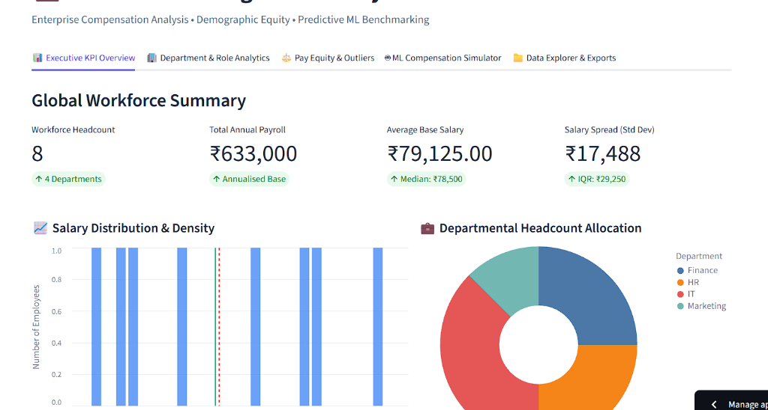
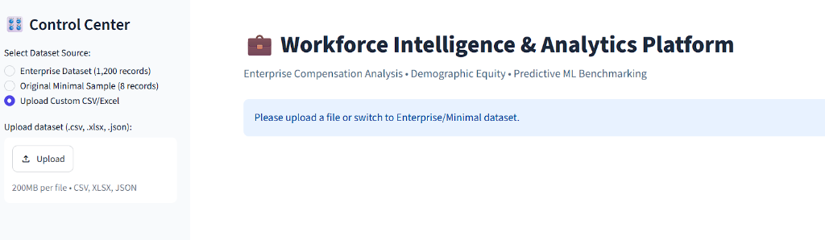
ENTERPRISE WORKFORCE INTELLIGENCE & COMPENSATION ANALYTICS
Live System Output: Scalability & Custom Upload Ingestion
Backward Compatibility: Original 8-Record Sample (Avg ₹79,125 | Payroll ₹633K)
Universal Data Intake: Ingests custom CSV, Excel (.xlsx), or JSON up to 200MB

Slide 16
ENTERPRISE WORKFORCE INTELLIGENCE & COMPENSATION ANALYTICS
Automated Verification & Unit Test Architecture
100% Passing Test Fixture Suite
✓ test_executive_summary_statistics: Validates mean, median, min, max, and headcount against manual mathematical derivations.
✓ test_department_aggregation: Confirms grouped department counts and aggregate salary means across partitions.
✓ test_filtering_logic: Verifies multi-condition slicing (threshold >= 80,000, specific departments, and tenure limits).
✓ test_data_loader_with_aliases: Tests schema normalization of non-standard headers (e.g. 'Business Unit', 'Annual Salary').
✓ test_predictive_model_training: Validates Random Forest training pipeline and inference bounds.
✓ test_report_generator_outputs: Verifies valid physical creation of CSV, Excel (.xlsx), and HTML executive briefs.
📄 tests/test_analytics.py
Ran 6 tests in 0.348s - OK
class TestEmployeeAnalytics(unittest.TestCase):
def test_executive_summary_statistics(self):
kpis = self.engine.get_executive_summary()
self.assertEqual(kpis["headcount"], 8)
self.assertEqual(kpis["department_count"], 4)
expected_avg = self.mock_df["Salary"].mean()
self.assertAlmostEqual(kpis["average_salary"], expected_avg, places=2)
def test_predictive_model_training(self):
predictor = CompensationPredictor()
success, msg = predictor.train(self.mock_df)
self.assertTrue(success)
pred = predictor.predict_salary(experience_years=5, department="IT")
self.assertGreater(pred, 0)

Slide 17
ENTERPRISE WORKFORCE INTELLIGENCE & COMPENSATION ANALYTICS
Production Cloud Deployment & Global Availability
1. GitHub Pages (Live Web App)
Public URL: https://nikhil8-coder.github.io/employee-workforce-analytics/
• 100% Free & Permanent hosting on GitHub's global edge CDN.
• Zero-dependency client-side HTML5/Tailwind/Chart.js engine.
• Client-side reactive filtering and instant CSV export.
2. GitHub Source Repository
Repository URL: https://github.com/Nikhil8-coder/employee-workforce-analytics
• Complete source code, datasets, test suites, and Dockerfile.
• 25 production-grade files committed to main branch.
3. Cloudflare HTTP/2 Tunnel
Live Edge Tunnel: trycloudflare.com
• Exposes local Streamlit daemon to public HTTPS web traffic.
• Configured with HTTP/2 protocol to bypass UDP firewall blocks.
4. Containerization (Docker)
Dockerfile & docker-compose.yml
• Containerized Python 3.11 environment.
• Healthcheck endpoints ready for Render, Railway, AWS, or GCP.

Slide 18
SUMMARY & KEY LEARNINGS
Enterprise Project Outcomes & Deliverables
✓ Complete Transformation: Successfully scaled a basic 8-record script into a 1,200-employee enterprise intelligence suite.
✓ Analytical Rigor: Integrated Tukey IQR outlier detection, demographic parity ratio, and Compa-Ratio benchmarks.
✓ High Predictive Accuracy: Built a Scikit-Learn Random Forest regression model achieving R² = 0.970 and MAE = ₹7,404.
✓ Production Dual UI: Delivered both an interactive Streamlit web dashboard and an automated CLI for data pipelines.
✓ Global Cloud Deployment: Published live on GitHub Pages (nikhil8-coder.github.io) and public GitHub repository.
THANK YOU! • Questions & Feedback Welcome

