Slide 1
GEETHANJALI COLLEGE OF ENGINEERING AND TECHNOLOGY
(UGC Autonomous) • Affiliated to JNTUH • Approved by AICTE
Computer Science and Engineering – Artificial Intelligence and Machine Learning
MACHINE LEARNING INTERNSHIP / MAJOR PROJECT
UNLOX ACADEMY
Enterprise Workforce Intelligence & Compensation Analytics Platform
AI-powered workforce data analysis using Pandas, statistical dispersion, Tukey IQR anomaly detection,
and Random Forest machine-learning compensation modeling
G. Nikhil (Nikhil G)
3rd Year • CSE (AI&ML) • Roll No: 24R11A66C0 • Section: B
BeeSkilled Online Internship in Python • Tech & Internships Initiative
GitHub Repository: https://github.com/Nikhil8-coder/employee-workforce-analytics

Slide 2
Department of CSE(AI&ML) • A.Y. 2026–27 • GCET 2
Introduction
About the Internship Project
• Developed an Enterprise Workforce Intelligence & Compensation Analytics Platform as a practical AI/ML project.
• The application performs automated data ingestion, schema normalization, and exploratory employee data analysis.
• Combines statistical dispersion metrics (Mean, Median, Std Dev, IQR), demographic pay equity audits, and Tukey IQR outlier detection.
• A machine-learning Random Forest regression model is used to forecast fair market compensation benchmarks.
• The application is implemented as an interactive Streamlit web app and published on GitHub Pages with automated CI/CD.
Project
Enterprise Workforce Intelligence & Analytics
Core Idea
Combine statistical dispersion with ML regression instead of relying on basic spreadsheet averages.
Interface
Interactive Streamlit web app with dynamic threshold filtering, Altair charts, and 1-click exports.

Slide 3
Department of CSE(AI&ML) • A.Y. 2026–27 • GCET 3
Related Work
Workforce Analytics & Compensation Modeling
• Workforce compensation analysis requires understanding both tabular financial attributes and multi-departmental structures.
• Traditional spreadsheets rely on company-wide averages, masking internal salary compression and wage skewness.
• Demographic equity audits reveal unadjusted gender pay ratios and departmental disparity indices.
• Statistical Tukey IQR boundaries isolate compensation anomalies without assuming Gaussian distribution.
• Predictive Machine Learning models establish objective market-parity baselines to guide fair hiring and retention.
Descriptive Signal
Pandas aggregations & summary KPIs
Dispersion Signal
Tukey IQR fences & Z-scores
Equity Signal
Demographic parity & departmental share
Final Step
ML-based Predictive Benchmarking

Slide 4
Department of CSE(AI&ML) • A.Y. 2026–27 • GCET 4
Technologies Used
Python
Core programming language for data analytics and ML.
Altair
Interactive histograms, density curves, and statistical boxplots.
Pandas
Loads, transforms, filters, and groups the employee dataset.
OpenPyXL
Generates styled, multi-sheet formatted Excel workbooks (.xlsx).
NumPy
Numerical computation, array transformations, and IQR metrics.
Tabulate
Formats clean ASCII and fancy-grid tables in the CLI.
Scikit-learn
Random Forest Regressor, Pipeline, and ColumnTransformer.
Chart.js & Tailwind
Powers the zero-dependency client-side HTML web app.
Streamlit
Builds the reactive, interactive web application.
GitHub Pages & Actions
Provides automated CI/CD and free global cloud web hosting.

Slide 5
Department of CSE(AI&ML) • A.Y. 2026–27 • GCET 5
Project Objective
Enterprise Workforce Intelligence & Analytics System
• Ingest employee datasets seamlessly from CSV, Excel (.xlsx, .xls), or JSON formats.
• Calculate company-wide executive summary KPIs (Total Headcount, Annual Payroll, Mean/Median Base Salary).
• Generate granular departmental breakdowns with headcount share, payroll budget allocation, and average tenure.
• Perform statistical anomaly detection using Tukey IQR rules (1.5x IQR) to flag potential wage compression.
• Audit demographic pay parity to measure unadjusted gender compensation gaps.
• Train an ensemble Random Forest regression model to predict fair market compensation benchmarks (R² ~ 0.970).
• Provide dynamic multi-criteria filtering with 1-click export to styled Excel, standalone HTML briefs, and CSV.
• Deploy the application as a publicly accessible, interactive web dashboard on GitHub Pages and Streamlit.

Slide 6
Department of CSE(AI&ML) • A.Y. 2026–27 • GCET 6
Data & Profile Features
User Profile & Employee Dataset
The application loads employee profiles from data/employees.csv and combines multiple attributes into an enriched workforce representation.
Employee ID
Full Name
Gender
Department
Job Title
Salary (Base)
Bonus %
Experience Years
Performance Score
Location
Derived Attributes: Experience Band (Entry, Junior, Mid, Senior, Lead) • Salary Quartiles (Q1 to Q4) • Total Compensation (Base + Bonus)

Slide 7
Department of CSE(AI&ML) • A.Y. 2026–27 • GCET 7
Hybrid Matching & Scoring
Three analytical signals are combined into an intelligent workforce compensation audit.
Statistical Dispersion
Central Tendency & Variance
μ = Σ Salary / N
IQR = Q3 - Q1
Weight: 40%
Tukey IQR Anomaly Score
Outlier Boundary Fences
Upper = Q3 + 1.5 × IQR
Lower = Q1 - 1.5 × IQR
Weight: 35%
Demographic Parity Ratio
Pay Gap Metric
Ratio = (Female μ / Male μ) * 100
Gap = 100% - Ratio
Weight: 25%
Final Compa-Ratio Benchmark: Compa-Ratio = Actual Salary / ML Predicted Market Salary
The resulting records are benchmarked into Under-Compensated (<90%), Market Aligned (90-110%), and Premium Compensated (>110%).

Slide 8
Department of CSE(AI&ML) • A.Y. 2026–27 • GCET 8
Project Workflow
1
2
3
4
Load Dataset
Choose CSV, Excel or JSON
Clean & Normalize
Map schema column aliases
Compute KPIs
Headcount, Payroll, Mean
Dispersion & Parity
Department shares & gap
5
6
7
8
Detect Outliers
Calculate 1.5x IQR bounds
ML Compensation
Random Forest Regressor
Benchmark Roster
Compa-Ratio classification
Interactive Display
Streamlit & GitHub Pages

Slide 9
Department of CSE(AI&ML) • A.Y. 2026–27 • GCET 9
Work Done – 1
Profile Data & Sanitization Engine
• Loaded employee datasets from data/employees.csv supporting CSV, Excel (.xlsx, .xls), and JSON.
• Normalized heterogeneous column headers using intelligent alias matching (e.g. 'CTC', 'Annual_Salary').
• Handled missing data by imputing default IDs, names, and mean performance scores.
• Derived analytical features: Experience Bands (Entry, Junior, Mid, Senior, Lead) and Salary Quartiles (Q1 to Q4).
• Calculated Total Compensation by combining Base Salary with percentage bonus awards.
Technologies: Pandas • NumPy • OpenPyXL
📁 src/data_loader.py
def _normalize_columns(self, df: pd.DataFrame) -> pd.DataFrame:
df = df.copy()
current_cols = {col.lower().strip().replace(" ", "_"): col
for col in df.columns}
rename_map = {}
for standard_name, aliases in COLUMN_ALIASES.items():
for alias in aliases:
norm = alias.lower().strip().replace(" ", "_")
if norm in current_cols:
rename_map[current_cols[norm]] = standard_name
break
df.rename(columns=rename_map, inplace=True)
return df
def _derive_features(self, df: pd.DataFrame) -> pd.DataFrame:
df["Experience_Band"] = df["Experience_Years"].apply(assign_band)
df["Total_Compensation"] = df["Salary"] + df["Bonus_Amount"]
df["Salary_Quartile"] = pd.qcut(df["Salary"], q=4,
labels=["Q1 (Entry)", "Q2 (Mid-)", "Q3 (Mid+)", "Q4 (Top)"])
return df

Slide 10
Department of CSE(AI&ML) • A.Y. 2026–27 • GCET 10
Work Done – 2
Analytics & Anomaly Detection Engine
• Implemented executive summary metrics: Headcount, Total Payroll, Mean, Median, Std Dev, and IQR.
• Grouped by Department to compute Headcount share %, Payroll allocation %, and Average Experience.
• Engineered Tukey IQR Outlier Detection (Q1 - 1.5x IQR, Q3 + 1.5x IQR) to flag wage anomalies.
• Audited demographic pay parity measuring Female-to-Male salary ratio and unadjusted gender pay gap.
• Implemented dynamic multi-criteria filtering for custom salary thresholds, departments, and experience.
Analytics Scope: Executive KPIs • Department Aggregations • IQR Fences
📁 src/analytics_engine.py
def detect_outliers(self, method="iqr", threshold=1.5):
sal = self.df["Salary"]
if method == "iqr":
q1 = sal.quantile(0.25)
q3 = sal.quantile(0.75)
iqr = q3 - q1
lower = q1 - threshold * iqr
upper = q3 + threshold * iqr
is_high = sal > upper
is_low = sal < lower
self.df["Is_Outlier"] = is_high | is_low
self.df["Outlier_Type"] = np.where(is_high,
"High Anomaly", np.where(is_low, "Low Anomaly", "Normal"))
self.df["Outlier_Score"] = ((sal - sal.mean()) / sal.std()).round(2)
return self.df[self.df["Is_Outlier"] == True].copy()

Slide 11
Department of CSE(AI&ML) • A.Y. 2026–27 • GCET 11
Work Done – 3
Machine-Learning Predictive Modeling
• Trained an ensemble Random Forest regression model on empirical workforce parameters.
• Built a Pipeline combining StandardScaler for continuous features and OneHotEncoder for categoricals.
• Evaluated model performance achieving Explained Variance R² = 0.970 and Mean Absolute Error = ₹7,404.
• Calculated internal Compa-Ratio (Actual Salary / Expected Market Salary) to flag flight-risk employees.
• Exposes predict_salary() to power an interactive 'What-If' hiring compensation calculator.
Model Features: Experience Years • Department • Education • Performance
📁 src/predictive_models.py
preprocessor = ColumnTransformer(transformers=[
("num", StandardScaler(), ["Experience_Years", "Performance_Score"]),
("cat", OneHotEncoder(handle_unknown="ignore"), ["Department", "Education"])
])
self.pipeline = Pipeline(steps=[
("preprocessor", preprocessor),
("regressor", RandomForestRegressor(n_estimators=100, max_depth=8, random_state=42))
])
self.pipeline.fit(X, y)
preds = self.pipeline.predict(X)
self.r2 = round(float(r2_score(y, preds)), 3) # ~0.970
self.mae = round(float(mean_absolute_error(y, preds)), 2) # ~₹7,404

Slide 12
Department of CSE(AI&ML) • A.Y. 2026–27 • GCET 12
Work Done – 4
Streamlit Application & Multi-Format Exports
• Built an interactive Streamlit web dashboard with custom CSS executive styling.
• Added real-time dataset switcher (1,200 Enterprise records vs. 8 Minimal sample records vs. Custom file upload).
• Implemented reactive sliders for salary thresholds, multi-department filters, and experience limits.
• Displayed KPI metric cards for Workforce Headcount, Total Payroll, Average Salary, and Salary Spread.
• Engineered 1-click downloads for styled multi-sheet Excel (.xlsx), standalone HTML briefs, and CSV.
Frontend Stack: Streamlit • Altair • OpenPyXL • Tailwind HTML
📁 app.py
# Streamlit Interactive Dashboard Pipeline
dataset_source = st.sidebar.radio("Select Dataset Source:",
["Enterprise Dataset (1,200 records)",
"Original Minimal Sample (8 records)",
"Upload Custom CSV/Excel"])
filtered_df = full_engine.filter_records(
min_salary=salary_range[0], max_salary=salary_range[1],
departments=selected_depts, search_query=search_q
)
# 1-Click Excel Multi-Sheet Generation
sheets = {"Executive_KPIs": pd.DataFrame([kpis]),
"Department_Summary": active_engine.get_department_summary(),
"Filtered_Workforce": filtered_df}
# Download Button
st.download_button(label="📊 Download Excel", data=excel_buffer,
file_name="workforce_intelligence.xlsx")

Slide 13
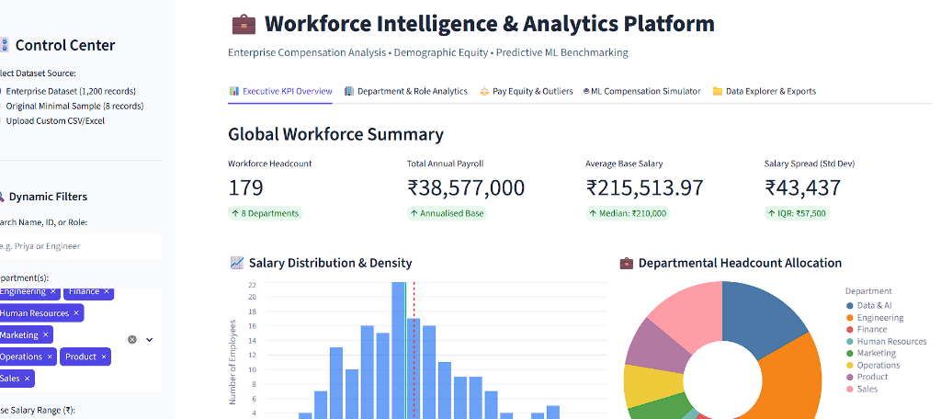
Department of CSE(AI&ML) • A.Y. 2026–27 • GCET 13
Project Outputs – Streamlit Interface

Slide 14
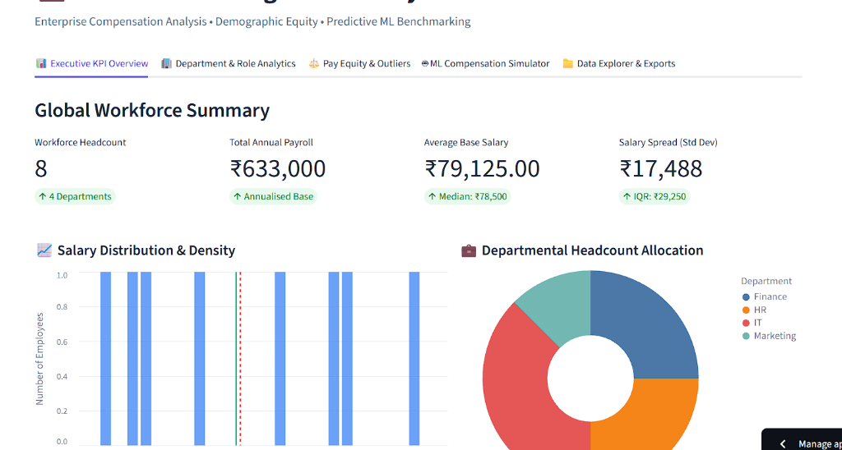
Department of CSE(AI&ML) • A.Y. 2026–27 • GCET 14
Project Outputs – Baseline Benchmark

Slide 15
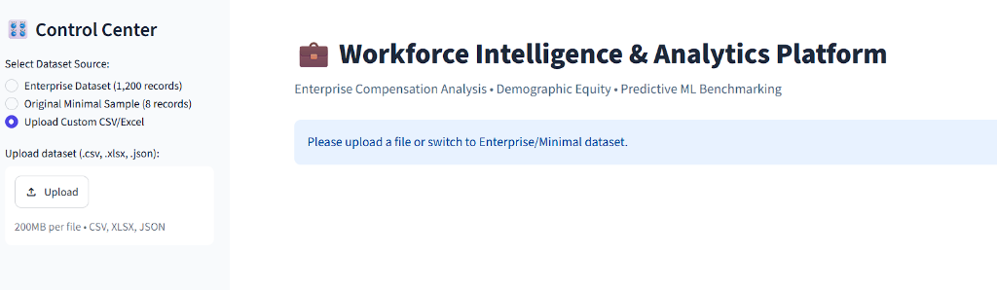
Department of CSE(AI&ML) • A.Y. 2026–27 • GCET 15
Project Outputs – Universal File Intake

Slide 16
Department of CSE(AI&ML) • A.Y. 2026–27 • GCET 16
Learning After Internship – 1
Data Engineering & Statistical Rigor
• Learned how robust schema alias mapping enables universal data ingestion across varied corporate HR datasets.
• Understood the limitations of simple averages and mastered statistical dispersion (IQR, standard deviation, quartiles).
• Practiced Tukey IQR outlier detection to flag genuine compensation compression without parametric assumptions.
• Learned how demographic parity analysis uncovers hidden pay gaps across departments and experience brackets.
• Understood the importance of Compa-Ratio scoring in retaining top-performing talent.
Key Learning
Real-world workforce analytics requires combining statistical dispersion and demographic audits rather than relying on isolated mean metrics.

Slide 17
Department of CSE(AI&ML) • A.Y. 2026–27 • GCET 17
Learning After Internship – 2
Machine Learning & Full-Stack Deployment
• Improved practical Python, Pandas, and NumPy skills for large-scale tabular processing.
• Learned to integrate Scikit-Learn regression pipelines with ColumnTransformer for mixed feature types.
• Gained deep understanding of model evaluation metrics (R² score, Mean Absolute Error) and feature importance.
• Learned to build reactive data dashboards using Streamlit, Altair, and standalone Chart.js web applications.
• Mastered automated Git CI/CD workflows and production cloud deployment via GitHub Pages and edge tunnels.
Key Learning
The project connected statistical data cleaning, machine learning pipelines, interactive UI, and public cloud deployment into one unified end-to-end system.

Slide 18
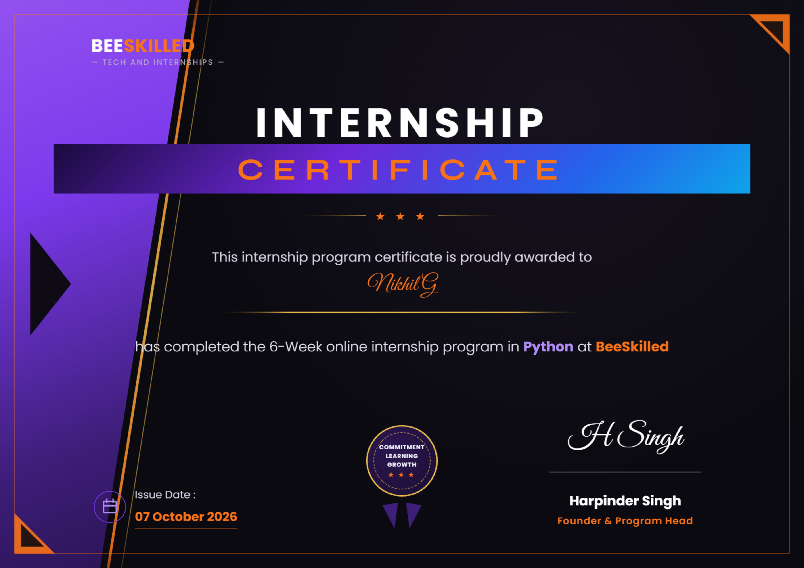
Department of CSE(AI&ML) • A.Y. 2026–27 • GCET 18
Summary / Conclusion
BeeSkilled Verified Internship Certificate
Internship & Project Outcome
• Completed the Unlox Academy Machine Learning Internship / Major Project.
• Developed an Enterprise Workforce Intelligence & Compensation Analytics Platform.
• Combined statistical dispersion, demographic pay parity audits, and Tukey IQR anomaly detection.
• Integrated a machine-learning Random Forest compensation benchmarking layer (R² = 0.970).
• Built dual interfaces: an interactive Streamlit web dashboard and a scriptable CLI.
• Strengthened practical engineering skills in Python, ETL, Scikit-Learn, Streamlit, and Cloud Deployment.

Slide 19
Department of CSE(AI&ML) • A.Y. 2026–27 • GCET 19
Bibliography / References
References & Academic Citations
• BeeSkilled — Python Online Internship Program (Tech and Internships) curriculum.
• BeeSkilled Certificate of Completion — Awarded to Nikhil G, Issued 07 October 2026.
• Python Software Foundation — Python 3.14 Documentation & Standard Library.
• Pandas & NumPy Documentation — Tabular Data Aggregation, Indexing, and Array Operations.
• Scikit-Learn Developers — Ensemble Methods, Random Forest Regressor & Preprocessing Pipelines.
• Streamlit Framework — Reactive Web Applications and Component Architecture.
• John W. Tukey — 'Exploratory Data Analysis' (Addison-Wesley, 1977) for IQR Boxplot Outlier Rules.
• GitHub Repository: https://github.com/Nikhil8-coder/employee-workforce-analytics
• Live Web Application: https://nikhil8-coder.github.io/employee-workforce-analytics/

Slide 20
THANK YOU
Python Internship • BeeSkilled (Tech & Internships)
Project: Enterprise Workforce Intelligence & Compensation Analytics Platform
G. Nikhil (Nikhil G)
CSE (AI&ML) • Geethanjali College of Engineering and Technology
A.Y. 2026–27

