Slide 1
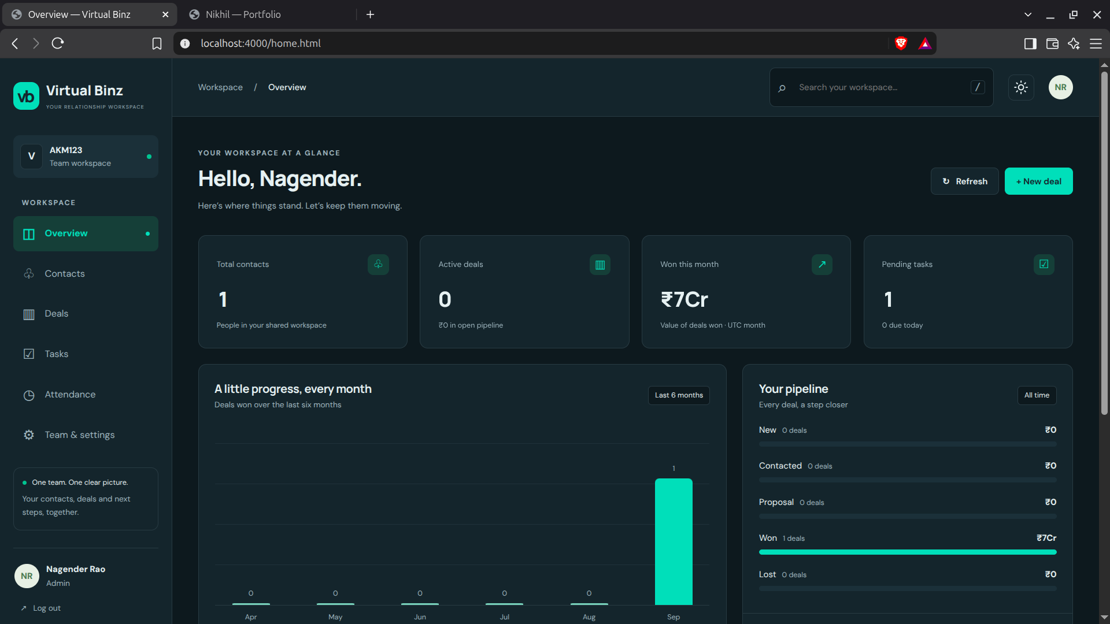
FULL-STACK PROJECT
CRM
Management System
Dashboard
A practical CRM for contacts, deals, tasks, teams, permissions, attendance and operational history.
Web Developer
BTech · 4th Year
Nagender Rao
Portfolio Project · 2026
HTML · CSS · JavaScript · Node.js · Express · PostgreSQL · Prisma

Slide 2
PROJECT OVERVIEW
Built to manage the full customer workflow
From a contact entering the system to team ownership, deal tracking, tasks and day-to-day employee operations.
Customer records
Sales pipeline
Task execution
Searchable contacts with company, phone, owner and record lifecycle controls.
Deals move through stages, keep expected close dates and track won value.
Tasks link back to CRM records and can be assigned to employees.
Teams & roles
Attendance
Recovery & history
Admin, sub-admin and employee roles with team-aware access and ownership.
Check-in, breaks, check-out, history and correction review integrated into the same workspace.
Recycle bin and activity history make changes easier to review and recover.
Design goal
Keep sales, people and operational workflows in one clean, role-aware interface.

Slide 3
TECHNOLOGY
Simple stack. Clear responsibilities.
The project uses a browser frontend, an Express API, Prisma as the data layer and PostgreSQL for persistence.
Frontend
Server
ORM
HTML · CSS · JavaScript
Node.js · Express.js
Prisma
Database
Security
Tooling
PostgreSQL
Cookie sessions · CSRF
Git · GitHub
Browser UI
Express API
Prisma
PostgreSQL

Slide 4
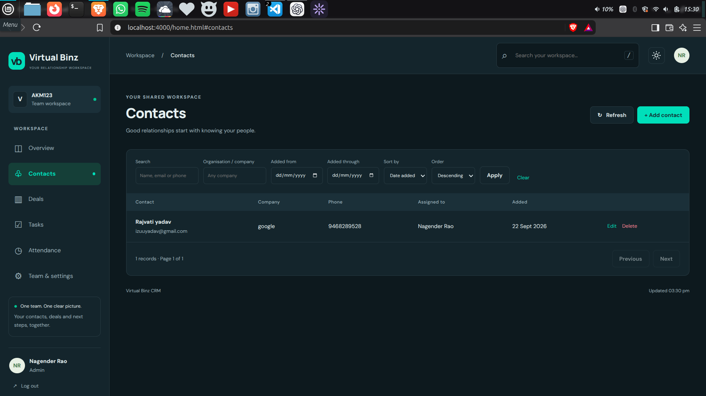
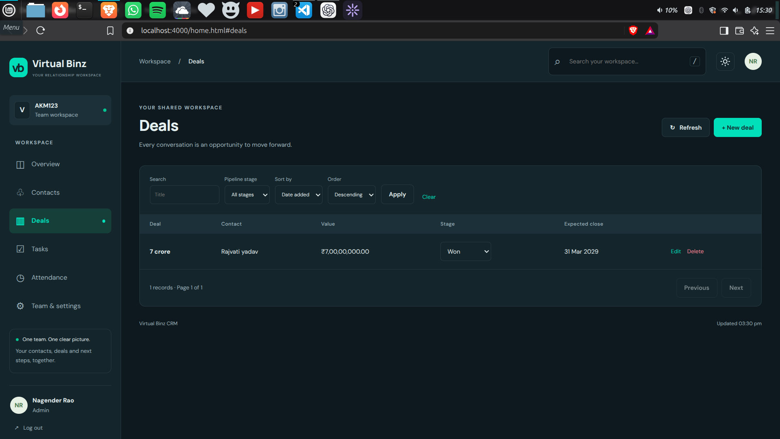
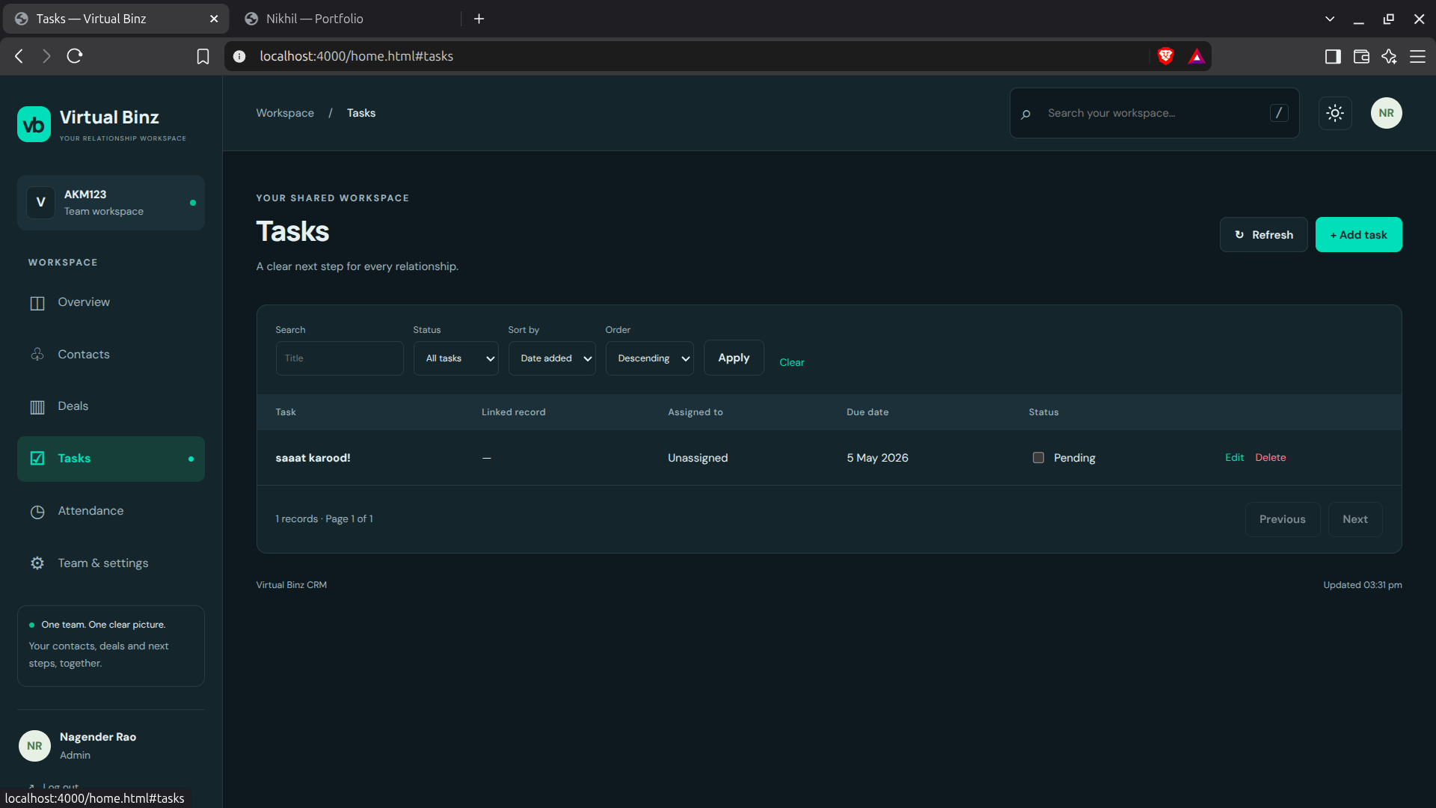
CORE CRM
Contacts → Deals → Tasks
The three everyday screens are intentionally consistent: filter, review, act.
Contacts
Deals
Tasks
Contacts
Deals
Tasks
Search by name/email/phone, filter records and assign ownership.
Track value, stage and expected close date with inline stage updates.
Link work back to CRM records and keep ownership visible.

Slide 5
DASHBOARD
A quick read of the workspace
KPIs, won value, pipeline distribution and task workload are visible without digging through tables.
Overview
KPIs
Contacts, active deals, won value and pending tasks.
Trend view
Monthly wins make progress visible over time.
Pipeline
Stage-by-stage deal value gives a quick sales snapshot.

Slide 6
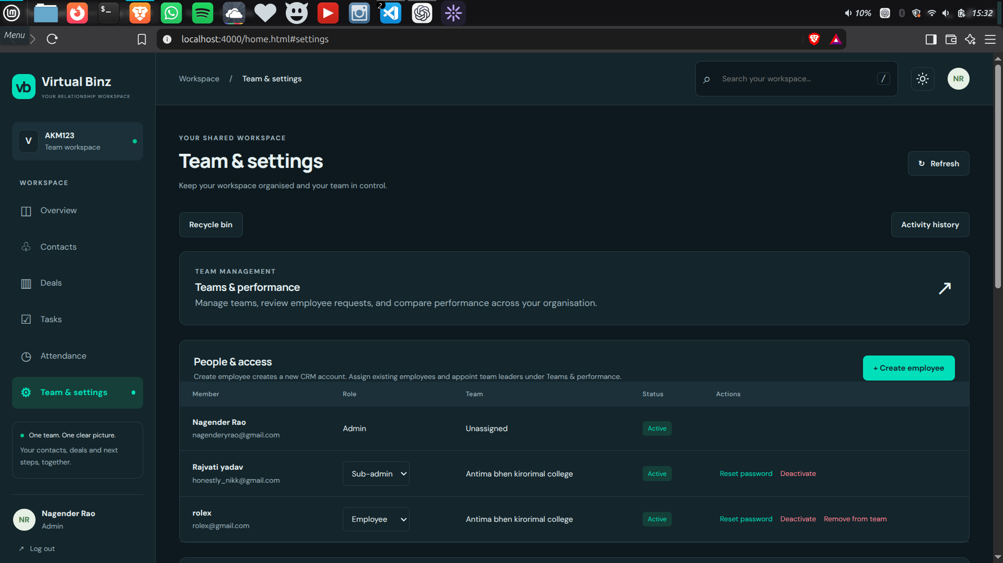
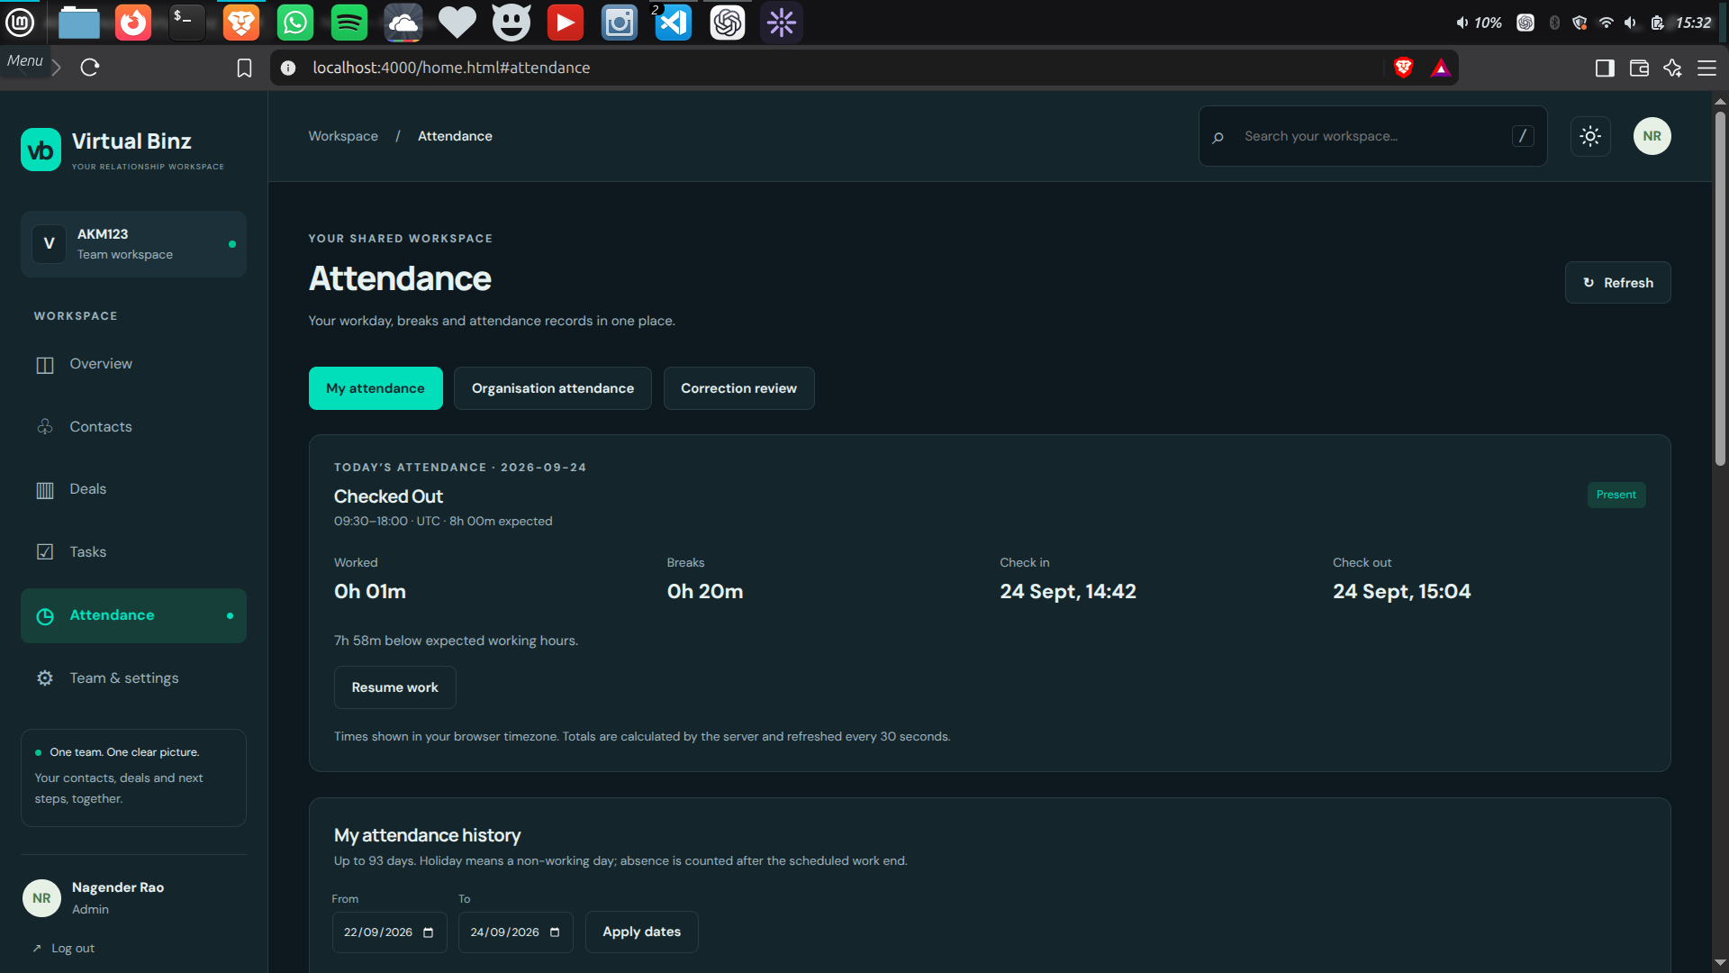
PEOPLE OPERATIONS
Teams, access and attendance in the same system
The CRM goes beyond customer records by handling employee roles, team ownership and day-to-day attendance.
Team & Settings
Attendance
Admin / Sub-admin / Employee roles
Organisation-wide view for admins
Create employees and assign existing employees to teams
Team-aware access for sub-admins
Check-in, break, resume and check-out workflow
Server-calculated working time
Attendance history and correction review
Attendance events reflected in activity history

Slide 7
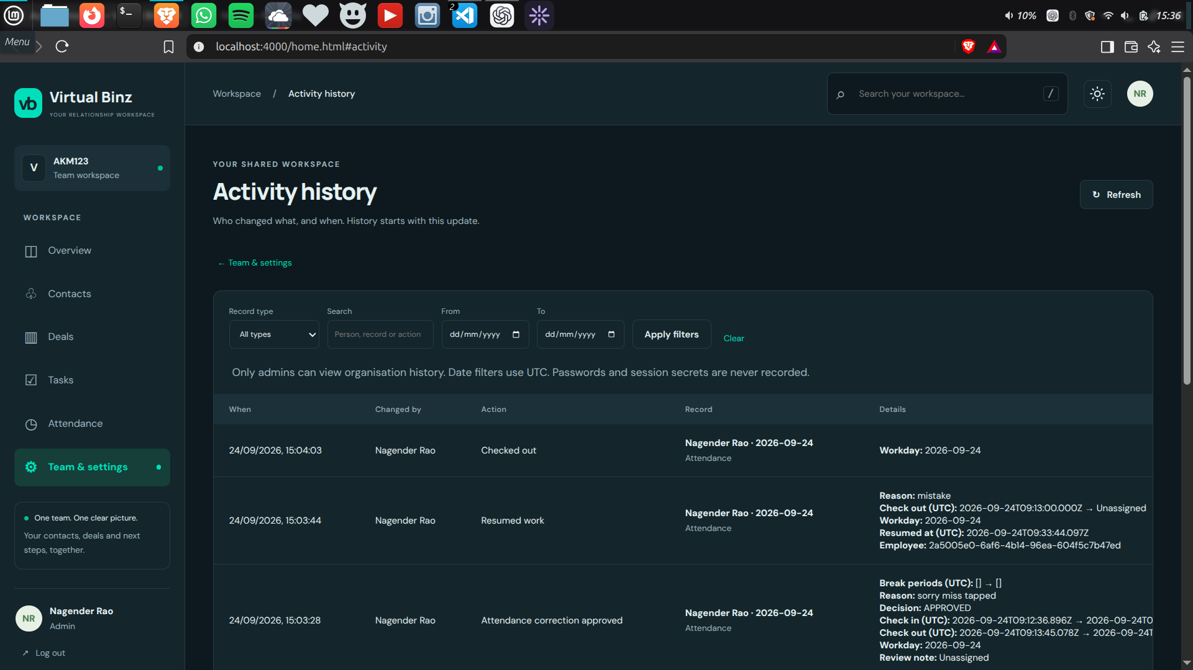
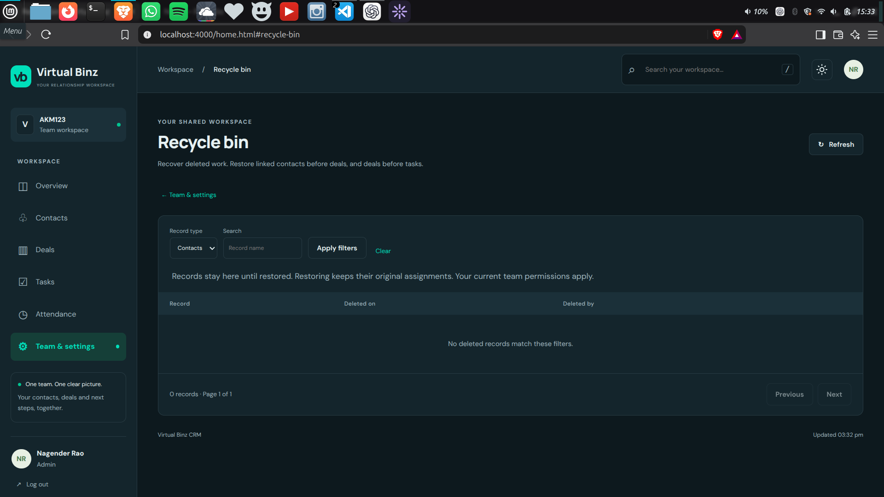
OPERATIONAL SAFETY
See what changed. Recover what was deleted.
Activity history and recycle bin make the application more forgiving and easier to audit.
Activity History
Recycle Bin
Activity history
Recycle bin
Tracks who changed what and when, including attendance-related actions.
Deleted CRM records can be restored while respecting current permissions.

Slide 8
PROJECT SUMMARY
A CRM built as a complete
working product, not just a CRUD demo.
Nagender Rao
Web Developer · BTech 4th Year
What this project demonstrates
GitHub
Frontend UI and responsive product design
github.com/Nikhil9466/CRM
Backend API design with role-aware permissions
LinkedIn
PostgreSQL data modelling through Prisma
Nagender Rao
Authentication, sessions and CSRF protection
Business workflows across sales and employee operations
Built with HTML · CSS · JavaScript · Node.js · Express · PostgreSQL · Prisma

