Slide 1
Snapdeal
Review Summarizer
By Group 31
Nikhil Pathak - 2101CS50
Tejas Tupke - 2101CS78
Vineet Kumar - 2101CS83
Submitted to: Dr. Sourav Kumar Dandapat

Slide 2
Problem Definition
With a large number of online product reviews, it's difficult for customers to make informed purchase decisions.
Reading all reviews manually is inefficient and often misleading.
Many reviews are unstructured, unverified, and vary in language style.
The project aims to:
Scrape reviews from Indian e-commerce platforms (Snapdeal)
Perform sentiment analysis
Conduct aspect-based opinion mining
Summarize whether a product is useful in India

Slide 3
Methodology
Web Scraping: Used Playwright to scrape product reviews from Snapdeal.
Preprocessing: Cleaned text data (e.g., removed dates, noise, and irrelevant information).
Sentiment Analysis: Applied NLTK’s VADER to analyze sentiment of reviews (positive, negative, neutral).
Aspect-Based Opinion Mining: Extracted key aspects of products (e.g., quality, delivery) and their associated sentiment.
Classification Model: Developed a model to predict product usefulness in India based on sentiment and aspects.

Slide 4
Scrapping Reviews
Primary Source: Snapdeal (originally Myntra, switched due to scraping restrictions).
Total Reviews: 500 (50 products, 10 reviews per product).
Reviews include both verified and non-verified users, mostly Indian consumers.
Scraping Tool: Playwright (automated browser-based scraper).
Annotation includes sentiment & usefulness in India.
Data cleaning: Removal of HTML tags, timestamps, and irrelevant text artifacts.

Slide 5
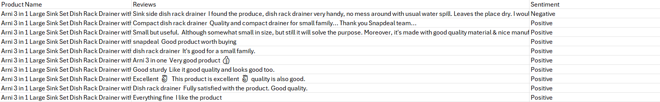
Sentiment Analysis
Used VADER (Valence Aware Dictionary and Sentiment Reasoner) from NLTK, a lexicon-based sentiment analyzer well-suited for social media and short reviews.
For each review, VADER returns:
Positive Score
Negative Score
Neutral Score
Compound Score (combined overall score)

Slide 6
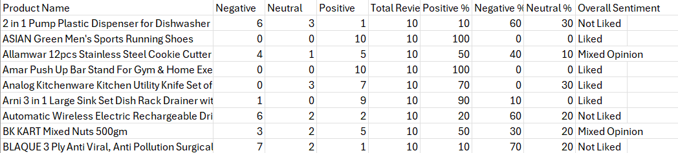
Sentiment Analysis
Based on the compound score:
≥ 0.05 → Positive
≤ -0.05 → Negative
Else → Neutral
Outcome: We now had each review labeled with a sentiment tag (Positive / Negative / Neutral).

Slide 7
Aspect-Based Opinion Mining
For each cleaned review:
Performed Part-of-Speech tagging using SpaCy to identify noun phrases (potential aspects like “quality”, “design”, “delivery”).
Analyzed words surrounding the aspect to check for adjectives, adverbs, or sentiment-bearing words (e.g., “excellent”, “good”, “nice”).
Calculated polarity of that local sentence segment using TextBlob or custom polarity rules.
For example: "The battery life is amazing." → Aspect: “battery”, Sentiment: Positive

Slide 8
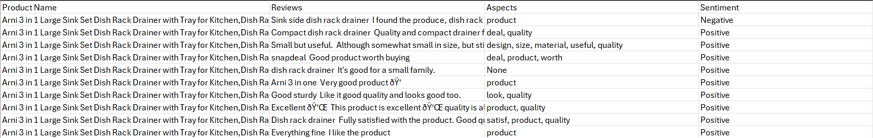
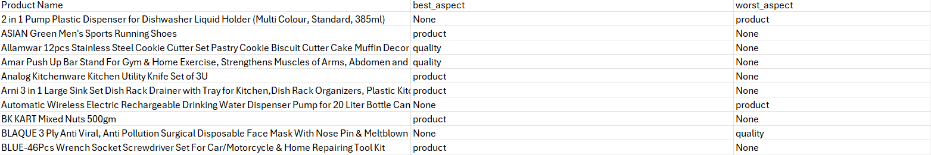
Aspect-Based Opinion Mining

Slide 9
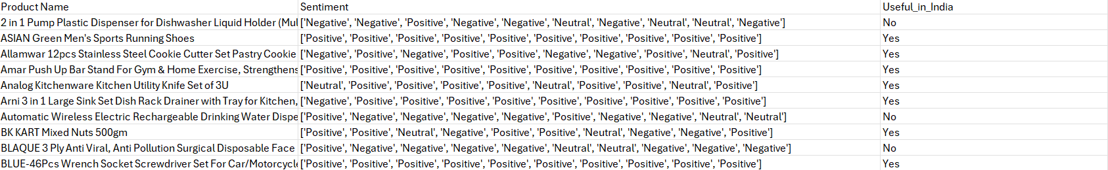
Annotating Usefulness in India
For each product, calculated the number of positive, neutral, and negative reviews.
If positive reviews outnumbered negative ones significantly,the product was labeled as:
Useful in India
Otherwise, it was labeled as:
Not Useful in India

Slide 10
Model Training & Evaluation
We built a pipeline using CountVectorizer and a Random Forest classifier to predict whether a product is useful in India based on the sentiment labels extracted from reviews.
The sentiment features were combined and converted into numerical form using CountVectorizer, and the classifier was trained on 80% of the data and tested on the remaining 20%.
It achieved 100% accuracy, correctly classifying all test samples. To verify robustness, we also performed 5-fold cross-validation, which consistently maintained high accuracy across folds.
To further validate performance, we plotted the ROC-AUC curve, which demonstrated perfect separation between the classes with an AUC score of 1.0.

Slide 11
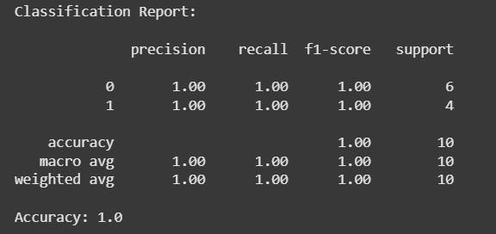
Results

Slide 12
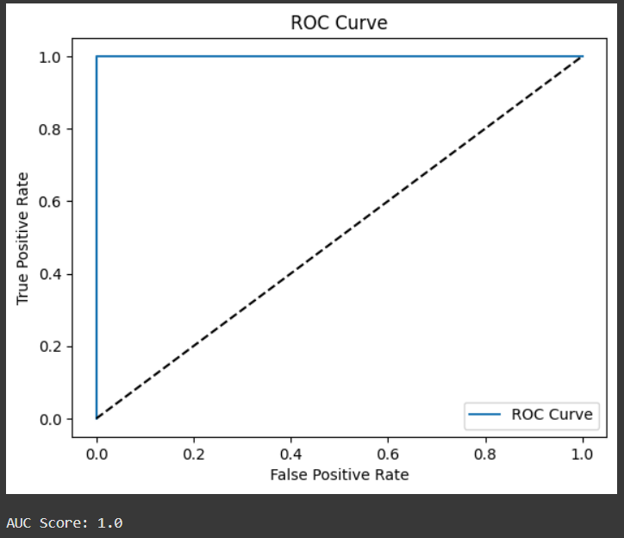
Results

Slide 13
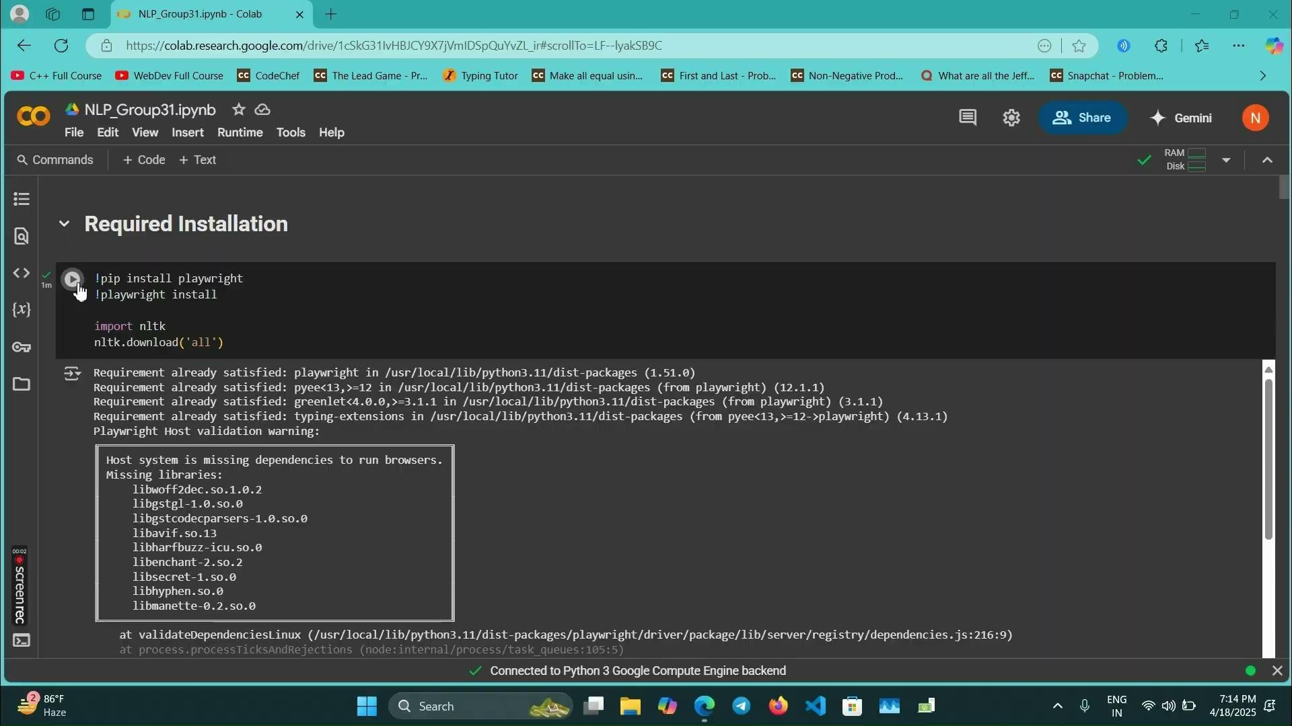
Project Demo

Slide 14
Conclusion & Contributions
Conclusion:
Built end-to-end review summarizer for Indian users.
Useful insights extracted from noisy review data.
Contributions:
Nikhil Pathak: Web Scraping, Aspect-based opinion mining, Summarization, Assisting model training.
Vineet Kumar: Dataset collection, Review preprocessing, Implemented sentiment analysis
Tejas Tupke: Implemented Aspect-based opinion mining, Dataset Annotation, Classification model training.

Slide 15
THANK YOU

