Slide 1

CREATE A EMR ON AWS

Slide 2

INSTRUCTION
1
1.FIRST LOG IN AWS ACCOUNT
2.THEN START THE LAB(WAIT TILL THE AWS DOT TURNS TO GREEN
3. GO TO SERVICES AND SELECT EMR

Slide 3
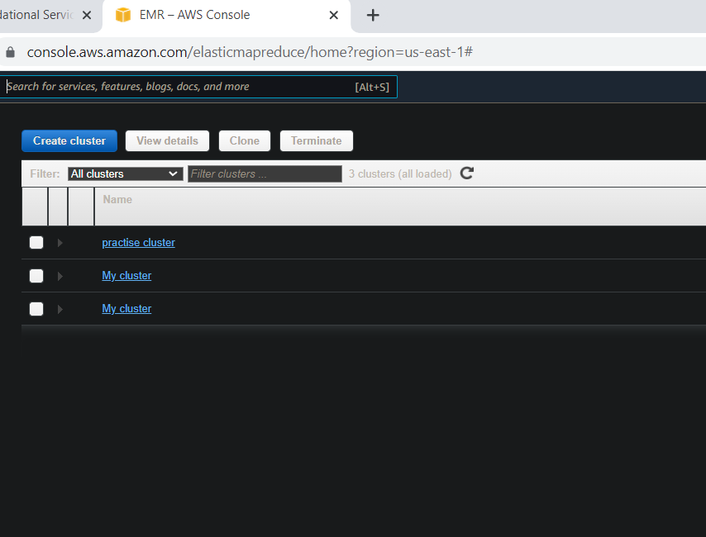
Hello!
CREATE A NEW CLUSTER :-

Slide 4
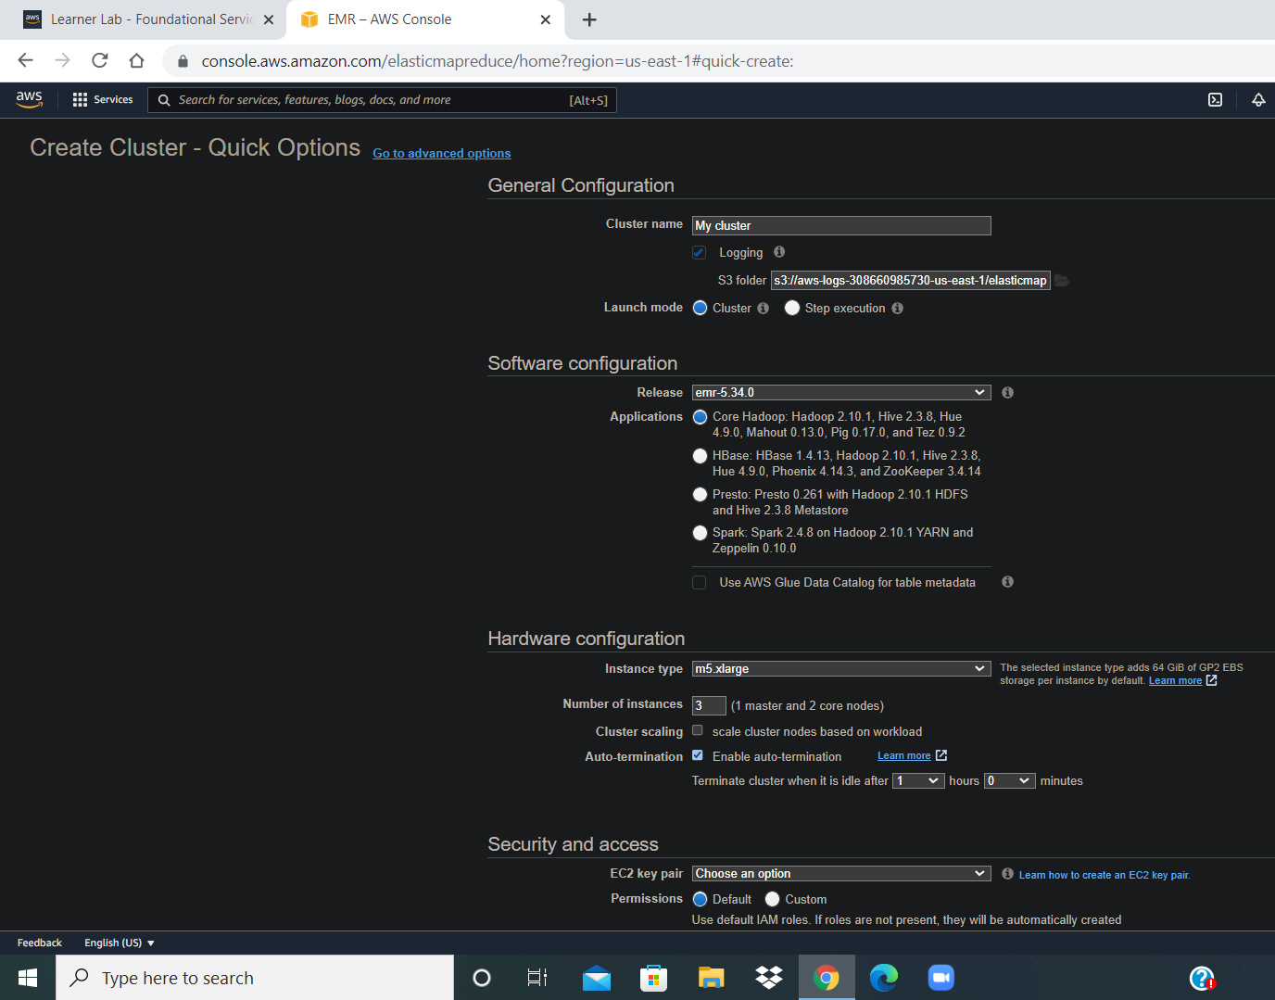
.
GO TO THE ADVANCED OPTION :-

Slide 5
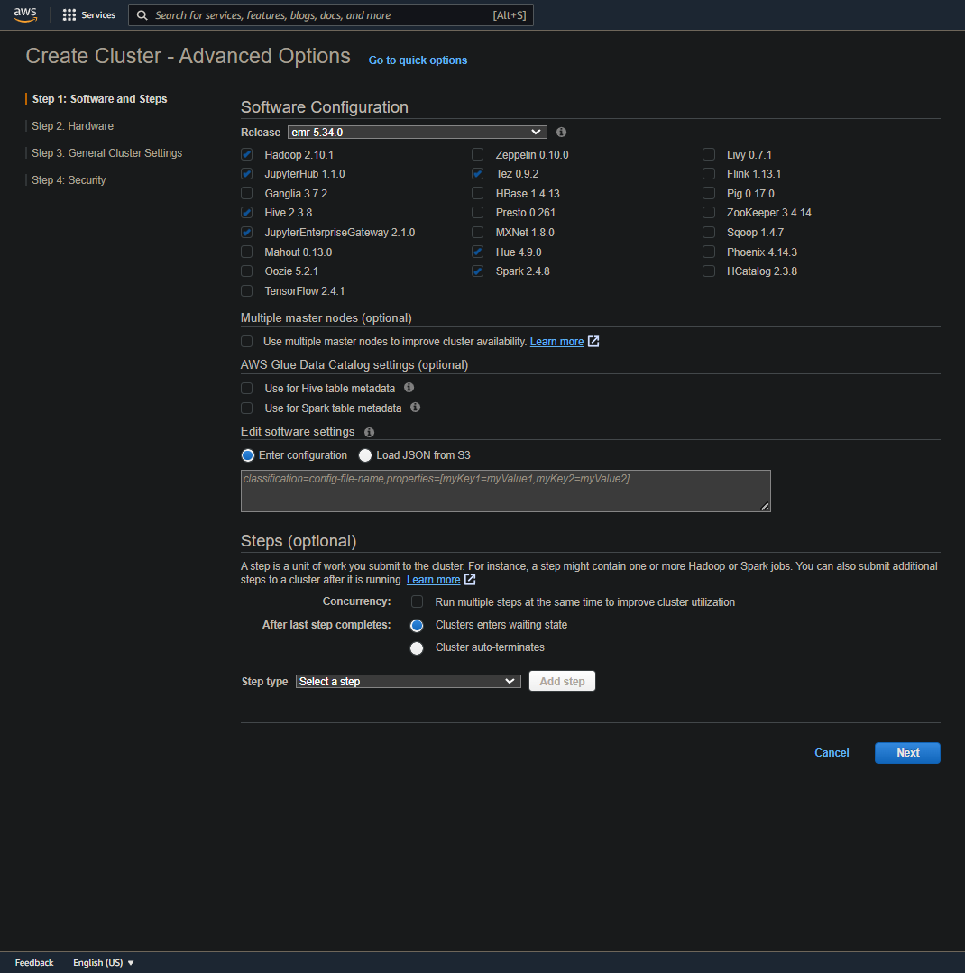
.
SELECT WHICH SOFTWARE CONFIGURATION YOU WANT IN EMR CLUSTER :
1.HADOOP
2.JUPYTERHUB
3.HIVE
4.JYPUTERENTERPRICE GATEWAY
5.TEZ
6.SPARK

Slide 6
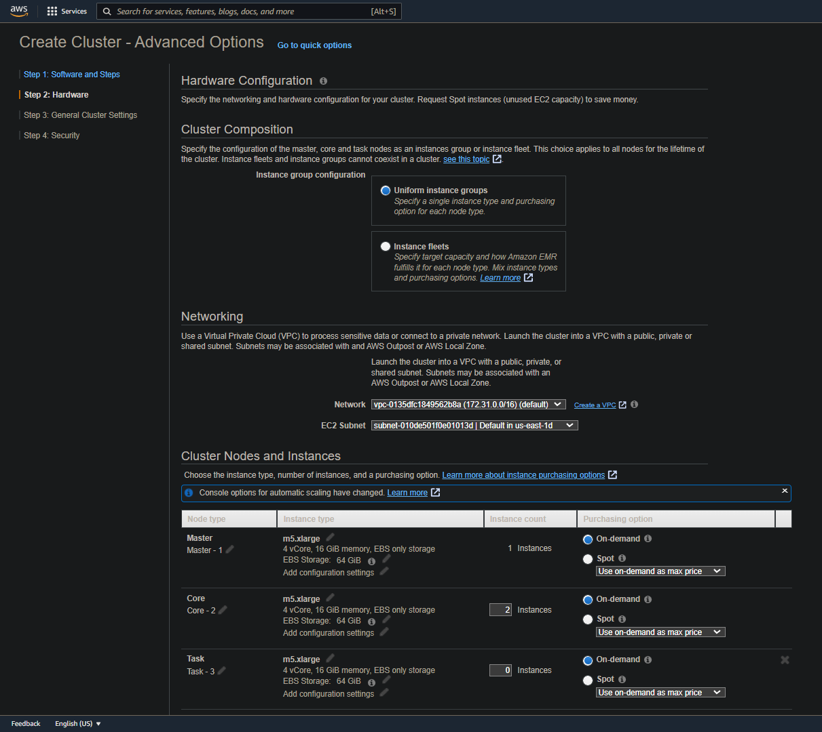
.
CLUSTER NODE AND INSTANCES :
HERE WE CAN EDIT NO. OF MASTER AND INSTANCES AS PER OUR REQUIRMENTS

Slide 7
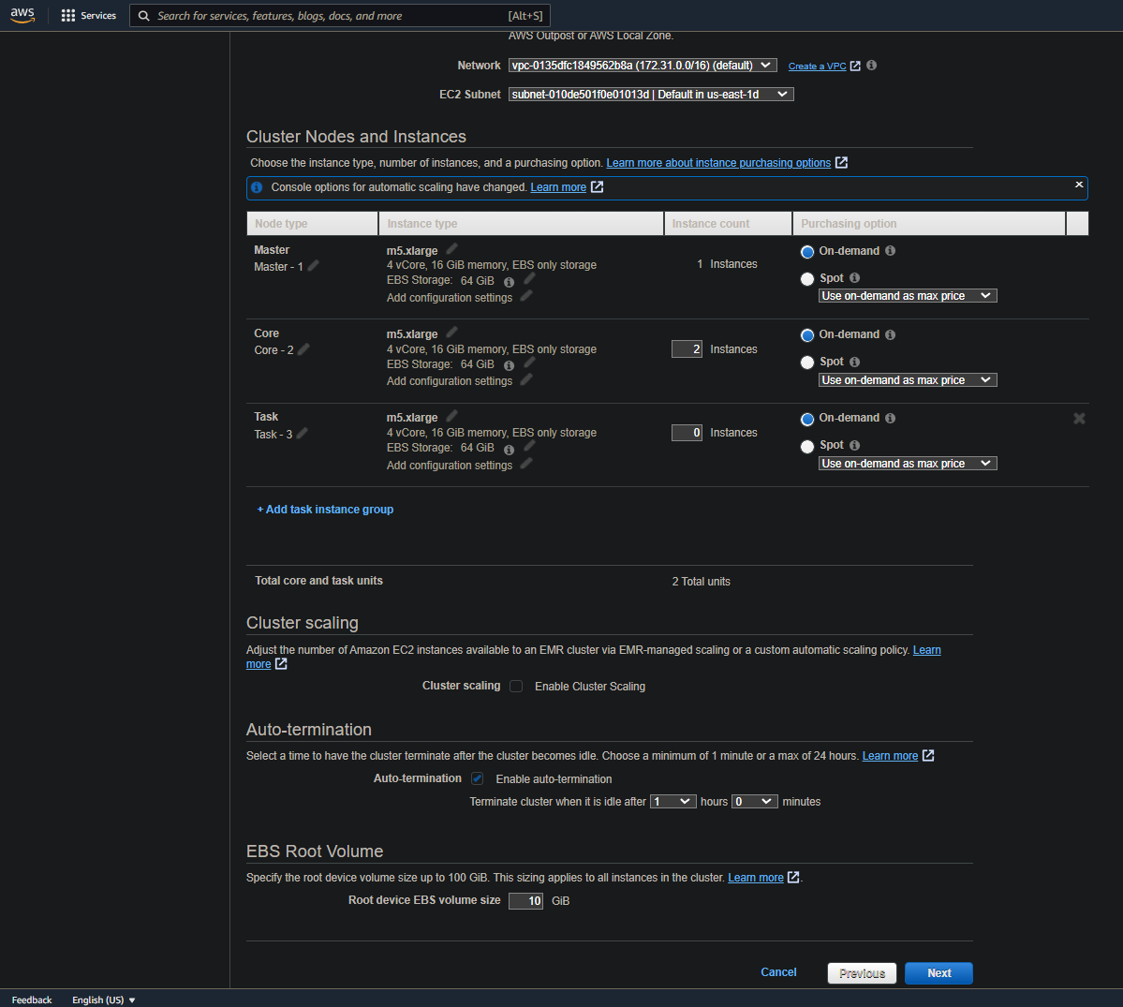
.
CLUSTER SCALING :

Slide 8
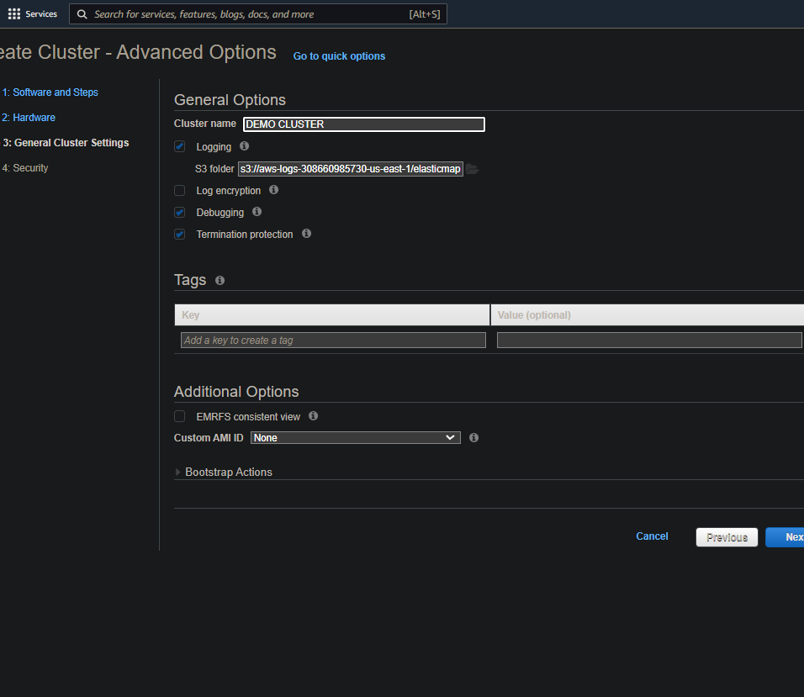
.
CLUSTER NAME :

Slide 9
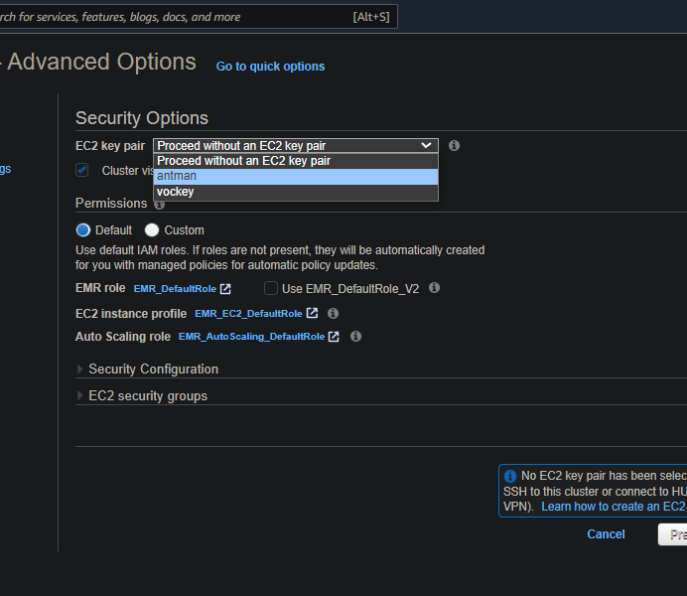
.
SECURITY OPTION :
EC2 KEY PAIR

Slide 10
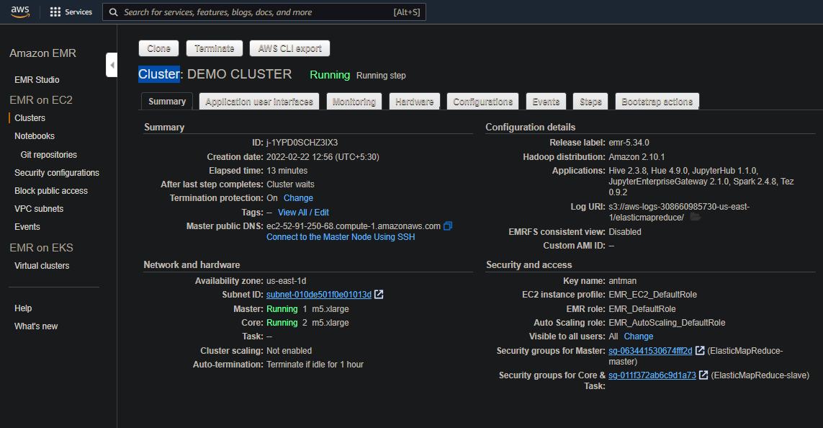
.
EMR CREATED

Slide 11
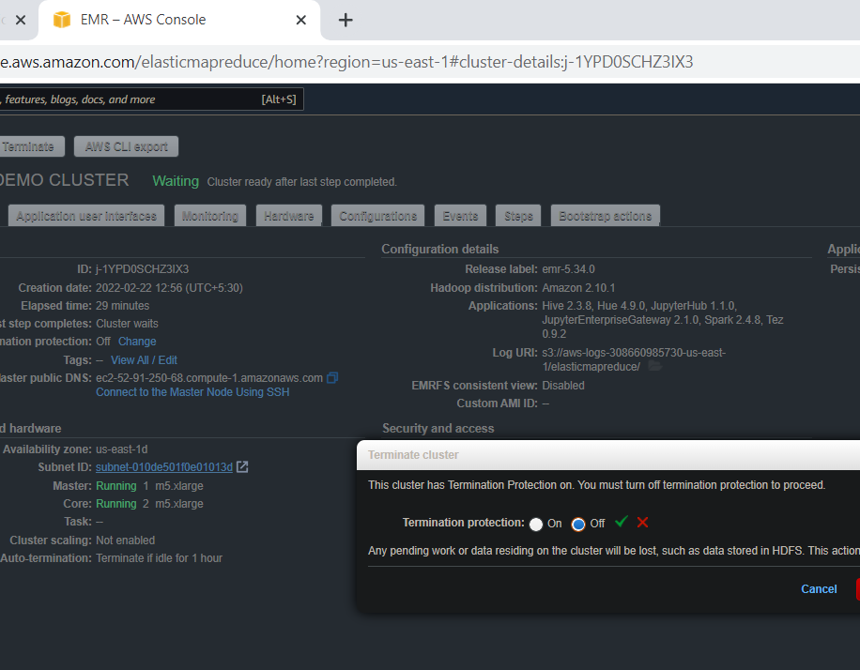
.
EMR TERMINATE

Slide 12
CREATE A S3 BUCKET ON AWS

Slide 13
INSTRUCTION
1
1.FIRST LOG IN AWS ACCOUNT
2.THEN START THE LAB(WAIT TILL THE AWS DOT TURNS TO GREEN
3.GOTO TO SERVICES SELECT S3

Slide 14
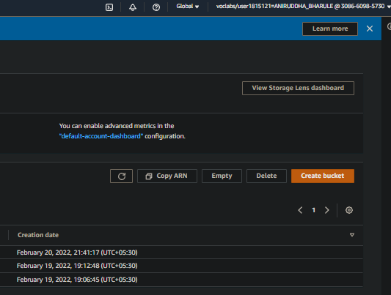
.
CREATE S3 BUCKET :

Slide 15
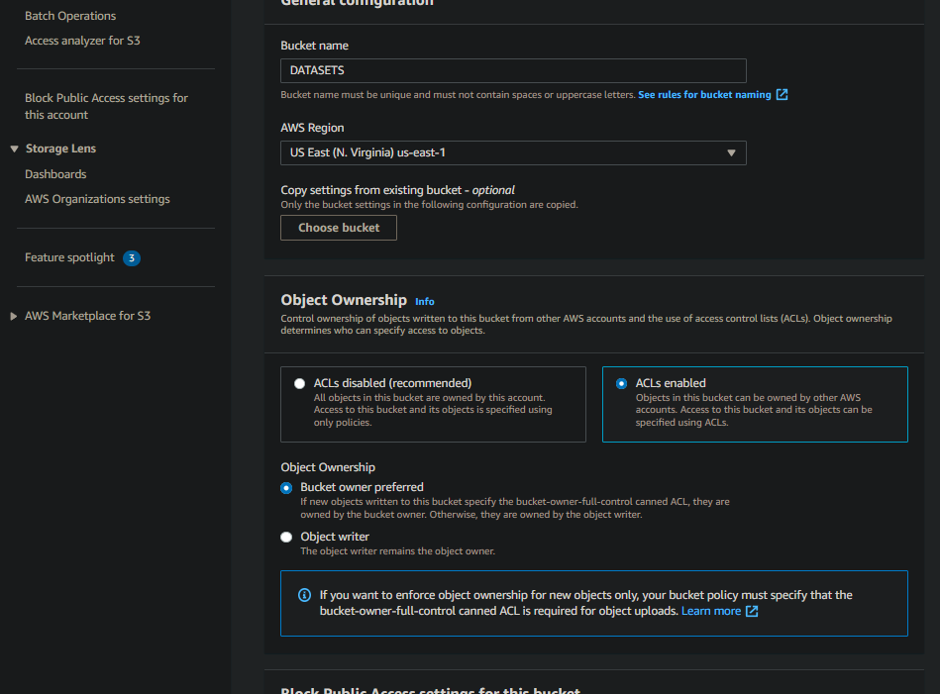
.
BUCKET NAME :
ACL ENABLE
BLOCK ALL PUBLIC ACCES

Slide 16
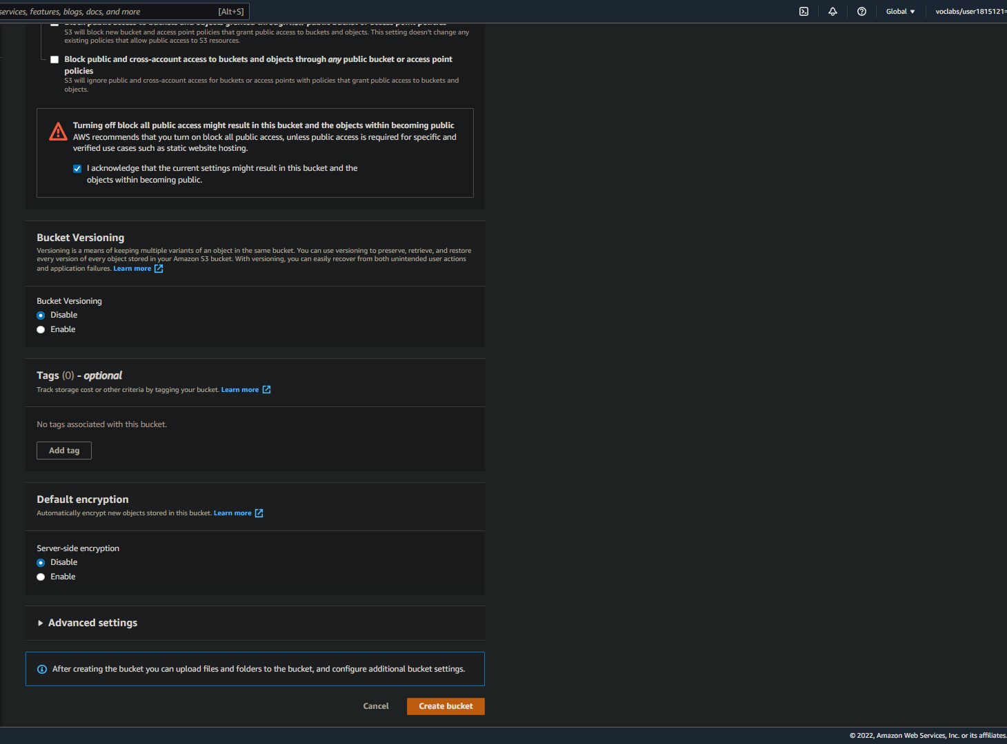
.
CLICK ON ACKNOWLADGE
CREATE BUCKET

Slide 17
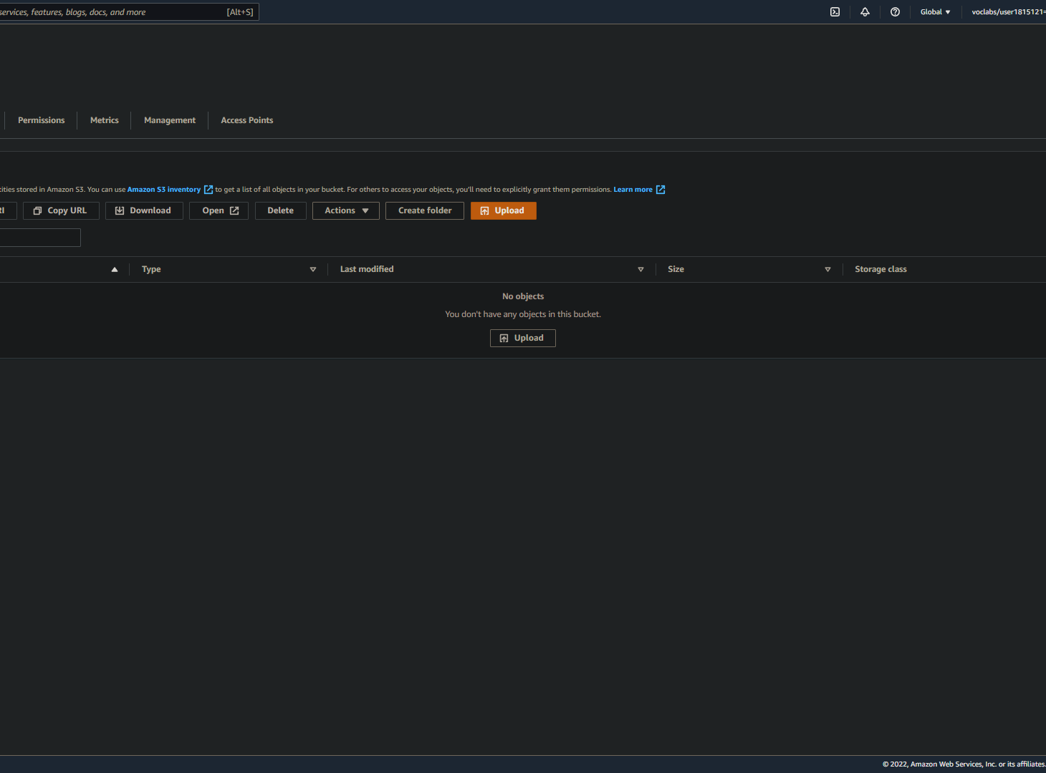
.
UPLOAD FILE FOLDER :

Slide 18
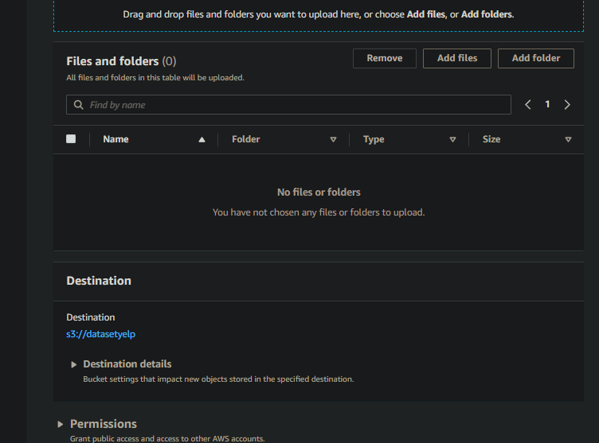
.
ADD FILE OR FOLDER :
UPLOAD
UPLOAD

